Slide 1
CareerSource Flagler Volusia
Employment Trend Report
August 10, 2018

Slide 2
The Goal
to increase the prosperity of workers and employers; reduce welfare dependency, increase economic self-sufficiency, meet employer needs; and enhance productivity and competitiveness

Slide 3
what does manufacturing look like today?
top 10 occupations

Slide 7
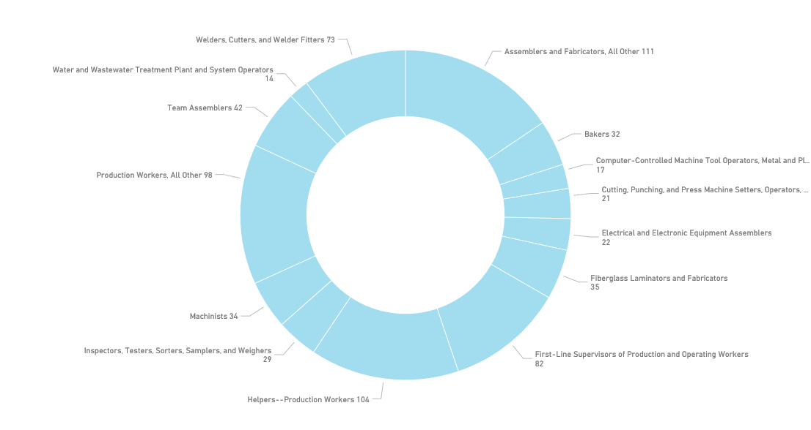
www.careersourcefv.com/businesses/recruiting/talent-mapping

Slide 8
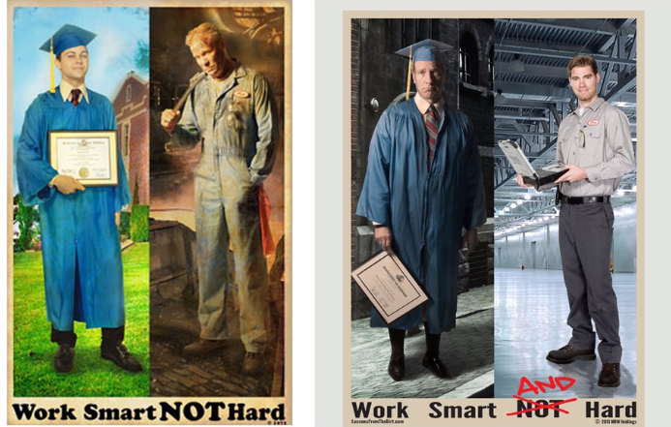
1977 vs. today
time to change the message.

Slide 13
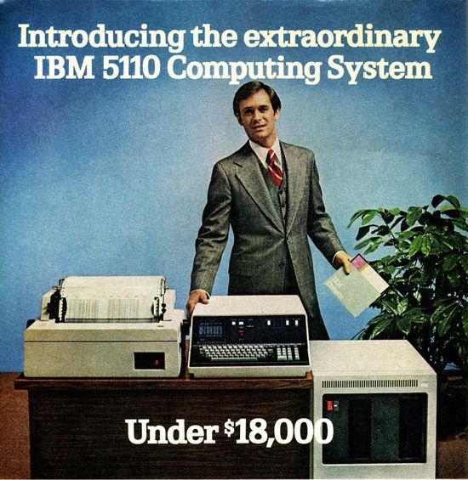

Slide 14
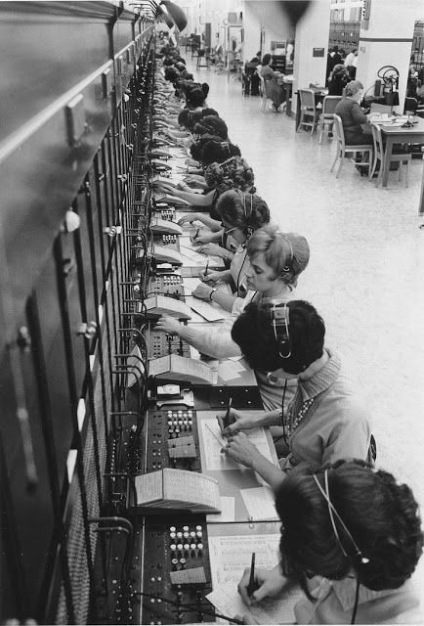

Slide 15
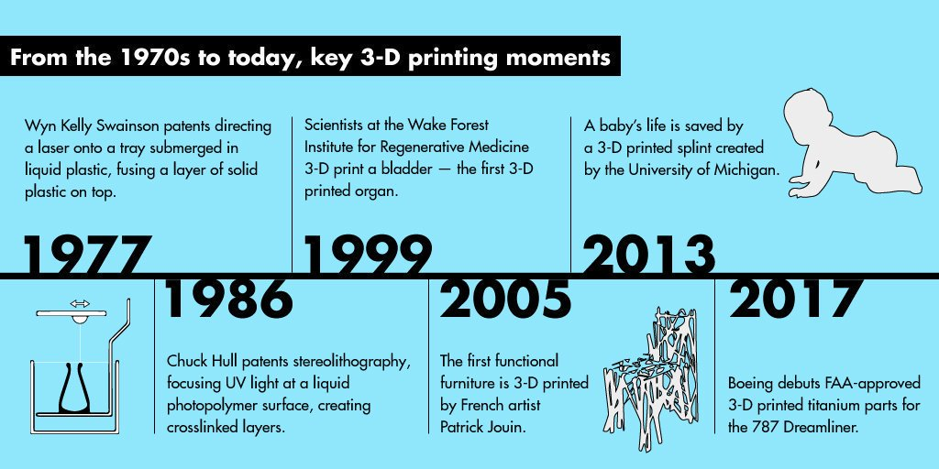

Slide 17
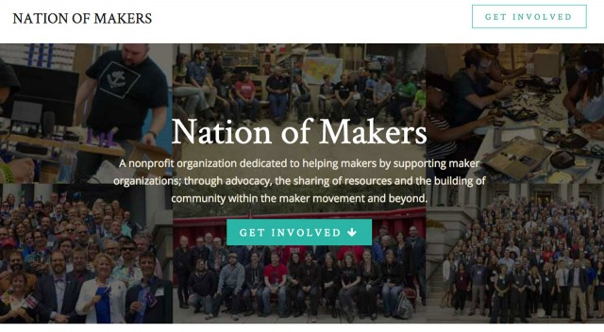

Slide 18
Robin King
President & CEO
CareerSource Flagler Volusia
386.323.7077
robinking@careersourcefv.com

