Slide 1
Amendment 1 Panel Discussion Pat Northey

Slide 2
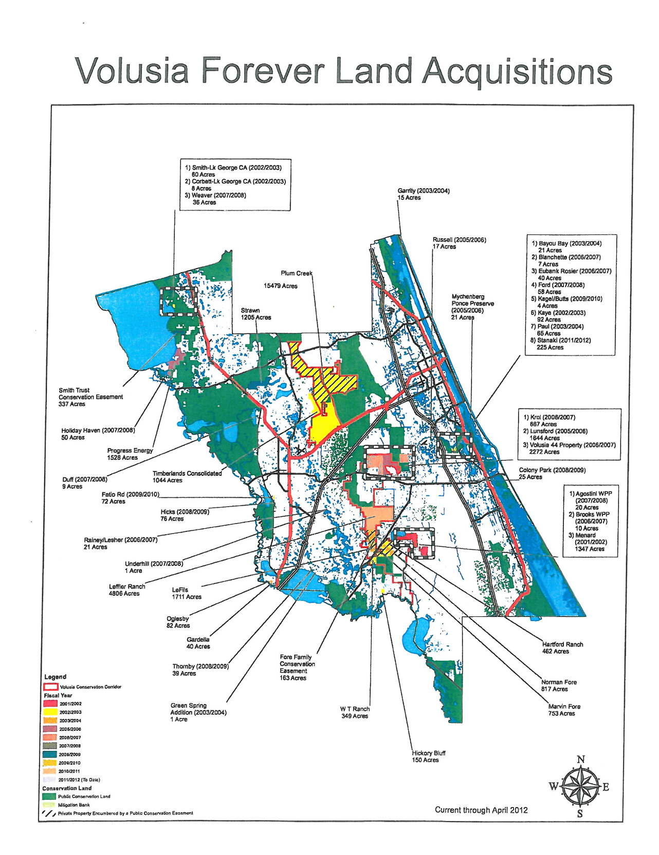
Notes:
In addition, 18,700 acres acquired in the 1986 Endangered Lands Program

Slide 3
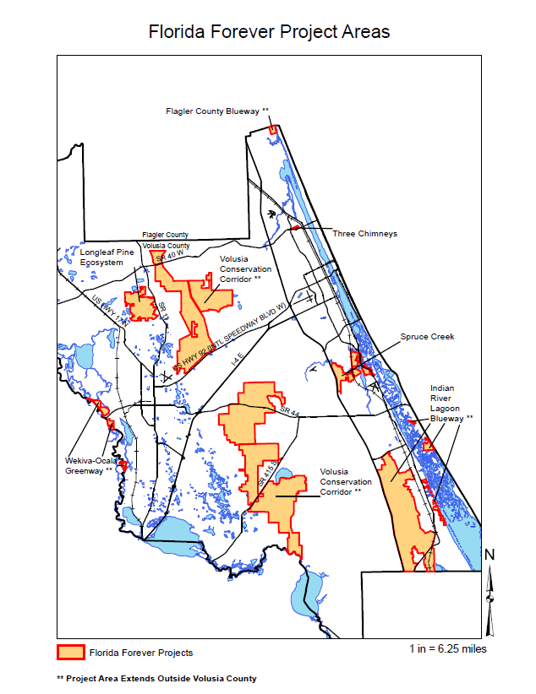

Slide 4
Conservation Corridor
Remaining Acreage ...... 20,800 (in Volusia and Flagler)
Source: "Florida Forever Project Evaluation Comparative Analysis" Florida Natural Areas Inventory, November 2013. ........ This report is produced annually to support the State's Acquisition and Restoration Council.
Remaining Acreage in Volusia County .... 12,500

Slide 5
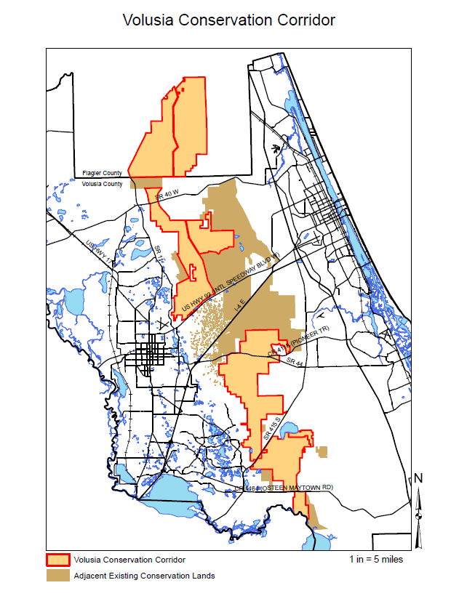

Slide 6
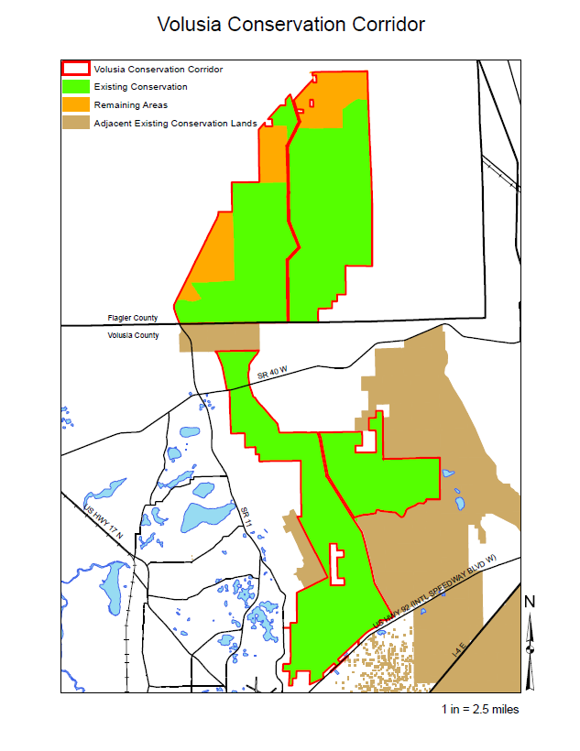

Slide 7
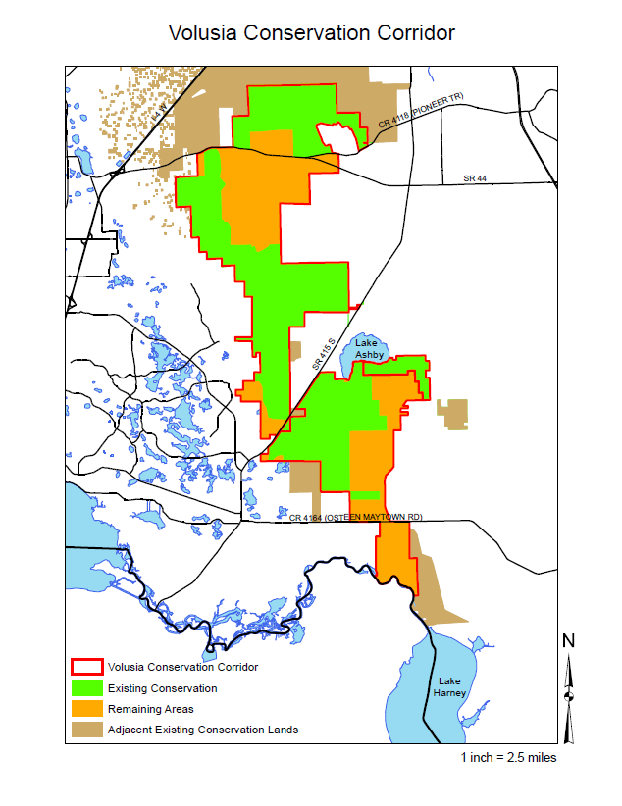

Slide 8
Amendment 1 Implementation
The County of Volusia intends to engage in the development of criteria to fund important water quality infrastructure improvements.

Slide 9
Amendment 1 Implementation
Volusia County has identified four primary ways to improve water quality:
1) Eliminating septic tanks in watersheds/springsheds of priority water bodies;
2) Improving stormwater conveyance and treatment systems to reduce nutrient pollution;
3) Developing meaningful education and outreach programs to inform citizens about water quality,
4) Reducing nutrients from wastewater plant discharges to surface or ground water.

Slide 10
Tomoka River
OFW and Manatee Sanctuary
Water Quality
Exceeds state standard for chlorophyll, due to nutrients (N and P)
Stormwater discharge, fertilizer
Contains Tomoka Marsh Aquatic Preserve
Has both freshwater and marine segments
Septic tanks
Pollutant Sources
Notes:
The Tomoka River originates in wetlands southwest of Daytona Beach flows north for approximately 20 miles, emptying into the Halifax River just north of Ormond Beach. Drains an area of about 110 square miles. Designated as OFW and Manatee Sanctuary. Has both freshwater and marine segments.
TMDL 2013 sets Chloro A and TN and TP targets.

Slide 11
Halifax River
Atlantic Intracoastal Waterway
Water Quality
Consistently exceeds N standard
Occasionally exceeds P and chlorophyll standards
Stormwater discharge, fertilizer
Septic tanks
340 square mile, highly urbanized drainage area
23 miles from Tomoka River to Ponce Inlet
Wastewater discharge
Pollutant Sources
Averages .5 mile wide and 4 - 5 feet deep
Notes:
The Halifax River is a 23 mile section of the Atlantic Intracoastal Waterway, originates at the confluence of the Tomoka River, and flows south to Ponce Inlet. The Halifax River's drainage basin includes most of eastern Volusia County, 340 square miles. The Halifax River is relatively shallow, averaging 4-5 feet deep.
2013 TMDL 9% reduction from stormwater – stormwater accounts for 73% of TN inputs and 45% of TP

Slide 12
Spruce Creek
OFW and State Canoe Trail
Water Quality
Saltwater segment exceeds N and P standards, low DO
Stormwater discharge, fertilizer
Contributions from upstream (freshwater segment)
Has both freshwater and marine segments
20 miles long from wetlands west of NSB to Halifax River
Septic tanks
Pollutant Sources
Primarily rural watershed
Notes:
Spruce Creek is designated as Outstanding Florida Waters and an official State Canoe trail. Spruce Creek is a blackwater stream that forms in wetlands about 5 miles west of New Smyrna Beach, flows 20 miles north and east to where it ends at the Intracoastal Waterway.
Spruce Creek has both freshwater and marine segments.
The Spruce Creek watershed is a primarily rural area that is facing increased development pressures.
2008 TMDL – 27% reduction in TP from non-point sources (25% BOD)

Slide 13
Indian River/Mosquito Lagoon
Mosquito Lagoon is a 60 square mile sub-basin
Water Quality
Meets current criteria for chlorophyll, N and P
Stormwater runoff, including fertilizer
Wastewater discharge
Class II shellfish harvesting waters
Includes the 4,740 acre Mosquito Lagoon Aquatic Preserve
Septic tanks
Pollutant sources
Very shallow, extreme salinities, long retention time
May exceed proposed DEP criteria for chlorophyll, N and P
Notes:
Mosquito Lagoon is a 60 square mile sub-basin of the Indian River Lagoon. It extends from Ponce de León Inlet to the north end of Merritt Island. It connects to the Indian River via the Haulover Canal.
Includes the 4,740 acre Mosquito Lagoon Aquatic Preserve. Class II shellfish harvesting waters.
Mosquito Lagoon is dominated by shallow flats, is often highly saline, with levels comparable to the ocean. Due to the distance between inlets, the lagoon has a long retention time, and very little flushing.
For decades Mosquito Lagoon has had good water quality. Currently meets federal and state standards for Total Nitrogen, Total phosphorous & chlorophyll, although the DEP is proposing new standards, which we will not meet.

Slide 14
St. Johns River
American Heritage River, portions are OFW
Water Quality
Elevated N and P
Low DO
Stormwater runoff, fertilizer
Wastewater
Septic tanks
Pollutant Sources
Primarily freshwater, fed by springs and surface flow
310 miles long, dark water system, north flowing
Typically slow moving, difficult to flush pollutants
Notes:
American Heritage River and designated Blueway, portions are OFW.
The St. Johns River is 310 miles long and it flows north from Indian River County to Jacksonville. The middle basin is the area where the river widens forming lakes Harney, Jesup, Monroe and George.
The SJR is primarily a freshwater system fed by surface flow and springs – spring water quality impacts the river
Because the river flows slowly, it is difficult to flush pollutants.
The St. Johns has elevated levels of total nitrogen and phosphorus, and has low dissolved oxygen. Major pollution sources include runoff from urban and agricultural areas, groundwater leaching from septic tanks, and discharges from wastewater treatment plants.
TMDL for Harney-Monroe TN and TP, DO?

Slide 15
Gemini Springs
2nd magnitude spring
Water Quality
Elevated N (nitrates)
Primarily groundwater fed
Fertilizers
Purchased by Volusia County in 1994
Two primary vents
Septic tanks
Pollutant sources
Closed for swimming since 2000 due to high bacteria
Four fold increase in urbanized areas since 1973
Notes:
Gemini Springs is a second-magnitude system, discharging 6.5 million gallons of freshwater each day. The springs consist of two primary vents. Gemini Springs was purchased by Volusia County in 1994 and is managed as a park.
Land use in the Gemini springshed changed considerably from 1973 to 2004. During this period, the areal extent of urbanized areas increased four-fold, open-water/wetland areas doubled in size, and forestland decreased 95 percent.
The spring has elevated nitrates, and has been closed for swimming since 2000 due to high bacteria levels.
Potential pollution sources include septic systems, and fertilizer, stormwater runoff.

Slide 16
Blue Spring
1st magnitude spring
Water Quality
Elevated N (nitrates)
Groundwater fed
Fertilizers
100 square mile springshed, increasingly urbanized
Primary warm water refuge for manatees
Septic tanks
Pollutant sources
Algae overgrowth
Notes:
Blue Spring is one of 33 1st magnitude springs in FL with flows averaging 101 million gpd.
Blue Spring is a primary warm water refuge for manatees in the St. Johns River. The manatees congregate in great numbers in the spring and spring run during the winter months when the spring water is considerably warmer than the water of the St. Johns River.
The approximately 100-square mile springshed that provides the groundwater for Volusia Blue Spring has seen substantial changes in land use in the last 50 years, from predominantly rural and agricultural to one with increasing high intensity development.
Blue Spring has elevated nitrates and an overgrowth of algae.

Slide 17
Water Quality Resolution
Adopted September 18, 2014.
Seeking partnerships with cities for water quality projects.

Slide 18
More than 90,000 septic tanks
Halifax River
Mosquito Lagoon

Slide 19
SEPTIC RETROFIT AREAS OF CONCERN
Areas #Units* Cost **
North Peninsula 6,220 $93,300,000
Wilbur/Ponce Inlet 1,753 $26,295,000
Southeast Volusia 2,477 $37,155,000
Blue Springshed 13,220 $198,300,000
Gemini Springshed 2,754 $41,310,000
TOTALS 26,424 $396,360,000
*Unit count based on ‘Report on the status of sewage disposal and collection in Volusia County, FL’, VCHD November 2013
** Approximate unit cost of $15,000 will vary by location and available infrastructure.

Slide 20
Showcase Trails

Slide 21
Volusia County Amendment 1 Resolution (Adopted 2-19-15)
The county council advocates that the legislature allocate Amendment 1 funding to provide for infrastructure supporting the water quality initiatives and local priorities of Volusia County, as follows:
that implementing legislation provide a long-term commitment of funding to water quality projects targeting 1st magnitude Florida springs, Mosquito Lagoon and Indian River Lagoon and their associated tributaries;
that implementation of Amendment 1 recognize a balance of interests and a range of community priorities by provision for equal allocation of funding to infrastructure and land acquisition;
that the elimination of substandard septic systems is crucial to the restoration and protection of water bodies of critical state importance, including but not limited to the Mosquito Lagoon, Indian River Lagoon, Blue Spring, the St. Johns River, and the Halifax River and the outstanding waters of Spruce Creek and Tomoka River; and
that the provision for dedicated infrastructure funding recognize the burden of major infrastructure investments on properties below the median values for comparable development in the state by allowance for a higher percentage of project funding.

