Slide 1
Legislative & Quasi Judicial: What Every Planner Should Know
Florida Planning & zoning conference
June 3, 2022
South seas resort
Captiva Florida

Slide 2
Who we are and why this matters (Max)

Slide 3
Who we are
Max Forgey AICP; Proprietor, Forgey Planning, a Cape Coral-based consulting firm
Andrew Dickman, Esq., AICP; Dickman Law Firm, St. Pete Beach City Attorney, Collier County Hearing Examiner.

Slide 4
Why this matters
Land use decision-making happens every day
66 county governments*
411 municipalities (cities, towns, villages)
https://en.wikipedia.org/wiki/List_of_municipalities_in_Florida
Other governmental bodies (WMDs, RPCs)
* The Duval County/ Jacksonville exception

Slide 5
Florida’s Growth Management Scheme
Protect State resources
All local governments must prepare, adopt, and implement a Comprehensive Plan.

Slide 6
Why Planners need to understand
Because bosses and clients don’t always understand
You may have to explain it to them…

Slide 7
The Comprehensive Plan & Why it Matters
Ch. 163 Legislative Intent
The FLUM
Goals, Objectives & Policies

Slide 8
Comprehensive Plan Requirements
Enact land development regulations
Approve development orders only if they are consistent with the Comprehensive Plan
Avoid sprawl; embrace compatibility
Recognize private property rights
See definitions on next slide

Slide 9
§163.3164 definitions
(15) “Development order” means any order granting, denying, or granting with conditions an application for a development permit.
(16) “Development permit” includes any building permit, zoning permit, subdivision approval, rezoning, certification, special exception, variance, or any other official action of local government having the effect of permitting the development of land.
(26) “Land development regulations” means ordinances enacted by governing bodies for the regulation of any aspect of development and includes any local government zoning, rezoning, subdivision, building construction, or sign regulations or any other regulations controlling the development of land, except that this definition does not apply in s. 163.3213.

Slide 10
Summary
Legislative procedures = Making policy
Quasi-judicial procedures = Applying policy

Slide 11
Legislative vs. Quasi judicial

Slide 12
Legislative vs. Quasi-judicial
Legislative
Quasi judicial
Policy-making
Adopting/ Amending Comp Plan
Adopting/ Amending LDRs
Applying Comp Plan or LDRs
Rezones
Adopting/ amending PUD
Variances/ waivers
Special exceptions/ Cond. Uses

Slide 13
Origin of the Legislative vs. Quasi-judicial distinction
Board of County Commissioners of Brevard County v. Snyder.
(627 So. 2nd 469)
Appeals to legislative decisions are highly deferential to the local government. (“Any rational basis”)

Slide 14
Common factor in both Legislative Meetings and Quasi-judicial Hearings
Due process applies
Public notice required
Some opportunity to be heard
Sec. 166.041 established minimal notice for public meeting
Florida’s strict public records and Sunshine Law

Slide 15
What is allowed at a Legislative Meeting that might not be allowed at a Quasi-judicial Hearing
Petitions
Matching green T-shirts
“I think” and “I believe…”
Lay testimony about traffic, noise, construction debris, glare, odor, vibrations, past experience with similar uses
Show of hands
Andrew will explain how this is different from a quasi-judicial hearing.

Slide 16
A Legislative Hearing in City of Cape Coral

Slide 17
Quasi-judicial Hearings (Andrew)

Slide 18
Snyder and Quasi-judicial decision-making
Board of County Commissioners of Brevard County v. Snyder
(627 So.2d 469)
Florida’s Supreme Court establishes new test
Rezonings are quasi-judicial (not legislative) and create:
A NEW two-prong test
Shifting burden of proof

Slide 19
The two-fold Snyder test
“[W]e hold that:
(1) A landowner seeking to rezone property has the burden of proving that the proposal is consistent with the comprehensive plan and complies with all procedural requirements of the zoning ordinance.

Slide 20
The second Snyder prong
“(2) At this point, the burden shifts to the governmental board to demonstrate that maintaining the existing zoning classification with respect to the property accomplishes a legitimate public purpose. In effect, the landowners' traditional remedies will be subsumed within this rule, and the board will now have the burden of showing that the refusal to rezone the property is not arbitrary, discriminatory, or unreasonable. If the board carries its burden, the application should be denied.”

Slide 21
Quasi-judicial Requirements & Best Practices
Ex parte disclosures/ voting conflicts/ lobbying
Identification of parties and participants
Affected party status
Sworn testimony
Expert and lay testimony
How does your local jurisdiction handle these issues?
Do you know of any exemplary or questionable approaches?

Slide 22
Testimony in Quasi-judicial Hearings
Qualification of expert witnesses. Who can challenge?
Resumes & CVs—getting them on record
Examination & Cross Examination
The Expert Report (Applicant/ Staff/ Opposition)
Findings of Fact (Staff recommended/ Alternative Findings)
St. Johns County’s double set of Findings
Can Opposition offer Expert Report in Legislative hearing?

Slide 23
Competent Substantial Evidence (CSE)
Why can’t your attorney be an expert, even if she’s also AICP?
Is Expert Witness testimony automatically CSE?
Can a Lay Witness provide CSE?
What isn’t CSE?

Slide 24
The “Record”
Applicant’s goal—approval, no successful appeal
Opponent’s goal—get everything ready for appeal
Help the Clerk or Reporter with spelling and addresses
Always have two copies of thumb drive plus hard copies of your evidence
Why are Court Reporters sometimes working at hearings?

Slide 25
The Venue: Assume Nothing!
Audio-visual issues
IT issues
Hybrid/ Zoom meetings
Where do your people sit?
Who uses which microphone?
Who controls the overhead projector?

Slide 26
City of North Port Commission Chambers

Slide 27
Time
Allotments for Applicant and Opponents
What is fair?
Adversely Affected Party status
How many cases per agenda?
Mandatory adjournment time
How late is too late?

Slide 28
The Decision
Review criteria
Findings of fact
The Recommendation
The Final Decision
The Appeal or Rendition

Slide 29
The Planner’s Toolbox (Max)
Reference books for people who write reports

Slide 30
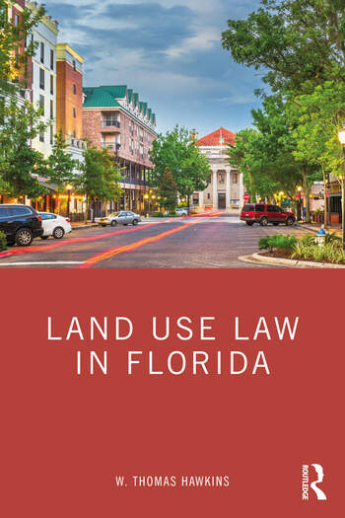
W. Thomas Hawkins

Slide 31
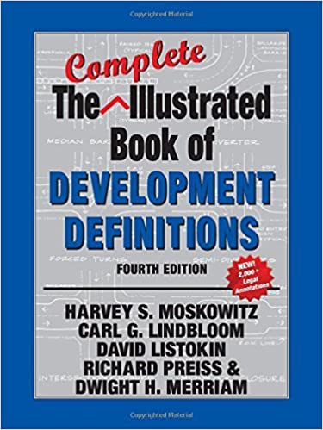
Moskowitz & Lindbloom

Slide 32
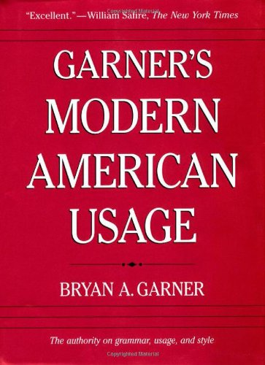
Bryan A. Garner

Slide 33
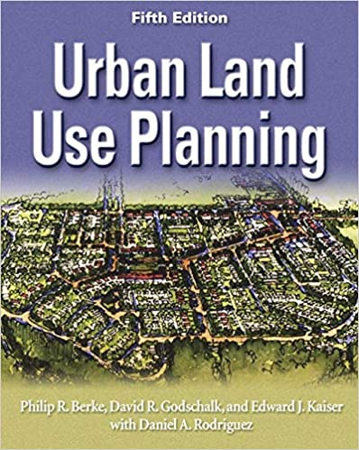
Berke & Godschalk

Slide 34
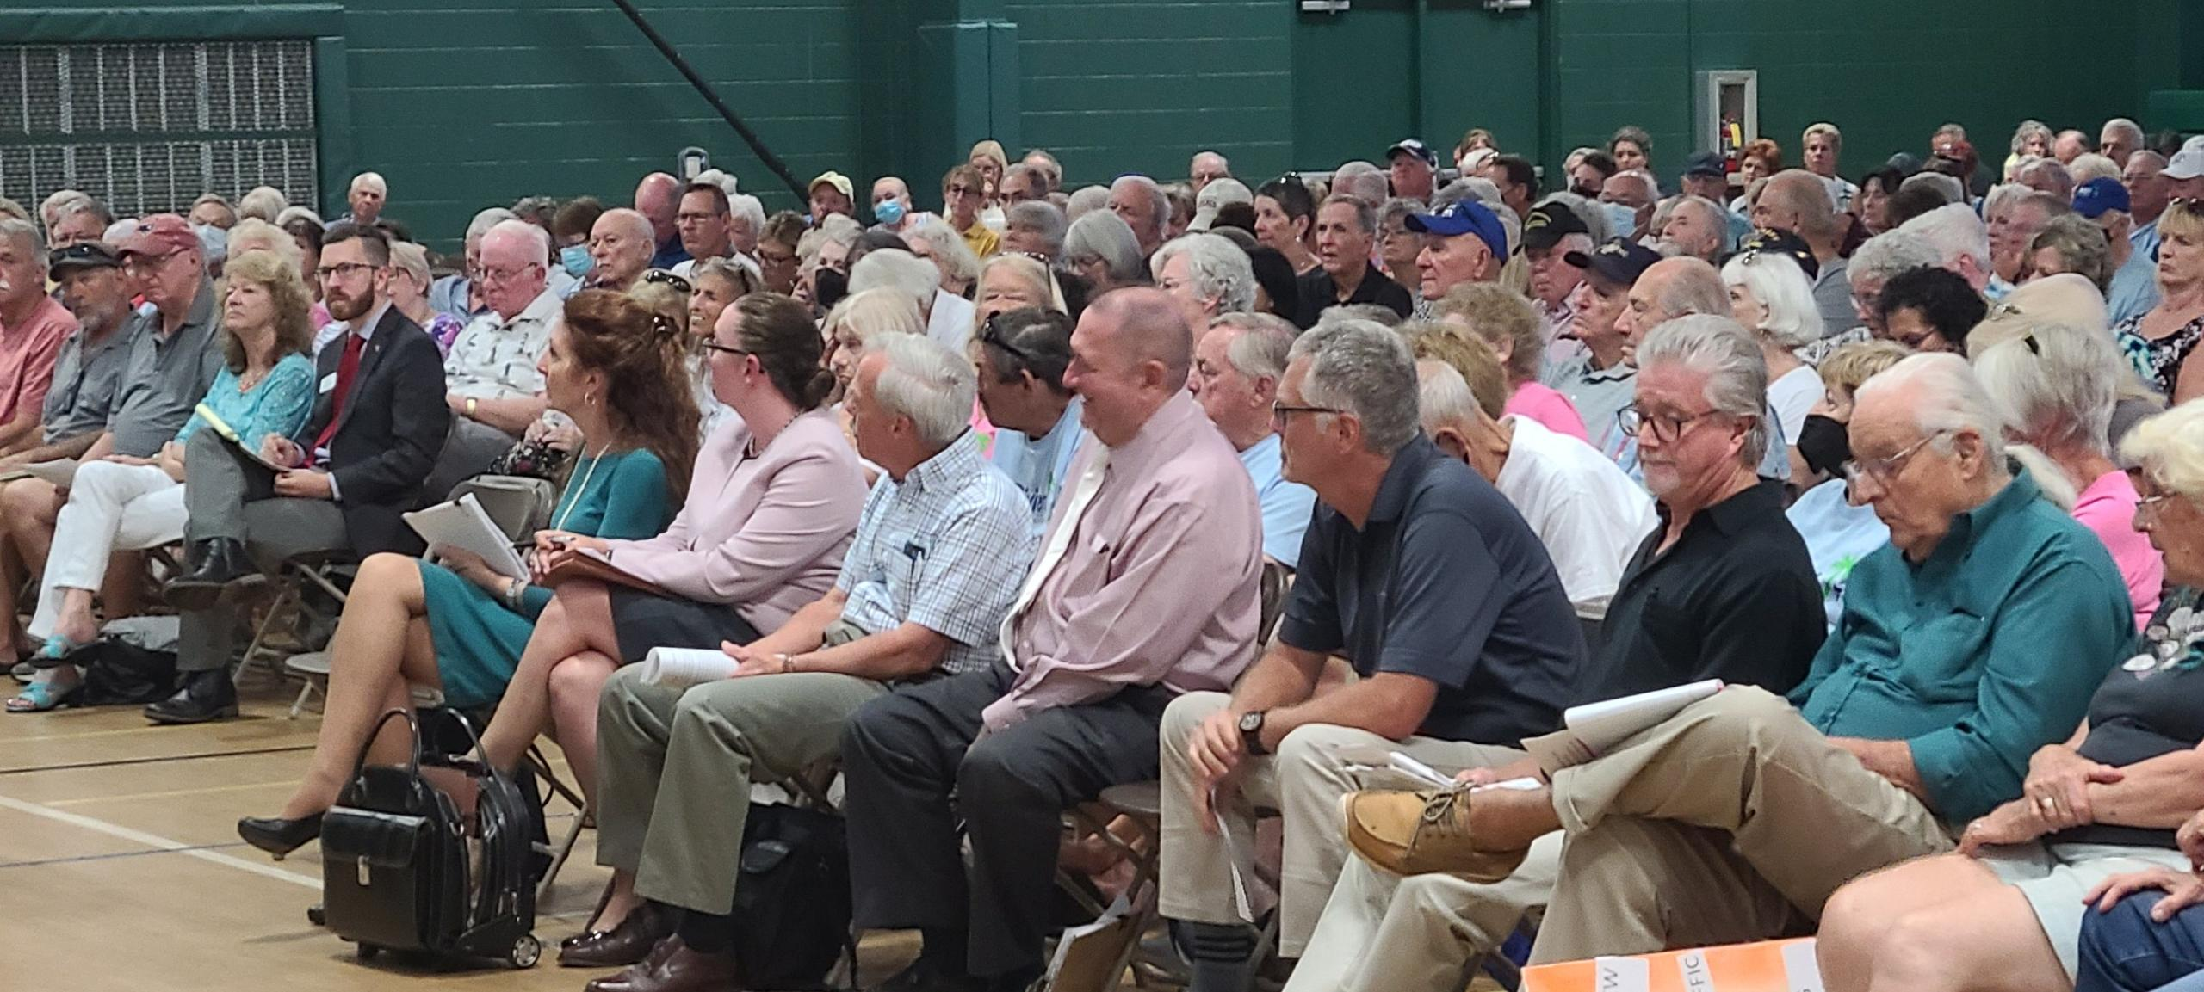
Questions?

Slide 35
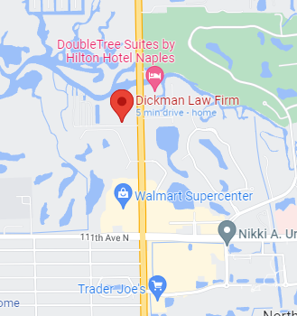
Thank You
809 Walkerbilt Rd. Suite 6
Naples, FL 34110
(239) 434-0840
www.dickmanlawfirm.org
Andrew@dickmanlawfirm.org

