Slide 1
Resiliency as a Catalyst
Charles Abbatantuono, East Central Florida Regional Planning Council

Slide 2
Why Focus on Coastal Resiliency
With 120 miles of coastline the East Central Florida region stands to be one of the most impacted areas of the country from impacts of sea level rise and storm surge
Impacts are already seen nearly daily in South Florida, our slightly further upland areas of Brevard and Volusia have slightly more time before risks are just as serious

Slide 3
A Wholistic Approach
Public Engagement
Addressing the issues of sea level rise and storm surge requires input from all stakeholders and community members alike
Vulnerability Analysis of Storm Surge and Sea Level Rise allows us to gain an increased awareness and understanding as to which areas of the town are at highest risk
Tangible results come from policy implementation and infrastructure investment
Implementation
Vulnerability Analysis
Community Resiliency
Policy Updates
Strategy Development

Slide 4
VA Process
Land cover change associated with sea-level rise using GIS Modeling
High resolution land use change models with stakeholders input and expected population growth
Implement conservation optimization models based on the GIS Analysis result and terrestrial land use change model
Develop specific policy and conservation land acquisition and focus area recommendations to governmental and non-governmental entities
Direct public engagement ( elected officials. public representatives, technical knowledge sharing)
Professional development support for undergraduate students, post-doctoral researcher, etc.

Slide 5
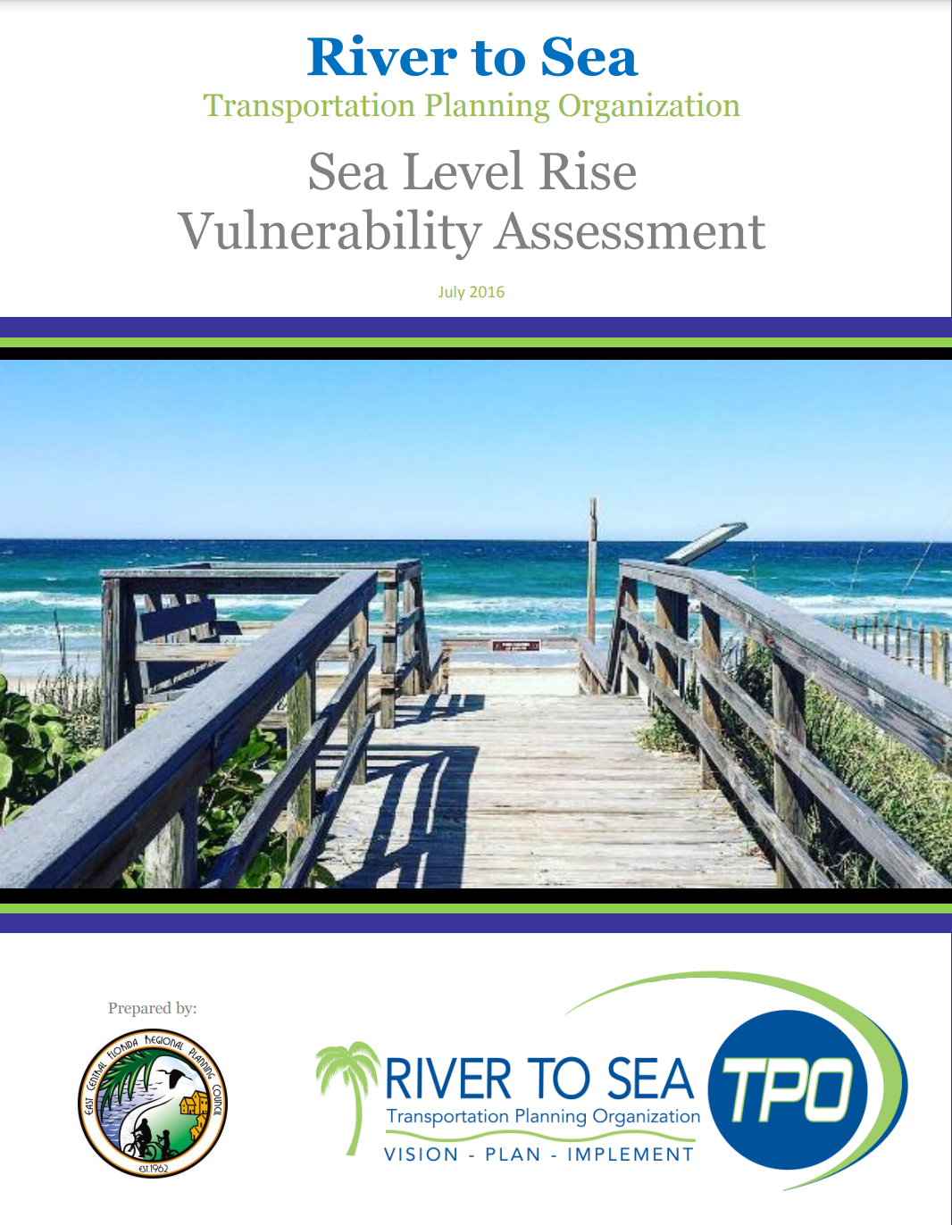
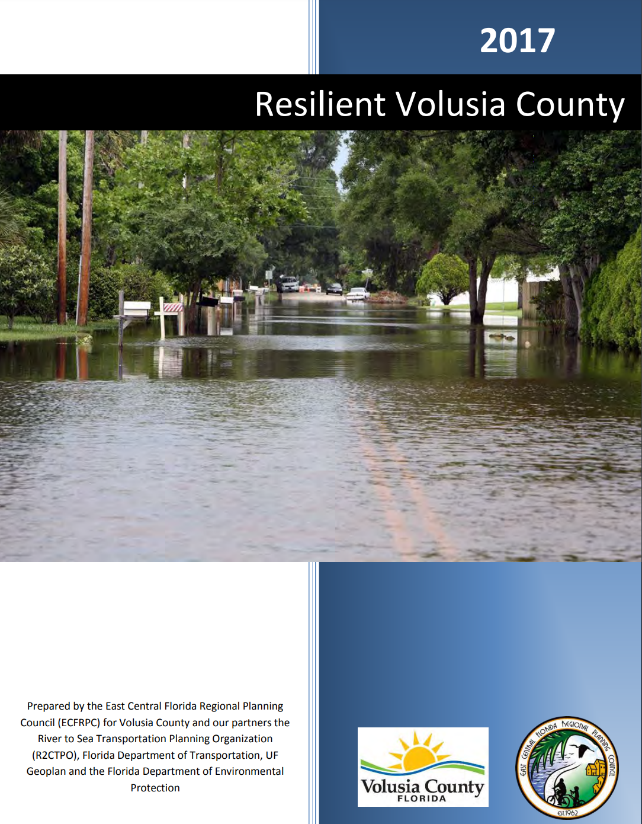
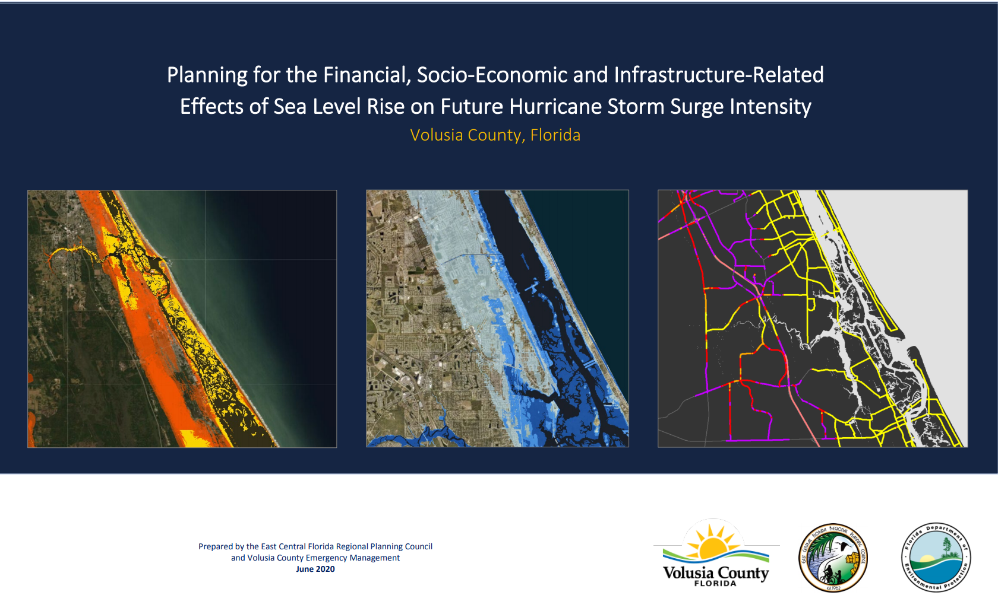
Where We've Been?

Slide 6
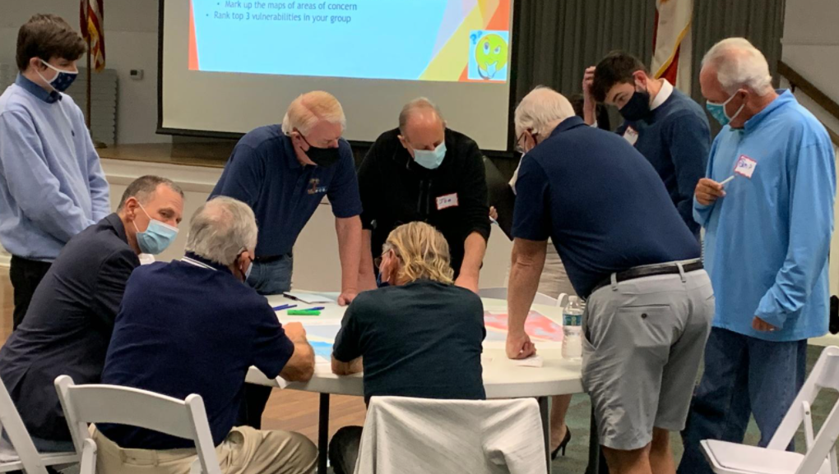
Public Engagement Workshop Ponce Inlet
Explain reasons behind project
Break out group discussions
Provided maps of flooding/sea level rise
Rank top vulnerabilities
Input taken into account for survey

Slide 7
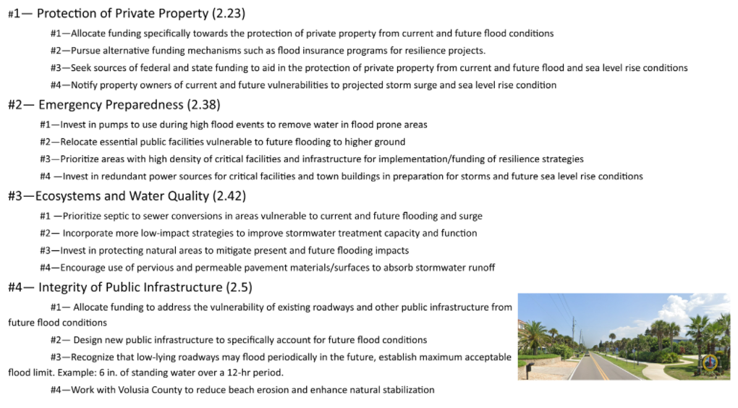
Public Survey Input
Compliment to Public Engagement Workshops
Allows us to dig deeper into specific strategies and what policies the public would like to see implemented
Feedback imperative to understanding how to talk about sea level rise and resiliency to the public

Slide 8
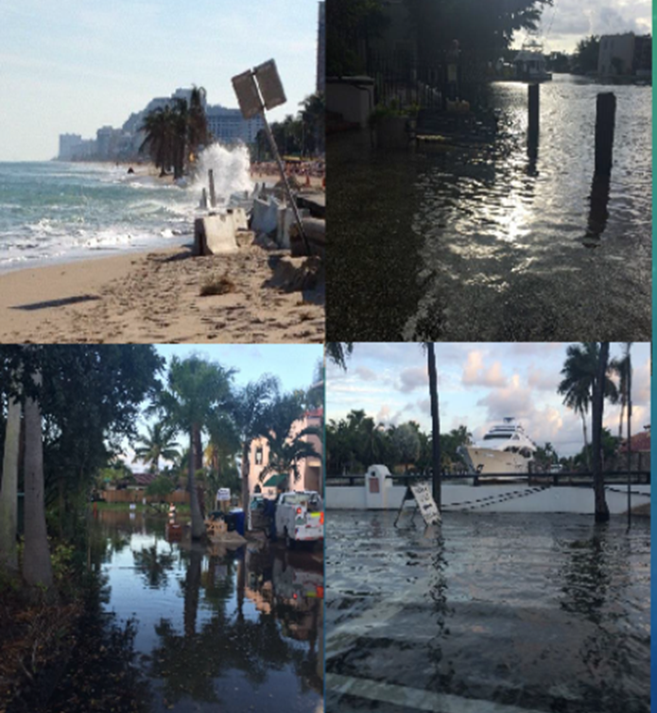
What’s Next? Tangible Policy
Communities work with ECFRPC staff to develop new policies for the comprehensive plan to meet “Peril of Flood” Requirements
Peril of Flood requirements signed into law in 2015
Section 163.3178, F.S.
Development and redevelopment principles and strategies, that reduce the flood risk in coastal areas from high-tide events, storm surge, flash floods, stormwater runoff, and the related impacts of sea-level rise.
Best practices
Site development techniques
Notes:
1.Development and redevelopment principles and strategies, that reduce the flood risk in coastal areas from high-tide events, storm surge, flash floods, stormwater runoff, and the related impacts of sea-level rise.
2. Best practices for the removal of coastal real property from FEMA flood zones
3. Site development techniques that may reduce losses and claims made under flood insurance policies
4. Be consistent with, or more stringent than, the flood-resistant construction requirements in the Florida Building Code and flood plain regulations
5. Construction activities consistent with Chapter 161.
6. Encourage local governments to participate in the National Flood Insurance Program Community Rating System

Slide 9
Tangible Results: Green Infrastructure
Living Shorelines
Stormwater management
Investments in natural land buffers
Removal of septic/conversion to sewer
Unique to each community

Slide 10
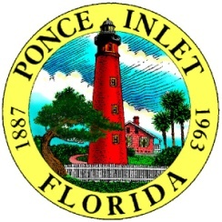
Resilient Ponce Inlet
Public Engagement Experience
Florida Planning & Zoning Association State Conference
June 3, 2022

Slide 11
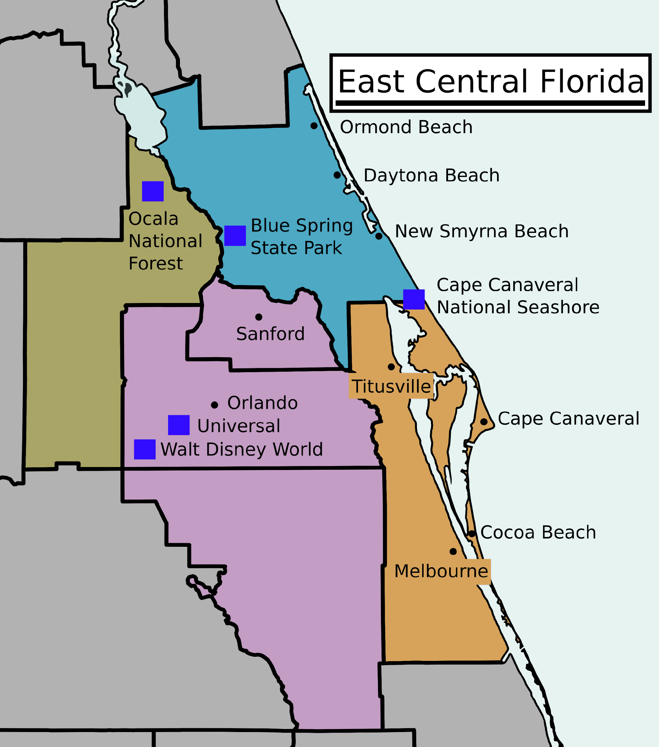
Location
Ponce Inlet

Slide 12
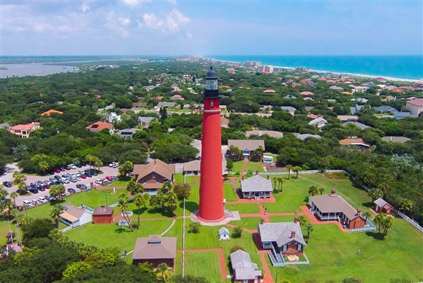
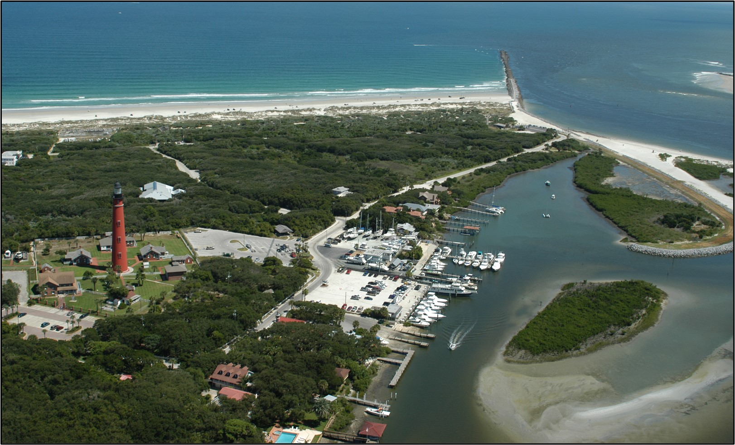
Town of Ponce Inlet
Surrounded by water on 3 sides
Looking north
Looking east

Slide 13
Background
Special Town Council meeting - Presentation by ECFRPC and American Flood Coalition on sea level rise
ECFRPC hired to conduct Peril-of-Flood Vulnerability Assessment
Project Kick-off
March 10, 2020
October 15, 2020
January 6, 2021

Slide 14
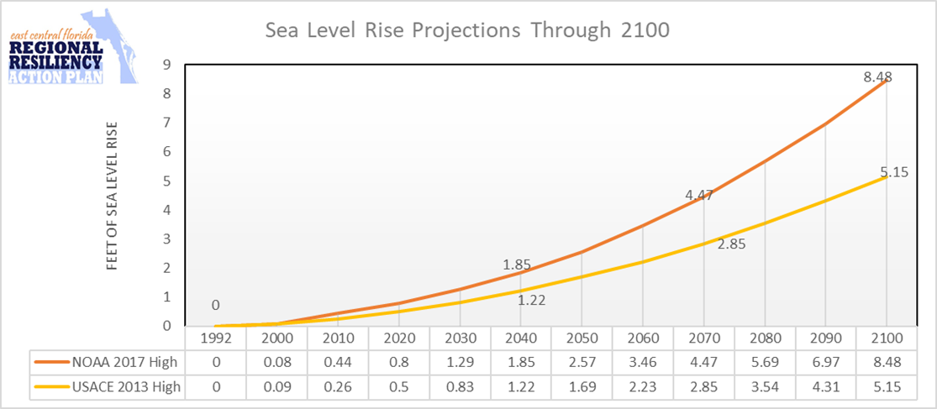
Ponce Inlet sea level rise scenarios
NOAA 2017
2040 – 1.85 feet
2070 – 4.47 feet
2100 – 8.48 feet
USACE 2013
2040 – 1.22 feet
2070 – 2.85 feet
2100 – 5.15 feet
Source: ECF Regional Resiliency Action Plan, 2018

Slide 15
Public Engagement
First public workshop
On-line survey – MetroQuest
Second public workshop
Final presentation to Town Council
February 25, 2021
July-August 2021
October 19, 2021
February 17, 2022

Slide 16
NOAA Sea Level Rise Projections with Critical Facilities
Source: Resilient Ponce Inlet Vulnerability Assessment, 2022

Slide 17
1st Public Workshop – 2/25/21
38 live and virtual participants.
Live participants divided into groups.
Presented maps of projected flooding, storm surge, and sea level rise.
Participants ranked top vulnerabilities and offered solutions.
Residents concerned about short- and long-term problems of dune erosion, stormwater runoff, pollution, electric grid issues, and coastal flooding.

Slide 18
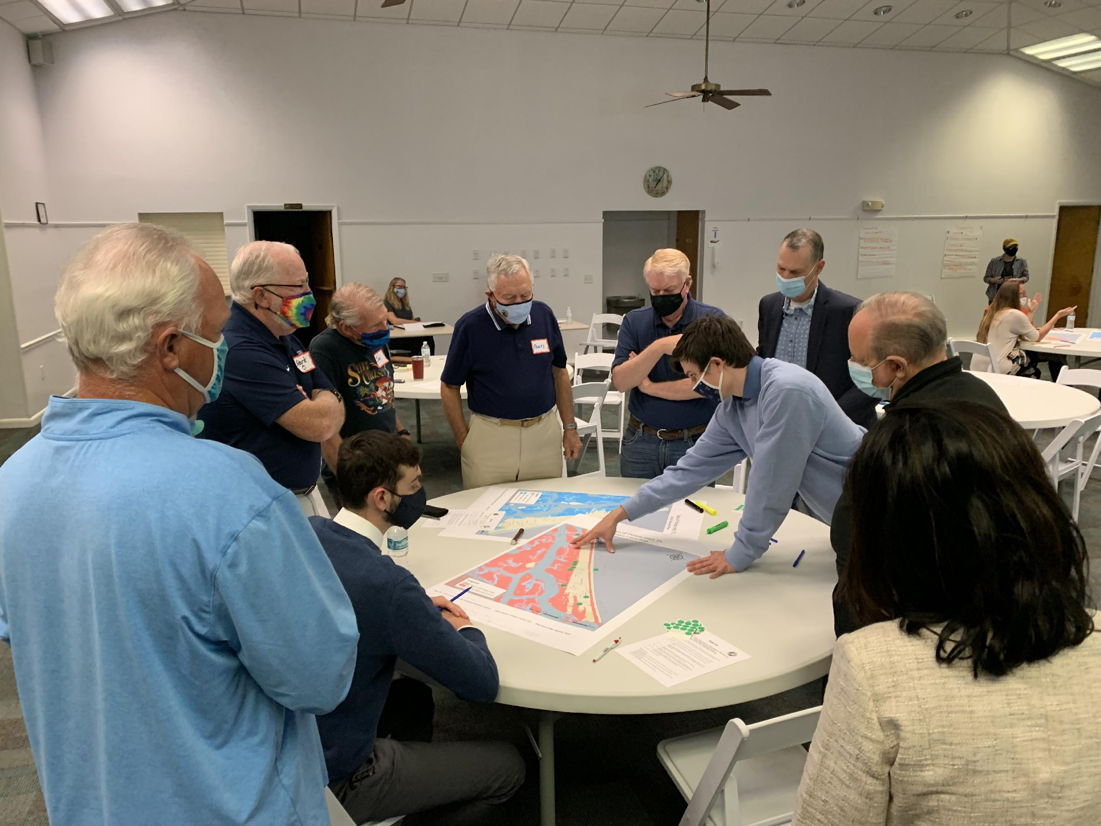
1st Public Workshop – 2/25/21
Key takeaways:
Strong preference for living shorelines.
Preserve marshlands and other natural coastal areas as buffers.
Continue septic-to-sewer conversions.
Invest in low-impact development strategies. green infrastructure, and nature-based solutions.
Upgrade emergency management facilities and other critical infrastructure.
Protect historical resources.
Strengthen development requirements.

Slide 19
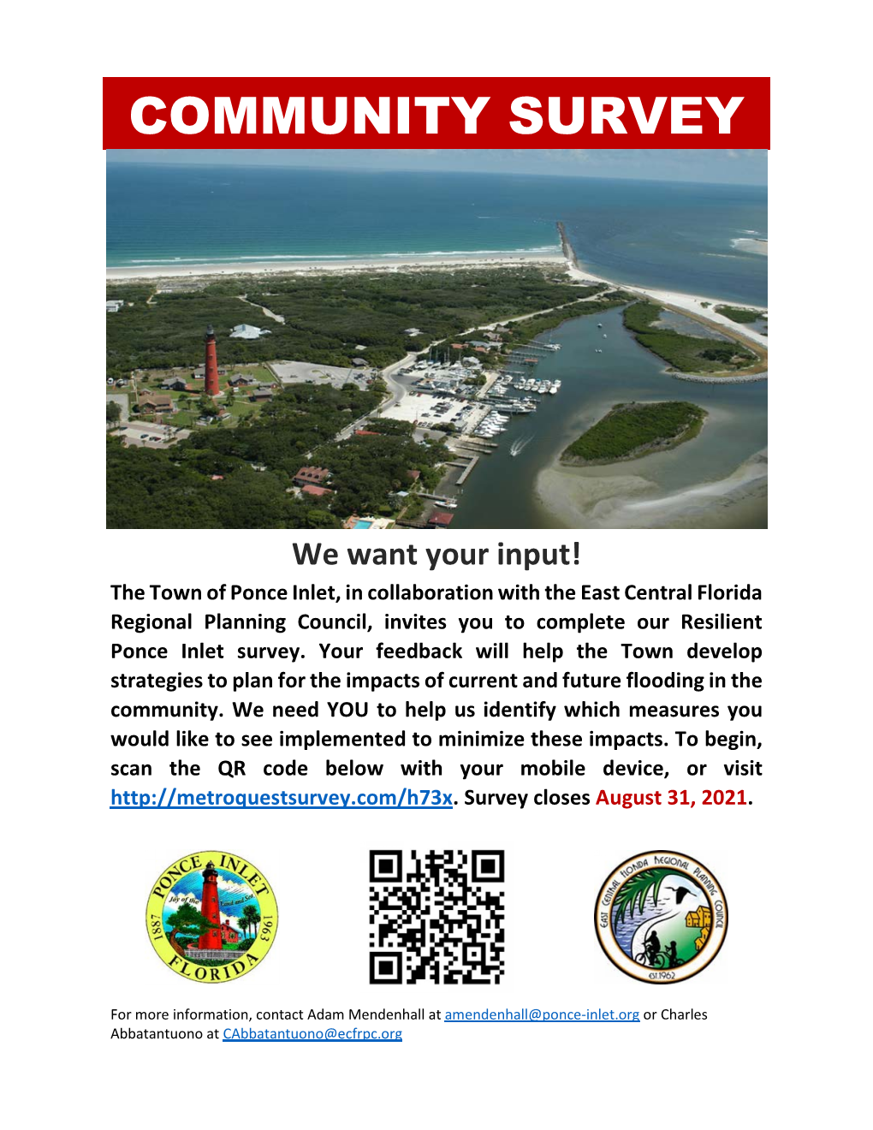
On-Line Survey - MetroQuest
Advertised July-August…
Posted on Town website
Posted to Facebook multiple times
E-mailed to Town news subscribers same time as Facebook posts
E-mailed directly to Ponce Inlet Business Association
Posted on Citizens for Ponce Inlet website
Flyer posted at Town Hall and other community facilities with QR code

Slide 20
Survey Respondents
Metrics:
341 people completed the survey (over 10% o f permanent, non-seasonal population.
Many more that started the survey but did not finish.
45% of respondents over Age 65.
83% full-time residents.
12% part-time residents.
5% non-residents.
27 business owners.

Slide 21
Survey Component – Values
Responses from 1st workshop used to generate list of 7 key values.
Respondents asked to rank their top 4 values.
Results:
Protection of private property
Emergency preparedness
Ecosystems and water quality
Integrity of public infrastructure
Source: Resilient Ponce Inlet Public Engagement Report, 2022

Slide 22
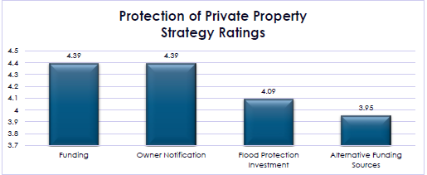
Survey Component – Strategies
Respondents asked to rate various strategies within each of their top 4 Values.
5 stars = highest, 1 star = lowest
Generated report with ranking of each strategy within each Value.
Source: Resilient Ponce Inlet Public Engagement Report, 2022

Slide 23
Survey Component – Strategies
Top Results:
Seek federal and state funding sources to protect private property.
Invest in redundant power sources for critical facilities.
Protect natural areas to mitigate present and future flooding impacts.
Reduce beach erosion and enhance natural stabilization.
Source: Resilient Ponce Inlet Public Engagement Report, 2022

Slide 24
Survey Component – Tradeoffs
Respondents were asked to weigh in on trade-off scenarios.
Top Results:
Higher density in highest elevation areas.
Long-term approach with higher tax burden.
Investing tax dollars in protecting structures.
Upgrading infrastructure for future sea levels.
Take proactive preventative measures for future sea levels.
Source: Resilient Ponce Inlet Public Engagement Report, 2022

Slide 25
2nd Public Workshop – 10/19/21
25 live participants, divided into groups for stake-holder role-playing game.
Roles included local resident, government official, investor/property owner, business owner, and environmental advocates.
Each participant given “$” to bring to the negotiating table to fund resilience measures, not to exceed total budget of $50 million.
Specific strategy options were based on the on-line survey.
Each group picked a set of strategies to create its own resilience plan.

Slide 26
2nd Public Workshop – 10/19/21
Key takeaways:
Community preferences were consistent across all 3 public engagement events, including:
Long-term investment to protect critical infrastructure
Strengthening development requirements to keep buildings above and away from flood-prone areas
Use of Low Impact Development techniques
Use of living shorelines
Maintaining water quality

Slide 27
Lessons
Surprises
Great deal of community understanding and acceptance about the issue and the range of options to deal with it – conceptually.
Despite participating in workshops and survey, some key stake-holders remain unconvinced sea level rise is happening.
Difficulties
Thinking about 80-year planning horizons, much less 20 years.
Reluctance to apply strategies to real-world properties and people.
Skepticism about the modeling – not local enough.
Defeatist thinking – nothing can be done to stop it, so why bother?
A lot of education and buy-in still needed.

Slide 28
Next Steps
Actionable Items:
Comprehensive plan policy amendments – Planning Board review
Watershed Master Plan / CRS Activity 450 – FDEP grant awarded May 2022
Adaptation action plan – FY 23-24 grant application
Living shorelines ordinance – TBD
Low Impact Development ordinance – TBD
Building height/freeboard ordinance – TBD
Critical infrastructure adaptation – TBD

Slide 29
Special Thanks to ECFRPC Partners
Tara McCue
Charles Abbatantuono
Lori Cox

Slide 30
Questions?
Michael E. Disher, aicp, cnu-a
Planning & Development Director
Town of Ponce Inlet
mdisher@ponce-inlet.org
(386) 236-2183

Slide 31
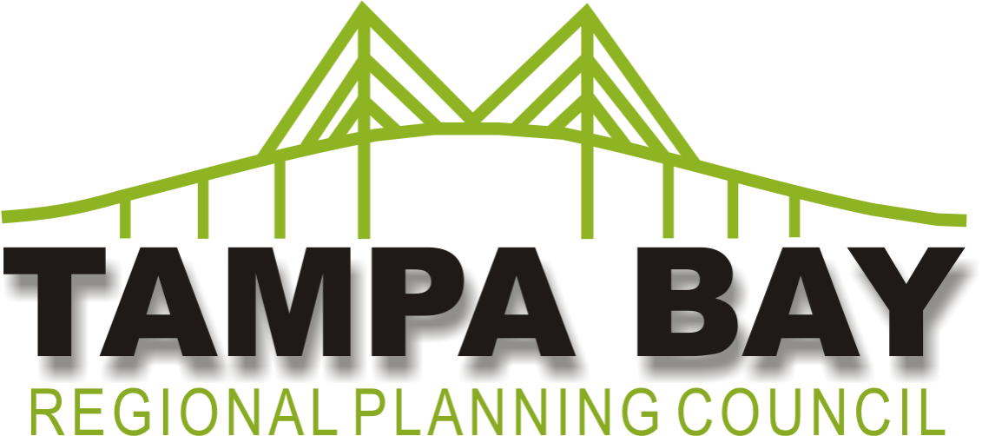
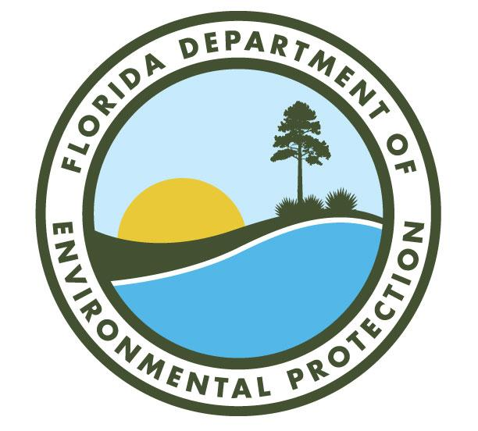
Resilient Shoreline Model Ordinance Template
Funded by a grant
from the 2021 FDEP
Florida Resilient Coastlines Program
Notes:
Good morning. In order to help create more resilient waterfronts, the TBRPC in collaboration with attorney Erin Deady and shoreline engineer Thomas Ries of ESA have worked for the past 8 months to develop a resilient shoreline model ordinance to serve as a template for local governments. This morning, we will preview some of the key sections. The draft ordinance will be distributed tomorrow to the you, the Coalition Management and Planning committee and the members of the working group.

Slide 32
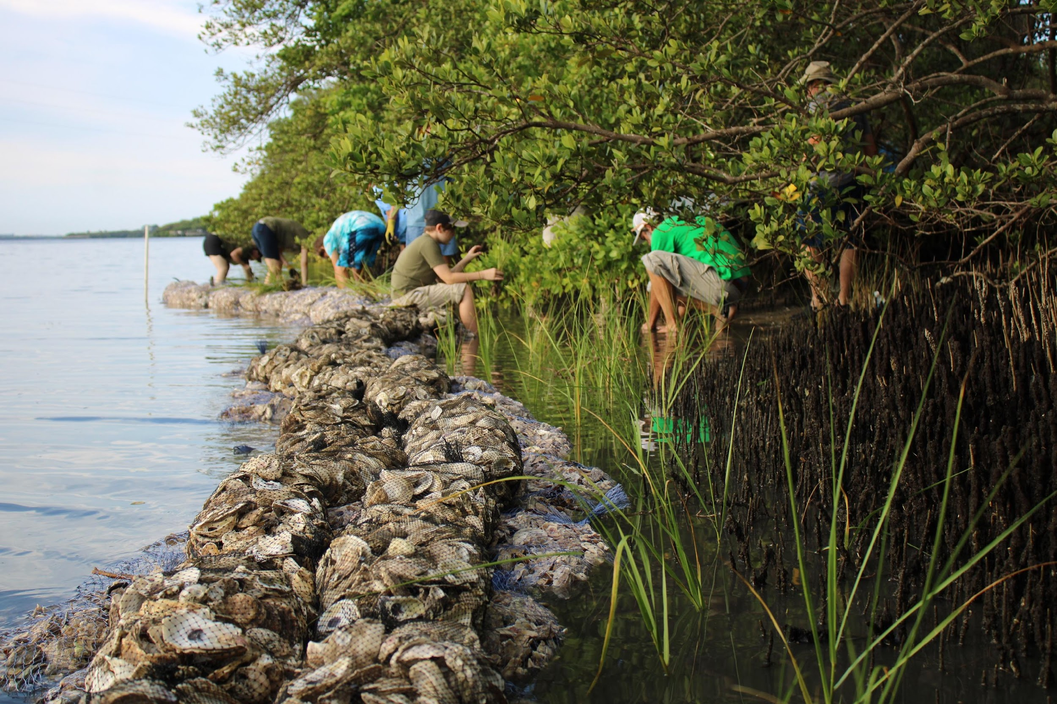
Research and Stakeholder Input Activities to Develop the Template
4 workgroup meetings in 2019-2020 2 workshops in 2021
Reviewed 30 comprehensive plans
Reviewed code from Broward, Monroe, other counties and cities
Reviewed multiple states’ programs and policies
10+ meetings with engineers, attorneys, CFMs
Pinellas County Philippe Park living shoreline:
installation Oct 2021
Notes:
Cara
The document has been developed through a robust process, engaging marine contractors, environmental resource managers, land-use attorneys and staff in many departments analyzing 30 comp plans in 2021 to identify that most local governments did not have a defined height. We compiled new code from other counties, looked at state programs in more advanced states and held meetings with experts to answer specific questions.

Slide 33
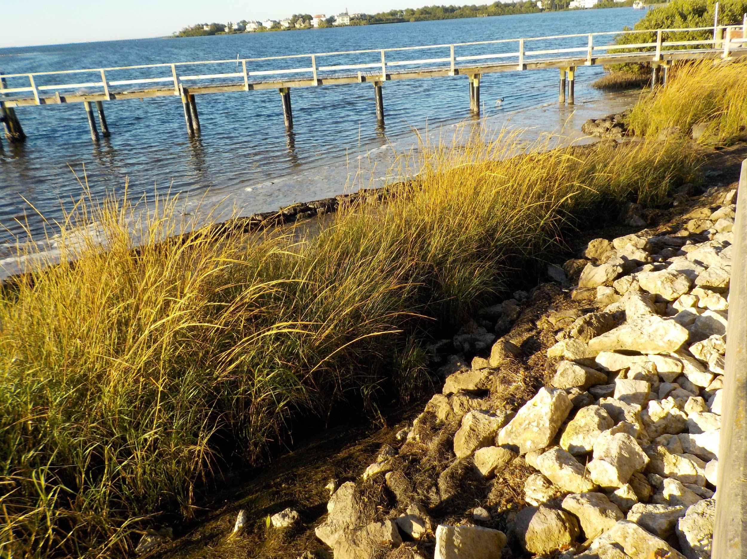
Summary of Key Concepts in the Ordinance
Sets minimum elevation for tidal flood barriers – seawalls to living shorelines.
Defines parameters for maximum height; does not set a height.
Establishes a Shoreline Protection Overlay District to define boundaries.
Creates 3 standardized project classifications and defines what is permitted, conditionally permitted and prohibited for each classification.
Establishes a target year for all shorelines to meet the minimum elevation requirement.
Ozona Park, Safety Harbor,
14 months after installation and after TS Elsa -- no damage.
Notes:
Cara

Slide 34
Ordinance -- 12 Sections
01: Purpose and intent
02. Applicability
03: Definitions
04: Minimum elevations for tidal flood barriers within tidally influenced areas
05: Shoreline overlay districts, shoreline structures and hierarchy of response
06. Design and Construction of Natural Shorelines
07: Design and Construction of Hybrid Shorelines
08: Design and Construction of Seawalls/bulkheads
09: Authorizations for tidal flood barriers, living shorelines and NNBFs—Required and Hardships
10: Applications for Permits
11: Maintenance and operations of tidal flood barriers, living shorelines and NNBFs
12: Required notifications in contracts for sale of real estate
Notes:
Cara – the draft ordinance has 12 sections, which address crucial requirements. Today, we will briefly review Sections 1-5 the applicability, definitions, Minimum elevation and Shoreline Overlay District and Hierarchy of response. The ordinance also has Sections on Design and Construction and Authorization, Permitting, Maintenance and notifications

Slide 35
Section 1 Purpose and Intent
Ensure that local shorelines are resilient to changing sea levels and tidally influenced flooding through 2070 to provide community flood protection benefits and ensure the ecological integrity of coastal habitats and shorelines on bay waters and riverine systems. Includes a consistent minimum elevation, design criteria, etc. for tidal flood barriers, living shorelines and natural and nature-based features (NNBFs) that will:
Create a standard for tidal flood barriers accounting for water levels predicted by 2070 for sea level rise.
(b) Ensure new shoreline protection structures and major shoreline modifications are designed for use as “tidal flood barriers” with standards accounting for future predicted tidal flood conditions in accordance with currently accepted sea level rise projections.
(c) Facilitate the construction of living shorelines and NNBFs, where appropriate, that can defend against tidal flooding, enhance water quality and improve natural resource benefits.
(d) Establish a policy for protecting and preserving natural shorelines, promoting living and hybrid shorelines and hardened structures where appropriate.
Notes:
Cara

Slide 36
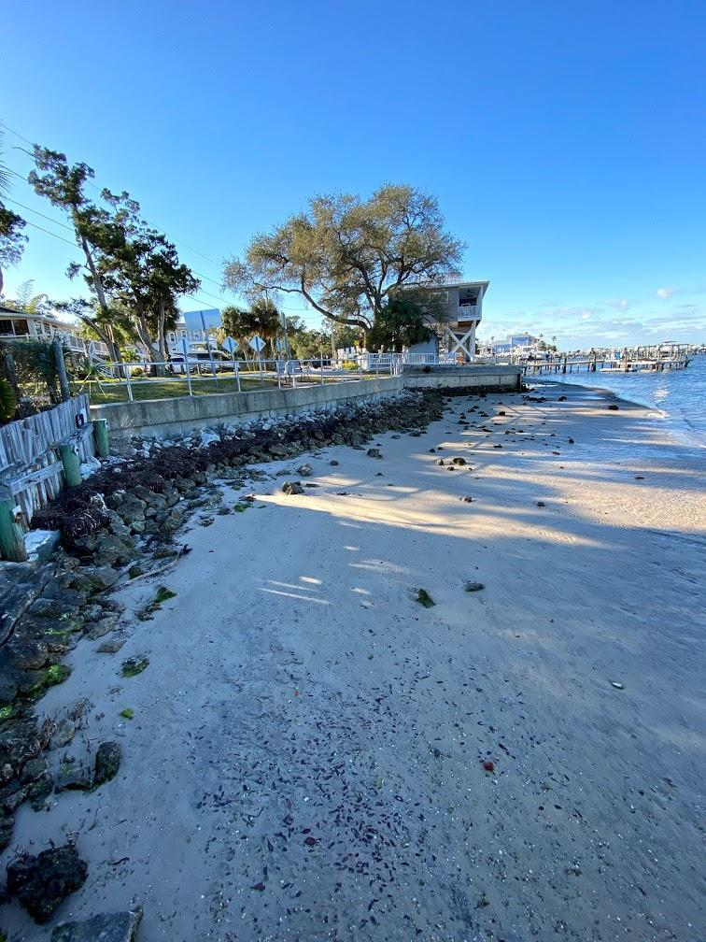
Section 2 Applicability
Specific conditions which trigger property owner action:
New tidal flood barriers;
Existing shorelines and shoreline structures which need substantial repair or substantial rehabilitation;
Failure to maintain a tidal flood barrier in good repair; and causing or allowing the trespass of tidal waters onto adjacent property, public right-of-way or other public infrastructure.
**** The model ordinance is not self-executing or retro-active.
Example: If a 3-foot seawall built in 2020 is in good condition and doesn’t cause flooding to adjacent property, the owner is not automatically required to make improvements.
Notes:
Cara

Slide 37
Section 3 Definitions
Comprehensive list of critical technical, construction and legal terms are provided. Example:
Substantial modification, repair or substantial rehabilitation means:
(a) Any modification to the shoreline or a shoreline structure along more than fifty percent (50%) of the length of the property's shoreline; or
(b) Any modification, alteration, or installation of an appurtenant structure (such as a dock) that exceeds fifty percent (50%) of the cost of a tidal flood barrier along the property's shoreline.
Notes:
Cara

Slide 38
Section 4 Minimum Elevation
(a) By 2040 all new or substantially repaired or substantially rehabilitated banks, berms, green-grey infrastructure, revetments, seawalls, seawall caps, upland stem walls, or other similar infrastructure shall perform as tidal flood barriers. Tidal flood barriers shall have a minimum elevation of five (5) feet NAVD88 to account for projected sea level rise by 2070.
Recommended height is derived from the following:
50-year planning timeframe/average life of sea wall is 40-50 years
Sec. 380.093, F.S.: NOAA 2017 Intermediate High 2070 = 3 ft. 6in (42 inches)
NOAA High Tide Flooding = 1 ft. 8 in. (20 inches)
Combined hazards = 62 inches/ 5 ft. 2 in.
Other factors
5 feet is consistent with Pinellas County, Broward County, multiple cities,
Others -- current code in our region at 4 ft
Provide minor surge protection 3-4 decades
Notes:
Cara

Slide 39
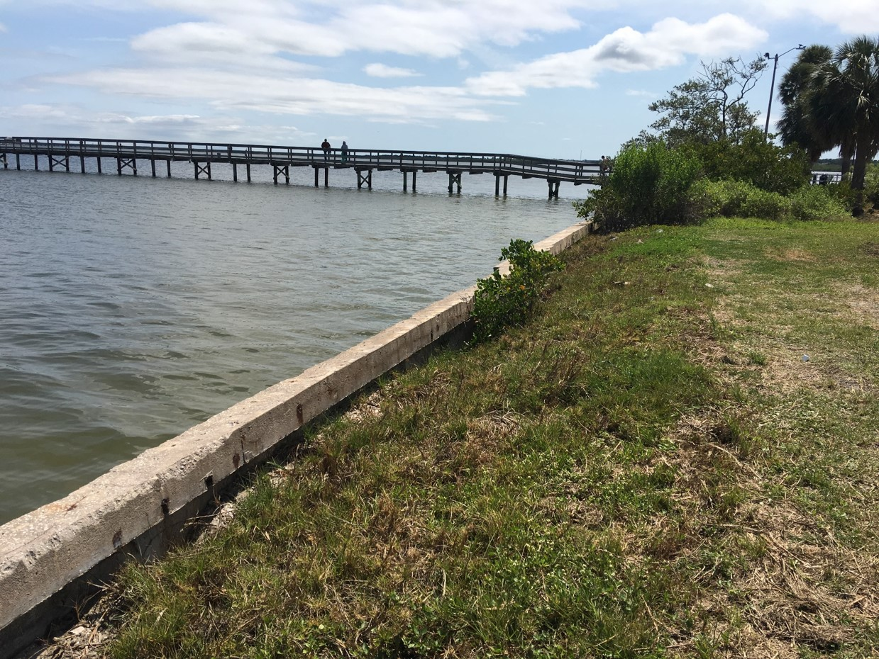
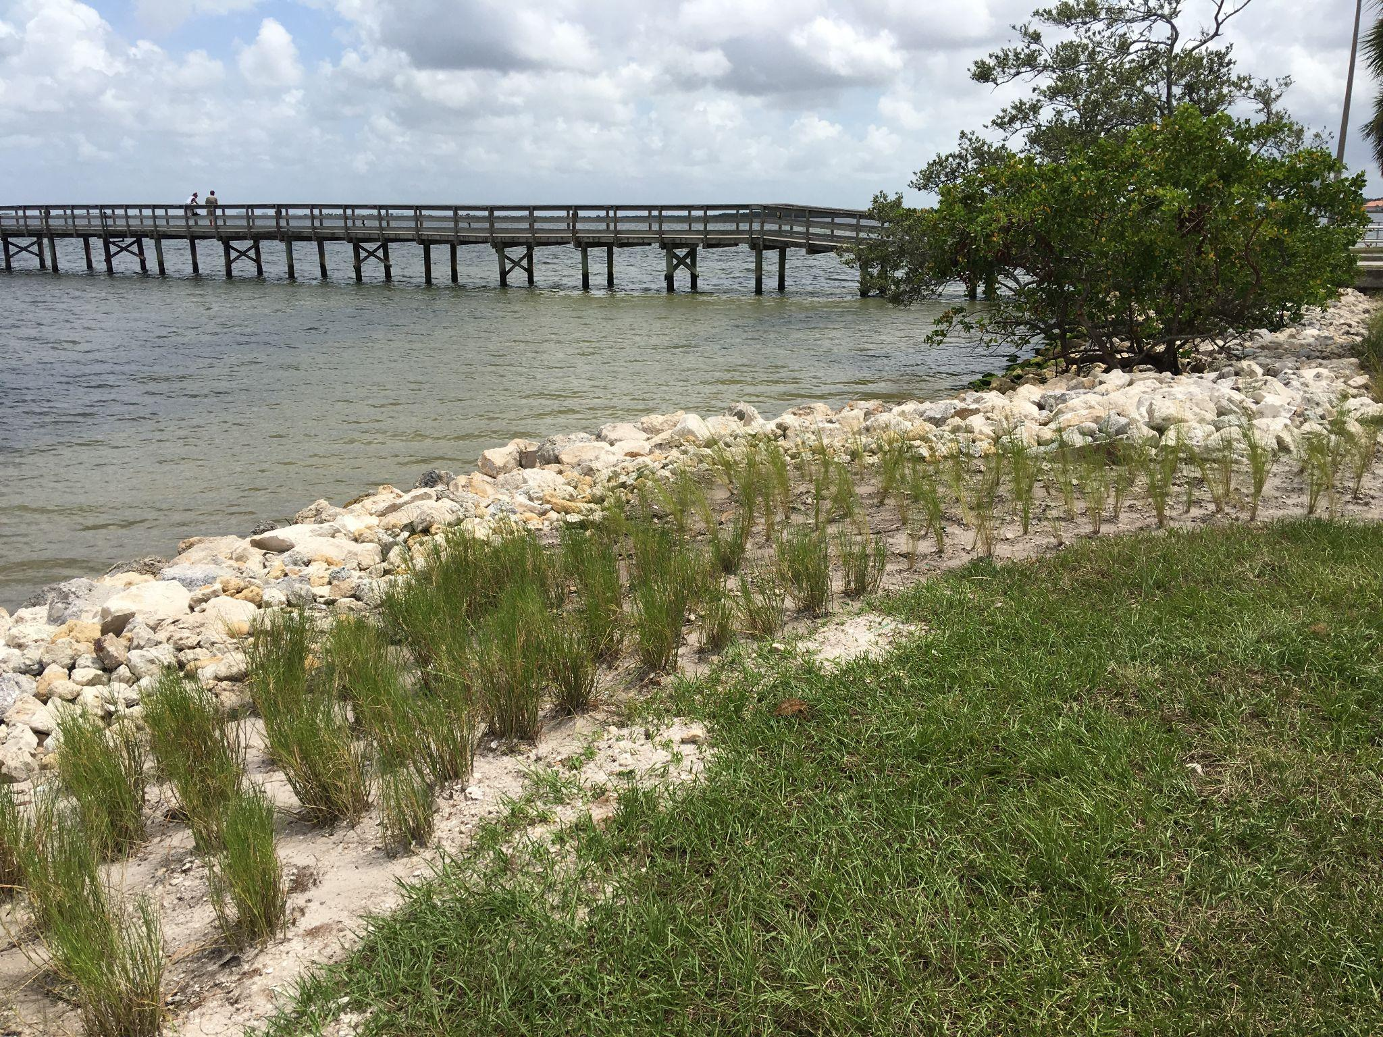
Section 5 Shoreline overlay districts, shoreline structures and hierarchy of response
Shoreline Overlay supports consistency and easier implementation for waterfront property owners.
Defines 3 shoreline types: natural, hybrid and seawalls
Defines what is permitted, conditionally permitted and prohibited for each category
Acknowledges nonconforming shoreline uses (tied to non-conforming sections of existing Code)
Links variance process to existing already in Code
Safety Harbor – top before & bottom after
Notes:
Cara

Slide 40
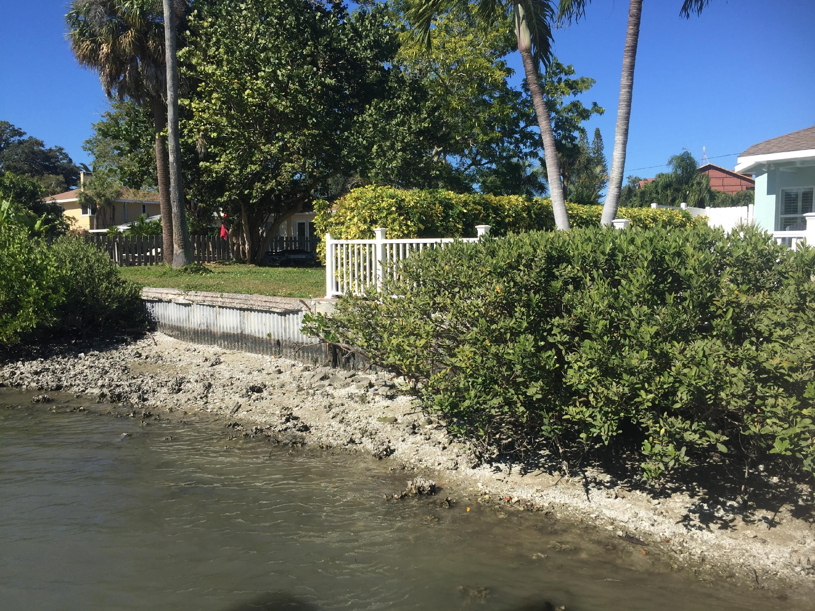
Benefits of Model Ordinance Template
Local Governments
Support Peril of Flood goals and TBEP CCMP goals
Vetted resource to update local code and plans
Increase consistency across departments and jurisdictions
Address interconnected issues
Support implementation of diverse shoreline types
Waterfront Property Owners
Offers more shoreline adaptation techniques
Provides clarity on responsibilities and future risks
Notes:
Cara

Slide 41
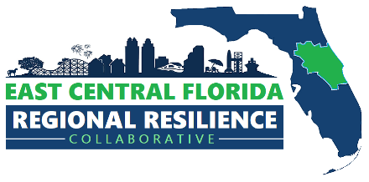
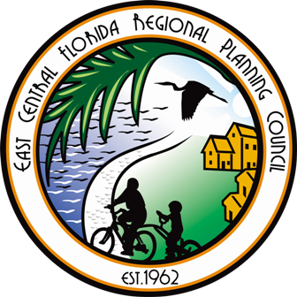
Regionwide Greenhouse Gas Inventory
Increasing Resilience
East Central Florida Regional Resilience Collaborative
(R₂C)
Tamara Pino
Resilience & Sustainability
Planner, ECFRPC

Slide 42
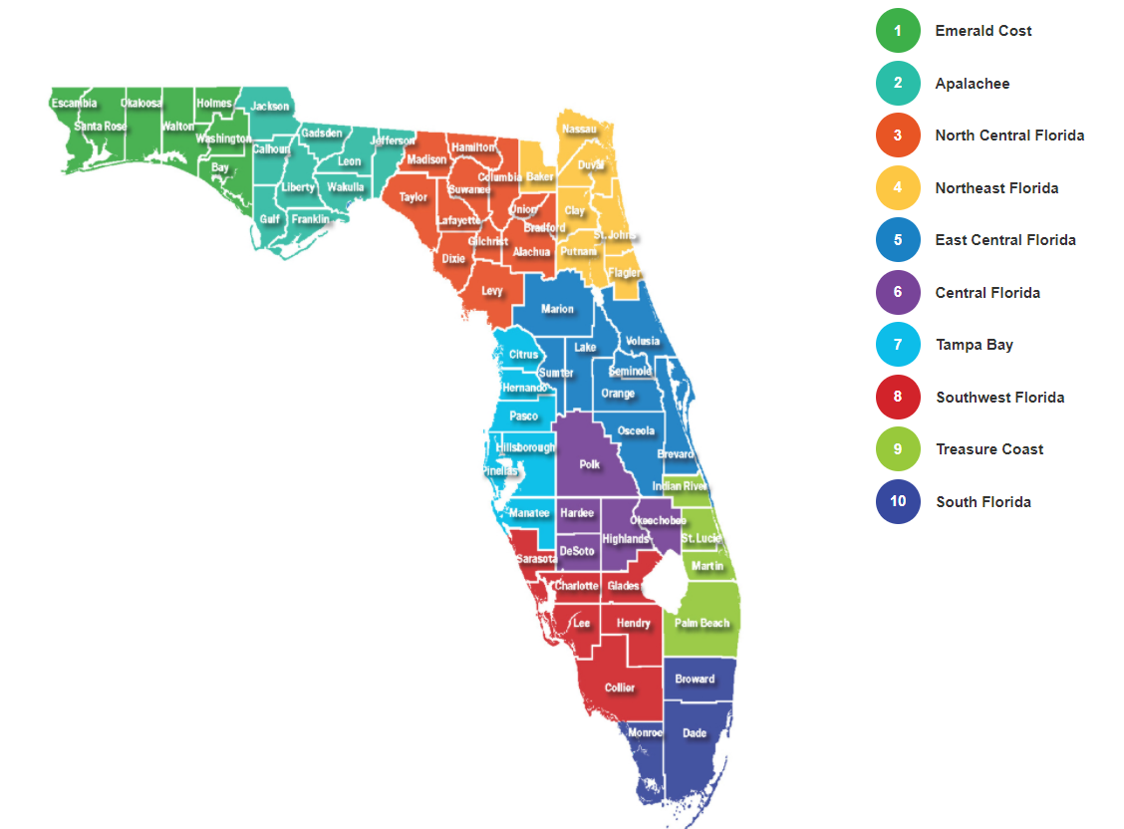
10 Regional Planning Councils
ECFRPC - established in 1962
No Regulatory Authority

Slide 43
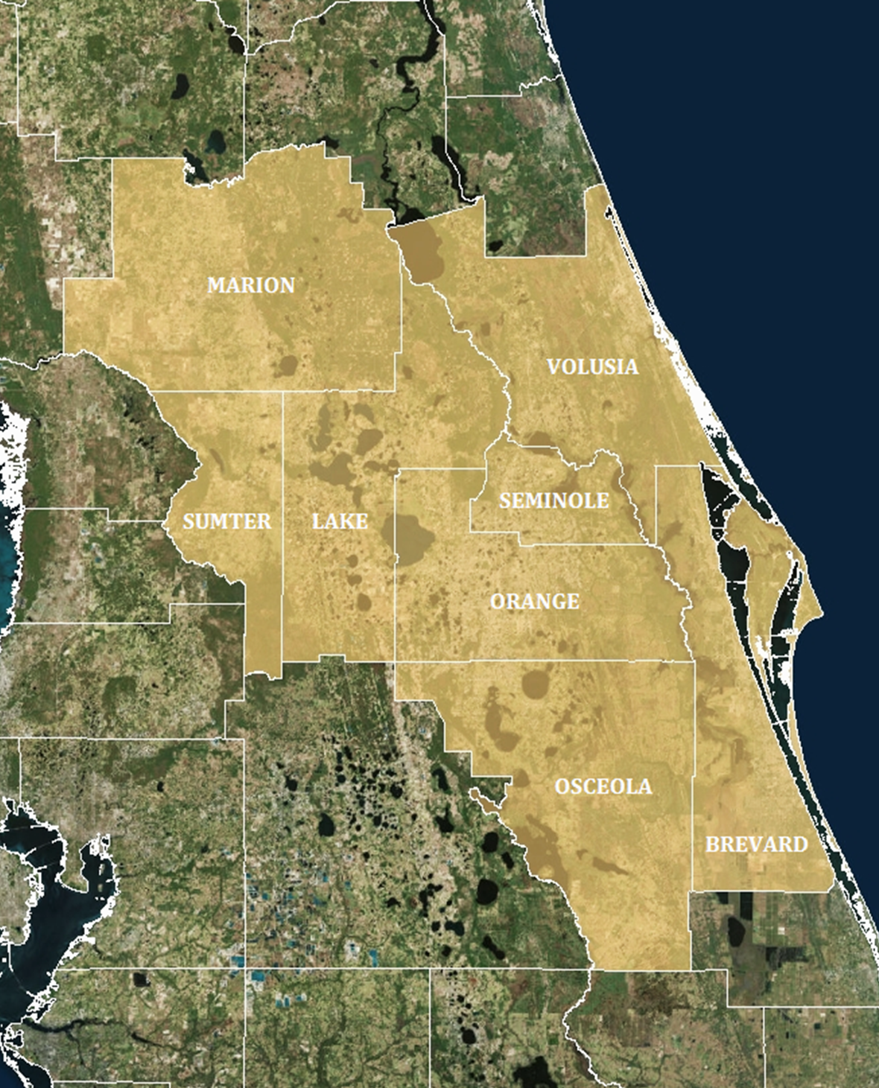
Serve Brevard, Lake, Marion, Orange, Osceola, Seminole, Sumter and Volusia counties
Ranking:
2nd in population
1st in area
Board make up
2 representatives from each county
1 representative from each League of Cities or largest City
1 representative from the City of Orlando
Gubernatorial appointees
Agency representatives

Slide 44
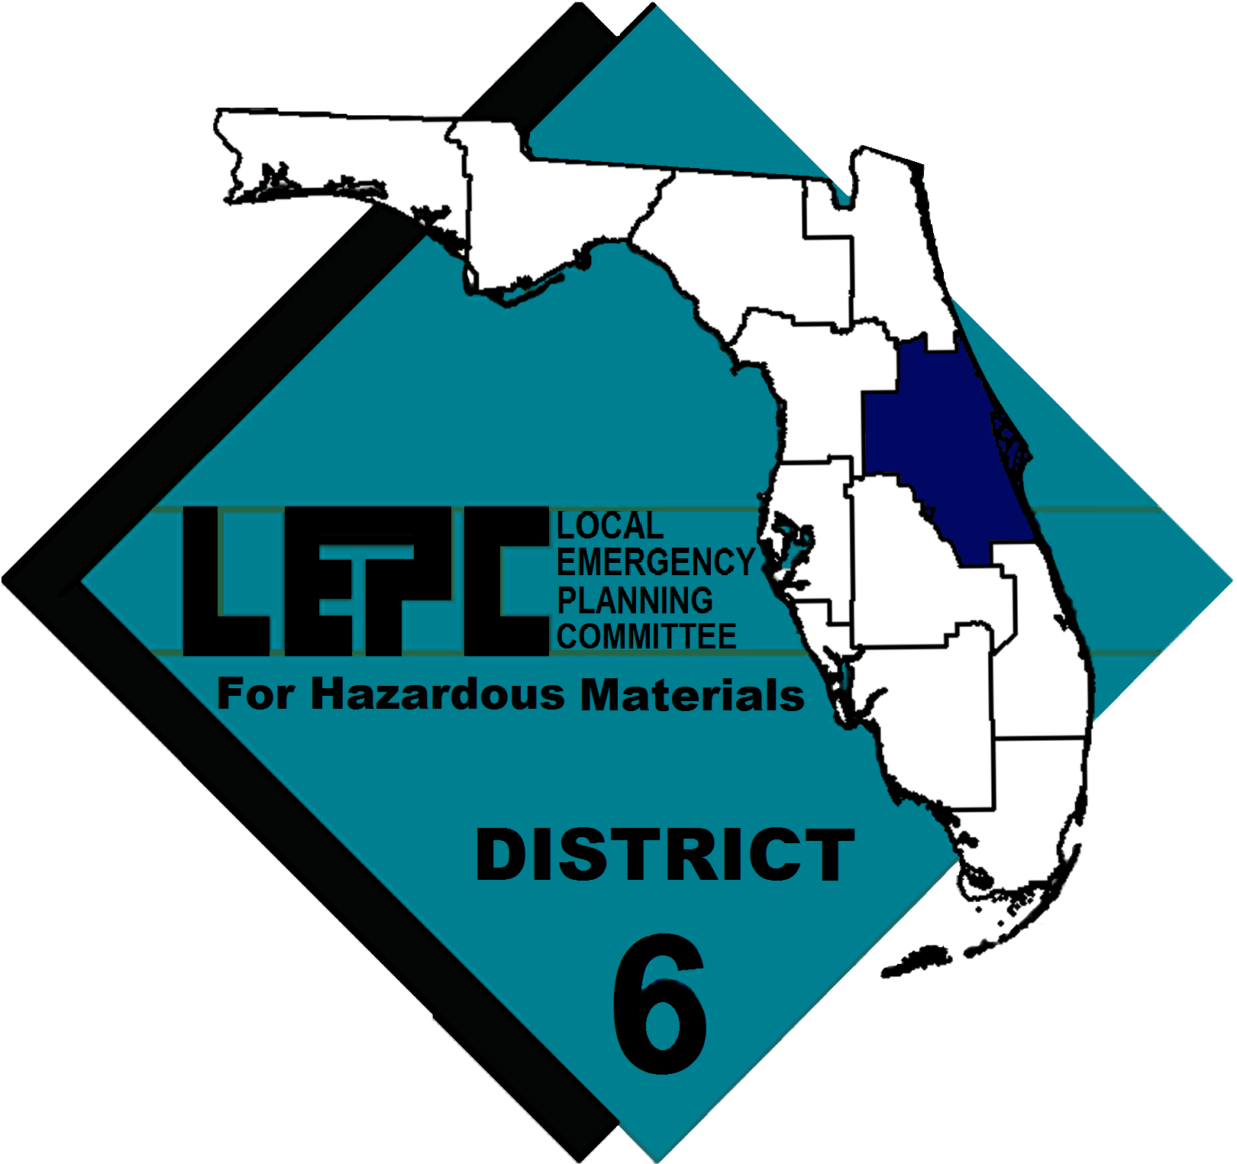
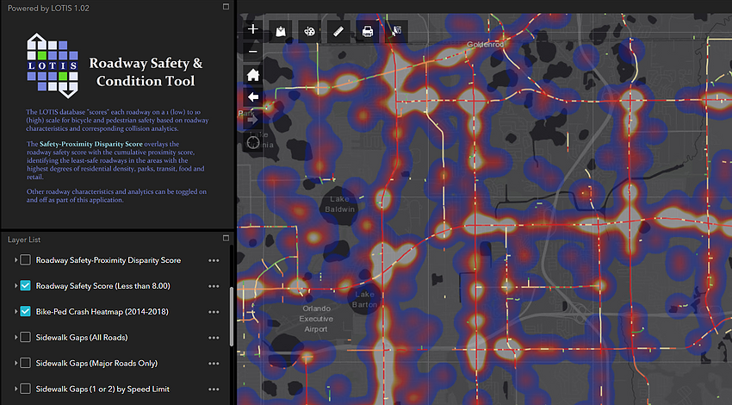
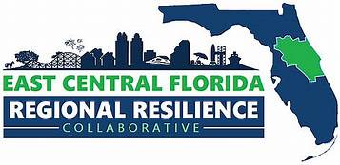
Areas of Expertise
Planning and Technical Assistance
Economic Development
Emergency Management
Geographic Information Services
Resilience 🡪 R2C

Slide 46
R2C
ECFRPC Resolution #03-2018 reaffirmed commitment to regionalism; recognized the relationship between economic development, planning and emergency management; directed to develop a structure and framework for a regional resilience collaborative.
Increase and amplify resilience efforts to better respond to shocks and stressors

Slide 47
Coalition Building
Establish common ground
Develop structure and framework for action
Shared definition and mission
Deeply listen and understand needs/existing gaps
Build capacity with strategic engagement
Use “strategic foresight” process
Secure funding
Develop Strategic Resilience Action Plan🡪 Roadmap for implementation
Yield greater collective impact toward stated goals

Slide 48
Framework
Resilience
People
Places
Prosperity
Health
+
Equity
Built Infrastructure +
Natural Environment
Economic
Resilience
Reduce the Carbon Footprint
Risk Reduction + Emergency Management
Sustainability Goals

Slide 49
Resilience
Resilience – the ability to bounce forward; absorb, recover and get better in the face of short term shocks like hurricanes or infrastructure failures and long – term stressors like affordable housing, aging infrastructure, shifting economic trends and climate change.

Slide 50
Mission
Empower our communities in East Central Florida to advance resilience strategies that strengthen and protect the built infrastructure and natural environment, enhance health and equity, and ensure a thriving economy.
Think Globally
Plan Regionally
Act Locally

Slide 51
Build Capacity & Capability with Strategic Engagement
Regional risk & vulnerabilities- integrating future conditions
Regional greenhouse gas inventory
Regional infrastructure assessment- grey, blue, green
Regional capacity building and training modules
Education and outreach plan that will include a component for Elected Academies
Build local awareness and regional capacity for including health + equity, social justice into resilience work
Seek & leverage external opportunities to build and sustain the collaboratives identity and impact
Catalyst for advancing preparedness /resilience policy and action across jurisdictions
Regional food systems inventory
Develop regional economic resilience capacity

Slide 52
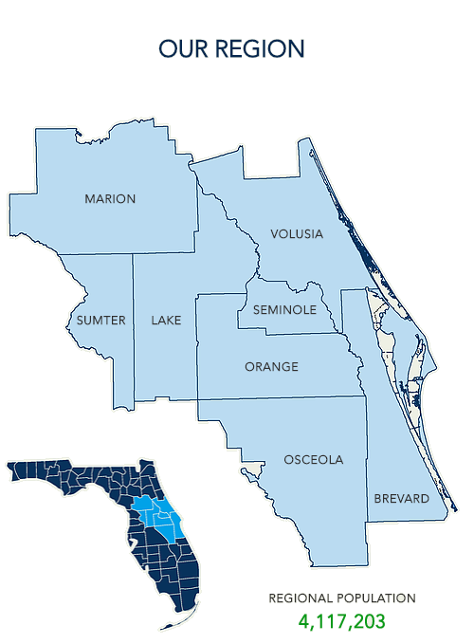
Regional Resilience Collaborative (R2C) Structure
Unified effort
East Central Florida
Regional Planning Council
Regional Risk & Vulnerability
Technical Advisory Committees
Council Sub Committee
Regional Greenhouse Gas Inventory
Steering Committee
Infrastructure Assessment – grey, green, blue
Engagement & Academy Development
Economic Resilience
Collective Impact
Health + Equity

Slide 53
Steering Committee
Unified Effort
Steering Committee
Disciplines with a unified effort
Economic
Health & Equity
Natural Resources
Create productive connectivity
Planning
Energy
Emergency Management
with
branded initiatives
Outreach and Public Policy
Transportation
.
Sustainability
Academia

Slide 54
Partner Engagement & Technical Advisory Committees
Regional Risk & Vulnerability
Building a collaborative ecosystem through engagement in technical advisory committees.
Committees are establishing and prioritizing goals and developing strategies for implementation.
Alignment of goals and leveraging resources with community partners.
Regional Greenhouse Gas Inventory
Infrastructure Assessment –grey, blue & green
Steering Committee
Engagement & Academy Development
CEDS – Economic Resilience
Health + Equity

Slide 55
The Process
Build the Narrative Arc
Strategic Foresight
Why does it matter?
Define the Role of the Committee & establish Partnerships
Build Understanding
Envision the region 2- 5 years, set goals
Build strategy /objectives to achieve goals and amplify efforts
Provide goals, objectives and recommendations for implementation and track metrics
How does it work?/ If it isn’t working, why not?
Define Action

Slide 56
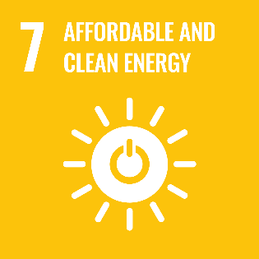
Regional Greenhouse Gas Inventory
Completed 2021, 2019 baseline R2C
Assess regional scale impacts from shocks and stressors in order to provide support for implementing strategies and resilient practices within the region. This regional risk efforts will be achieved by leveraging regional expertise; historic, current, and future conditions; consistent metrics and index evaluation; and through analysis of social and natural vulnerabilities.
Regional Risk & Vulnerability
GOAL: Develop a regional greenhouse gas (GHG) emissions inventory
GOAL: In conjunction with the regional greenhouse gas (GHG) emissions inventory, assist R2C partners/ local governments in the region with data collection and developing their internal capacity to conduct their respective GHG emissions/municipal operation inventories.
Regional Greenhouse
Gas Inventory
Infrastructure –grey, blue & green
Steering Committee
GOAL: Engage the Business community
GOAL: Conduct an inventory assessment
GOAL: Establish Science Based Target for the region
GOAL: Conduct Forecasting Analysis
GOAL: Planning : High Impact Action Analysis
GOAL: Develop an engagement strategy
GOAL: Regional Climate vulnerability assessment
ACTION: Develop a Regional Climate Action Plan
Engagement & Academy Development
Economic Resilience
Health & Equity

Slide 57
Strategy Maps
Goal or desired result: Develop a regional greenhouse gas (GHG) emissions inventory for cities and counties throughout East Central Florida and support local governments within the region with data collection. and developing their internal capacity to report their own GHG emissions inventories.
Strategic Objectives | Action Steps / Partnerships | Targets |  |  | Tracking Measurements/ Metrics /Indicators | SDG alignment
Develop inventory of current GHG inventory efforts across East Central Florida | Send survey to include, current state, years conducted, baseline years, baseline Identify current needs of local government members and their ability to perform GHG inventories | May 2020 |  |  |  | 13, 17
Identify and standardize the tool(s) used, baseline years and sectors to perform individual and regional GHG inventory | Engage the technical advisory committee in discussion and reach consensus on tool, baseline years and sectors to understand | June/July 2020 |  |  | Sectors: Transportation, Energy and Waste Baseline years 2016 and 2019 ICLEI ClearPath tool selected | 13
Secure funding to complete regionwide inventory | Develop one page primer outlining scope of work Reach out to potential funders that align with R2C goals Seek and apply for grants to fund the inventory & potential staff person
Standardize the assumptions, emissions factors, and methodologies for GHG inventories | RECORD METHODOLOGY for decisions |  |  |  |  | 7, 13
Develop list of providers in the region in appropriate category | Begin provider engagement to partner and understand constraints and timing for Federal reporting | September 2020 | Ongoing- November | Ongoing partnership development |  | 13, 17
Develop templates and standards for GHG emissions data requests | Work with tac and ICLEI to understand the protocol and develop appropriate regional templates Upon template completion, work with other regional collaboratives/ compacts/ coalitions to present, assist and distribute templates for statewide use Email templates |  | October/November 2020 | January 2021- ongoing | See templates for each sector | 7, 13, 17
Collect GHG data per category at the regional level | Collect data Continue to conduct outreach to providers Develop tracking spreadsheet for contact persons & information, dates Develop County Master Data Workbooks to prep and q/c data for ClearPath tool |  | January 2021 | ongoing
Develop regional priorities and recommendations following the GHG inventories |  |  |  | February 2021- ongoing
Who is better off? Children & Youth; Community Engagement; Criminal Justice; Economy; Education; Built infrastructure; Natural Environment; Food Access & Affordability; Government Practices; Health; Housing
Recommendation

Slide 58
Funding
DEO Technical Assistance Grants
FDEP FRCAP Grant
EDA
CDBG-MIT
Seed funding for RGHGi
The Nature Conservancy
Environmental Defense Fund
Audubon

Slide 59
Regional Greenhouse Gas Inventory
Groundwork
Consistent baseline year 2019
Measurements for the region
Unified platform for tracking
Building relationships with providers
Data collected at county scale, aggregated
Activity & Google EIE data utilized
Completed 2021
Stationery
Transportation
Waste
Residential Buildings
On road transportation
Solid waste
(MSW)
Commercial Buildings
Off road (rail)
Industrial Energy
Establish Clear Goals
Consistent
Baseline, Data &
Platform
Establish Partnerships
Secure Funding
Conduct Inventory
FIRST EAST CENTRAL FLORIDA REGIONAL GHG EMISSIONS INVENTORY

Slide 60
Collective Impact: AF + R2C Cohort
18 Local governments
6 counties, 13 cities
Status include:
Lead by example
Considering internal actions
Addressing inefficiencies
Reviewing procedures & ops
Improve activity monitoring procedures
Writing climate action plan
Countywide
Municipal Operations

Slide 61
GCoM Membership
Pledged to implement policies and undertake measures to (i) reduce / limit greenhouse gas emissions, (ii) prepare for the impacts of climate change, (iii) increase access to sustainable energy, and (iv) track progress toward these objectives. Specifically, within no more than three years of this commitment, we pledge to develop, formally adopt and report on the following:
A community –scale greenhouse gas (GHG) emission inventory
Ambitious, measurable and time-bound target(s) to reduce/limit greenhouse gas emissions;
An assessment of climate hazards and vulnerabilities;
Ambitious adaptation vision and goals, based on quantified scientific evidence when possible, to increase local resilience to climate change;
Ambitious and just goal to improve access to sustainable energy; and
Plan(s) to address climate change mitigation / low emission development, climate resilience and adaptation, and access to sustainable energy, including provisions for regular (annual or biennial) progress reports.

Slide 62
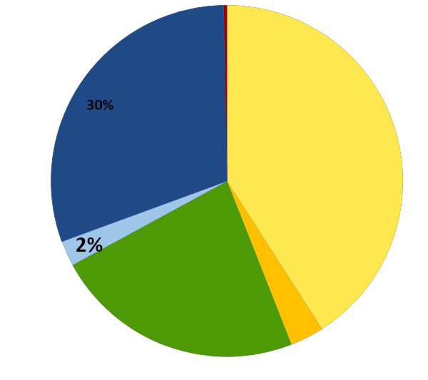
Region-wide CO₂e Emissions by Sector
Sector | Fuel or Source | Usage | Usage Units | Emissions
Residential Energy | Electricity | 34,427,810,716 | kWh | 13,614,601
Residential Energy | Natural Gas | 115,659,468 | Therms | 615,152
Residential Energy | Other |  |  | - 1.00
Residential Energy Total |  |  |  | 14,229,752
Commercial Energy | Electricity | 18,805,061,817 | kWh | 7,459,391
Commercial Energy | Natural Gas | 632,445,810 | Therms | 3,363,758
Commercial Energy | Other |  |  | - 1.00
Commercial Energy Total |  |  |  | 10,823,148
Industrial Energy | Electricity | 1,982,070,536 | kWh | 803,415
Industrial Energy | Natural Gas | 55,068,997 | Therms | 292,276
Industrial Energy | Other |  |  | - 2.00
Industrial Energy Total |  |  |  | 1,095,689
Transportation & Mobile Sources | Gasoline | 33,329,031,223 | VMT | 13,908,992
Transportation & Mobile Sources | Diesel | 3,555,686,820 | VMT | 5,251,678
Transportation & Mobile Sources | Other |  |  | 61,503
Transportation & Mobile Sources Total |  |  |  | 19,222,173
Solid Waste | Waste Sent to Landfill | 5,504,141 | Tons | 1,431,041
Solid Waste | Waste Sent to Incinerator | 156,413 | Short Tons | 542
Solid Waste | Other |  |  | 27,070
Solid Waste Total |  |  |  | 1,458,653
Process & Fugitive Emissions | Other |  |  | 139,346
Process & Fugitive Emissions Total |  |  |  | 139,346
TOTAL EMISSIONS |  |  |  | 46,968,761
0.3%
41%
23%
3%

Slide 63
Science Based Target
46,968,761 Metric Tons
2019 Region-wide CO₂e Emissions
Absolute SBT 54.3% by 2030

Slide 64
Science Based Target
Measurable and actionable clear pathway to resilience
Support United States goal
Alignment with latest climate science (IPCC)
Build internal and external support toward reductions
Drive innovation and collaboration
Reduce uncertainty
Improve region’s economic competitiveness & health

Slide 65
Region-wide 2019 primary emissions were estimated at 46,968,761 Metric Tons (CO₂e)
Emissions Forecast
Forecast begins with inventory assessment.
Creates projections of emissions trends based on anticipated variable changes:
Demographics
Economics
Policy
Four Variables:
Regional Population Growth
Commercial & Industrial Growth
On-Road transportation fuel efficiency standards
Utility Grid Decarbonization

Slide 66
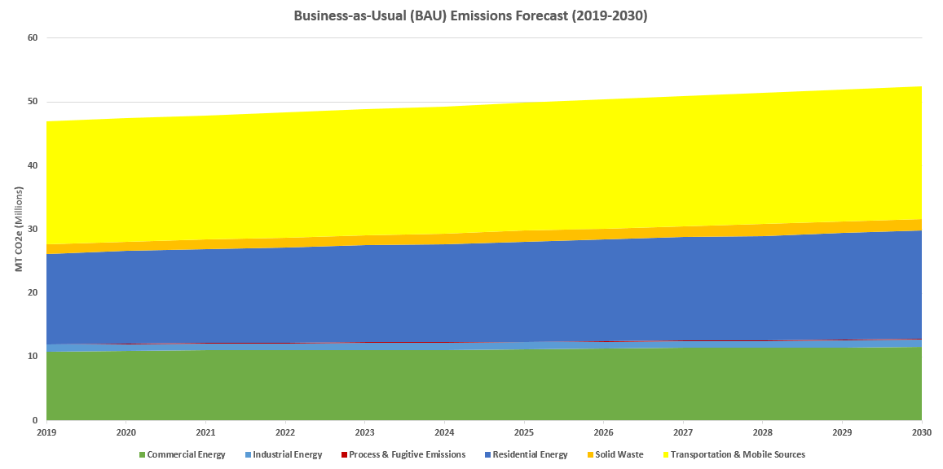
Forecasting Analysis, BAU

Slide 67
High Impact Actions (HIA)
Absolute SBT 54.3% by 2030
Grid decarbonization
VMT reduction
Gasoline reduction of 12% and diesel VMT reduction of 6%
EV adoption
Residential and commercial energy efficiency
Increase residential solar deployment
15% of the region's total residential rooftop solar PV capacity

Slide 68
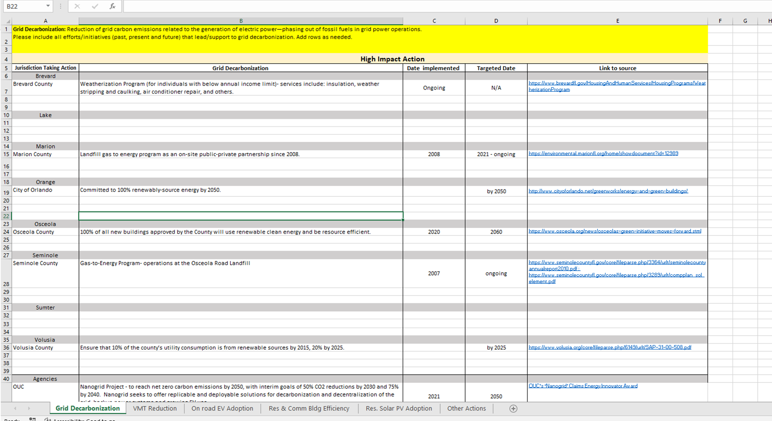
Momentum

Slide 69
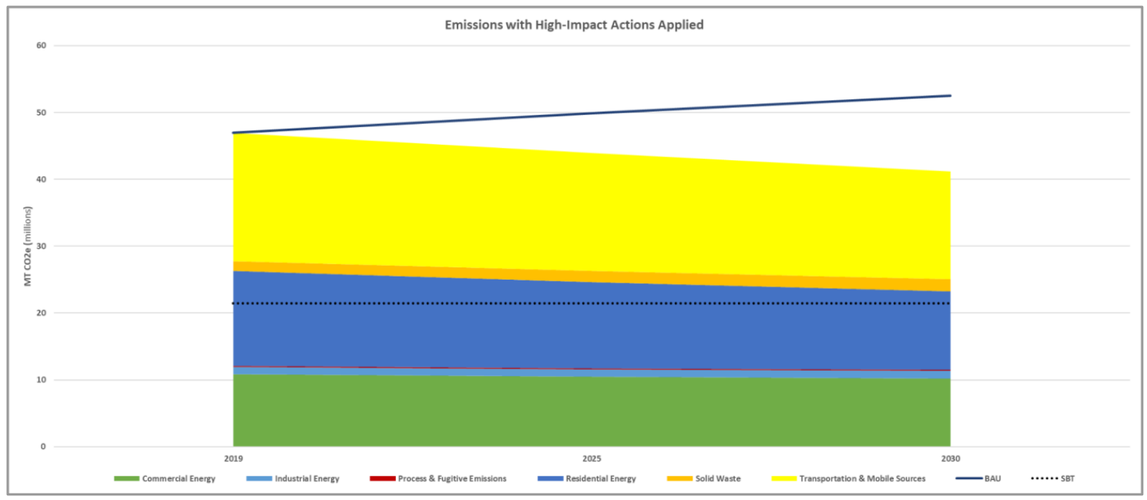
High Impact Action Analysis
·Changing the pace
·Emphasis
·Climate Action Plan
12.4%
Reduction

Slide 70
THANK YOU!
Tamara Pino
Resilience & Sustainability Planner
Contact: tpino@ecfrpc.org
Visit: ecfrpc.org/r2c

