Slide 1
Community Partnerships for a Lasting Legacy
Alison Stettner, AICP Director of the Office of Policy Planning
June 2, 2022
Notes:
This is also on the annotated agenda: Strengthening relationships among FDOT, local governments, and other transportation partners is a win-win for all involved. Working together aligns local and regional visions while coordinating land use and transportation decision-making. It generates greater trust and confidence among partners as well as a greater understanding of transportation planning processes and procedures and leads to desired planning outcomes at the local, regional, and state level. This session will discuss the value of collaborating early and often in the transportation planning process.

Slide 2
Why does Community Planning Matter?
Implements the Florida Transportation Plan
Supports FDOT’s Mission, Vision, Values and the Vital Few
- Improve Safety
- Enhance Mobility
- Inspire Innovation
Integrates land use and transportation through collaboration
2
Notes:
Community planning is also central to achieving FDOT’s Mission, Vision, and Values and supports the Vital Few Mobility and Safety goals as well as the Florida Transportation Plan, and in particular, key strategies addressing the integration of land use and transportation decisions as well as protecting water, air, lands, and habitats.
Integrating land use and transportation planning through collaboration includes:
Aligning transportation and land use through context classification to support community visions
Using community visions to set the framework for transportation decision making
Understanding how land use planning impacts the transportation network and safe use of all modes
---------------------
FTP examples if needed
FTP Vision Element: FORWARD-LOOKING PLANNING FOR HOW TRANSPORTATION CONTRIBUTES
TO A MORE COMPETITIVE, RESILIENT, AND SUSTAINABLE STATE
In the past, transportation decisions reacted to economic growth and development, and too often they had unforeseen consequences on our built and natural environment. We envision a future where effective transportation planning, in collaboration with land use, economic, and environmental planning, creates a stronger economy and enhances communities and the environment across the state.
FTP Policy Element: OBJECTIVES AND STRATEGIES TO GUIDE TRANSPORTATION PARTNERS STATEWIDE IN ACOMPLISHING THE VISION AND GOALS
Innovation means thinking more broadly about safety, so we address underlying socioeconomic or community factors that create systemic safety challenges. It means being more flexible in how we manage infrastructure and right of way, particularly how we adapt to risks. It means being more nimble in how we integrate both public and private mobility solutions across modes - connecting both services and data – to support end-to-end trips. It means being more proactive at how we link transportation, land use, economic development, and environmental stewardship decisions to enable growth and stewardship to go hand in hand. It means being more strategic in defining the evolving role of transportation agencies and workforce during this time of change.
Key Strategy – Protect water, air, lands, and habitats
Encourage early, large-scale coordination of transportation, land use, and conservation decisions to identify solutions that advance multiple goals, such as coordination on land purchases and easements and water storage, treatment, and drainage.
Key Strategy - Integrate land use and transportation decisions
Incorporate community context and land use plans as a key determinant of transportation planning and investment decisions.

Slide 3
How Does Community Planning Affect Our Work?
Context Classification/ Design
Speed Management
Community Planning
Traffic Operations
Project Development
Access Management/ Permits
Notes:
Community planning also affects FDOT’s day to day work. Planning decisions are used by FDOT in context classifications determinations, speed management solutions, safety, traffic operations, and access management. Context classifications, land use, zoning, and types of transportation users influence decisions about modes, connectivity, speed management, parking, preservation of community character, freight routes and delivery, and the balance between destination versus through traffic. Community planning decisions also affect a local government’s need for new transportation projects, improvements, or changes to existing facilities

Slide 4
FDOT’s Community Planning Policy (000-525-027)
Better integrate transportation and land use decisions
Proactively coordinate and collaborate with local governments, RPCs, developers, and other partners
Coordinate with DEO on community planning and transportation activities
Support a safer transportation network
Enhance mobility, promote economic prosperity, and preserve the quality of our environment and communities.
Notes:
With the passage of legislation over the past 12 years that significantly weakened Florida’s growth management laws and FDOT’s ability to impact local transportation and land use decisions, the Department has been exploring ways to influence transportation and land use decisions early in the transportation planning process and determined that building relationships with local governments and other transportation partners is a win-win for all involved. Working together aligns local and regional visions while coordinating land use and transportation decision-making. It generates greater trust and confidence among partners as well as a greater understanding of FDOT processes and procedures and leads to desired planning outcomes at the local, regional, and state level.
In response, FDOT adopted a Community Planning Policy, which became effective on February 28, 2022. It seeks to better integrate transportation and land use decisions by proactively coordinating and collaborating with local governments, regional planning councils, developers, and other partners. The Department will also coordinate with DEO on activities related to community planning and transportation, such as reviewing and commenting on local government comprehensive plans or plan amendments. Opportunities to coordinate and collaborate with local governments include access management, site plan review, context classification, and technical assistance, among others.
FDOT may also offer training, guidance, and other resources necessary to implement this policy. Finally, the policy supports a safer transportation network that enhances mobility, promotes economic prosperity and preserves the quality of Florida’s environment and communities.
-----------------
Statutory changes impacting FDOT, if needed:
Changes In Florida Statutes over the past 10 years
FDOT’s influence on community planning is limited
The current process of reviewing comprehensive planning and providing comments no longer adds value
Impact of 2011 Revisions on FDOT’s Community Planning Role
FDOT has minimal ability to ensure its comments are addressed by the local government
Lack of data and analysis limit FDOT’s ability to make informed decisions
Amendments come late in the planning process, FDOT shifts from a proactive position to a reactive position
Can’t capture the transportation impacts of large developments that are broken into smaller parcels
Local governments/developers are not financially contributing to improvements on impacted state facilities (FDOT can no longer secure financial exactions)

Slide 5
Community planning strategies
What?
Engage
Participate
Collaborate
Communicate
Assist
With whom?
Local & regional governments
Development and community partners
FDOT offices/staff
Why?
Improve
decision making
Promote data sharing/integration
Address funding challenges
Invest resources appropriately
Align FDOT and community visions
Build Partnerships
Notes:
Implementation of the Community Planning policy involves engaging, participating, collaborating, and communicating with, as well as assisting, local and regional governments, development and community partners, and our own colleagues within FDOT. The goal is to address transportation-related challenges and opportunities throughout the planning process (not just at the comprehensive plan review stage).
We educate through workshops, listening sessions, partner briefings, and training. We participate in local government visioning initiatives, development review committee meetings, access management meetings, and other partner meetings. Processes such as context classification designations and corridor and scenario planning present opportunities for collaboration. Communication is key to avoiding misunderstandings. We collaborate among FDOT staff, with MPOs and MPO liaisons, local governments, RPCs, developers, and other stakeholders. Finally, the comprehensive plan review process still offers us the ability to provide technical assistance to local governments. We also assist with traffic data, GIS, and applying for funding.

Slide 6
Notable practices: RELATIONSHIP BUILDING
Continuous engagement with development community & local governments
Regional transportation strategy, study, and methodology
Context-based planning
Notes:
This proactive engagement is already happening around the state.
District 1
Corridor Vision and action plans
Integrated land use and transportation vision
Framework for multi-modal transportation needs and complimentary land uses
The purpose of this study is to develop a Corridor Vision and Action Plan for the US 27 Corridor between County Road 720 and Palm Beach County Line within Hendry County. This project will be coordinated with local and regional agency partners such as the City of Clewiston, Hendry County, and the Central Florida Regional Planning Council to develop an integrated land use and transportation vision for the study corridor that provides the framework for multi-modal transportation needs and complementary land use policies. This study will include a community-based evaluation to determine how best to serve the needs of current and future users and to establish a long-term plan to guide evolution of the corridor toward the intended vision.
District 5
District 5 has been working with the Villages since they commented on the Wildwood CPAs in 2019 to come up with a mitigation agreement to address all of the Villages planned impacts across all jurisdictions.
This grew to include discussions about the Villages of West Lake, which was a CPA in Leesburg, and the District meets with them every month or so.
There have been ‘meet and greet’ meetings between Secretary Perdue, his leadership staff, and the Villages.
The District continues to work on a regional transportation strategy, study, and methodology
District 7
District 7 has had a culture of relationship building for quite some time.
Prior to Covid-19, District staff met once a week with Hillsborough County and with Pasco County, respectively, on local rezoning applications and site development applications. Early in the week, the District would receive an agenda form the local government with anywhere from five to 15 applications. These meetings gave District staff the opportunity to explain FDOT’s corridor and PD&E studies that might impact the applications as well as related design activity. Driveway permits might also be discussed. This did not just involve District planning staff, but transportation operations, design, and others. On the local government side, they had participants from site development, stormwater, traffic, planning, and zoning, depending on the issues at hand. Since the pandemic, these communications have continued through email and video conferences. Similar engagement through email has expanded to many of the District’s municipalities.
Also, prior to Covid-19, the District held pre-applications meetings with developers every Tuesday and Wednesday. Planning, stormwater drainage, access management, and traffic operations were all represented at these meetings. The District continues to hold these meetings through video conference and anywhere from six to 16 people attend. Thorough records of these meetings are kept in project files and referred to months and years down the road, improving the efficiency of plan and permit review.
The District also uses the comprehensive plan review process and responses to zoning applications to educate local governments on FDOT plans and policies that may be forthcoming as they move through the site development process by including this information in their plan amendment comment letters. This might include:
Explaining to the local government that a driveway permit will be needed on a state facility.
Providing a brief paragraph on what context classification the local government should be using.
Pointing out that an access permit might be needed.
Including hyperlinks to pertinent PD&E studies or design projects that are underway.

Slide 7
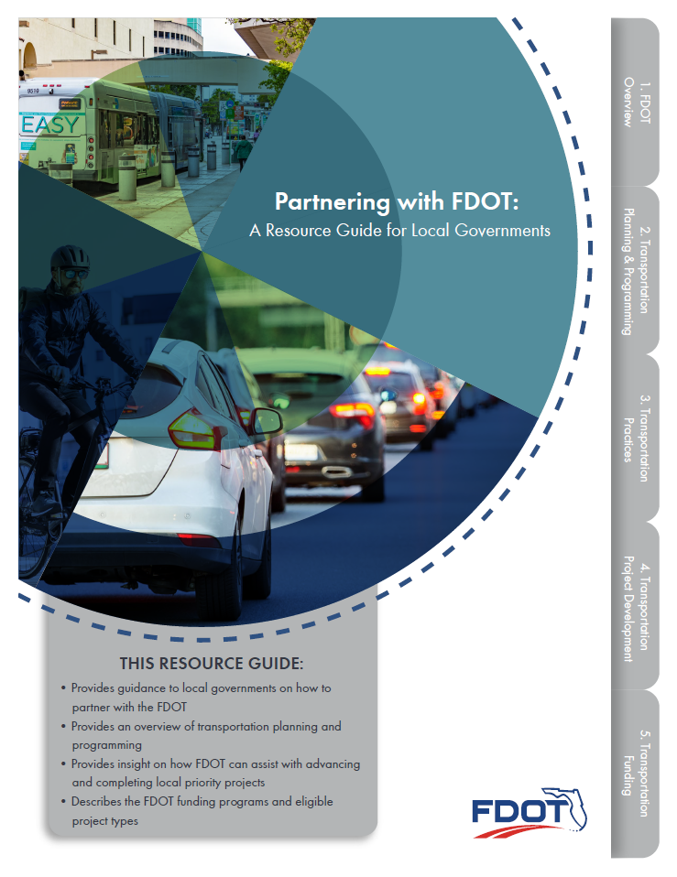
Resources
A Resource Guide for Local Governments
Community Planning Subject Briefs
Streamline FDOT’s comprehensive plan review process
Notes:
To help promote meaningful partnerships, we developed several educational resources for local governments and our partners:
A Resource Guide for Local Governments (updated version March 3)
Community Planning Subject Briefs, which include:
An overview of community planning
Comprehensive Planning
Complete Streets
Other subject briefs include:
Broadband deployment
Equity
Transportation funding
MPOs
Resiliency
Sea level rise
Sustainability
Transportation Workforce
Vision Zero

Slide 8
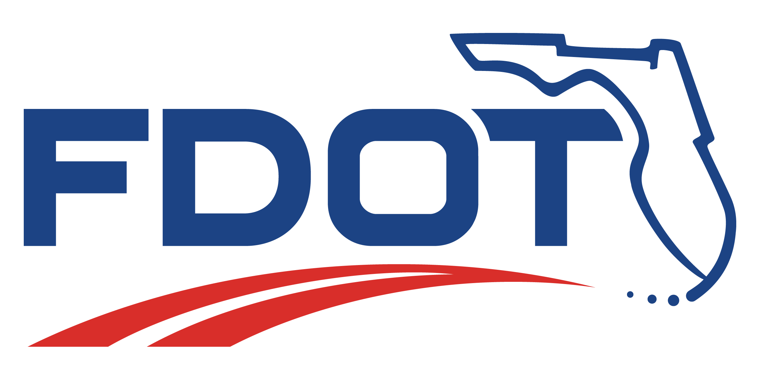
Safety is Everyone’s responsibility
Notes:
Finally, I can’t end a presentation without reminding you that Florida’s safety vision is to eliminate transportation-related fatalities and serious injuries for all modes of travel. Safety is everyone’s responsibility.

Slide 9
Alison Stettner, AICP Office of Policy Planning Florida Department of Transportation
Phone: (850) 414-4820
Email: Alison.Stettner@dot.state.fl.us

Slide 10
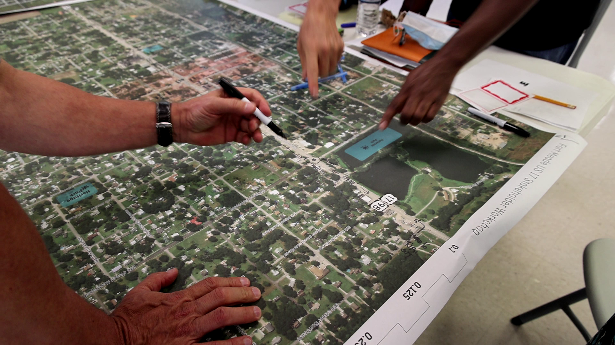
Planning Studio
June 2022

Slide 11
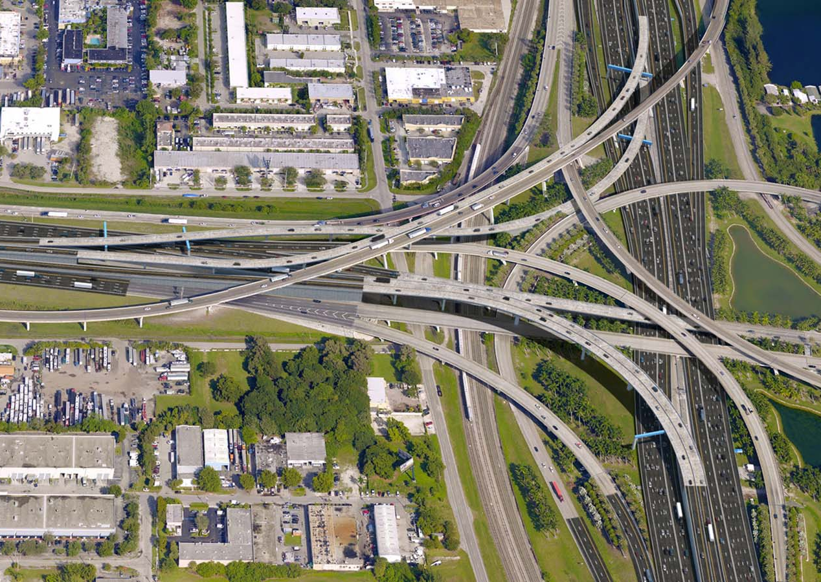
District 1 had a narrow “planning” focus
Focused on regional movement of cars and trucks.
Relying on a fractured growth management review process.
Problems
We didn’t have engagement until PD&E, Design, or later
We were not doing all we could to address mobility for all users
Missing oppurtunity to discuss future growth and development plans with partners

Slide 12
Planning Studio’s Charge
Lay the foundation for District projects
Integrate land use and transportation planning for the district
NEED TO: Actively engage community early and often
NEED TO: Build relationships with local community planners
NEED TO: Align with community vision

Slide 13
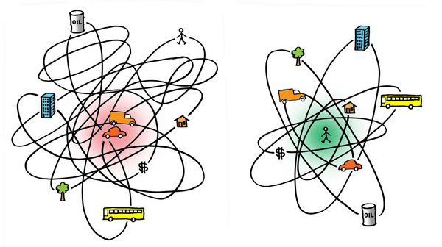

Slide 14
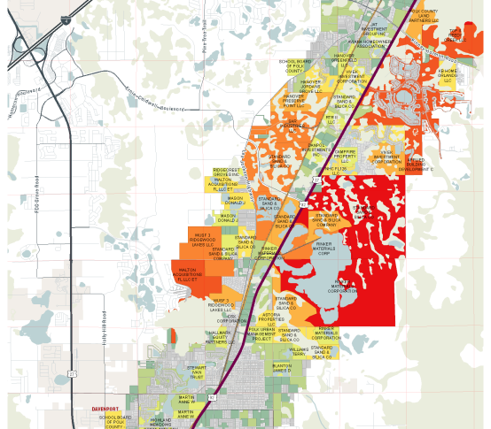
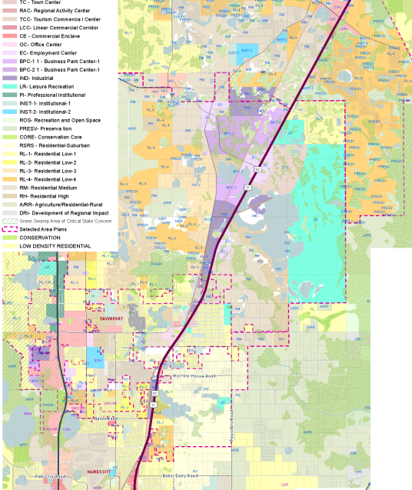
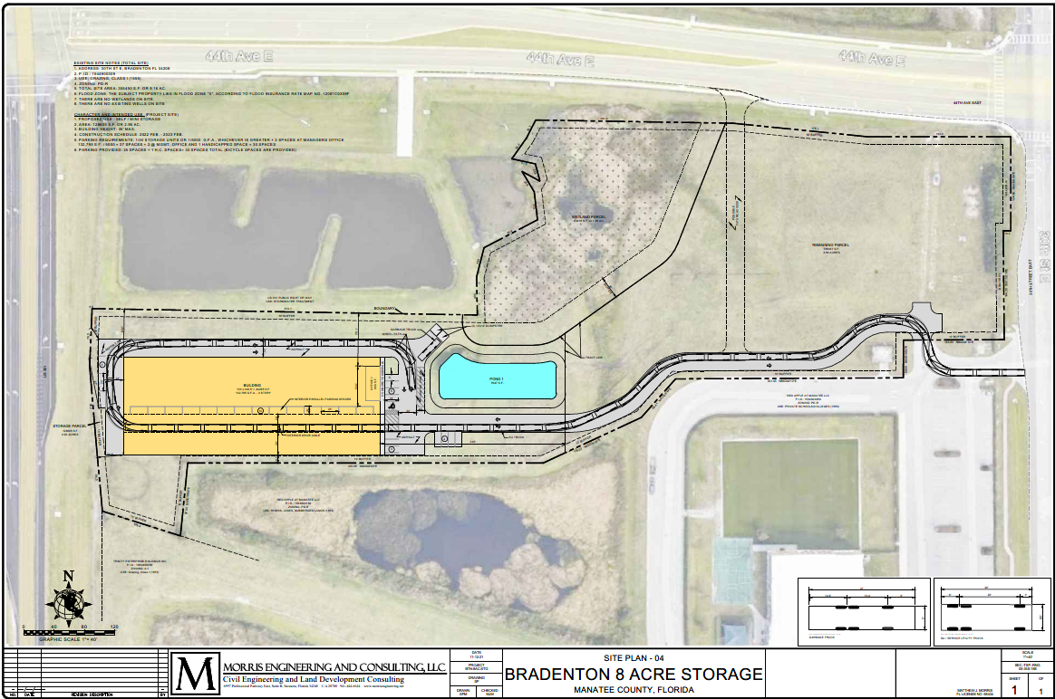
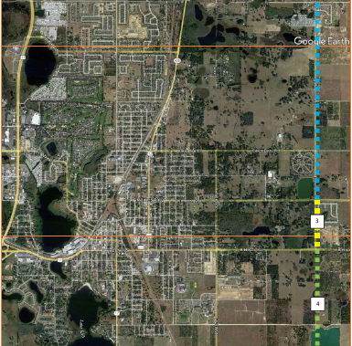
Community Planning Outreach
Outreach to select communities
Haines City
Davenport
Manatee County
Anticipate and Coordinate Future Growth
Engage Early and Often
Share Information
Find Opportunities
Notes:
Picture of Possible Power Line Road Extension and Upcoming Development on US 301 Manatee County

Slide 15
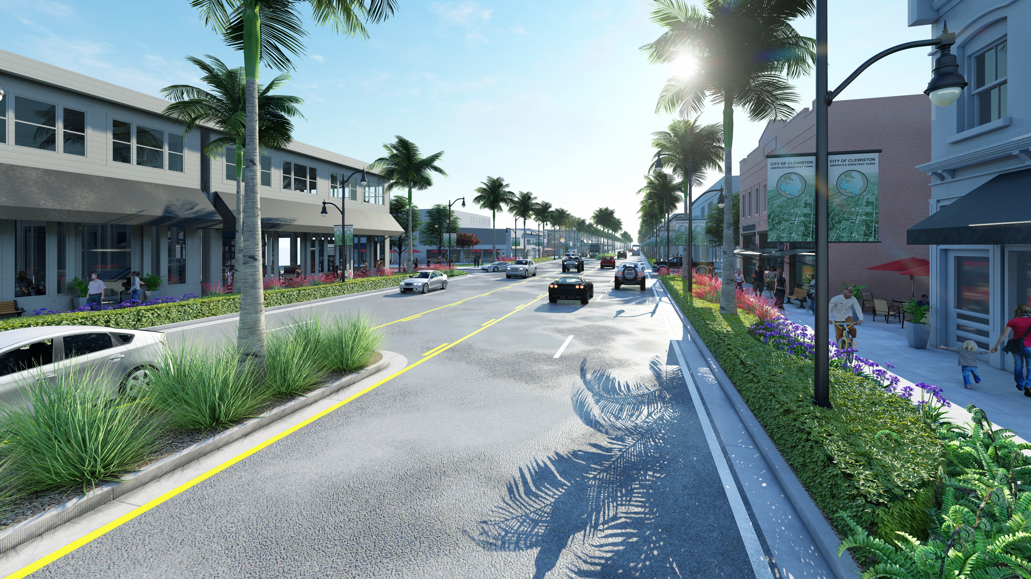
Corridor Vision Plan
A broader planning approach focusing on roadway functionality, local input and context sensitivity.
Clewiston Corridor Vision Plan

Slide 16
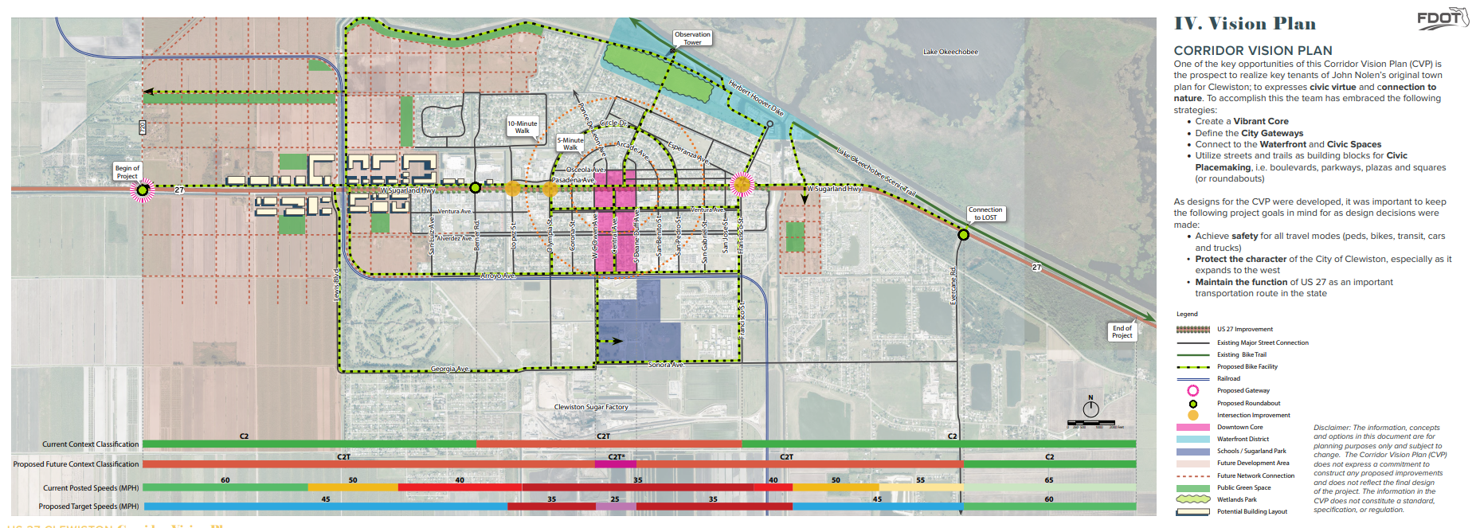
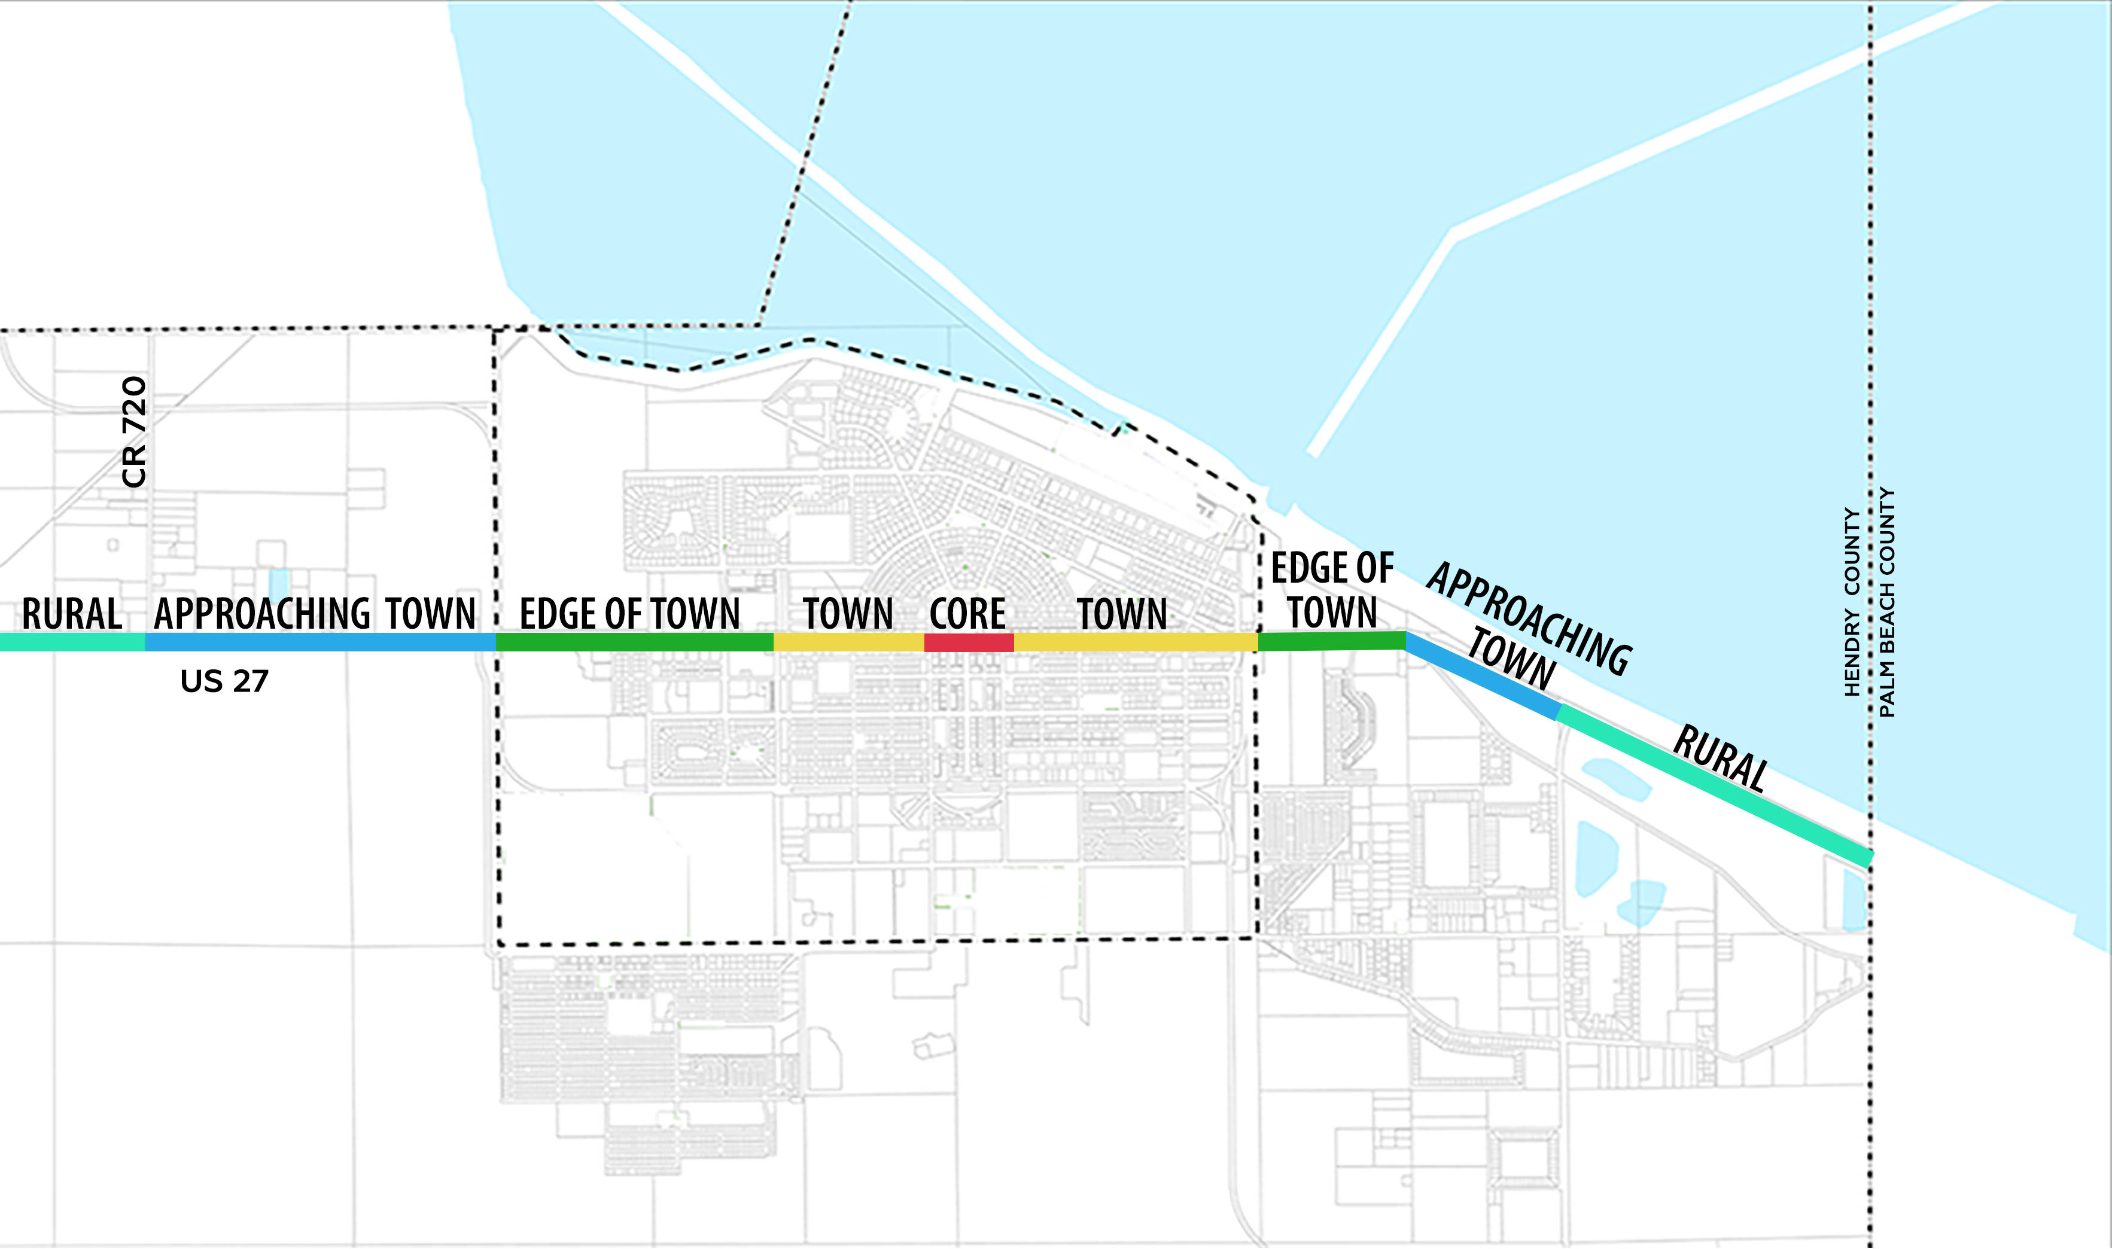
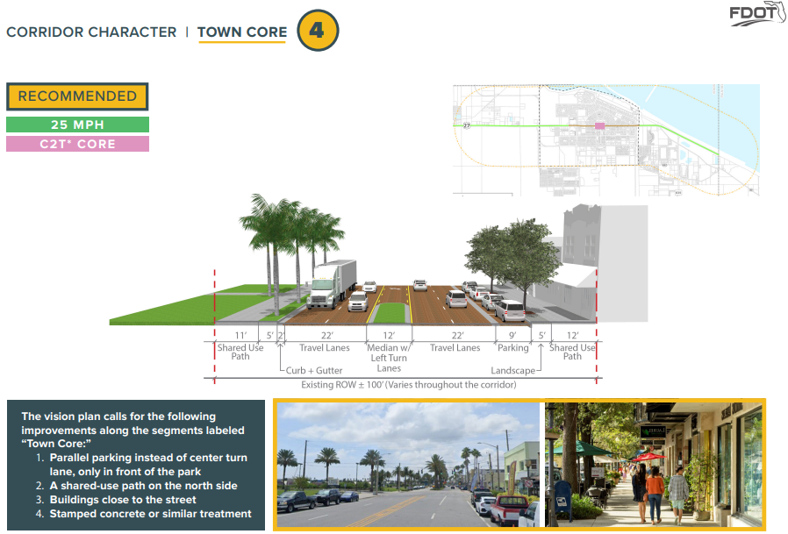

Slide 17
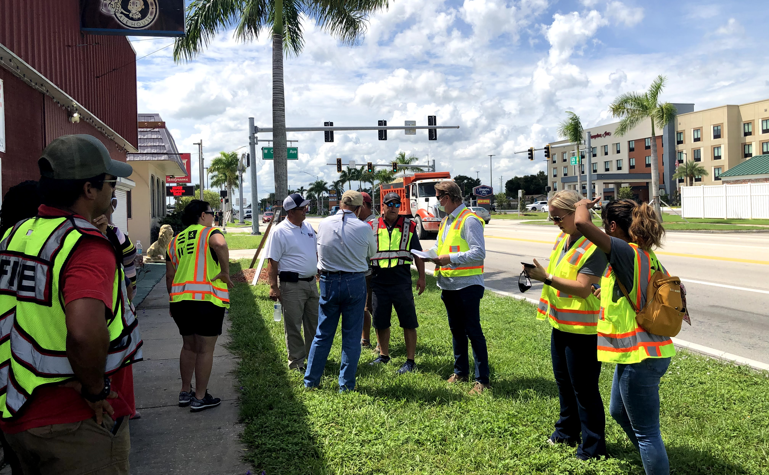
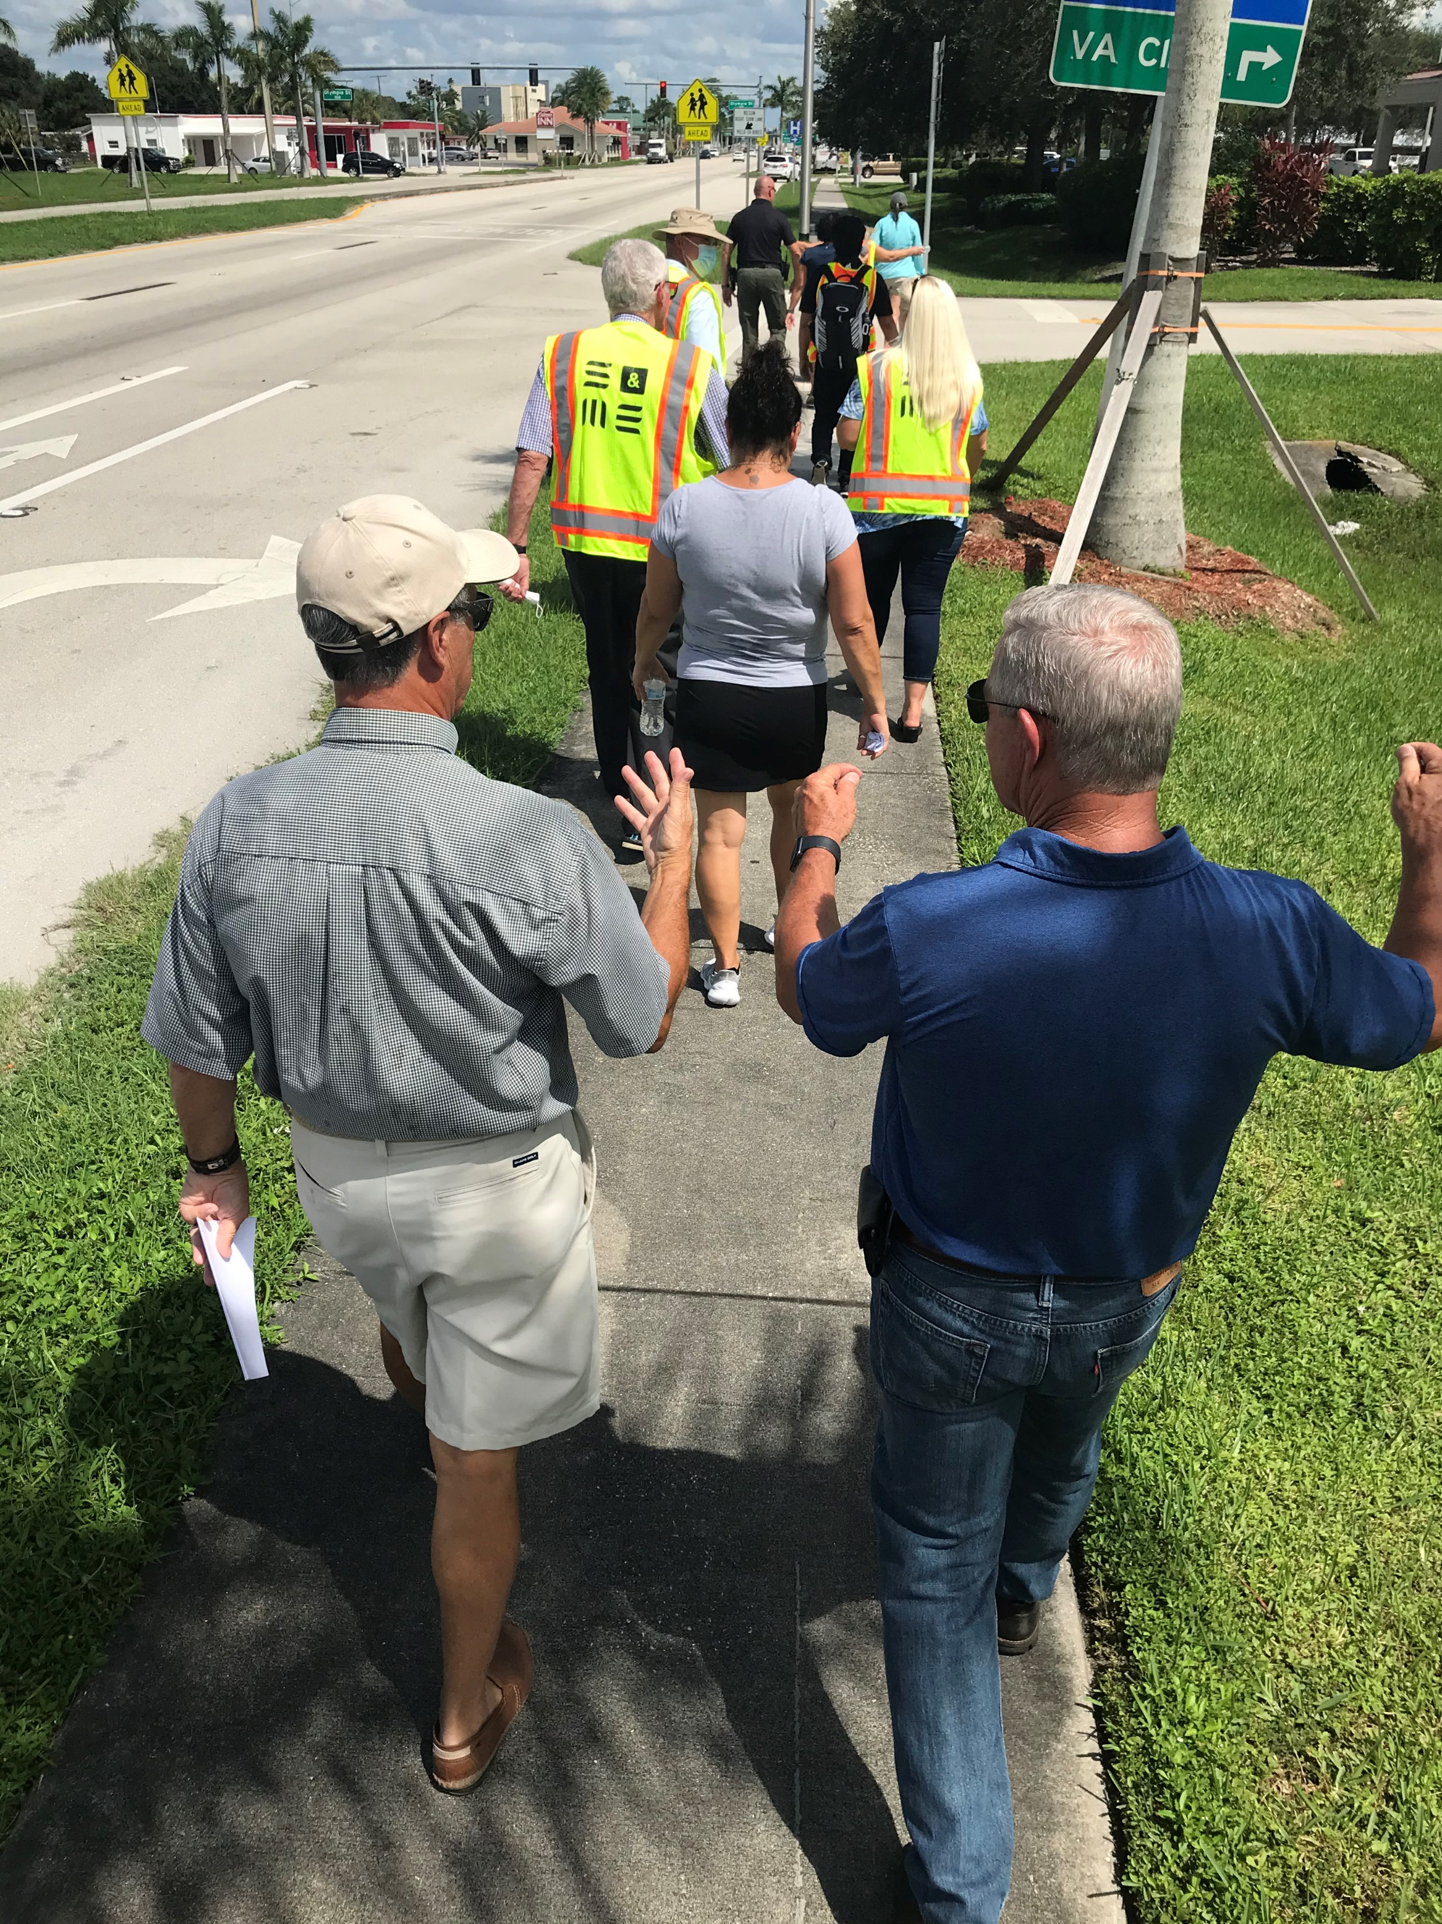
Engagement Strategy
One-on-One Meetings with Elected Officials
First Stakeholder Meeting/Workshop
Second Stakeholder Meeting/Workshop
Public Meeting
City Staff Review of Corridor Vision Plan Draft
Kick-Off Meeting
Field Visit with Elected Officials and City Staff

Slide 18
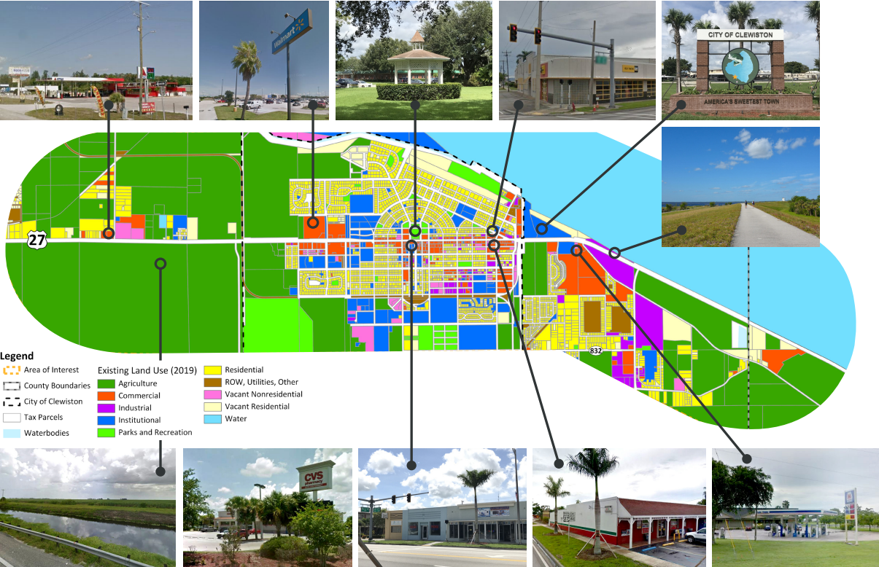
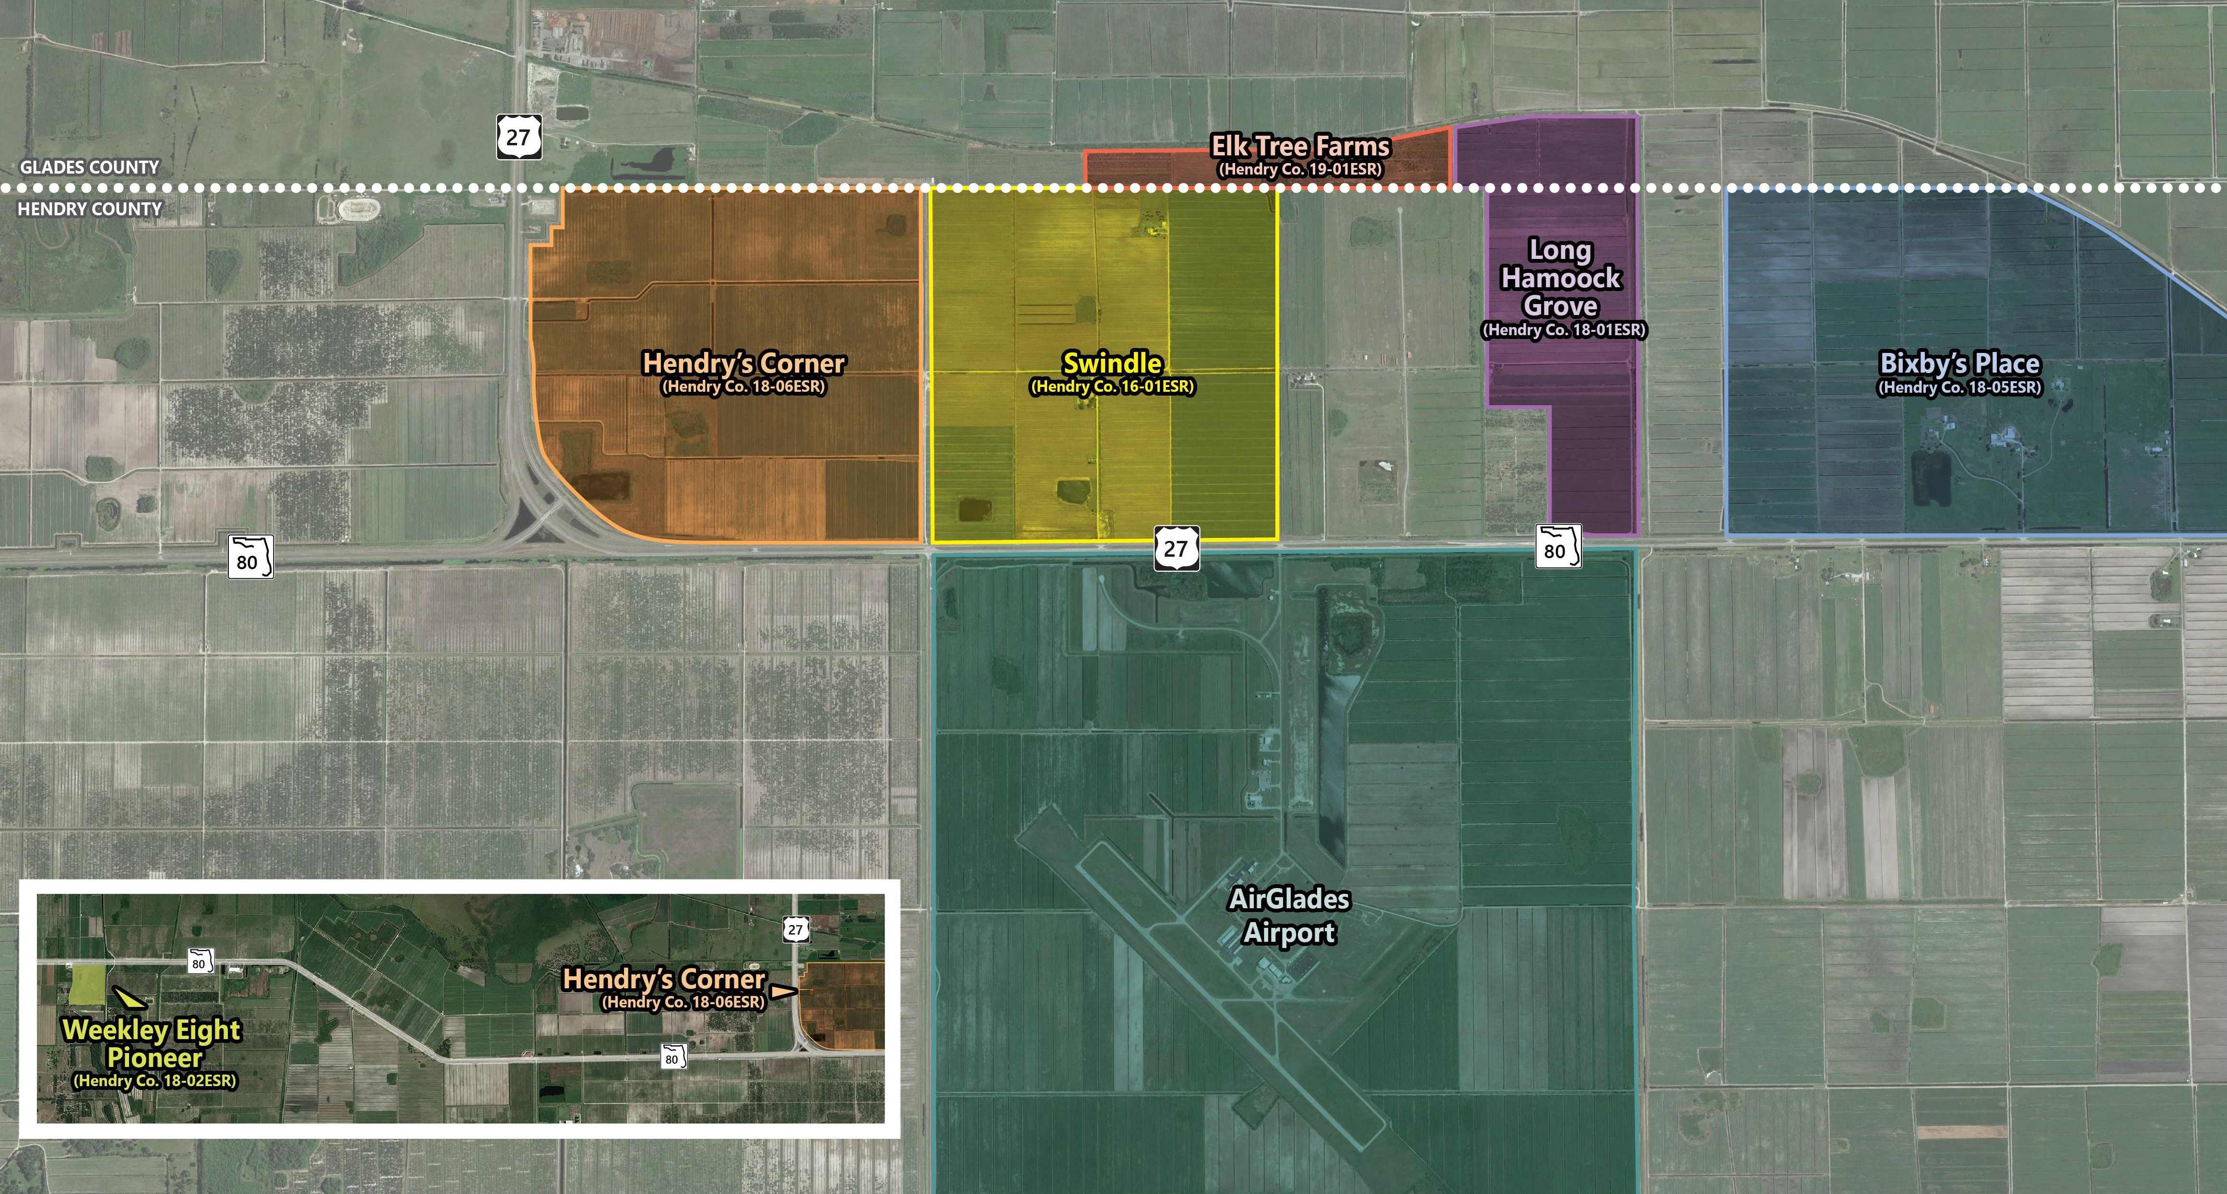
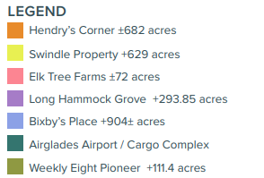
Focused on Partnership
Biweekly Progress Meetings
City Manager
Community Development Director
Continuous Engagement Beyond Progress Meetings
As need basis (emails and phone calls)
Upcoming Developments (US Sugar intent to develop west of city limits)
Existing and Programmed Projects (i.e., Waterfront Grant)
Coordinate meetings and workshops
After the CVP
Coordinate opportunities on upcoming FDOT projects to implement the Vision

Slide 19
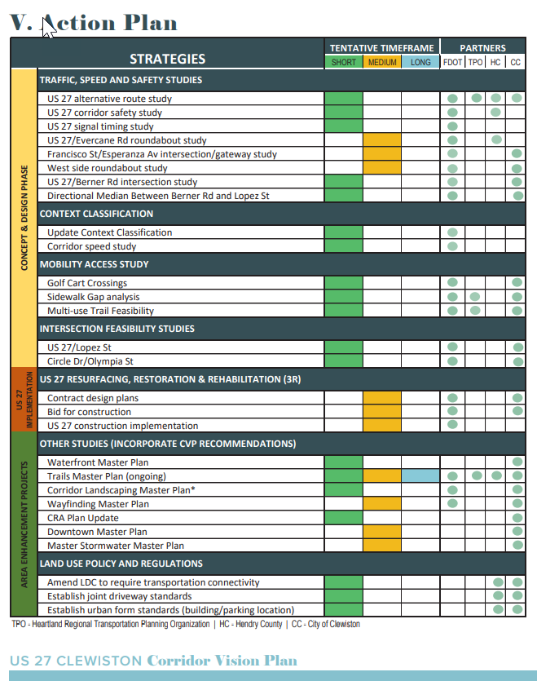
Focused on Partnership
Biweekly Progress Meetings
City Manager
Community Development Director
Continuous Engagement Beyond Progress Meetings
As need basis (emails and phone calls)
Upcoming Developments (US Sugar intent to develop west of city limits)
Existing and Programmed Projects (i.e., Waterfront Grant)
Coordinate meetings and workshops
After the CVP
Coordinate opportunities on upcoming FDOT projects to implement the Vision

Slide 20
Planning Studio can
Get Plans off the shelf and implement them!
Move the needle to create a safer roadway that is equitable for all users!
Solutions
Actively engage early with the public and local governments
Address mobility for all roadway users
Stay informed and involved on future growth and development along State roadways

Slide 21
Contact Information
Bessie Reina
Transportation Planning Manager
FDOT District 1
863-519-2656
Bessie.Reina@dot.state.fl.us
Vitor Suguri, Ph.D.
Community Planner
SIS Coordinator
FDOT District 1
863-519-1359
Vitor.Suguri@dot.state.fl.us
21

Slide 22
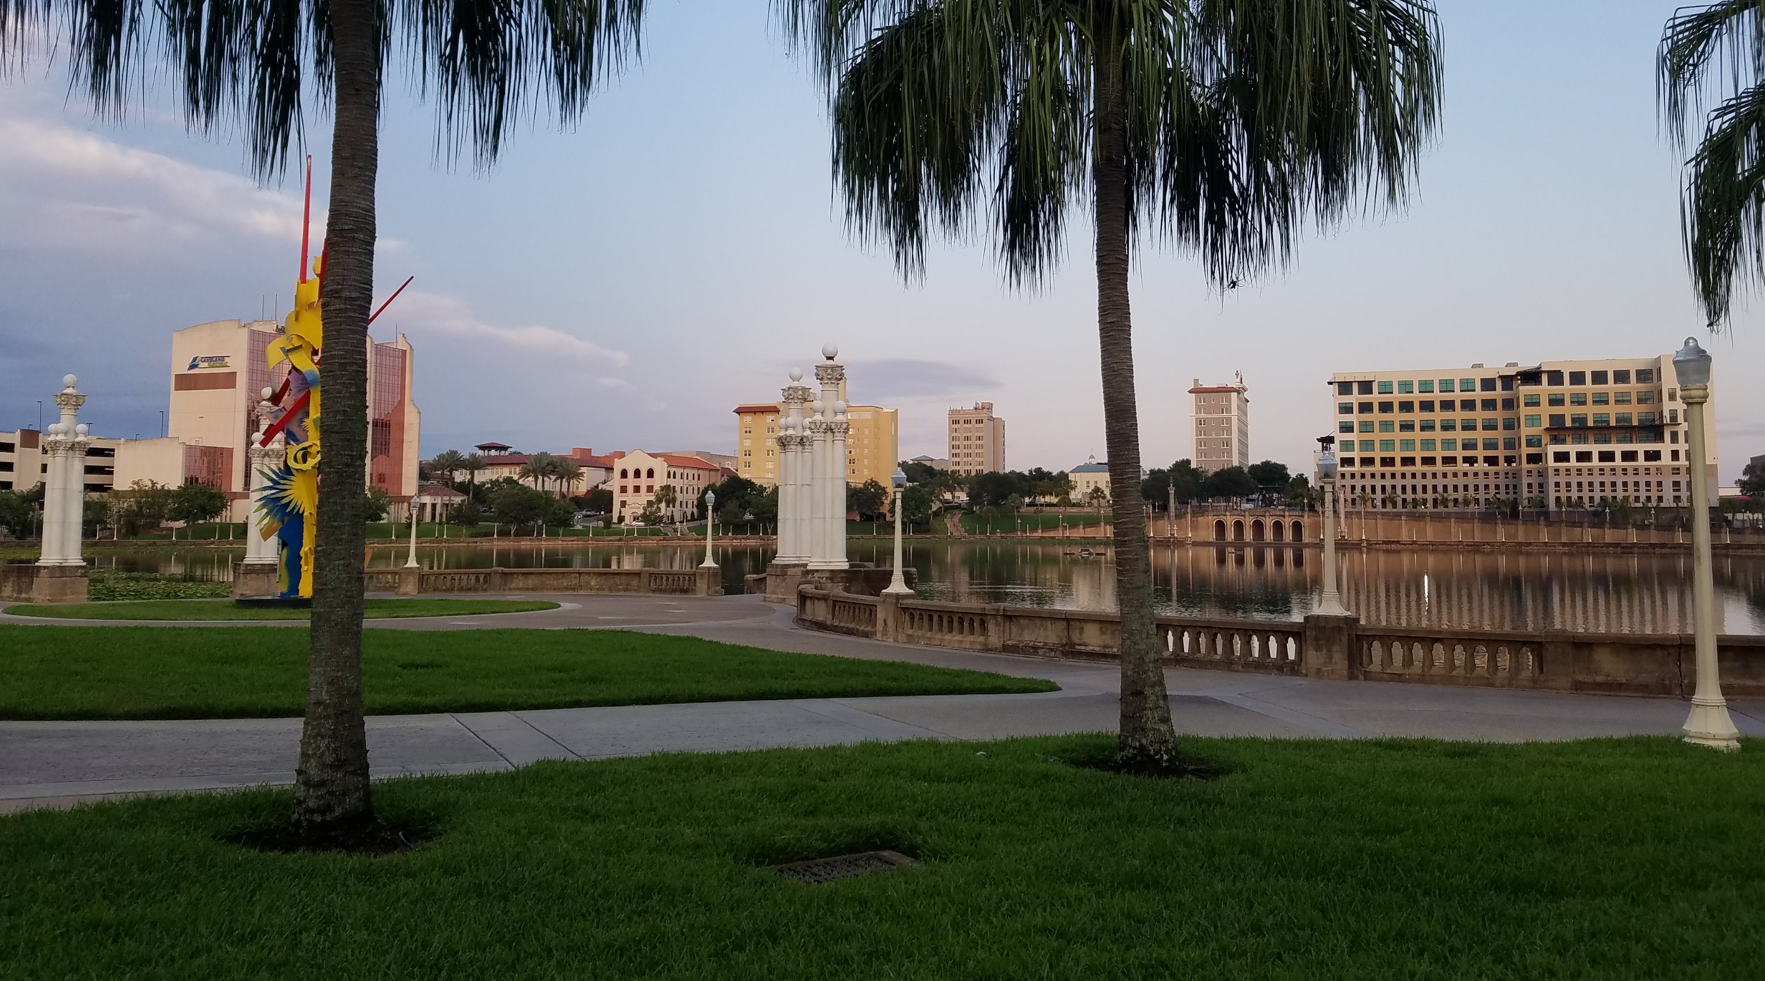
The Lakeland – FDOT Partnership Investments Supporting the Local Vision
FPZA Annual Conference
June 2, 2022

Slide 23
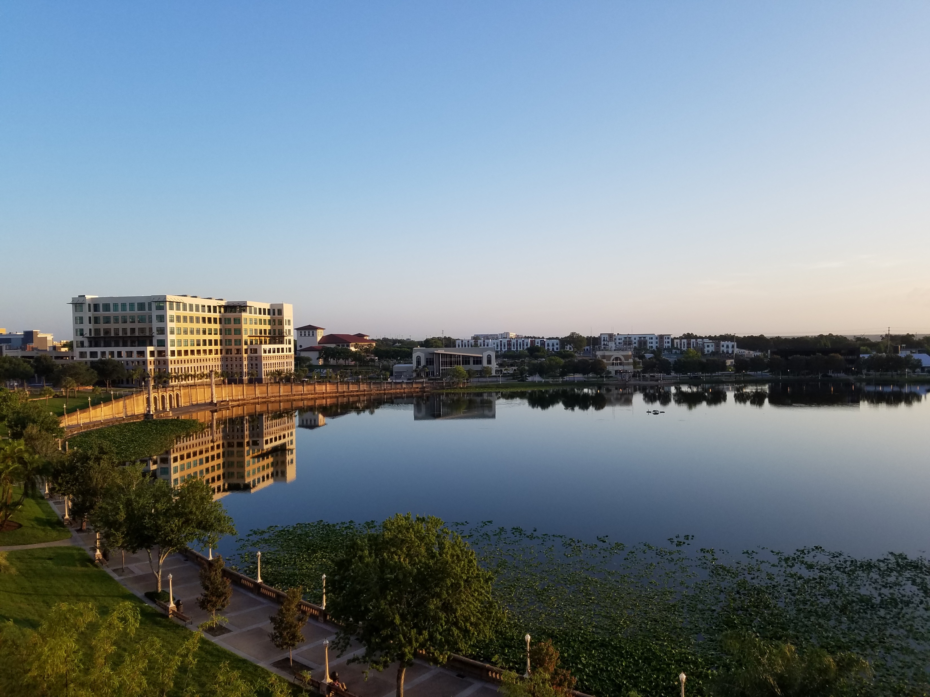
About Lakeland
Incorporated: 1885
Population: 116,000
Area: Approx. 75 sq. mi
Major Employers: Publix Super Markets, Lakeland Regional Health, Amazon, GEICO, Summit
Colleges/Universities: Florida Southern College, Southeastern University, Florida Polytechnic University
Transportation Hub: Convergence of several State arterial roads in Central Lakeland.

Slide 24
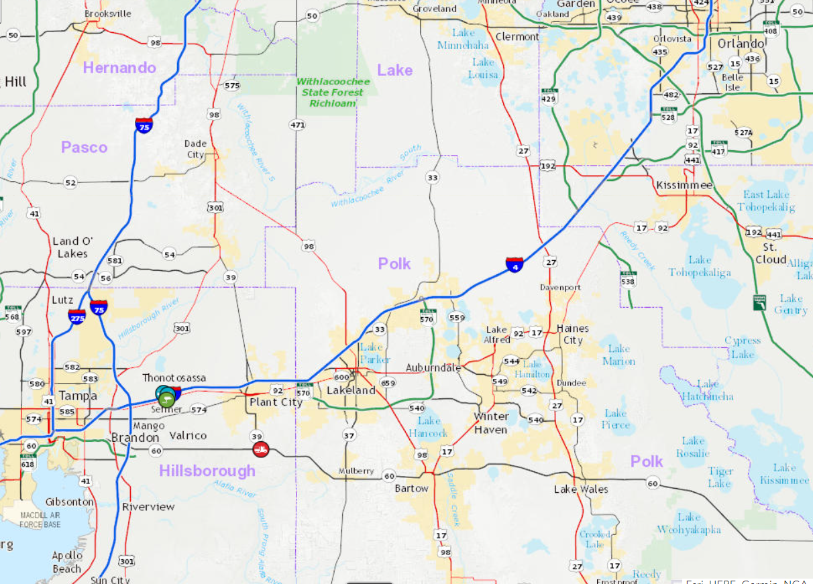
About Lakeland
Incorporated: 1885
Population: 116,000
Area: Approx. 75 sq. mi
Major Employers: Publix Super Markets, Lakeland Regional Health, Amazon, GEICO, Summit
Colleges/Universities: Florida Southern College, Southeastern University, Florida Polytechnic University
Transportation Hub: Convergence of several State arterial roads in Central Lakeland.

Slide 25
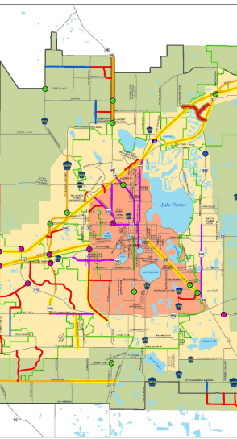
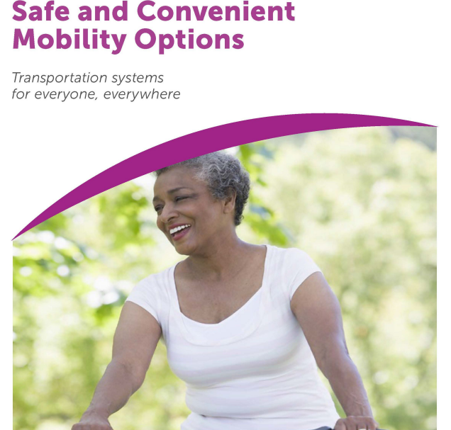
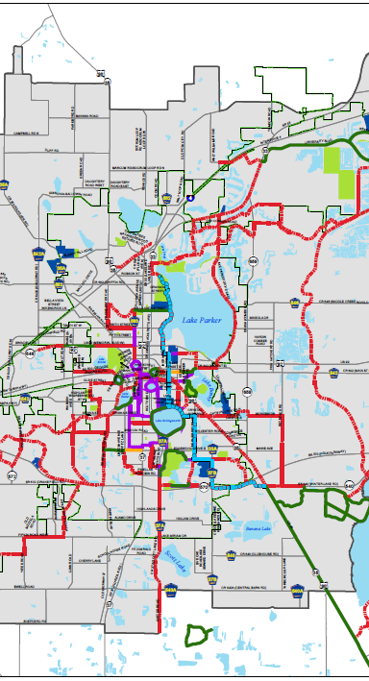

Slide 26
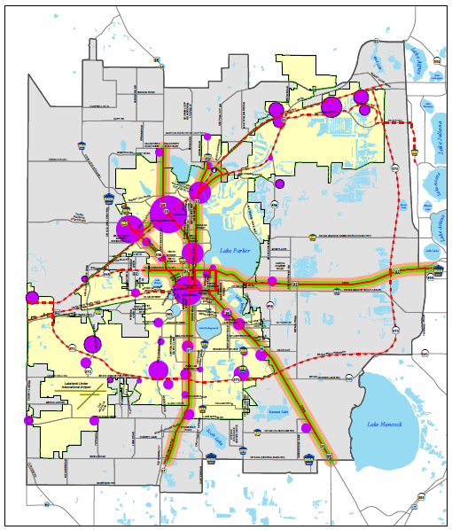
Transit Oriented Corridors
Mostly on State Highways
Constrained or Design-Exception
Higher-Frequency Transit Service
Focus on Central City area
Connects Activity Centers
Transit, Bicycle/Pedestrian, Complete Street Investment

Slide 27
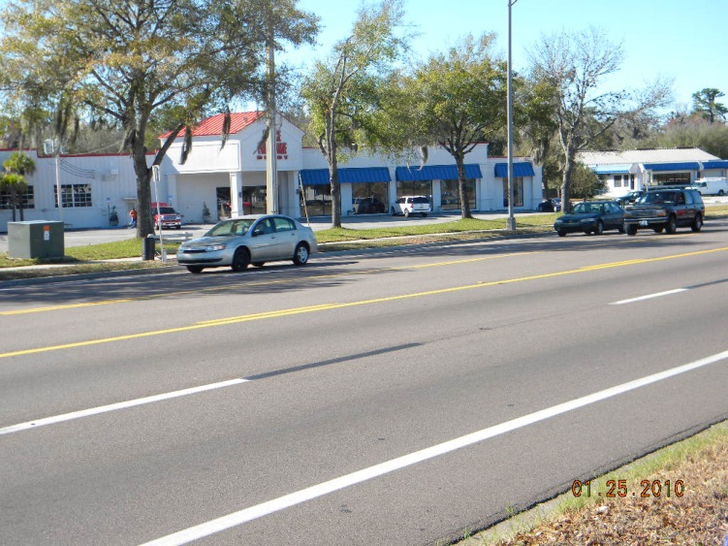
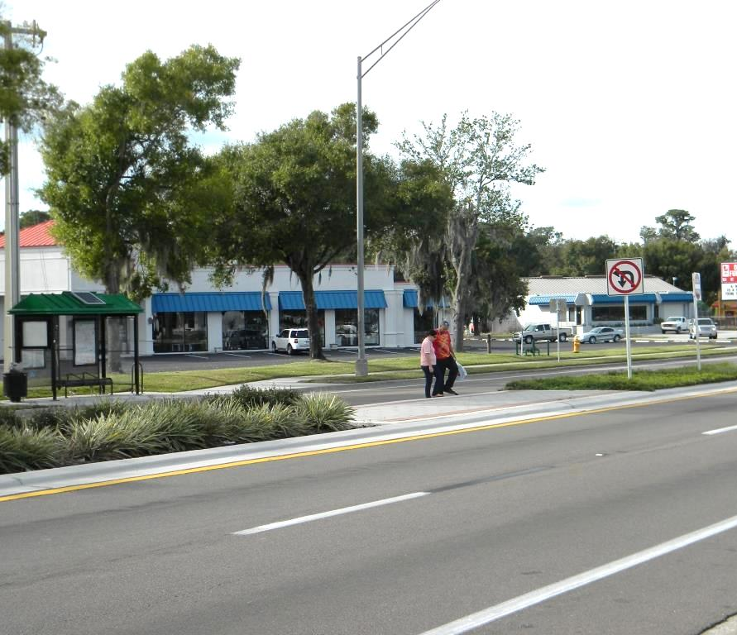

Slide 28
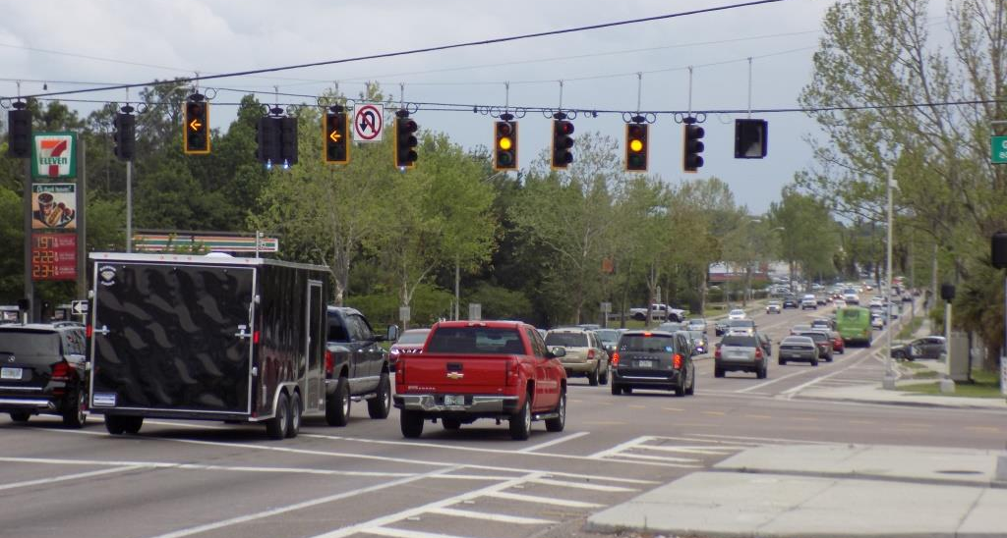
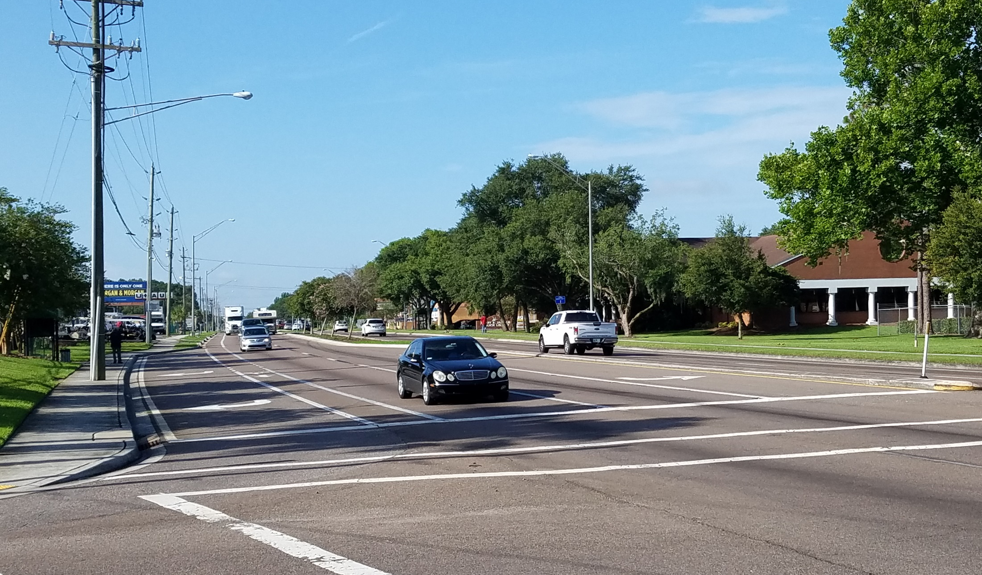
Regional Corridor with Multiple Contexts
What do you see in this photo?

Slide 29
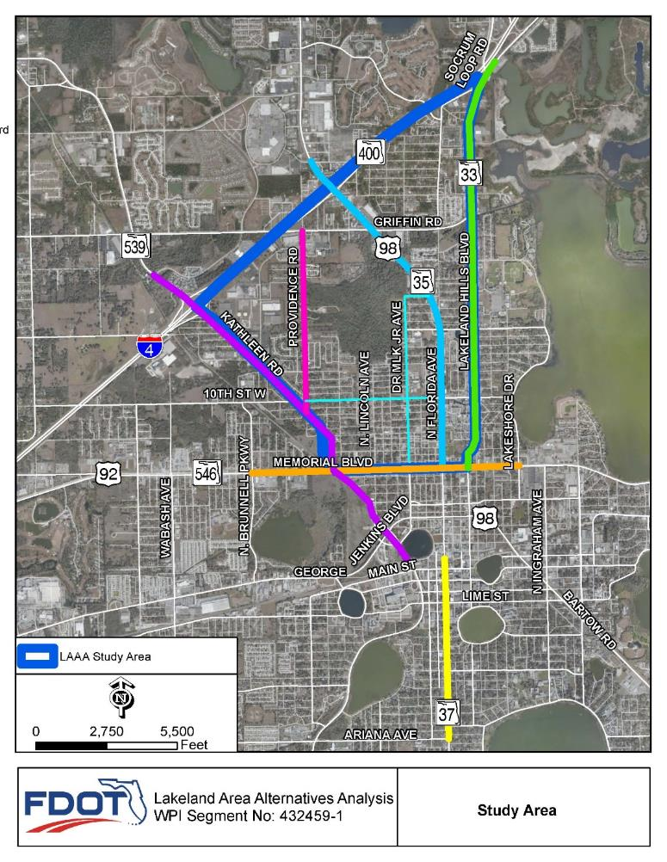
Lakeland Area
Alternatives Analysis
Proposed US 98 six-lane project Re-Evaluation and Design
Inconsistent with Comprehensive Plan and TPO Long-Range Transportation Plan
Proximity to neighborhoods, community facilities and employment centers
Specific study corridors
State and Local
Short- and Long-Term
Blueprint for Funding

Slide 30
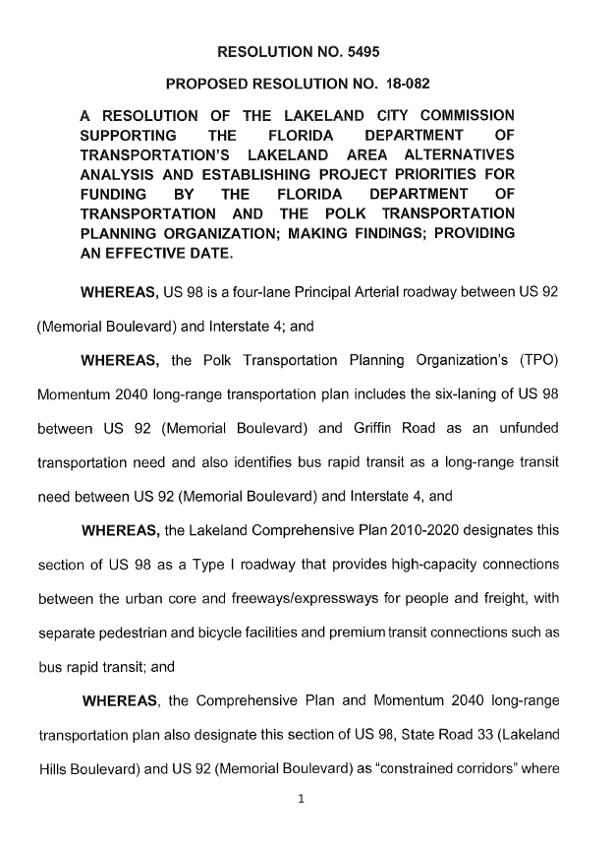
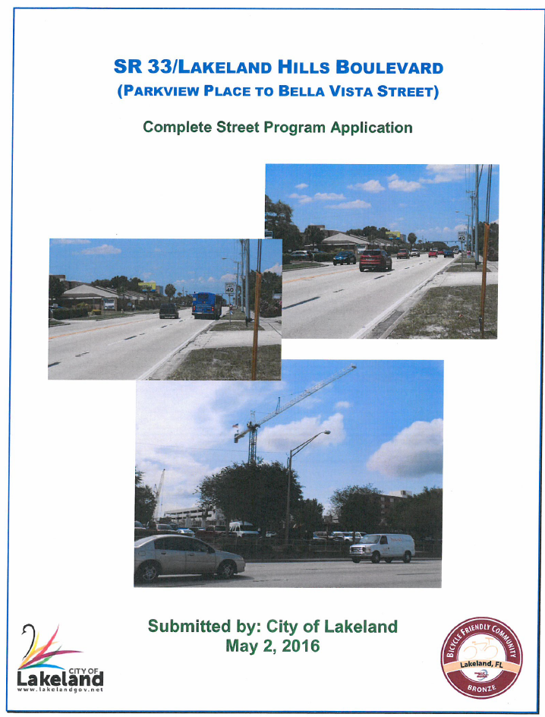
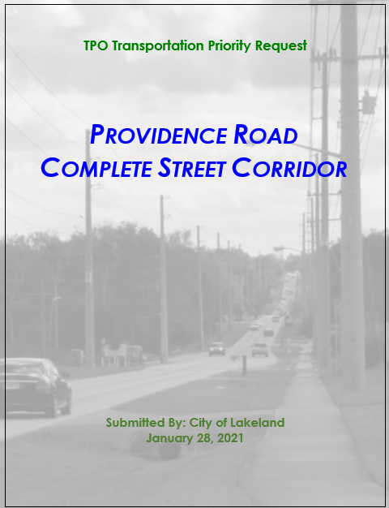
Priorities & Funding Partners
$ 4.1 Million - FDOT
$ 3.0 Million? - City
$ 14.8 Million – FDOT
$ 1.2 Million – City Utilities
$ 1.0 Million – City Impact Fees

Slide 31
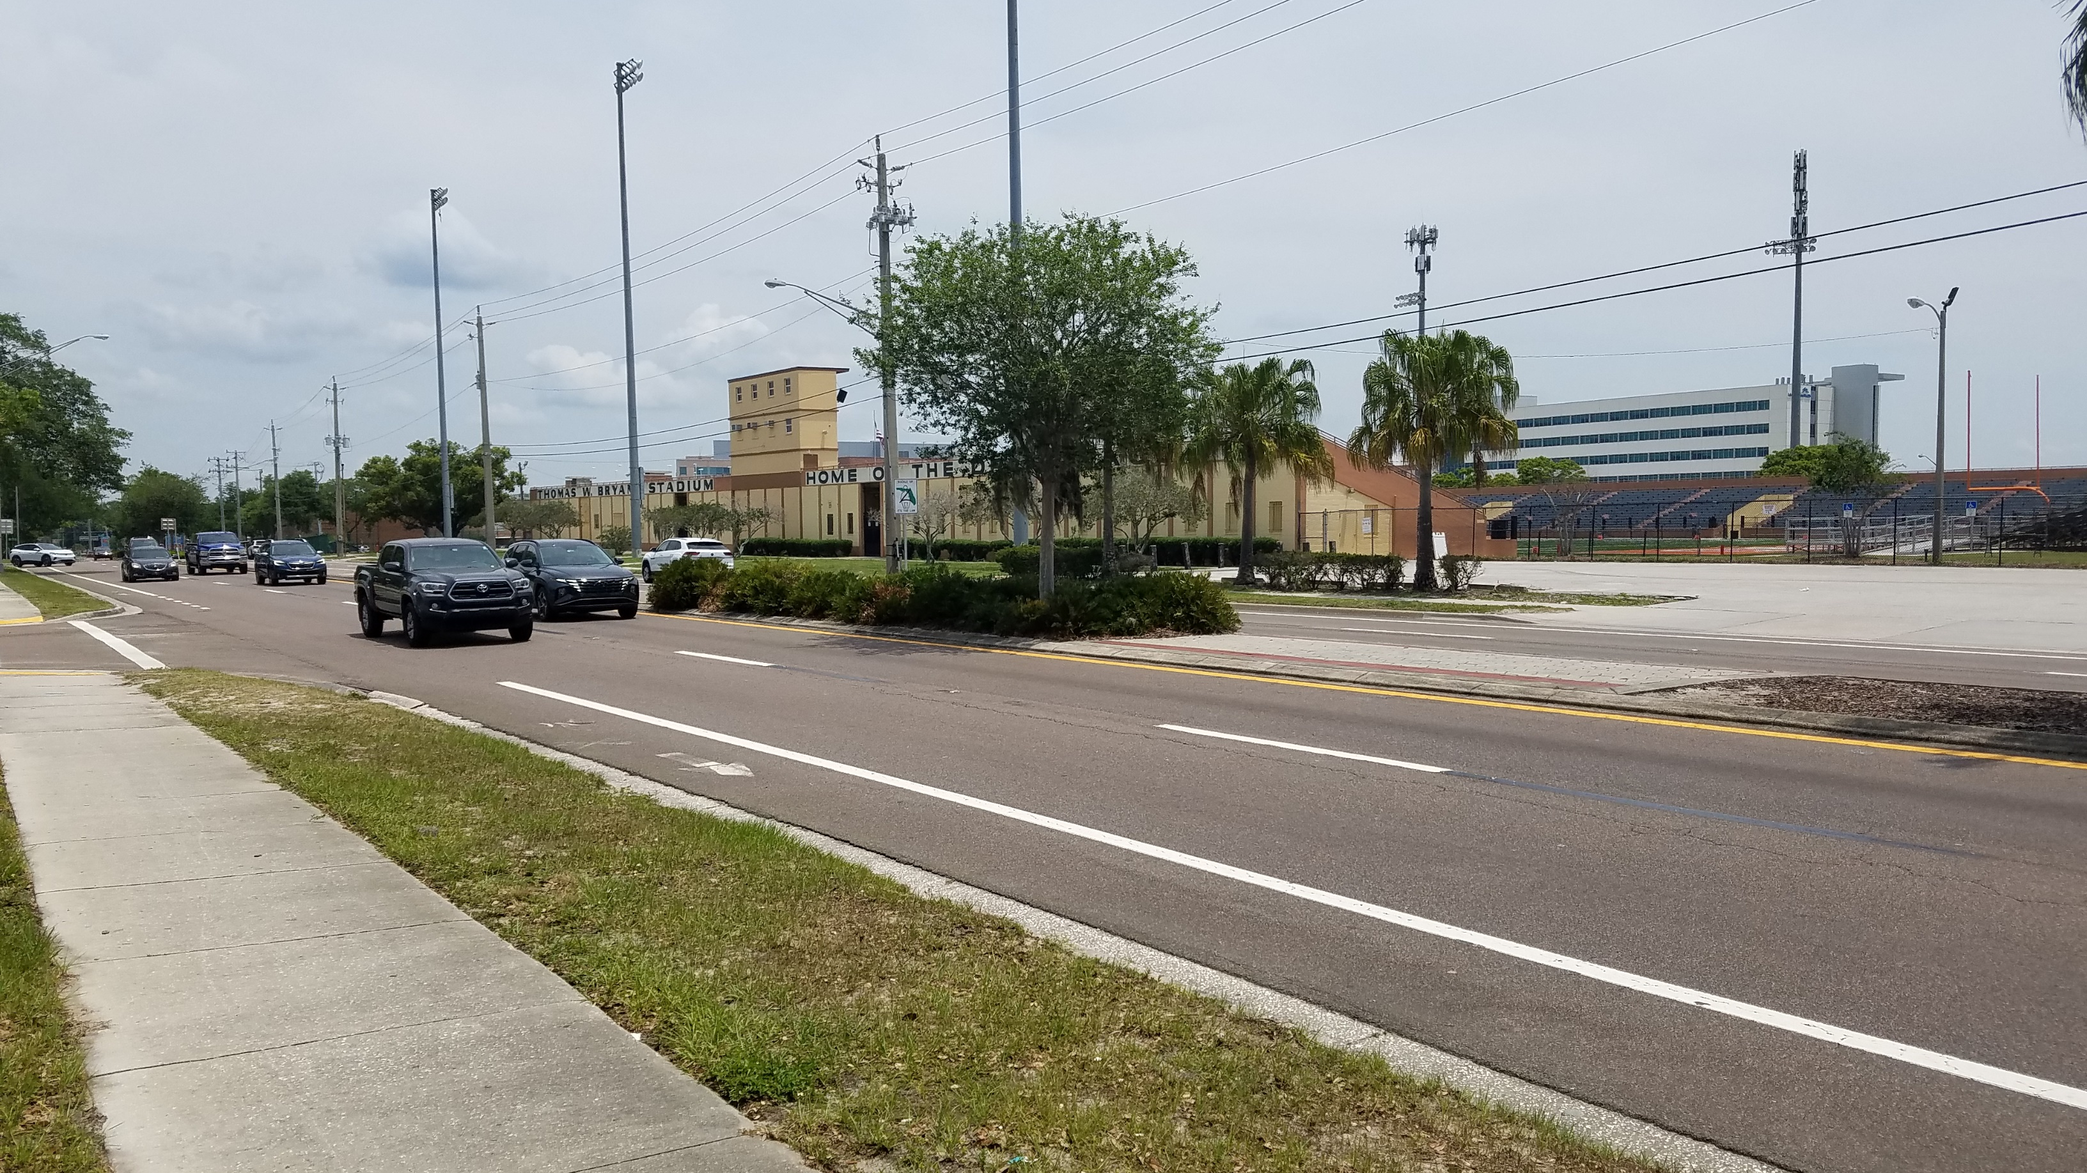
Planned Pedestrian Plaza @ Bryant Stadium & Henley Field

Slide 32
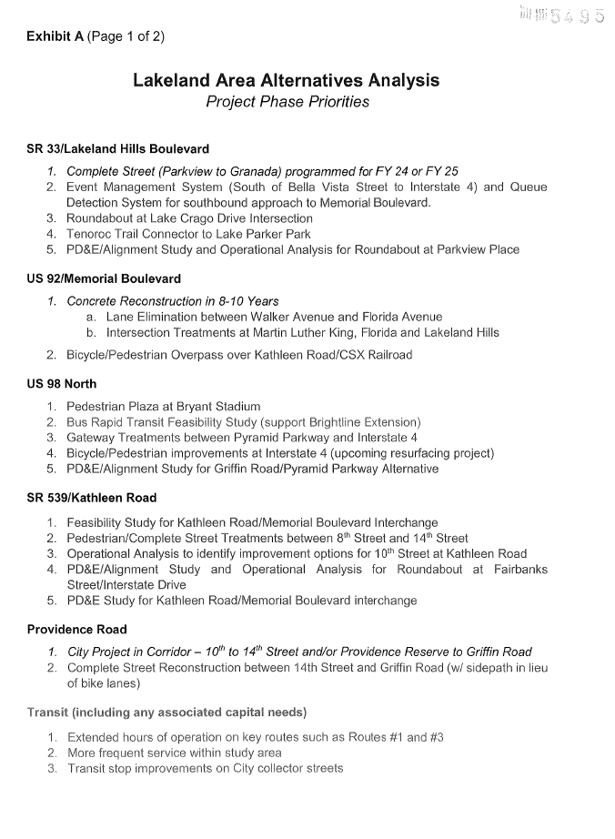
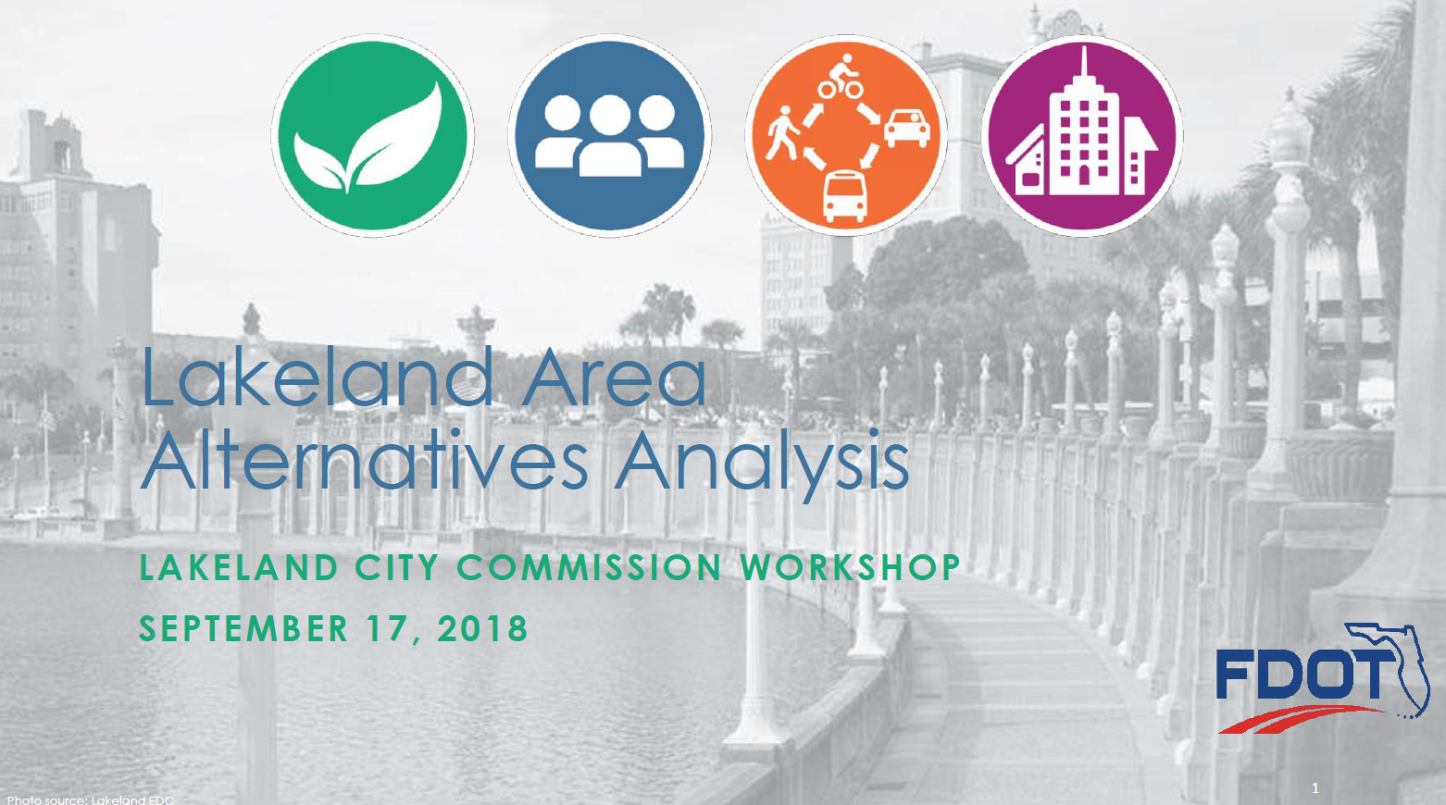
US 98 Bus Rapid Transit

Slide 33
US 98 Bus Rapid Transit
Source: Florida DOT

Slide 34
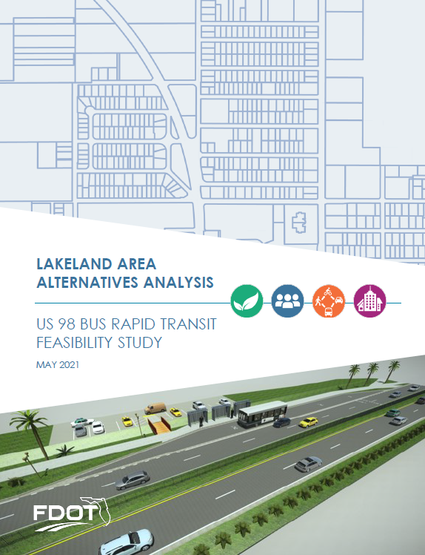
US 98 Bus Rapid Transit
Lakeland Intermodal Center to Lakeland Square Mall
Medical District and conceptual Brightline Station @ Interstate 4
Travel and Safety Data
Population & Employment projections under Trend and Transit Oriented Development Scenarios
Station-Area Hierarchy
Transit Improvement Options
Phasing for Implementation

Slide 35
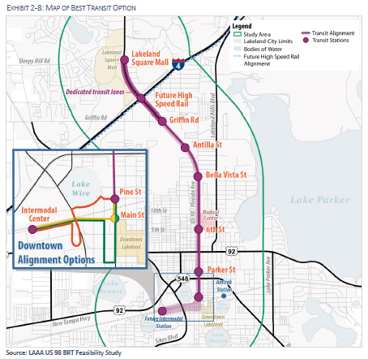
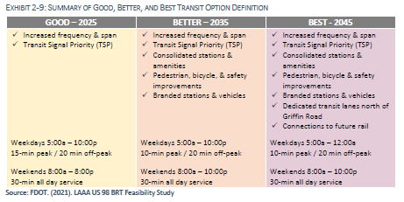
US 98 Bus Rapid Transit
Good, Better & Best Options in 2025, 2035 & 2045
Nine Station Areas
Transit Signal Prioritization, Increased Frequency, Extended Service, Branding, Dedicated Lanes, Station Consolidation & Amenities, Rail Connections

Slide 36
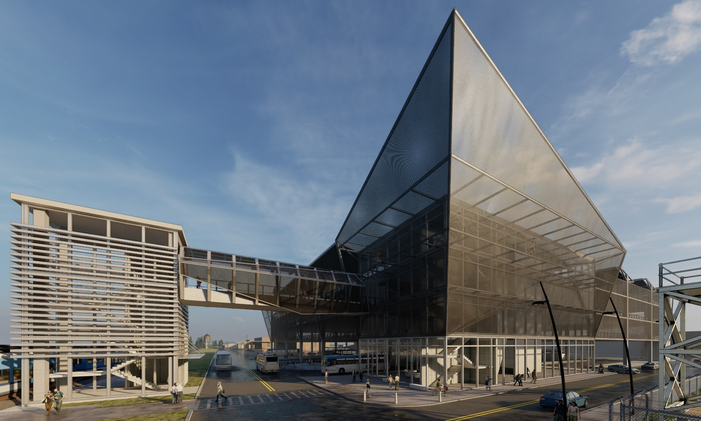
Lakeland Intermodal Center
FDOT Feasibility Study
Citrus Connection Terminal
New AMTRAK Station
Future SunRail Station
Source: Atkins, Florida DOT

Slide 37
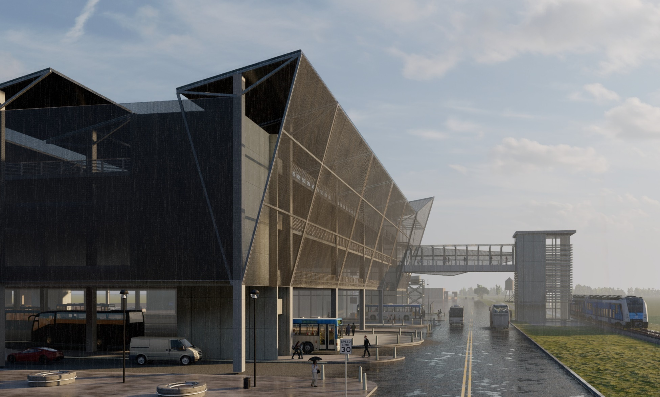
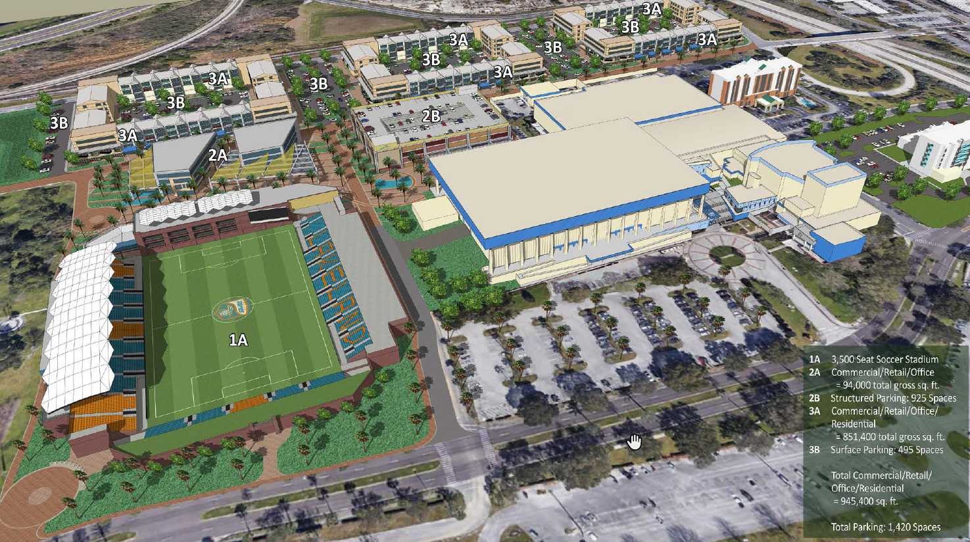
Lakeland Intermodal Center
Source: Atkins, Florida DOT
Source: Lunz Group/WMB ROI, City of Lakeland

Slide 38
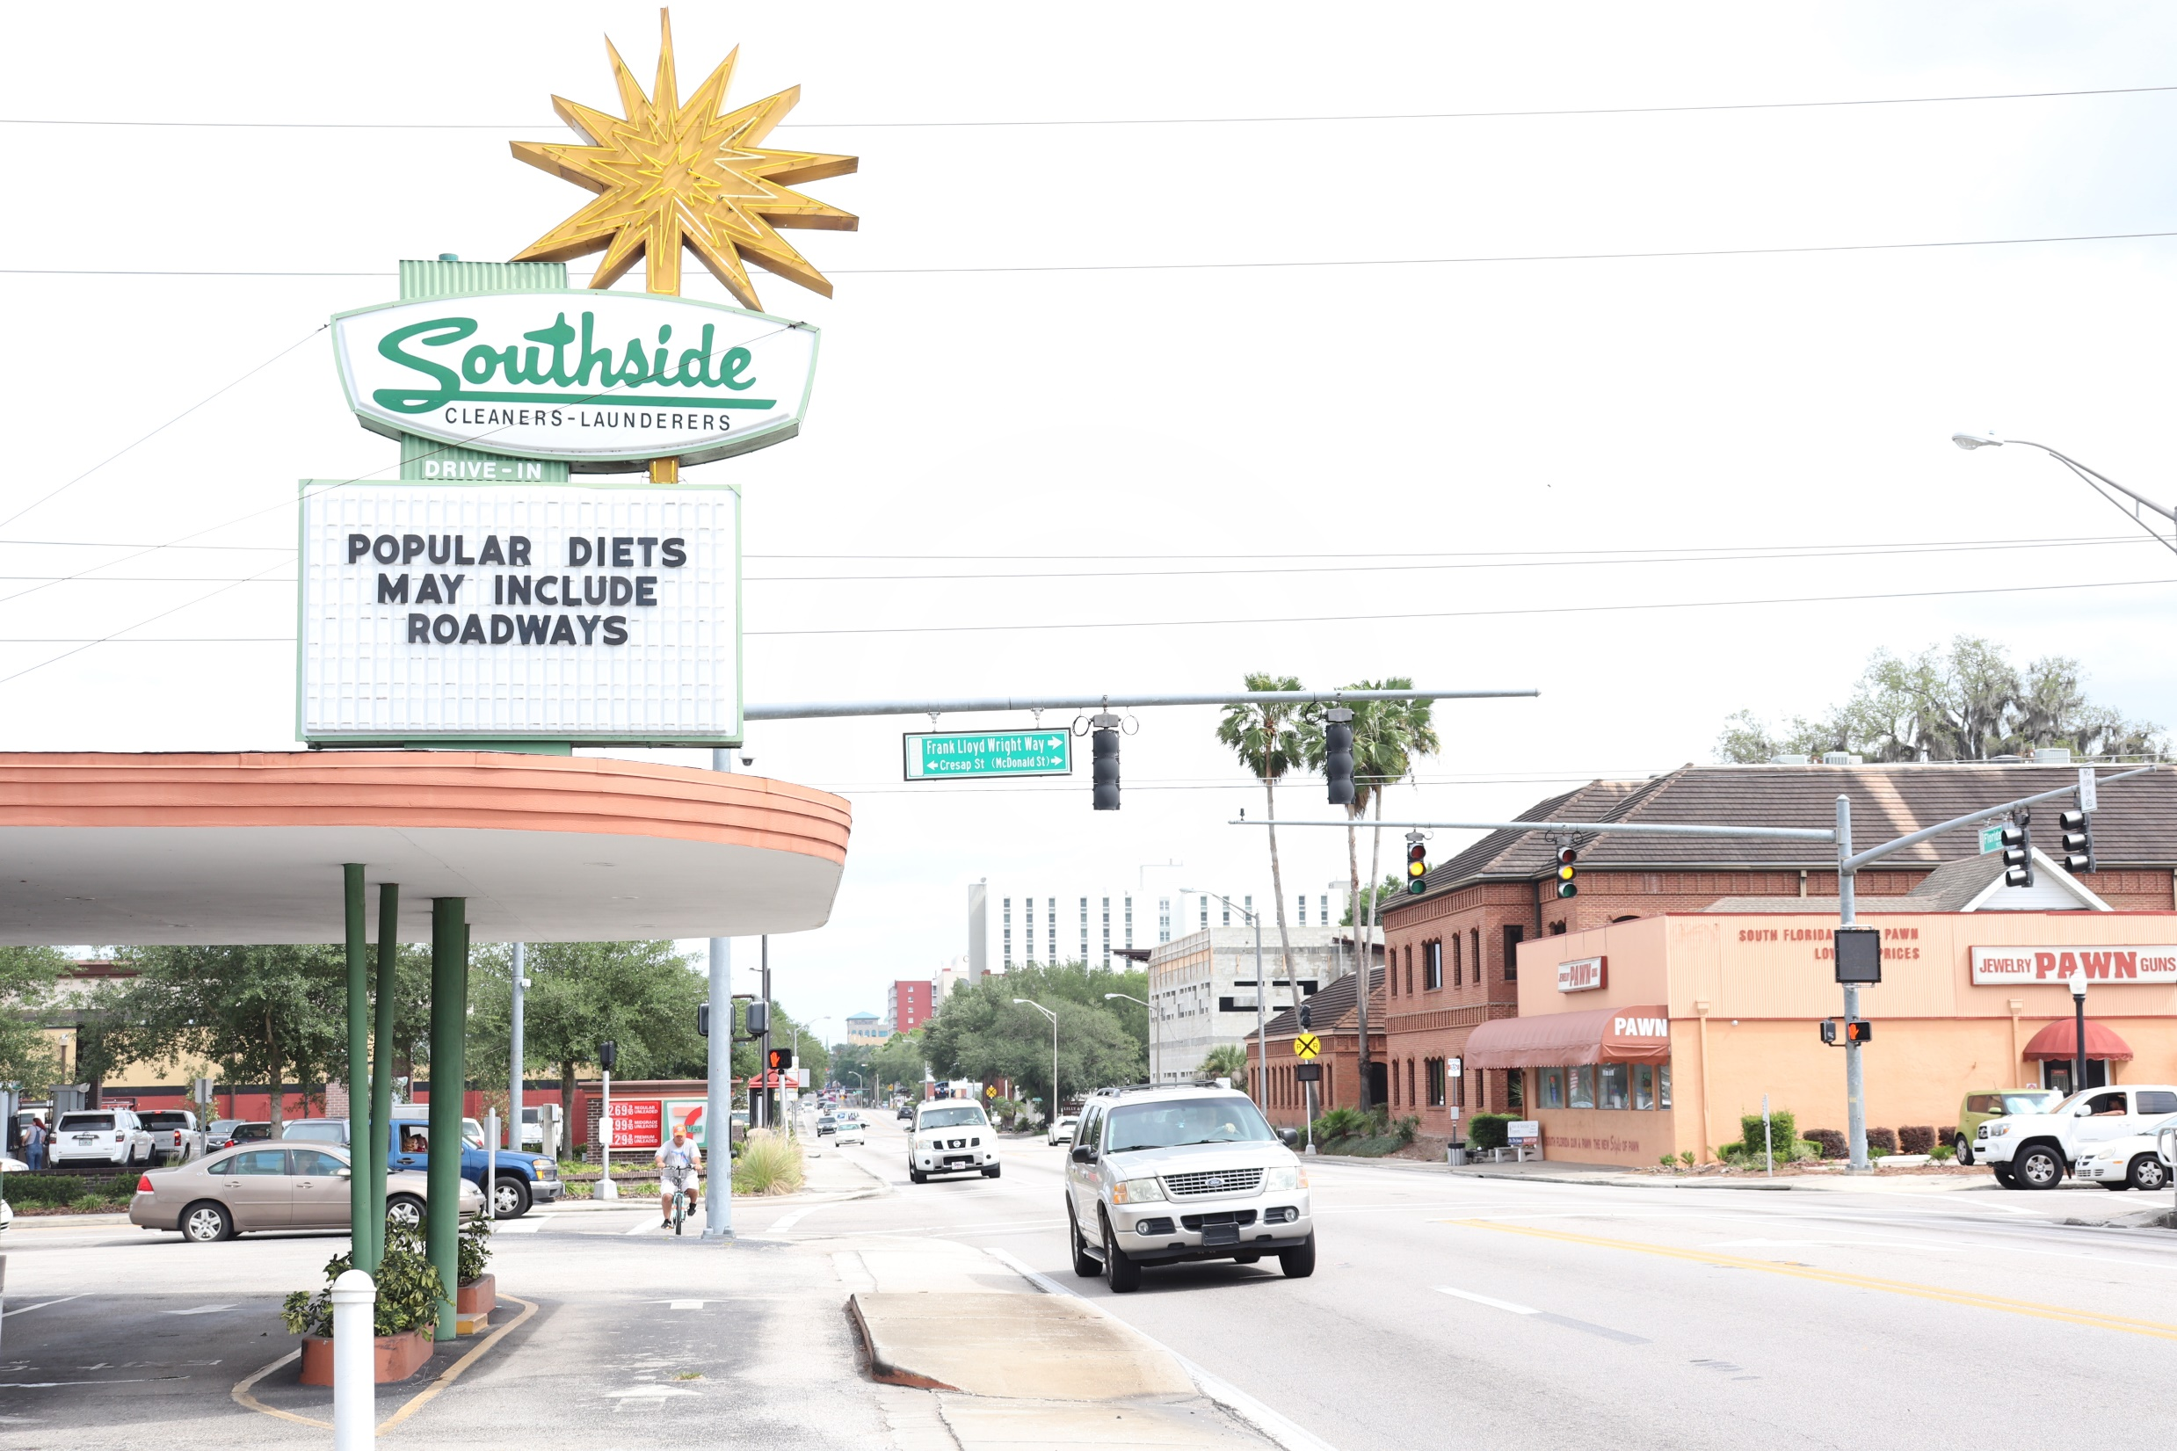
South Florida Avenue
Road-Diet Pilot Study
State Road 37
Ariana Street to Lime Street
Dixieland Business District
Economic Development & Visioning Analyses
Temporary Test
FDOT Data Collection: 93 Locations: 2020, 2021, 2022
Transit Circulator

Slide 39
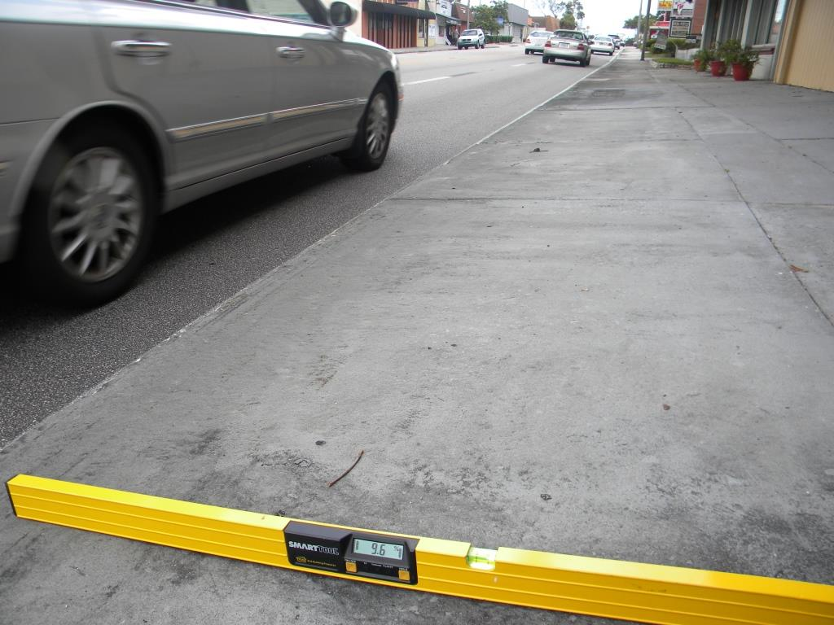
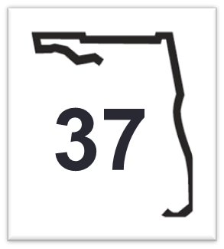
The Problem Presented to FDOT
Narrow travel lane width (8.5 – 9 feet)
Narrow sidewalks
Inadequate transit facilities
ADA compliance concerns
Hindrance to economic development
Divides adjacent neighborhoods
Discourages pedestrian & bicycle use
Road can play greater role in corridor redevelopment and mobility.

Slide 40
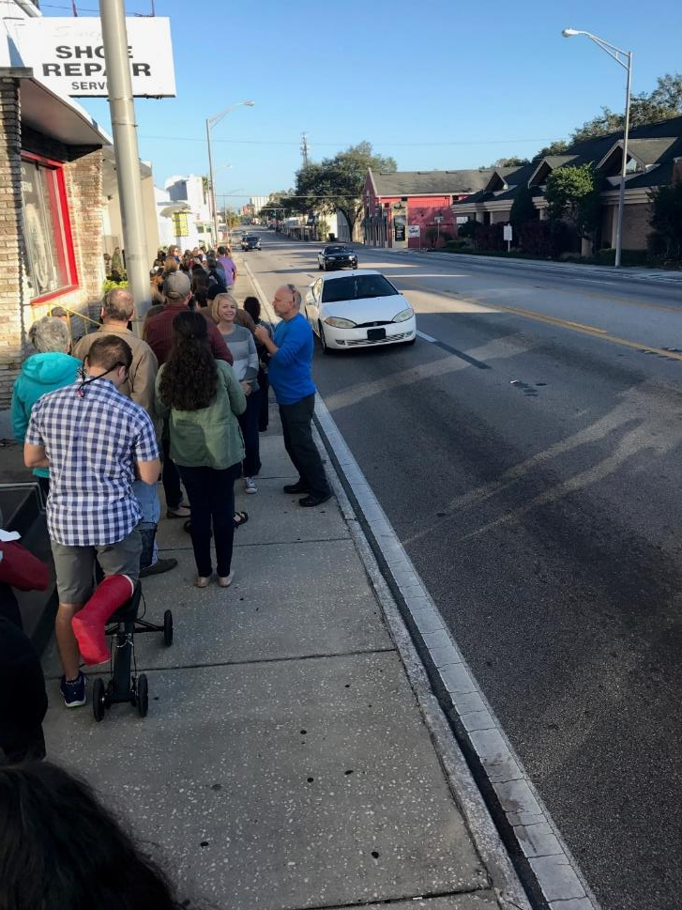
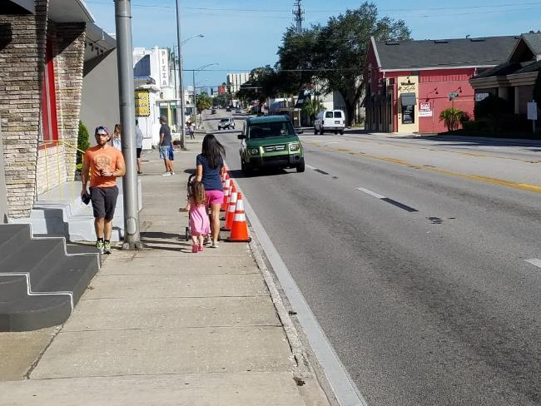
Safety &
Economic Development

Slide 41
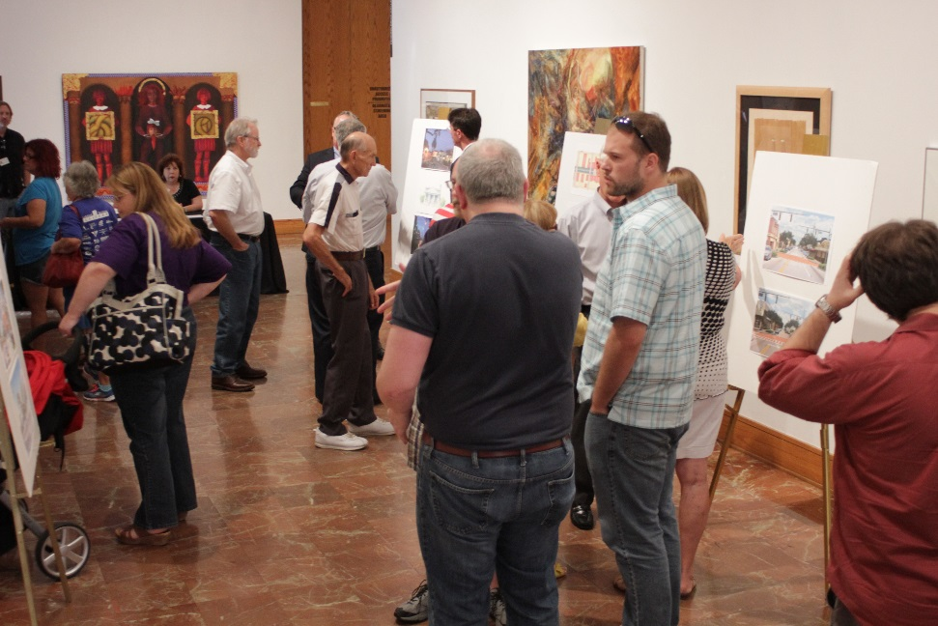
Corridor Master Plan (2016-2017)
Week-Long Design Studio
Work-in-Progress Presentation

Slide 42
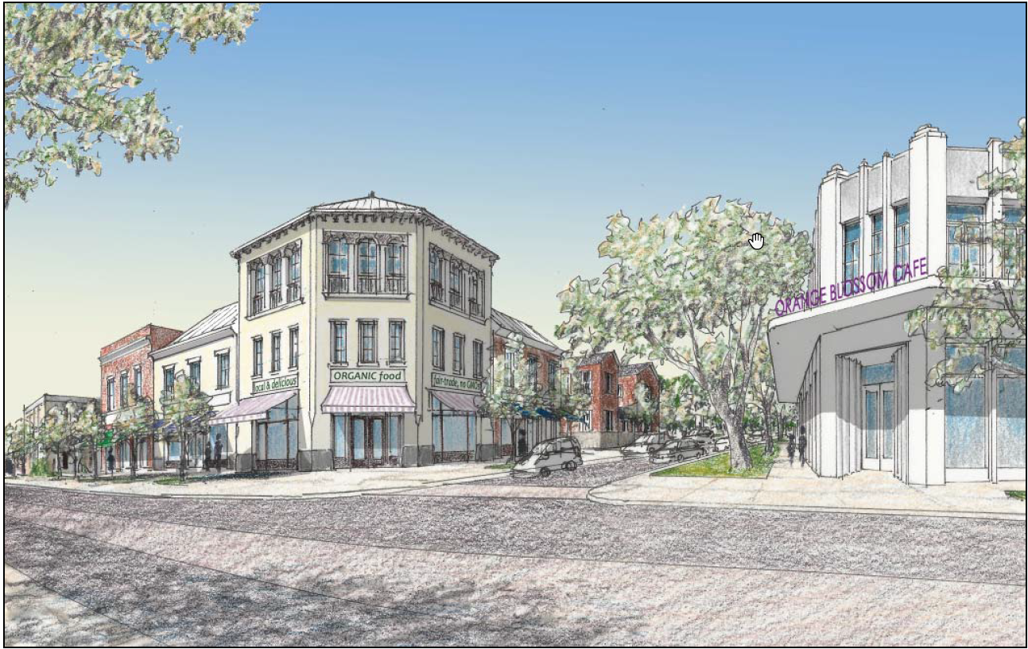
Corridor Master Plan (2016-2017) – at Waller Plaza
Rendering of potential future development at Hillcrest Avenue intersection, as prepared by Treasure Coast RPC

Slide 43
Corridor Master Plan (2016-2017) – at Waller Plaza
Existing development at this location.

Slide 44
Corridor Master Plan (2016-2017)
“After” image prepared by Treasure Coast RPC

Slide 45
City Commission Resolution #5370
Adopted on May 1, 2017
Street does not adequately serve all users
Significant safety concerns; does not contribute to CRA economic development objectives
Study documents deficiencies and improvements
Asks FDOT to evaluate alternatives, including road-diet
Requested test period of at least one year

Slide 47
South Florida Avenue Road-Diet Test
Lakeland CRA Corridor Study (Long-Term Vision)
Public Outreach Underway – Mythbusting
FDOT Metroquest Survey: June
Public Meeting Scheduled for July 11th
City Commission Decision: Late July/Early August
Regardless of Decision, Additional Analysis and Funding for Ultimate Cross-Section
Parallel Corridors, including US 98 (Bartow Road)

Slide 48
Lakelandgov.net/RoadDiet

Slide 49
In Conclusion
FDOT has been a great partner in exploring creative ways to address urban transportation issues – more so over the past several years.
Local governments should be clear in defining its vision, communicating this vision to FDOT and establishing funding priorities.
Agency partners must think of different ways to engage stakeholders.
Funding remains a key issue to implement even the lowest cost, most short-term improvements on the State Highway System.
It’s not just about transportation (particularly moving cars) anymore – it’s about quality of life.

Slide 50
The Lakeland – FDOT Partnership Investments Supporting the Local Vision
FPZA Annual Conference
June 2, 2022

Slide 51
FPZA Annual conference
Steven R. Cover, AICP
Director of Planning
City of Sarasota

Slide 52
US 41 - Before
Fruitville and US 41 Intersection
Photo Credit: Scene Sarasota
14th Street and US 41 Intersection
Taken from Google Earth

Slide 53
14th Street Roundabout
Photo Credit: Lochner

Slide 54
10th Street Roundabout
Photo Credit: Lochner

Slide 55
Fruitville Road Roundabout
Photo Credit: Sarasota Herald-Tribune

Slide 56
Seagrass by Casto Solano
Intersection of 10th St. and U.S. 41
Poly by Hou de Sousa Intersection of 14th St. and U.S. 41
Roundabout ART

