Slide 1
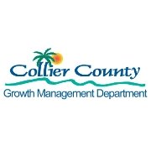
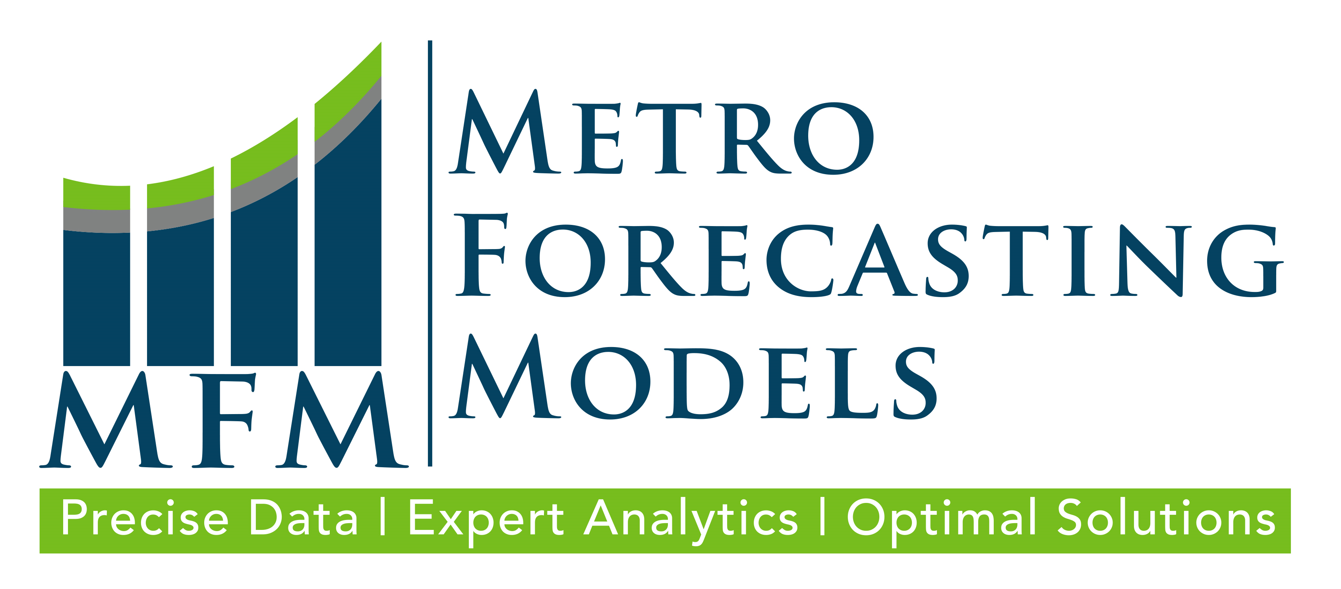
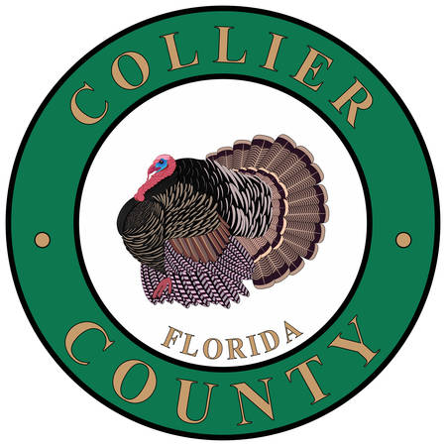
Revenue Hiding in Plain Sight:
Fostering Opportunities
for Redevelopment
June 2, 2022

Slide 2
Introduction
Michael Bosi, AICP – Collier County Director of Planning
David Farmer, AICP, PE – Metro Forecasting Models, CEO

Slide 3
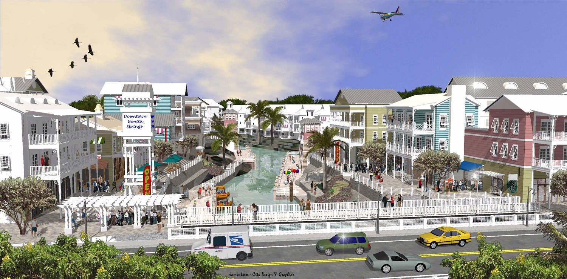
Agenda
What are we discussing today?
Definitions
Benefits and challenges of adaptive reuse
Land use planning
Policy and zoning considerations
Analyzing redevelopment areas
Landlords
Objections and solutions
Effective transportation/transit systems
Examples of successful redevelopment planning
Q & A

Slide 4
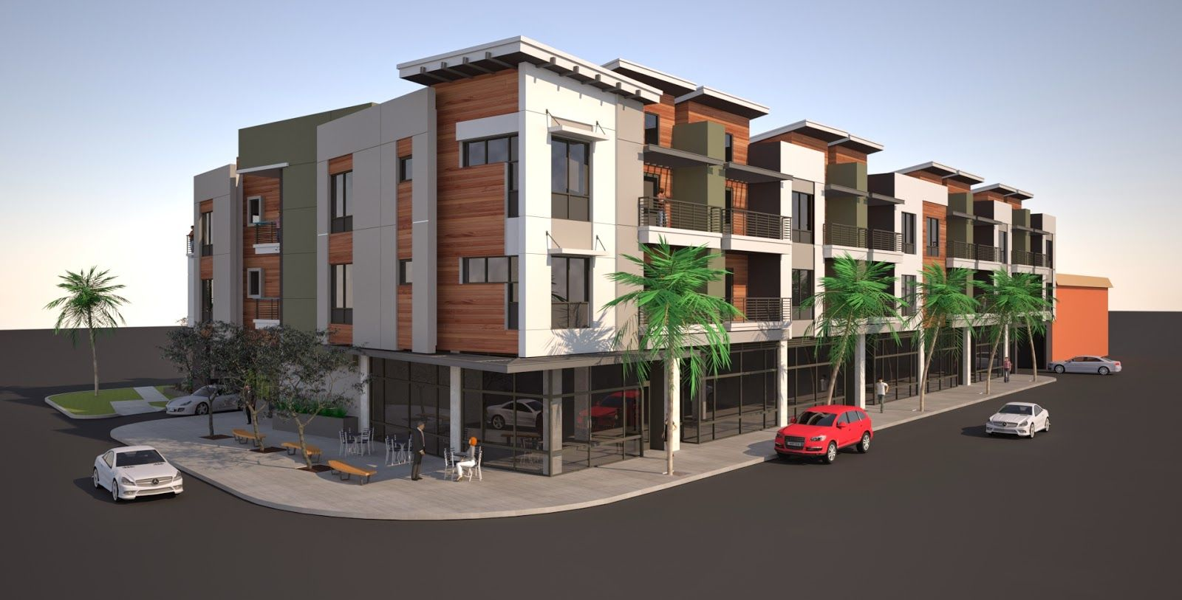
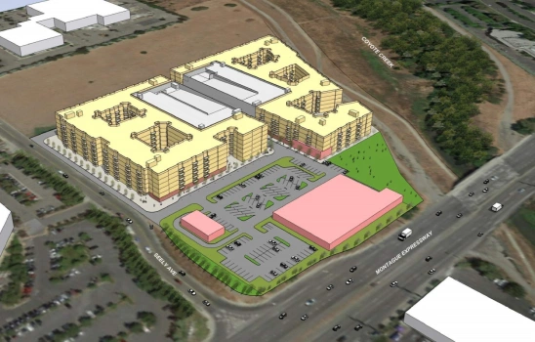
Mixed-Use Definitions
Mixed-use: Multiple land uses in a single project
Vertical/ Integrated Mixed-Use: Different uses in the same structure
Horizontal Mixed Use: Mixed use in separate structures
Adaptive Reuse: The process of redeveloping an existing structure for a new use or purpose.
Notes:
Effective transportation system: Efficient transportation systems, encouraging alternatives to single occupancy vehicles, and reducing the miles that vehicles travel can reduce greenhouse gas emissions, help conserve fuel and cut fuel costs, improve air quality, reduce traffic congestion and make streets safer for pedestrians, bicyclists, transit users and motorists.

Slide 5
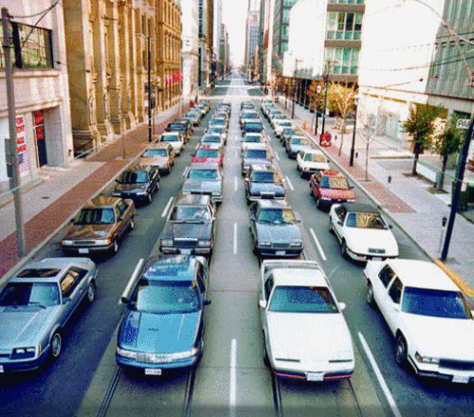
Transportation Definitions
Trip: single journey between two points by a specified mode of travel (also called boardings in transit).
Vehicle Miles Travelled (VMT): measures the distance of trips, calculated collectively.

Slide 6
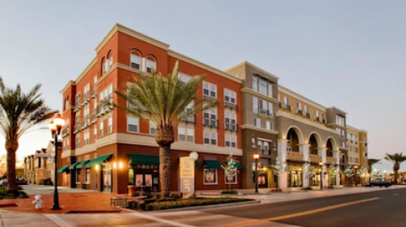
Advantages of Mixed-Use Projects
Provide convenience and walkability
Can create “village centers”
Enhance vitality and perceived security by increasing the number and activity of people
Encourage economic growth
Extend economic day
Create synergy between varied land uses

Slide 7
Advantages of Mixed-Use Projects
Opportunity for increased housing choices that are:
Not gated
Not single family
Potential to yield a more affordable price that what is currently available
Meets the demand for rentals
Transit system already exists in these areas
Full arrangement of existing infrastructure already in place

Slide 8
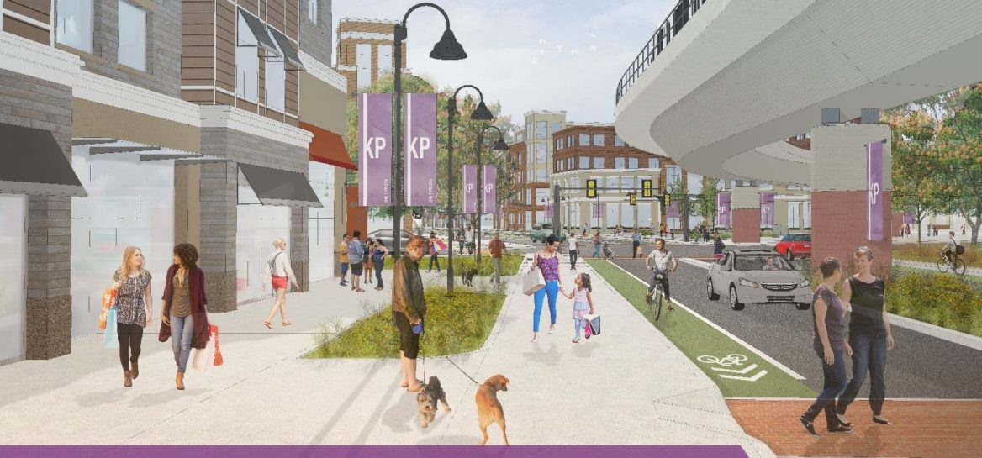
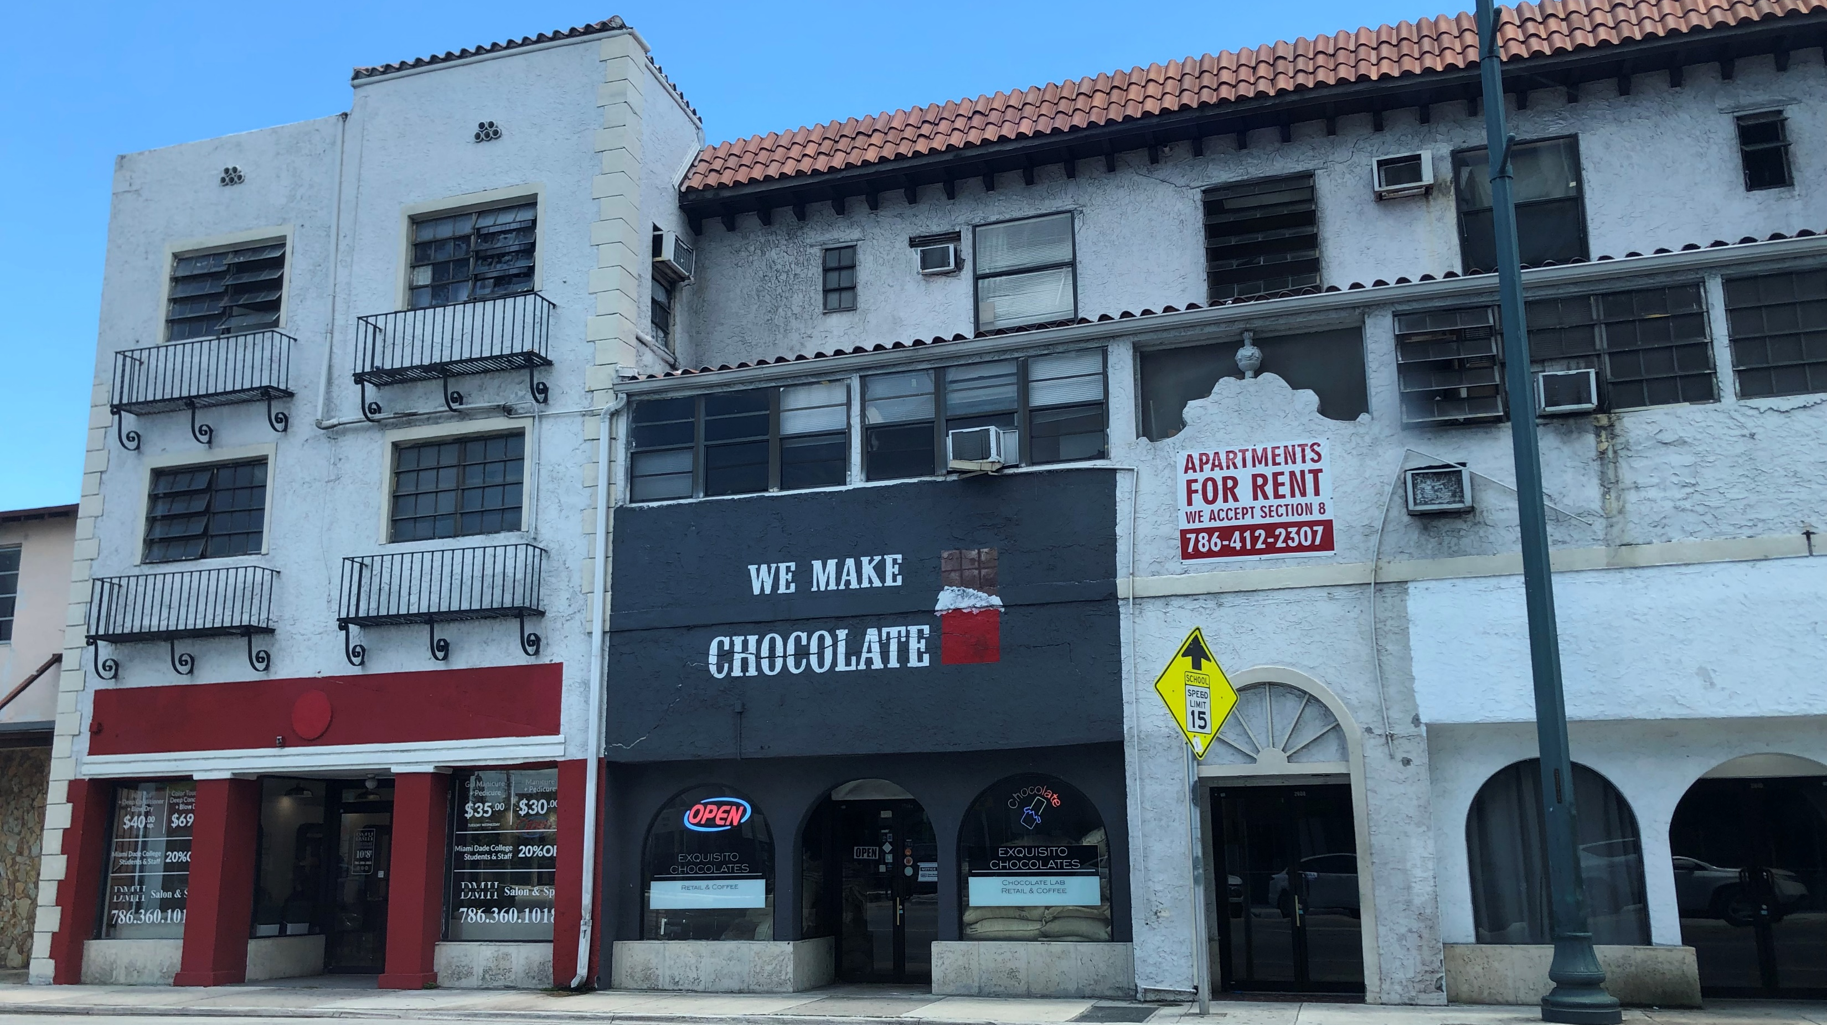
Benefits and Challenges of Mixed Use
Benefits
Efficient use of land
Can result in fewer, shorter trips/less VMT
Adding residential units to commercial areas helps support commercial uses
Challenges
Difficult to balance residential/ commercial)
Challenging to find developers who specialize in mixed use
Requires code tailored to mixed-use development, not Euclidean zoning

Slide 9
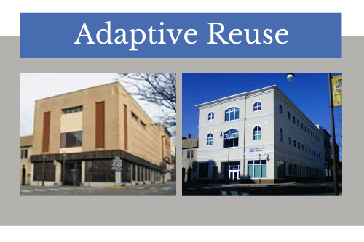
Community Benefits of Adaptive Reuse
Helps reduce the supply of unnecessary commercial and office space
By removing unnecessary supply, we make remaining businesses stronger
Adds housing choices to local area
Generally well located
Can convert a single-use project into a mixed-use project

Slide 10
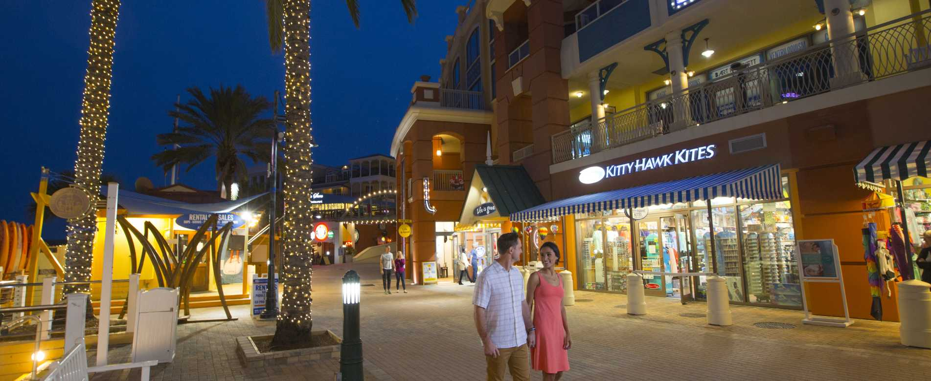
Benefits & Challenges of Adaptive Reuse
Benefits
Increases land value
Can result in less shorter trips/less VMT
Projects enhance the community in which they are located
Spurs revitalization
Can help provide resources to offset other projects
Ability to create vibrant community spaces
Challenges
Difficult to balance residential/commercial
Not enough “private” space for residents/parking
Difficult to develop
Noise and odor issues
Merging old tenants with new, residential tenants
Environmental mitigation may be needed

Slide 11
Land Use & Planning Overview

Slide 12
Benefits of Good Land Use Planning
Protects the Public Interest:
Advanced knowledge of future potential impacts
Limits objections from “new” residents for necessary uses
Reduces speculative entitlements/zoning changes
Think Regionally – Plan Locally:
Recognize proximate land uses in Adjacent Communities
Each planning area should support residents’ immediate day-to-day needs (groceries, pharmacies, schools & parks)

Slide 13
Balancing Land Uses
Land Uses are population-driven
Suburban Areas
Residential Trends 70% SF / 30% MF
Commercial Trends 66% Retail / 34% Office
Urban Areas
Residential Trends 50% SF / 50% MF
Commercial Trends 50% Retail / 50% Office
Urban College Towns
Residential Trends 40% SF / 60% MF
Commercial Trends 66% Retail / 34% Office

Slide 14
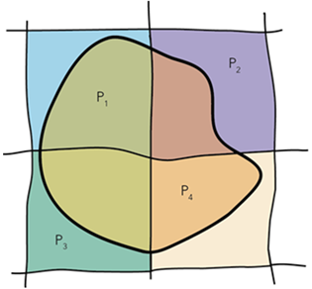
Land Use Metrics
Land Apportionment is Key
Residential considers unit density and population demographics
Commercial considers population needs and building intensity (FAR)
Industrial is a policy decision not a demand issue
Fire stations and schools are spatially located in populated areas
Parks are mostly spatial, but not always
Recreation utility key driver
Gold standard: 10 acres per 1,000 people

Slide 15
TOD Definitions for Suburbia
Transit Core: The area with the quarter mile around a transit stop.
Transit Oriented Development: A project that will be served by existing or planned transit service.
Compact, moderate to high density
Pedestrian oriented
Mid-rise
Prioritizes affordable housing and high density residential and mixed-use projects
Notes:
Effective transportation system: Efficient transportation systems, encouraging alternatives to single occupancy vehicles, and reducing the miles that vehicles travel can reduce greenhouse gas emissions, help conserve fuel and cut fuel costs, improve air quality, reduce traffic congestion and make streets safer for pedestrians, bicyclists, transit users and motorists.

Slide 16
TOD Design Standards
An example of what one community has adopted
Must be multi-family and submitted as a planned unit development
Baseline TOD: a maximum of 13 units per acre
Affordable Housing TOD: a maximum of 25 units per acre
Recommended density of 15-25 units per acre
Ideal minimum TOD project size is 200 units
Notes:
Where is it appropriate to convert commercial uses to residential?

Slide 17
Regulatory Flexibility Suggestions
Need to streamline development approval process to help reduce fiscal barriers
Ease standards on preexisting non-conforming lots
Eliminate need for variances
Develop infill and redevelopment performance standards that emphasize the resulting project
Alternative way to evaluate the project rather than rigid numerical dimensional standards
Reduced parking requirements based upon availability of transit and other offsets
May include Brownfield Program assistance programs to help navigate the process
Notes:
Where is it appropriate to convert commercial uses to residential?

Slide 18
What Can Be Done To Improve Policies?
Add policy considerations to encourage this type of activity
Incentives?
Flexibility?
Coordination between policies
Look for synergies
Improve efficiency
Capitalize on infrastructure and amenities

Slide 19
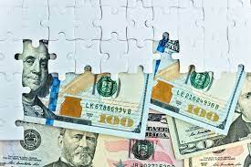
What is Revenue Hiding in Plain Sight?
Tax revenue that exceeds the cost to provide services
Based on raising the value of the existing land use
Low hanging fruit are underused or failing shopping centers
Potential to extend commercial activities beyond traditional 9 to 5 hours will reduce trip length and CO2 production

Slide 20
How to Analyze Redevelopment Areas
Good residential rezones:
Near employment centers/ commercial services
In areas with excess commercial space/land
Access to transit
Little choice in housing type, mono-culture of single family detached
Close proximity to parks and entertainment
Bad residential rezones:
In highly residential areas
In areas with minimal commercial lands
Low density
Long emergency service response times
Far from essential services

Slide 21
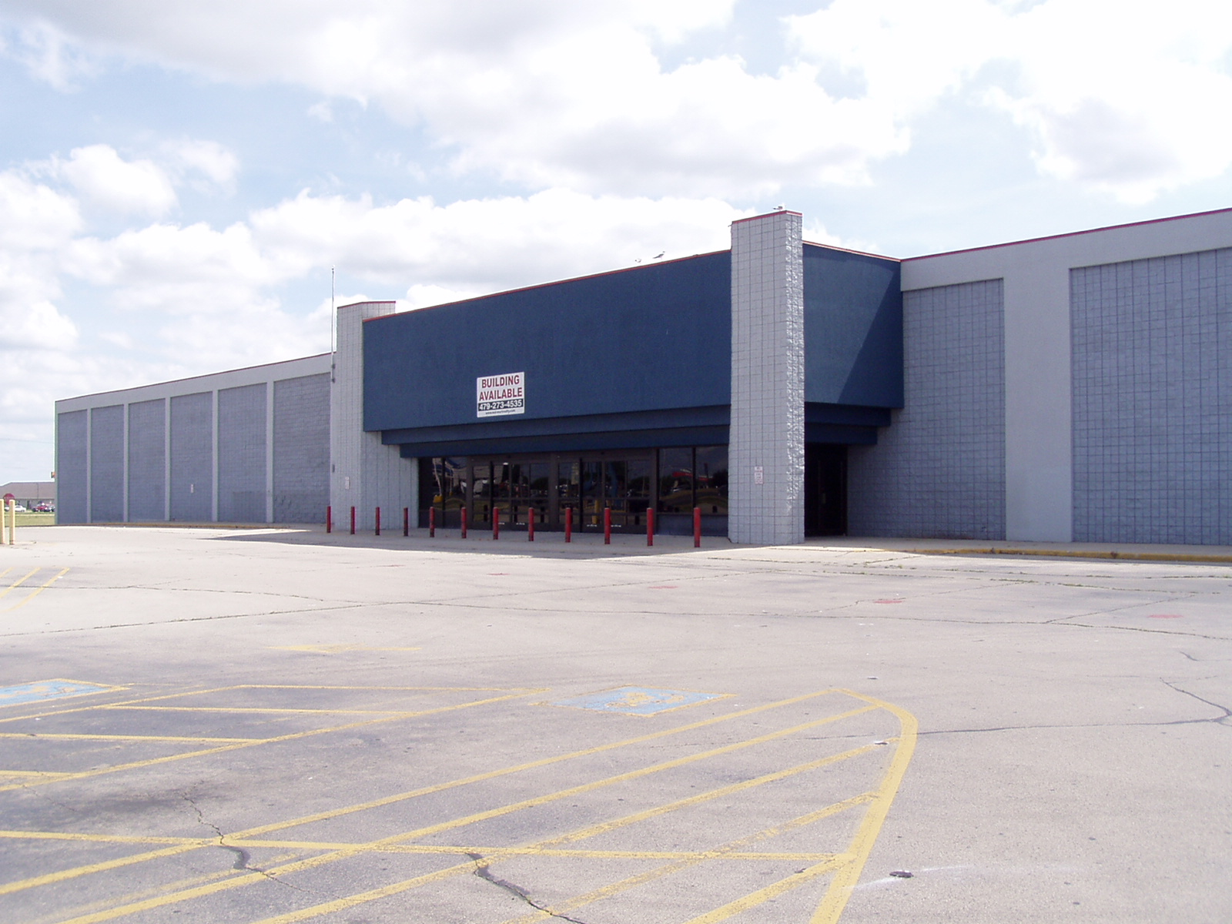
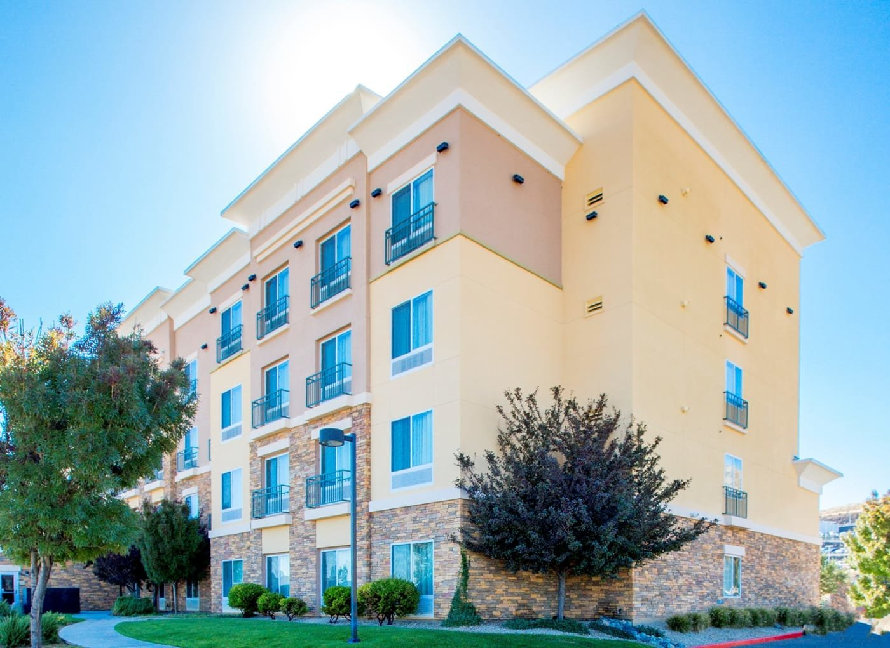
Typical Steps Of Adaptive Reuse
Identify specific projects by either type or area that has the potential to support residential land uses
Develop policies that are friendly to good adaptive reuse
Encourage landowners to make use of new policies through outreach or public workshops

Slide 22
Why Might Landlords Resist This Idea?
They understand and specialize in commercial
Commercial generally has fewer tenants
Most businesses operate 8-12 hours a day or less; residential requires 24-hour monitoring
May not see beyond traditional vertical mixed use and see how horizontal mixed use can fit within overall project
Doesn’t fit our existing Code!!
Notes:
Where is it appropriate to convert commercial uses to residential?

Slide 23
How to Engage the Landlords
Contact individual owners
Work with commercial brokers
Explain incentives to help them understand benefits of converting commercial to multi-family
Point out advantages of two streams of income
Notes:
Reasonable driving distance – no one knows better than a local

Slide 24
How to Engage the Landlords
Opportunity to reduce/reuse less productive building space
Adding residential to a project can create a built-in customer base for existing and future tenants.
Show examples of similar communities that have successfully adapted mixed-use code standards
Notes:
Reasonable driving distance – no one knows better than a local

Slide 25
Possible Objections
Local statutes assured that residences, shops and factories were separated for many generations
Multifamily developments can lead to school overcrowding
Traffic is always the #1 concern
No one wants to live next to or above commercial

Slide 26
Overcoming Objections
Destinations offer multiple draws for consumers
Provide diversification
Rezoning provides the opportunity to stimulate development
Residential creates far fewer trips than commercial attracts, overall net reduction in traffic intensity
Adding residential adds to housing choices and reduces environmental impacts
Benefits the environment, the budget, and existing commercial establishments

Slide 27
Overcoming Objections
Destinations offer multiple draws for consumers
Provide diversification
Rezoning provides the opportunity to stimulate development
Residential creates far fewer trips than commercial attracts, overall net reduction in traffic intensity

Slide 28
Overcoming Objections
Adding residential adds to housing choices and reduces environmental impacts
Benefits the environment, the budget, and existing commercial establishments

Slide 29
Selling Adaptive Reuse to Your Board
Talk traffic (trips, VMT)
Capitalize on existing infrastructure
Roads, waterlines
Utilities
Parks & Schools
Increase tax revenue without raising taxes
New residents will patronize on-site and adjacent goods and service providers
Coordinate with attention to other modes of transportation: walking, biking to complete the last mile to final destination

Slide 30
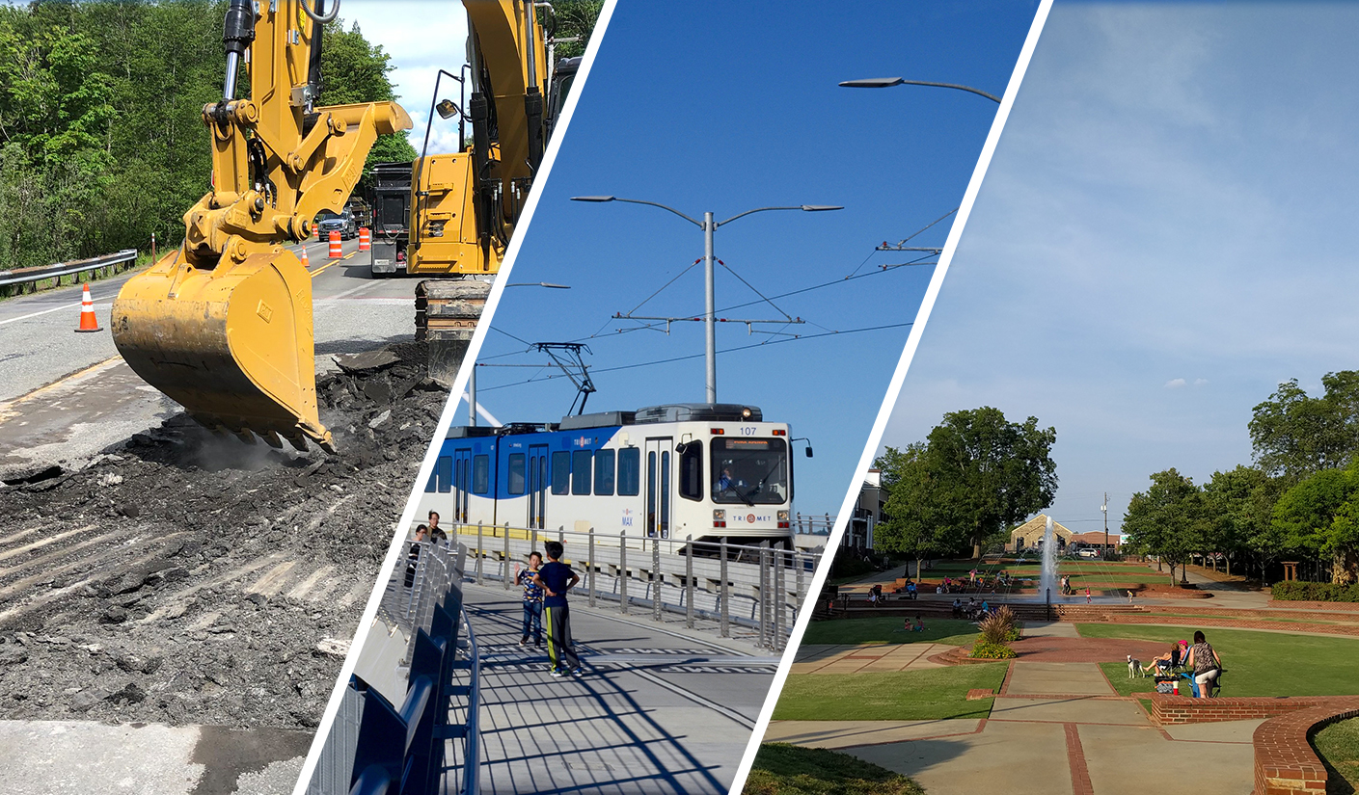
“A land development decision is a traffic decision.”

Slide 31
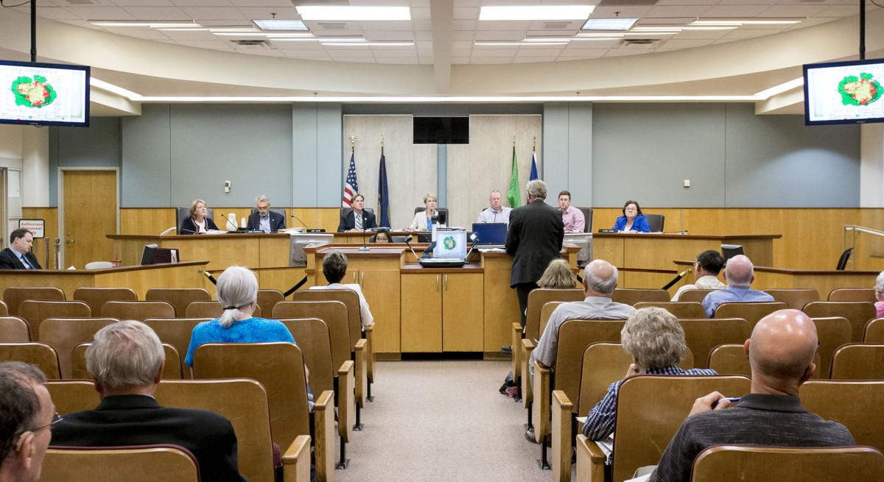
Where Does Politics Come In?/ The Politics of Redevelopment
NIMBY-ism
Perceptions of adding people to locations that were previously commercial
Perceptions of increased traffic
If we allow this in one location, will it set a precedent?
Important to talk to neighbors to make a good impression

Slide 32
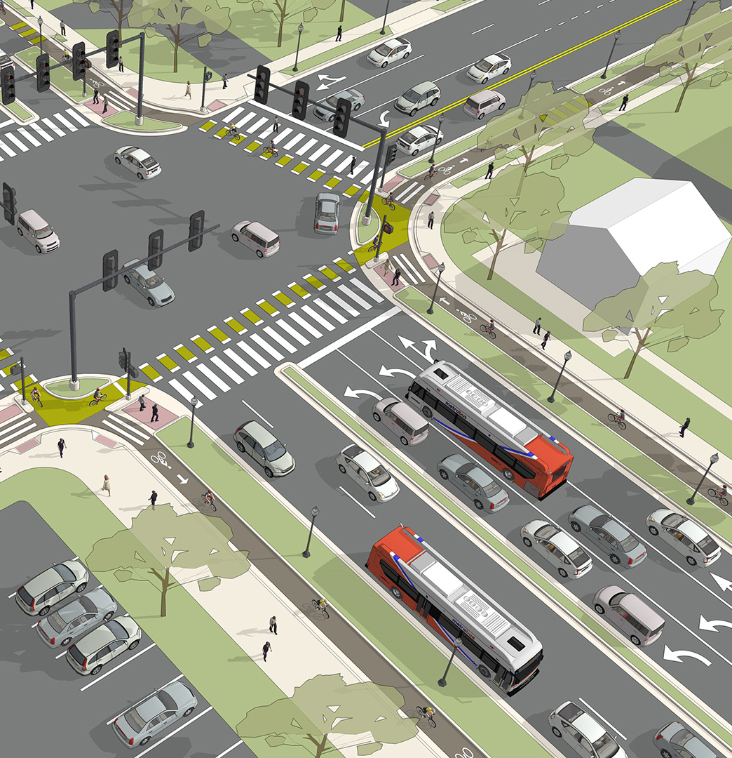
Effective Transportation/Transit Systems
What defines an effective transportation/ public transit system?
People are moved efficiently
Accessibility of alternative modes of transportation
Unified land use and transportation planning (LONG range)
Residential density/ Commercial intensity
Notes:
A land development decision is a traffic decision. Which potentially affects everyone in the area. (How much of the site is paved, and even what material is used for paving, affects how fast rainwater runs off from the property. – affecting water quality)

Slide 33
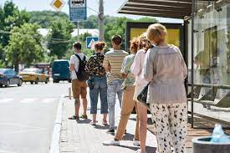
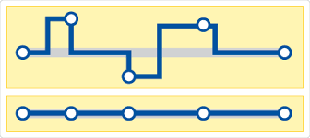
Adding Density to Your Transit System
Higher densities supply more potential riders for transit
More frequent service
A greater variety of routes
Mixed-use developments can help

Slide 34
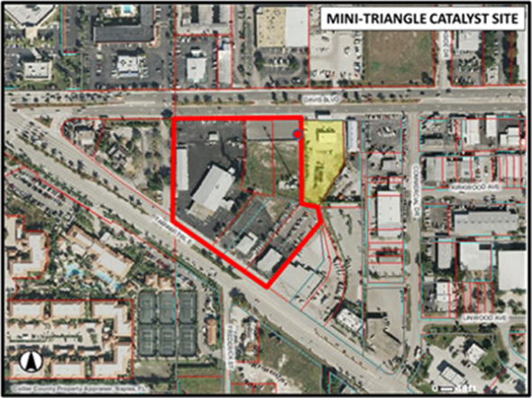
CRA Example: Bayshore
Bayshore CRA
Gateway Mini Triangle Project – 5.27 Acre Site purchased by Collier County (CRAs) in 2009.
Proposed Development:
Luxury hotel
270 Luxury apartments
Parking
Bus stop
Notes:
Parking/shuttle
Types of land uses: coffee vs. law offices

Slide 35
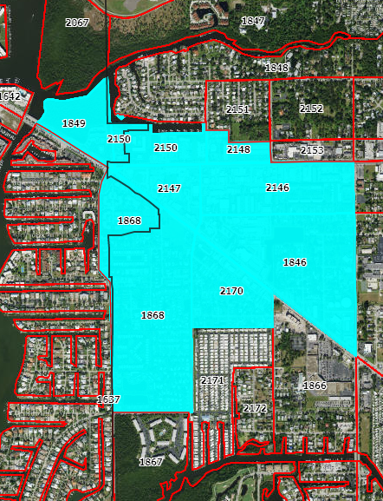
Bayshore Analysis
2020 Housing Units: 978
2020 Population: 1,743
Demographics:
Household size: 2.0-2.5
Vacancy rate: 25-40%
Using these demographics, the proposed project may add up to 486 residents
Notes:
Prior commercial (BK, gas station) unsuccessful
Retail/Restaurant Sqft: 499,219
Office/Hotel Sqft: 267,987

Slide 36
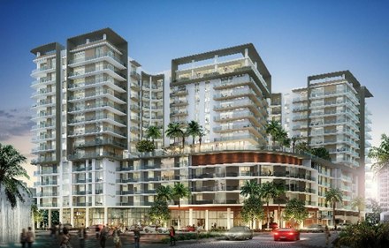
Bayshore Review
Excellent place for high-density residential
Ample commercial services
Existing infrastructure: roads and utilities
The area will likely need more residential to support the commercial uses, especially as Eastern Collier County develops.

Slide 37
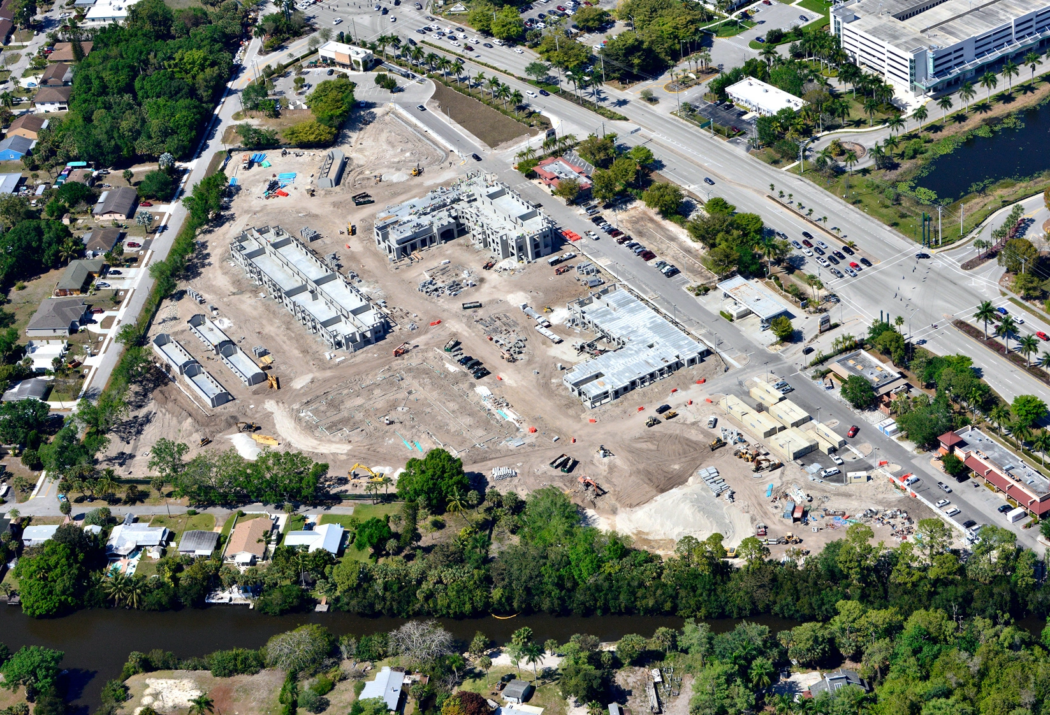
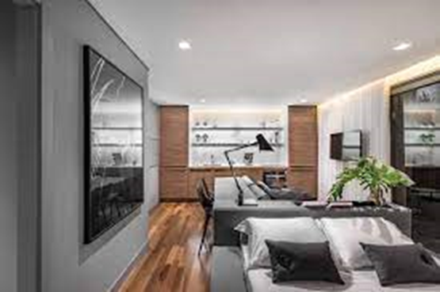
Bayshore Summary
Hotel site
Previous assessed value - $4.1 million
Estimated future assessed value - $49 million
1200% increase in taxable value
Mixed-use site
Previous assessed value - $6.4 million
Estimated future assessed value
$200+ million
3,000% increase in taxable value
Notes:
Located within 2 miles of a Publix shopping center
Where is it appropriate to convert commercial uses to residential?
Is this conversion appropriate for this site? How can this be quantified?

Slide 38
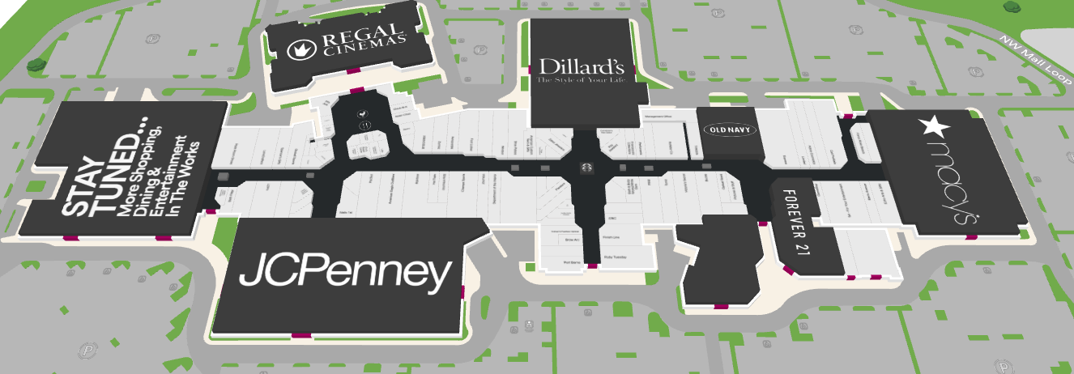
Mall Adaptive Reuse Example
Concerns: Transportation and Schools
Utilizes existing facilities/ infrastructure
Existing parking
Supports existing commercial, reduces VMT
Adds few students, school within 2-3 miles

Slide 39
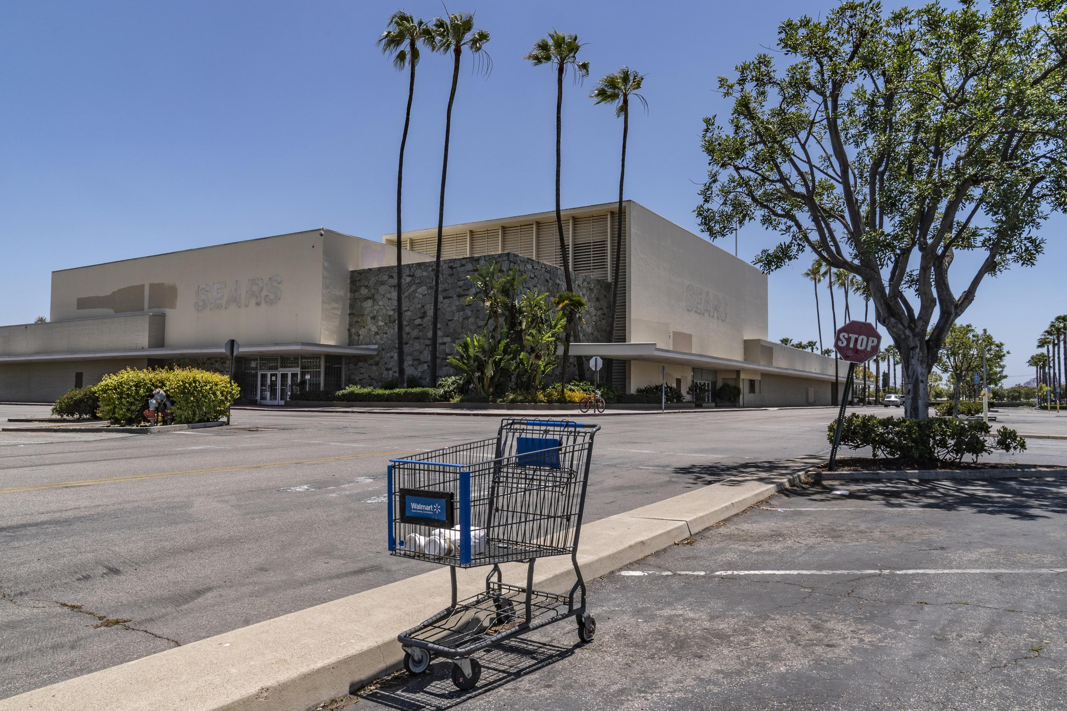
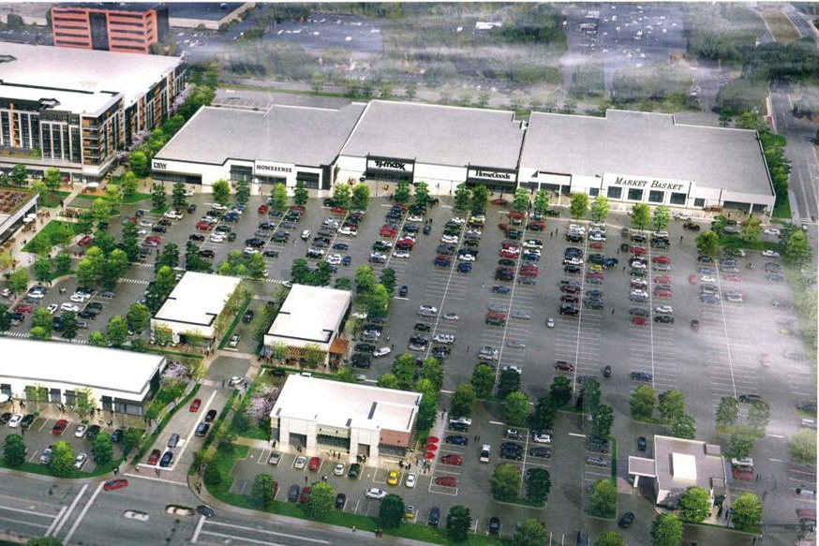
Mall Adaptive Reuse
Treasure Coast Mall
Large department stores may not renew leases
One major department store has the potential to add 150+ units, if allowed
Compatibility – intense uses
Existing bus stop

Slide 40
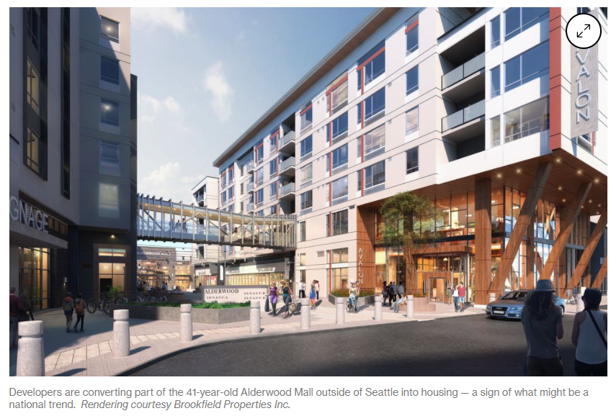
Mall Adaptive Reuse Analysis
Demographics:
Household size: 2.4
Vacancy rate: 17%
An additional 150 units may result in 299 people
Using the average % of school-aged children: 12.7%
Could add approximately 38 students

Slide 41
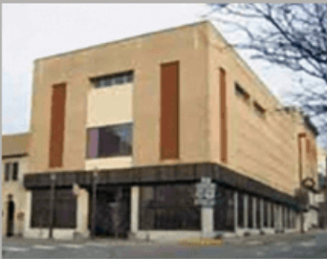
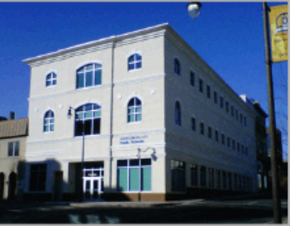
Mall Adaptive Reuse Summary
Treasure Coast Mall
Sears - 2022 assessed value $3 million
110,000 square feet of commercial building area
150 multi-family units @$220,000 per unit
Estimated future assessed value $33 million
1,100 % increase in taxable value

Slide 42
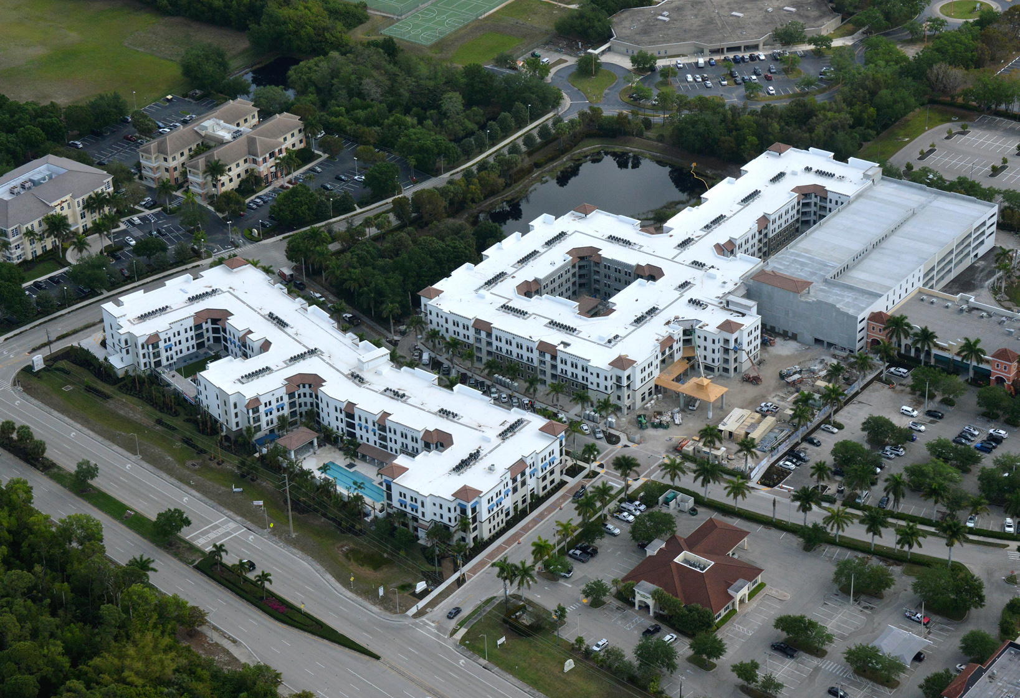
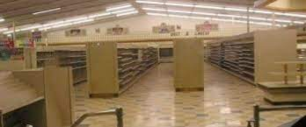
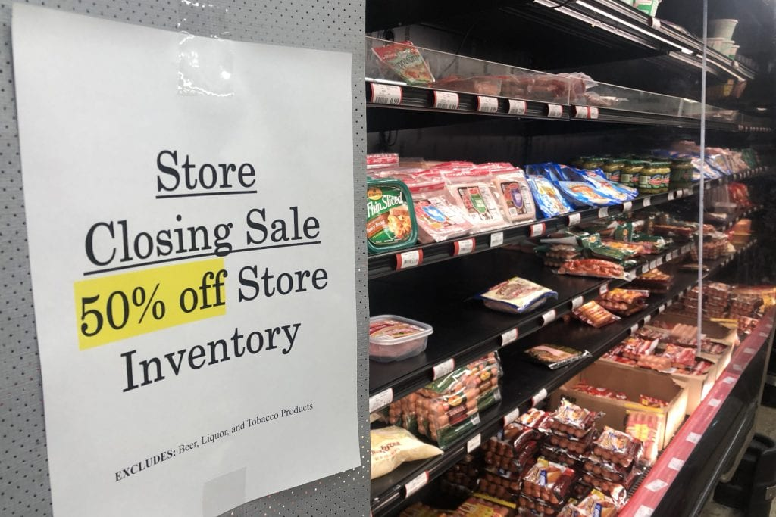
Sweetbay Redevelopment Example
Not enough commercial demand to support shopping center
Adding people (apartments) results in more housing and less obsolete commercial
Residents of this project more inclined to use transit than those living outside the urban area
Maximizes the governments’ investment in infrastructure
Notes:
Sweetbay – property taxes before and after, check PA
Tax-base trifecta. More economically productive (sales/property taxes could be 2x the value)
--close to essential services and employment centers!

Slide 43
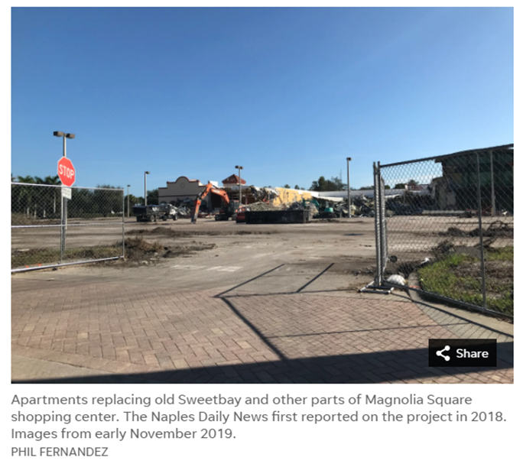
Sweetbay Redevelopment Analysis
How can we analyze where it is appropriate to add density?
Goal: effective transportation systems and optimal use of tax dollars
Minimize VMT, minimal vacant land available in the urban area
VMT from alternative location: 13 miles RT
Saved VMT: 1.4M annually
Notes:
Tax-base trifecta:
- Enhances transit, closer to the things people want to be close to. Even if not transit – reduces VMT

Slide 44
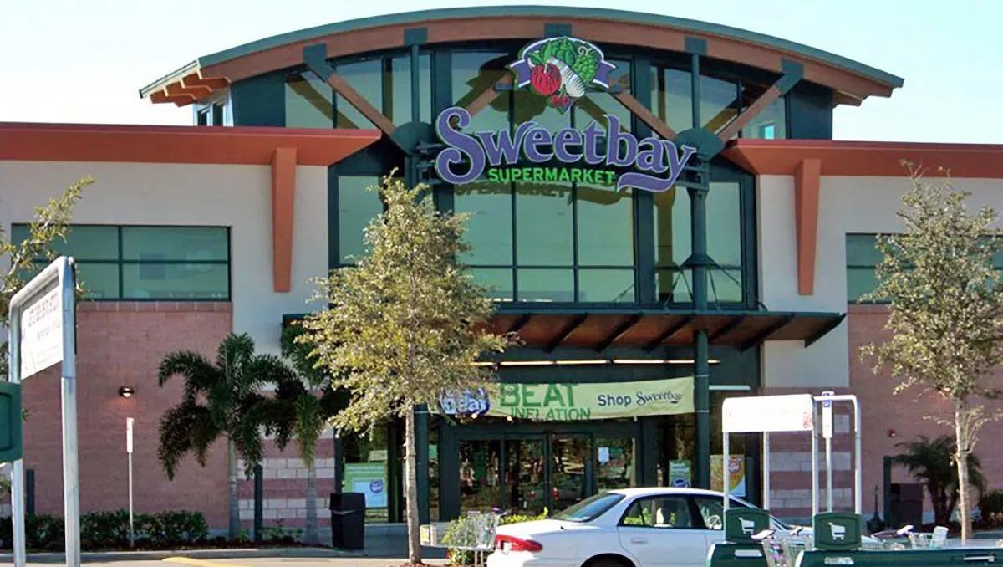
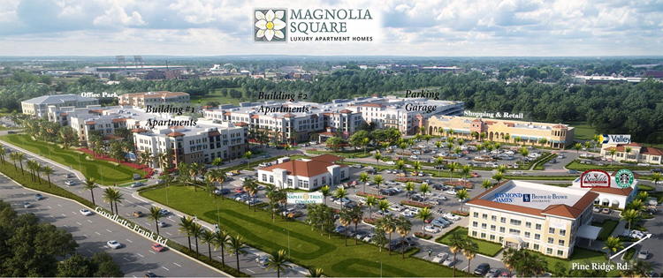
Sweetbay Redevelopment Review
Former Sweetbay shopping center - 120,000 Sqft of commercial building area
Now 290 multi-family units and 71,000 Sqft of commercial building area
Occupancy of Commercial: Retail - 100%, Office - 83%
Apartments are fully leased
Notes:
Located within 2 miles of a Publix shopping center
Where is it appropriate to convert commercial uses to residential?
Is this conversion appropriate for this site? How can this be quantified?

Slide 45
Sweetbay Redevelopment Summary
Apartment Subdivision
2018 assessed value - $20 million
290 multi-family units @$450,000 per unit
Estimated future assessed value - $130 million
650% increase in taxable value
Notes:
Located within 2 miles of a Publix shopping center
Where is it appropriate to convert commercial uses to residential?
Is this conversion appropriate for this site? How can this be quantified?

Slide 46
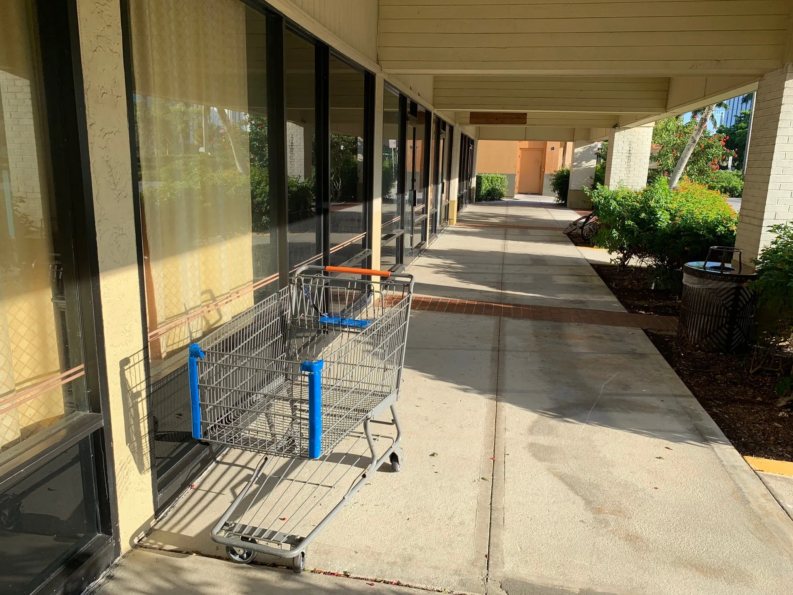
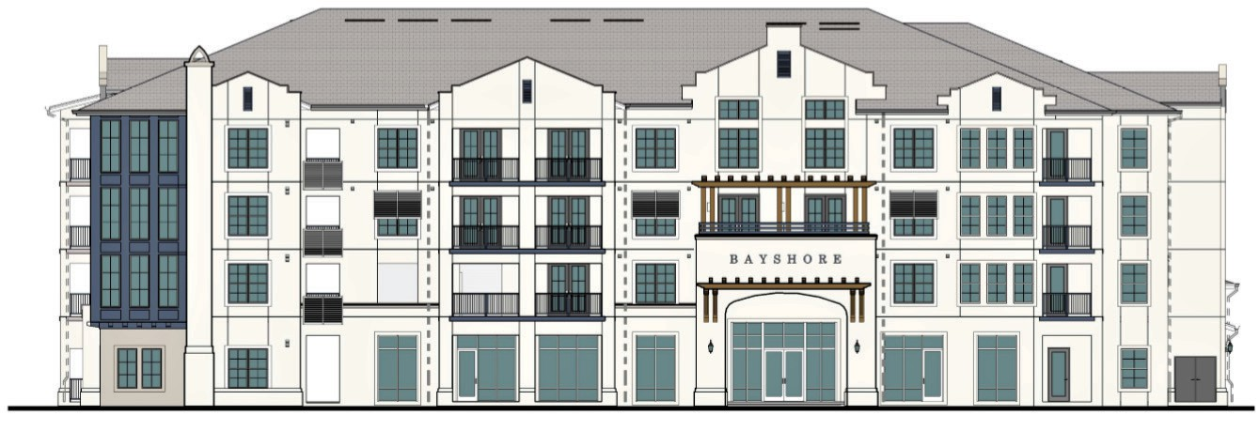
Courthouse Shadows Example
Former Walmart-anchored shopping center
150,000 square feet of commercial building area
Close to essential services: sheriff, fire, parks, schools already in place
Served by existing transit
Now 300 MF units and 65,000 Sqft of commercial building area
Notes:
Located within 2 miles of a Publix shopping center
Where is it appropriate to convert commercial uses to residential?
Is this conversion appropriate for this site? How can this be quantified?

Slide 47
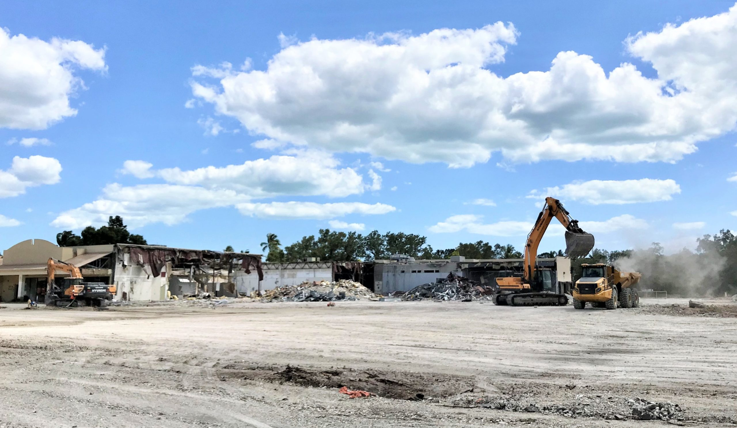
Courthouse Shadows Analysis
Close to essential services: sheriff, fire, parks, schools already in place
Served by existing transit
Current value $13.5 million
Proposed 300 MF units and 65,000 Sqft of commercial building area
Notes:
Located within 2 miles of a Publix shopping center
Where is it appropriate to convert commercial uses to residential?
Is this conversion appropriate for this site? How can this be quantified?

Slide 48
Courthouse Shadows Summary
2011 assessed value - $9 million
2021 sold for $13.5 million
300 multi-family units @$330,00 per unit
Estimated future assessed value - $99 million
740% increase in taxable value
Capitalizes on retail conversion from “goods” to “services” (entertainment, dining, etc.)
Notes:
Located within 2 miles of a Publix shopping center
Where is it appropriate to convert commercial uses to residential?
Is this conversion appropriate for this site? How can this be quantified?

Slide 49
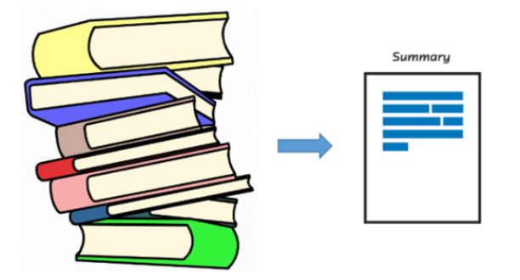
Summary
Adaptive reuse is a Win-Win
Developers
Government
Benefits the county in terms of additional tax revenue and higher transit density
Regulatory flexibility is crucial
Present a vision, not just a plan
Opportunities abound

Slide 50
Questions?
Please feel free to contact us with further questions:
Michael Bosi
michael.bosi@colliercountyfl.gov
239-252-1061
colliercountyfl.gov
David Farmer
dave@metroforecasting.com 239-913-6949 metroforecasting.com

Slide 51
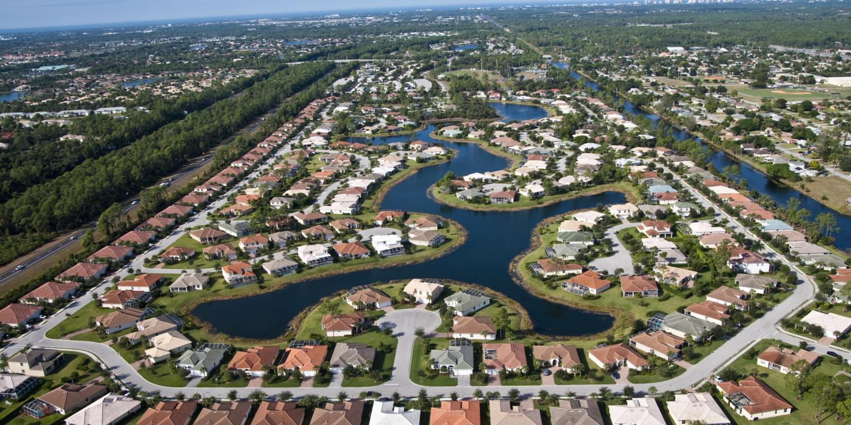
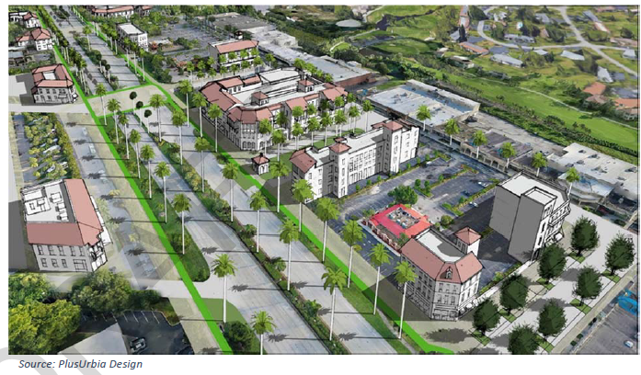
Residential and Commercial Balance
Land use allocation is a balancing act.
Good planning considers compatibility, proximity, and access.
Use zone (and adjacent zone data) to demonstrate the future supply or demand of land uses.
Adding people to places to places with high concentration of commercial improves commercial viability and positions residents near employment opportunities.

Slide 52
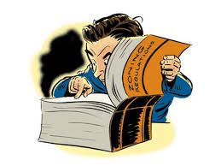
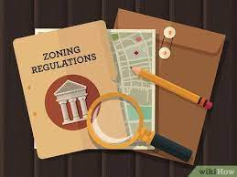
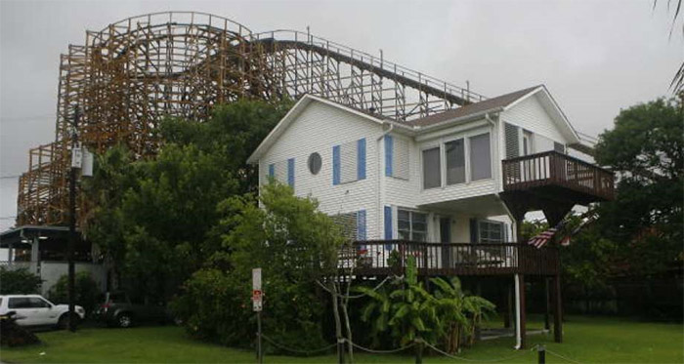
Zoning and Planning Considerations
Compatibility
Parking, noise, odor
Privacy
Budgeting for density
Allowable density
Proximity to government services

Slide 53
Mall Redevelopment Analysis
Using Martin County Average demographics: 2.40 HHS and 17% vacancy rate
An additional 400 units may result in 935 people
Using the average % of school-aged children: 12.7%
Could add approximately 119 students

Slide 54
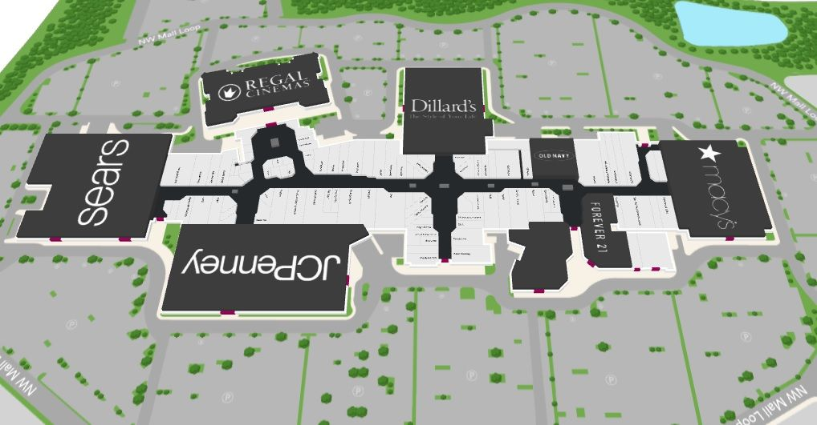
Mall Example Review
Concerns: Transportation and Schools
Utilizes existing facilities/ infrastructure
Existing parking
Supports existing commercial, reduces VMT
Adds few students, school within 2-3 miles

Slide 55
How to Engage the Landlords
Contact individual owners
Work with commercial brokers
Explain incentives to help them understand benefits of converting commercial to multi-family
Point out advantages of two streams of income
Opportunity to reduce/reuse less productive building space
Adding residential to a project can create a built-in customer base for existing and future tenants.
Show examples of similar communities that have adapted mixed-use code standards
Notes:
Reasonable driving distance – no one knows better than a local

