Slide 1
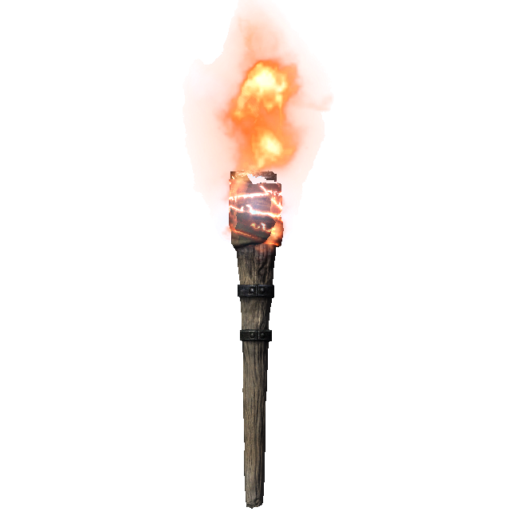
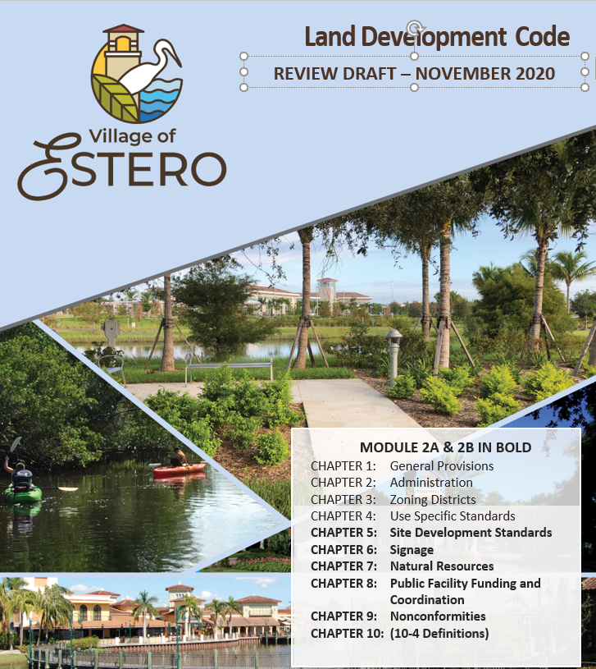
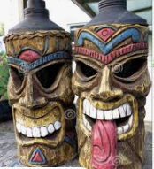
Survivor's Guide
For Updating Your Code
FPZA 2022

Slide 2

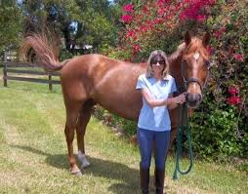
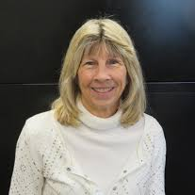
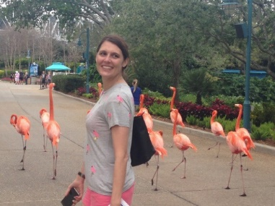
Your Tribal Presenters
Mary Gibbs, FAICP Laura DeJohn, AICP
Village of Estero Johnson Engineering

Slide 3
Overview
Background of Village of Estero
Review of LDC Process
Innovative Concepts
Practical Advice
Pop Quiz ???

Slide 4
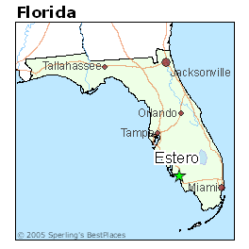
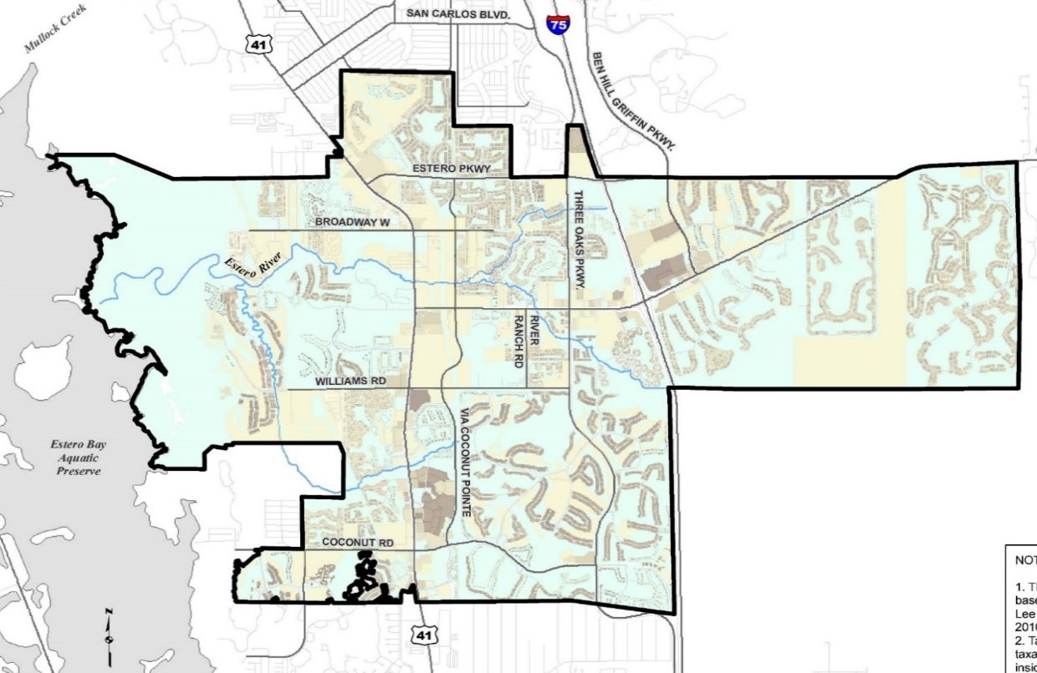
Estero Fun Facts
“Estero” Spanish for Estuary
3rd Newest City in Florida
26.5 square miles
2020
Permanent Population | 36,939
In Season | (+49%) 55,039

Slide 5
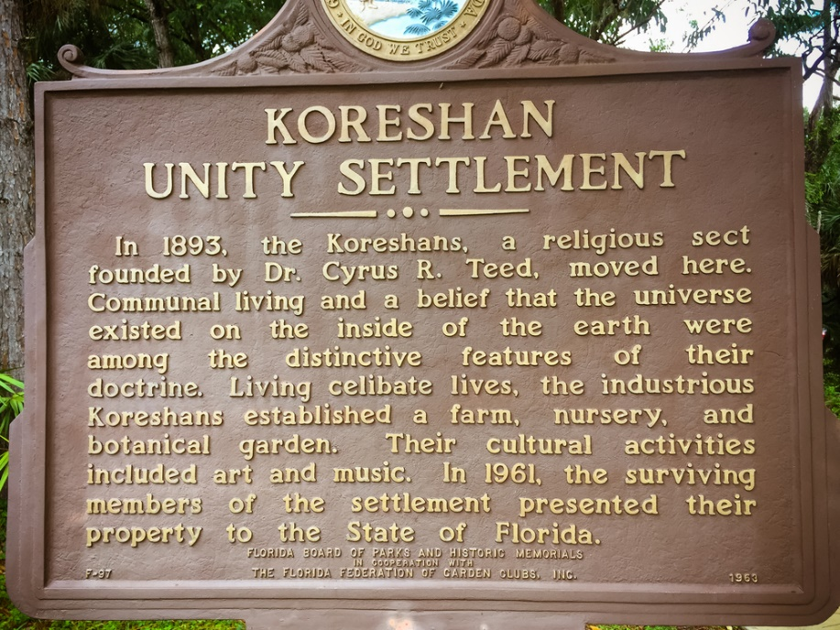

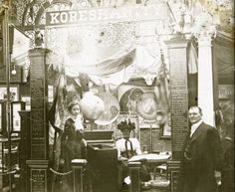
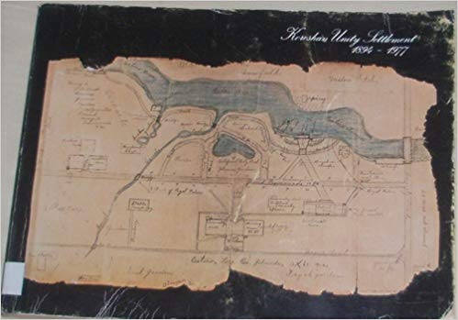
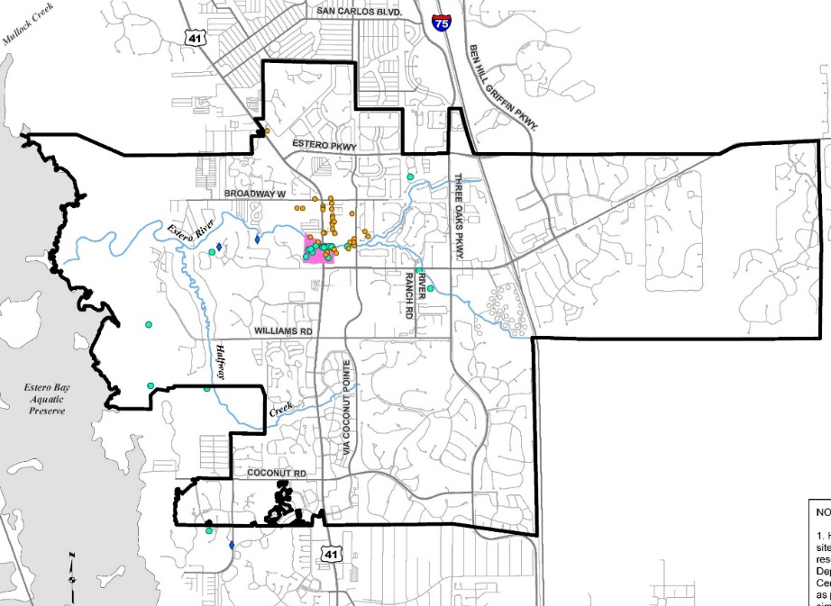
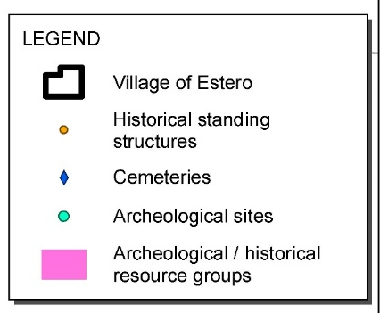
Incorporation – once by the Koreshans

Slide 6

Estero Incorporated Again 2014
1st Council March 17, 2015
Used County Comprehensive Plan & LDC as transitional documents
Adopted Comprehensive Plan 2018/2019
Adopted LDC January 2021 (I year per State statute)

Slide 7
Estero Code-Vision & Highlights
User Friendly Format – Use of graphics, tables & charts
Reduced Size - County Code = 1,000 pages
Incorporates new concepts from Comp. Plan
Mixed Use
Placemaking
Civic Spaces
Design and Character

Slide 8
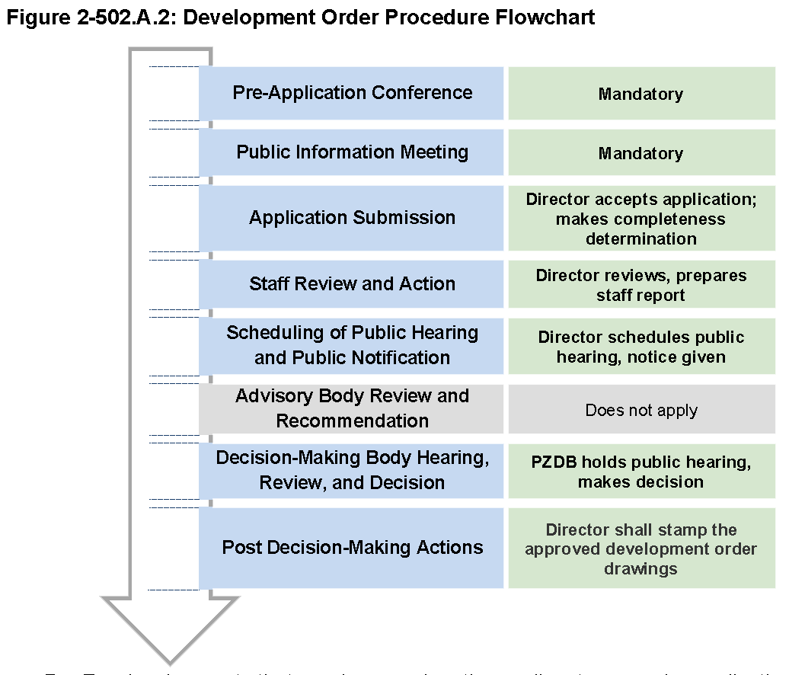
Chapter 2: Administration
Mary’s Favorite
Code Chapter
Consolidates all procedures in one chapter
  New graphics
  Flowcharts for each process
  Summary Table of Review Procedures
Chapter 2: Administration
Section 2-1 Purpose
Section 2-2 Summary Table of Applications
Section 2-3 Decision Making and Advisory Bodies and Persons
Section 2-4 General Procedures
Section 2-5 Application-Specific Review Procedures and Decision Standards

Slide 9
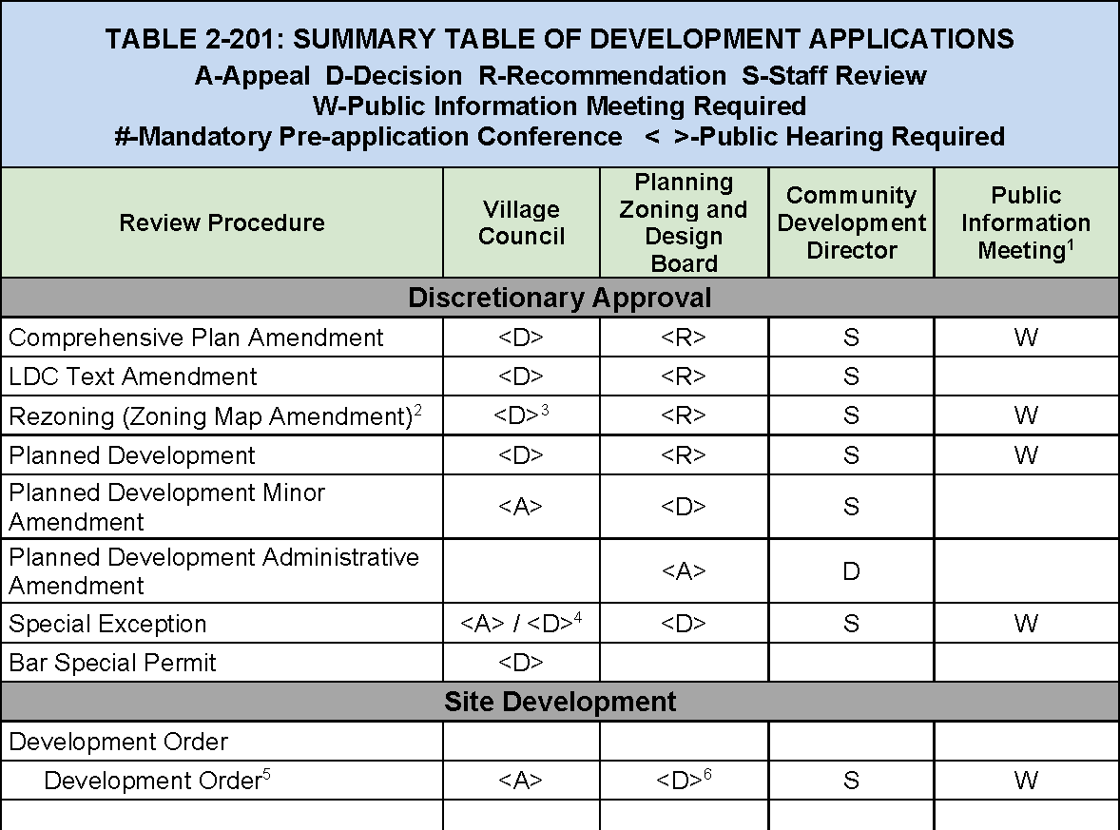
Section 2-2: Summary Table of Applications
Identifies:
Type of application
  Comprehensive Plan
  Rezoning
  Development Orders
  Other
Roles of decision-making bodies for each application
Shows when public information meetings and public hearings are required

Slide 10
Chapter 3: Zoning Districts
Modernizes and simplifies the Zoning District structure and also implements the Comprehensive Plan policies
Reduced number of Zoning Districts from 64 to 19
Added new Districts – Mixed Use Planned Development
Deleted Districts
Chapter 3: Zoning Districts
Section 3-1 General Provisions
Section 3-2 Agricultural District
Section 3-3 Residential Districts
Section 3-4 Commercial Districts
Section 3-5 Special Purpose Districts
Section 3-6 Legacy Districts
Section 3-7 Planned Development Districts
Section 3-8 Overlay Districts

Slide 11
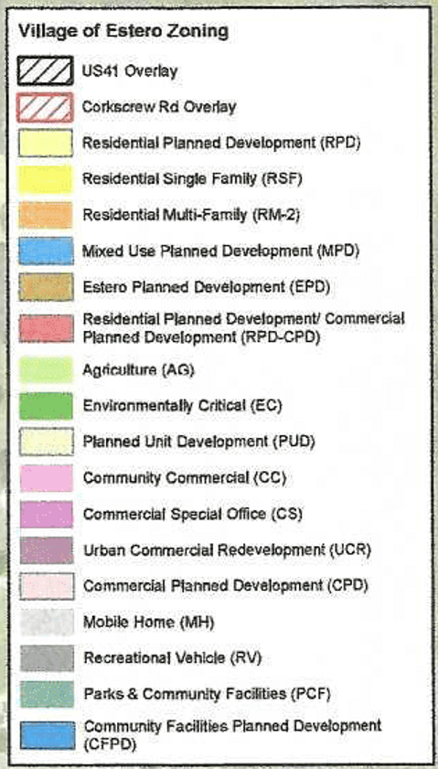
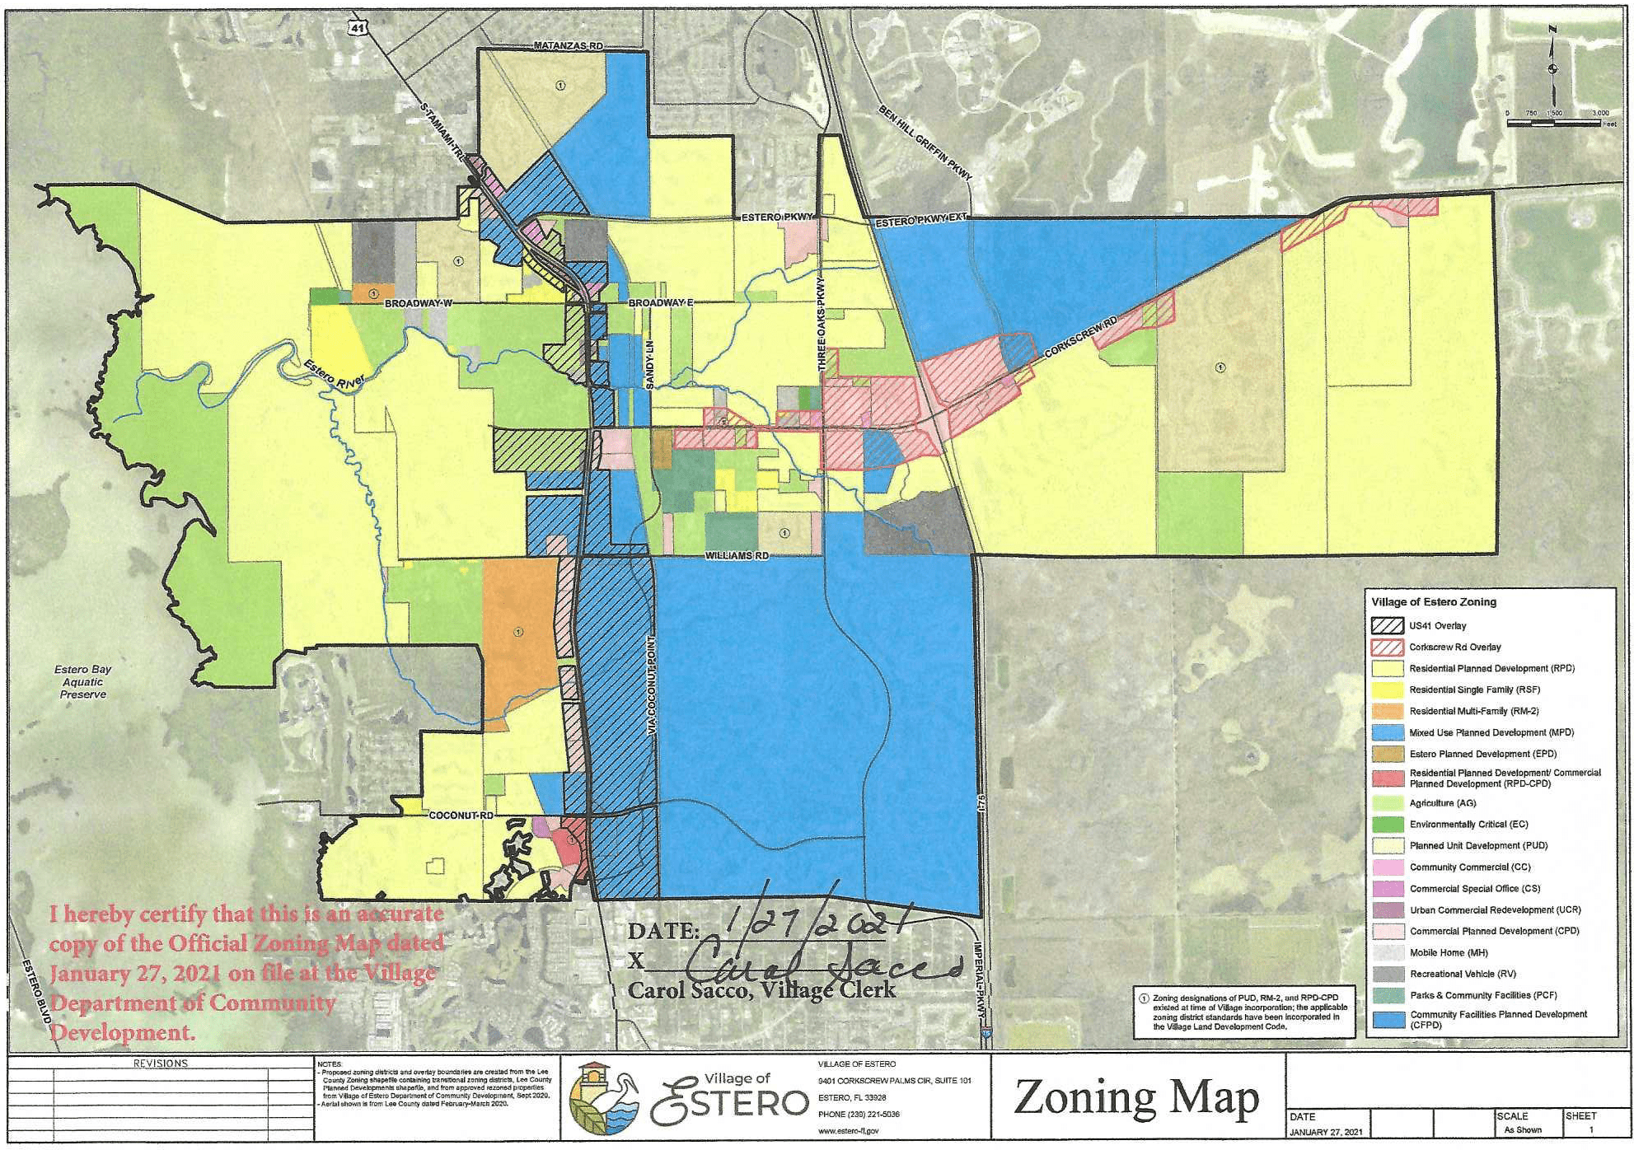
Official Zoning Map

Slide 12
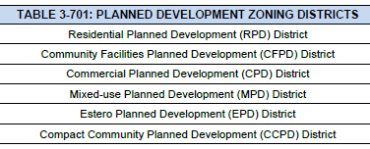
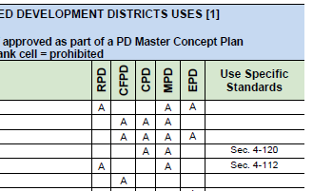
Chapter 3: Zoning Districts Sec. 3-7 Planned Development
Carried forward from transitional LDC, with refinements to implement Comprehensive Plan
All PD Districts must have a Master Concept Plan, a PD Phasing Plan (if phasing proposed) and a Pattern Book.
Underground utilities for new development

Slide 13
Chapter 4: Notable Changes
All Uses, If Rezoning
If commercial, or five acres or greater, developed as planned developments. (Exceptions for parks, schools, places of worship, religious facilities)
Principal Uses
Bar (4-107): Only allowed with Council Review on lands designated Transitional Mixed-Use and Village Center in Plan
Brewpub or Micro-brewery, -winery, or –distillery (4-109): (New use) Limits on non-production (restaurant, tours, etc.) area and limits on adverse effects from production and distribution
Medical Marijuana Dispensaries (4-124): Listed and specifically prohibited as per existing ordinance
Golf Course Conversion (4-121): If in or adjacent to planned development must be by planned development; “Preserve Areas” in master plan
Wireless Facilities (4-143): Updated to reflect the changes to State law in 2017
Accessory Uses
Electric Vehicles Charging Stations (4-202.E): Reserves EV charging-equipped spaces for EV vehicles and limits interference with circulation or landscaping
Outdoor Storage (4-202.L): For UCR, CC, and PDs– prohibits in front of the principal structure
Pickleball (4-202.M): In conventional districts only allowed by special exception with public hearing; limits adverse impacts to adjacent properties. (lighting, noise, etc.)
Director may require mitigation measures
Temporary Uses
Farmers Market (4-303.B): Replaces Oct. through April restriction - markets may be open a max. of 60 days a year. (can be nonconsecutive)
  Markets must have established rules and an authorized manager.
Special Event(4-303.G): Automobile, mobile home, RV and Boat sales not allowed as a special event
Notes:
Wireless Facilities (4-143)
Updated to reflect the changes to State law in 2017 that allow for small wireless facilities in the public right-of-way
Applicable to Village-controlled right-of-way (County and Utilities control their own)

Slide 14
Design Standards
Standards include:
  5-703. Architectural Styles and Characteristics (UPDATED)
    Mediterranean Revival (5 substyles), Florida Vernacular (3 substyles), Alternative Styles (Prairie or Iconic)
  5-704. Historic Preservation
  5-705. Site Contextual Standards
    Mixed Use Development Standards (NEW)
  5-706. Building Design Standards
    Exterior Color (UPDATED)
  5-707. Supplemental Standards for Specific Uses

Slide 15
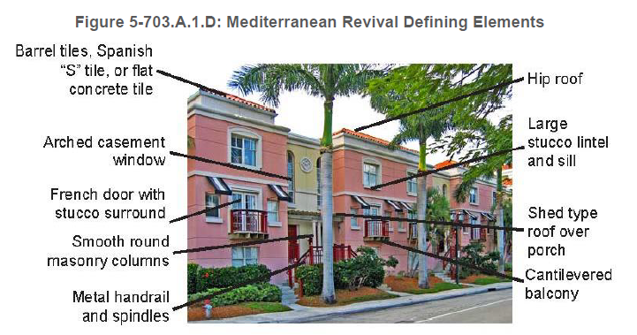
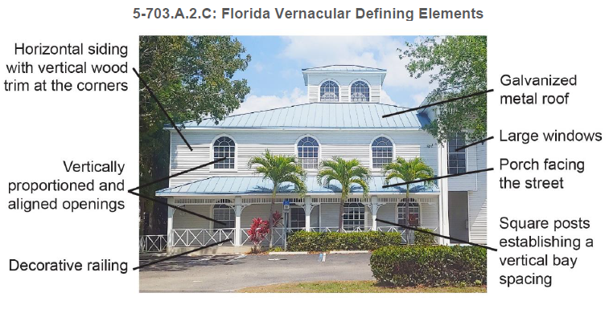
Section 5-7 Architectural, Form and Design Standards
5-703. Architectural Styles and Characteristics (UPDATED)
A. Primary Architectural Styles
Mediterranean Revival (5 substyles) and Florida Vernacular (3 substyles) are designated as the Village’s primary architectural styles.

Slide 16
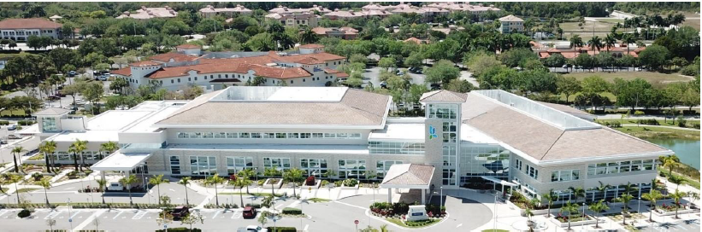
Section 5-7 Architectural, Form and Design Standards
5-703. Architectural Styles and Characteristics (UPDATED)
B. Alternative Styles
Alternative Styles subject to criteria and approval through review process
Prairie
Iconic: Buildings that are used for civic purposes and that are adjacent to public gathering places

Slide 17
Section 5-7 Architectural, Form and Design Standards
5-706. Building Design Standards
    Exterior Color (UPDATED)
D. Exterior Building Color
Exterior building colors shall be neutral, warm earth tones or subdued pastels. White or gray are prohibited as a predominant color.
  Where applicable, brightly colored trims, cornices, or columns may be used to create a special effect or setting. However, these contrasts shall create a harmonious impact, complementing the principal structure as well as existing surrounding building structures.

Slide 18
New LDC Concepts
Pattern Book requirements
Placemaking Standards
New Land Use Categories – Many
form based components (form based code “lite”)

Slide 19
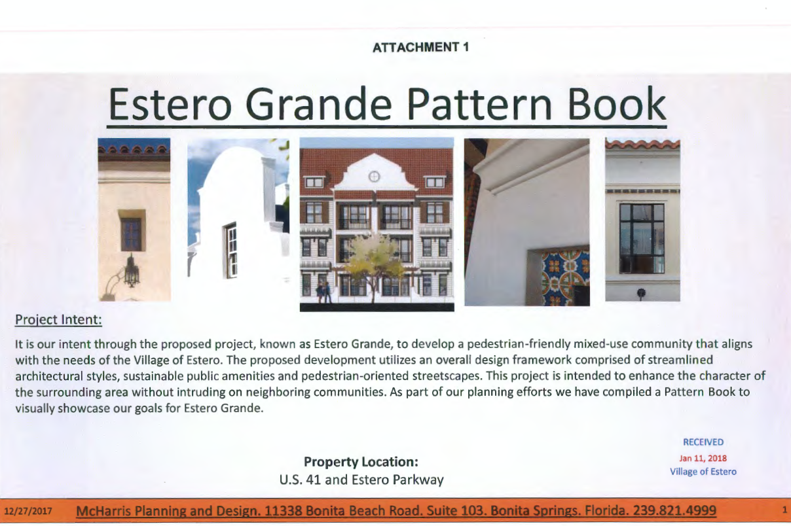
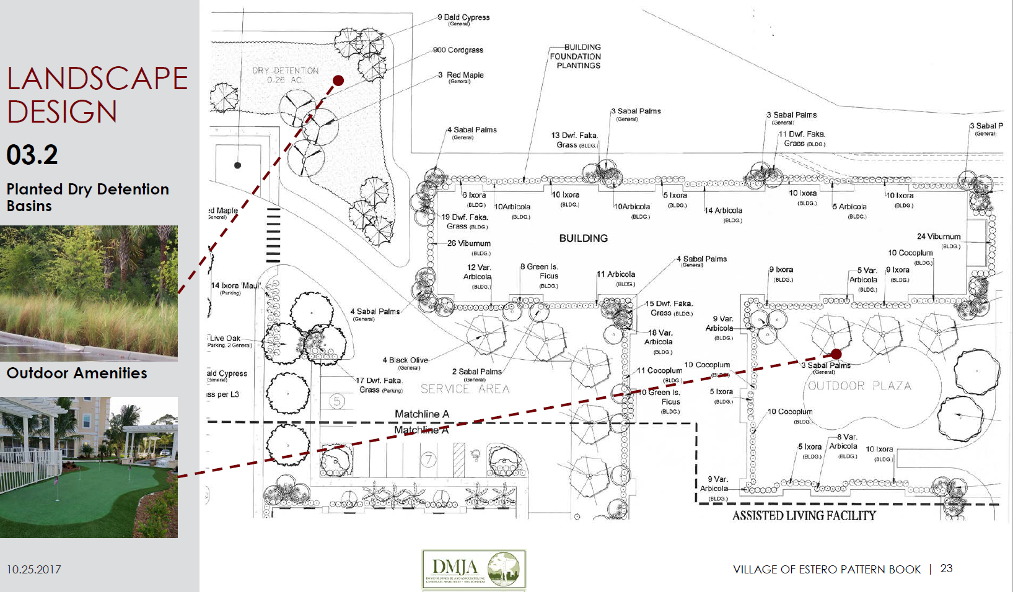
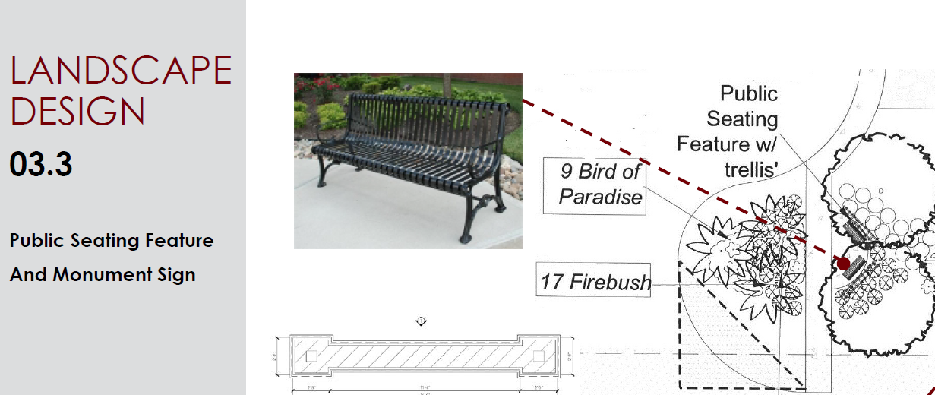
Pattern Book Concept
Pattern Book is a visual representation of what the project will look like when constructed
Focus on architecture, landscaping, connectivity and public spaces
Required at Zoning and/or Site Plan

Slide 20
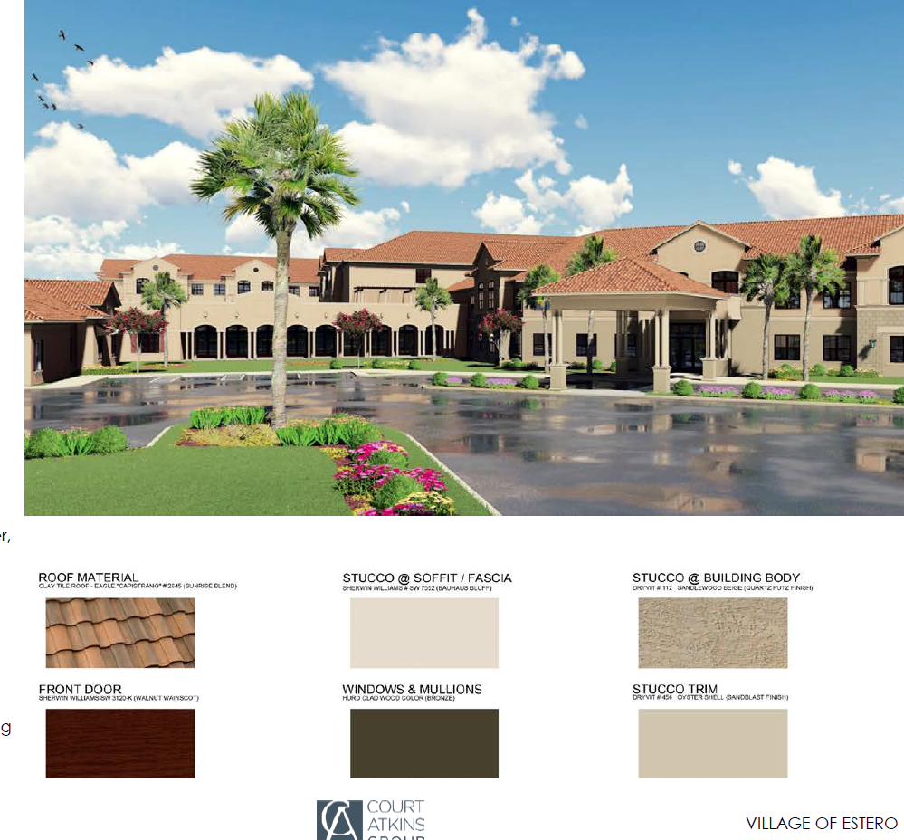
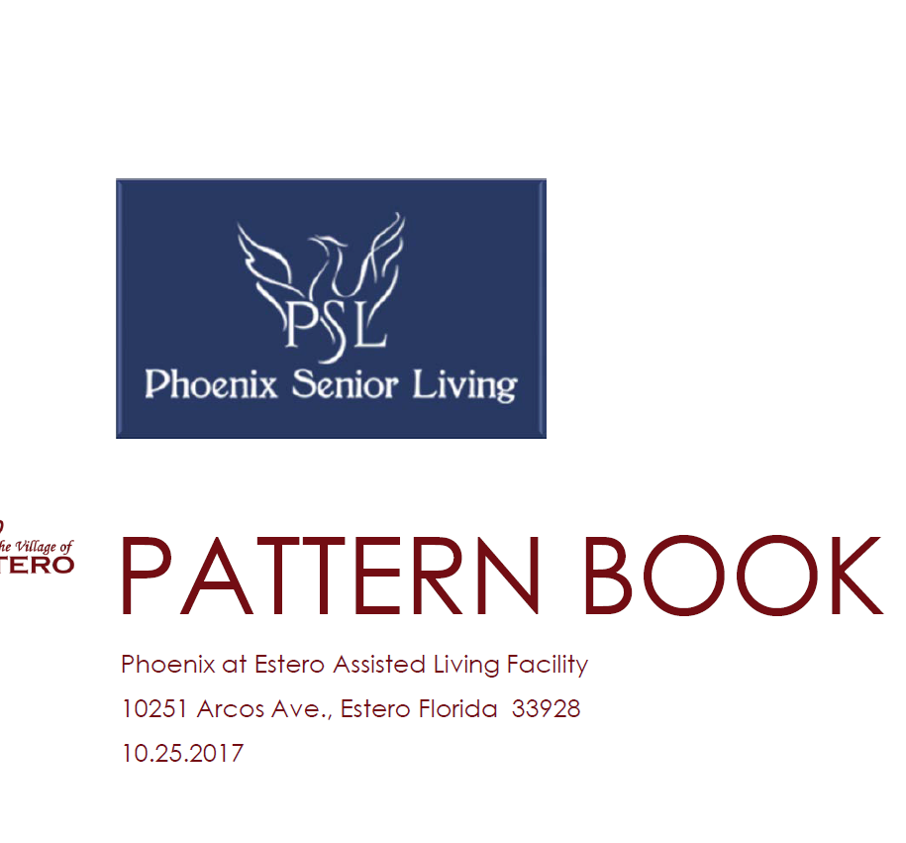
Pattern Book Examples

Slide 21
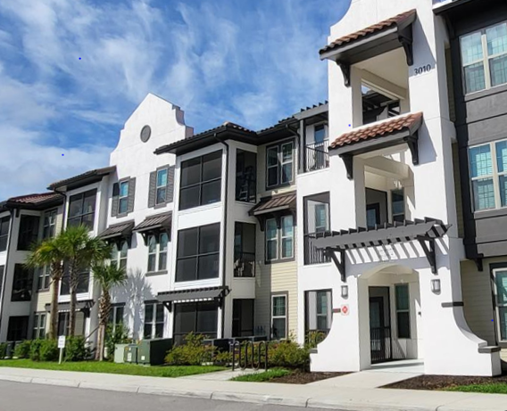
Pattern Book Examples
Projects must have consistent architectural theme

Slide 22

Placemaking Examples
New Projects

Slide 23
LDC Placemaking Standards
Public Art
Urban Green Space
Plaza
Identifiable Landmark
Hidden Off-Street Parking
Environmental Features
Traffic Calming Enhancements
Pedestrian Enhancements

Slide 24
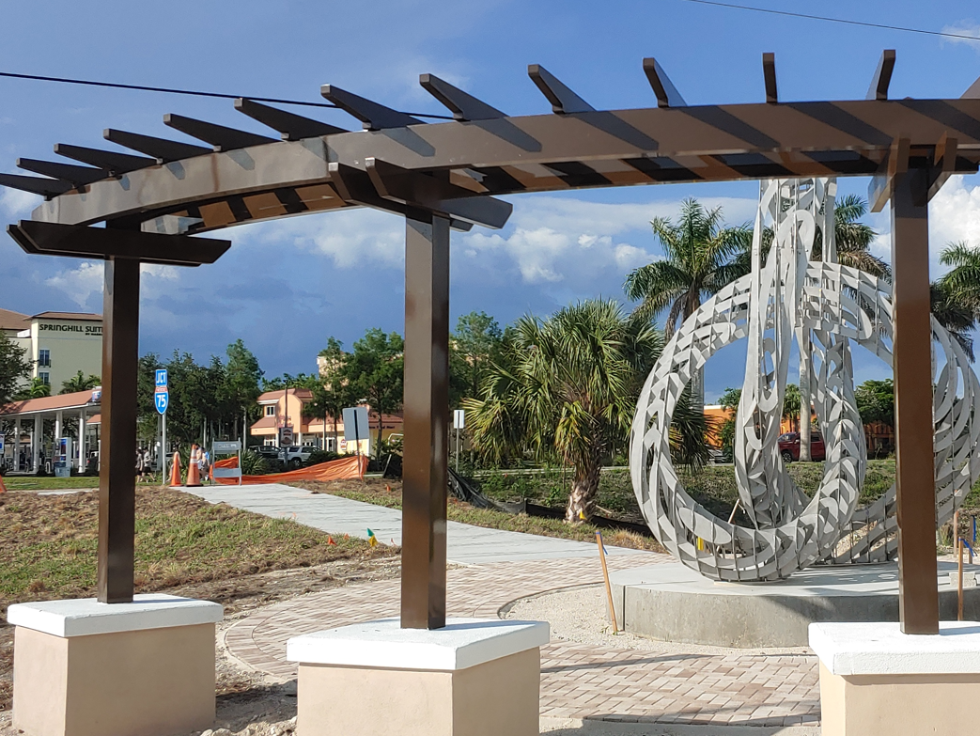
Stock Development Mixed Use Project
  Vertical Mixed Use
  Public Art
  Main Street area with on street parking
  Paseos
  Pedestrian Enhancements

Slide 25
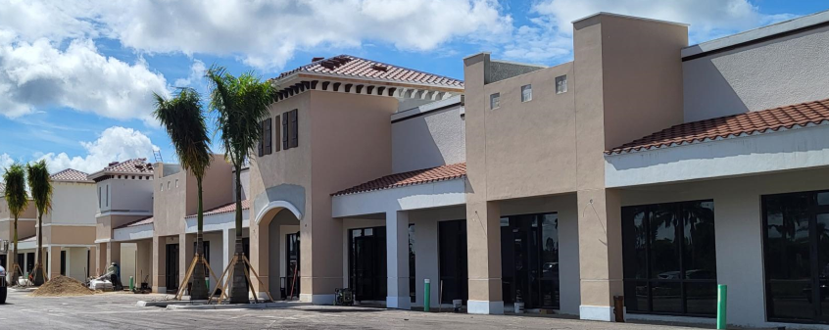
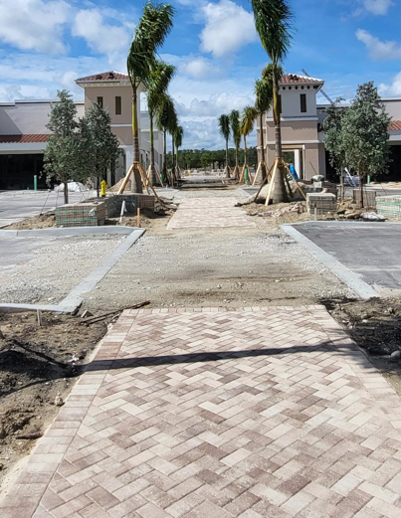
Stock Development Mixed Use Project
  Commercial portion under construction

Slide 26
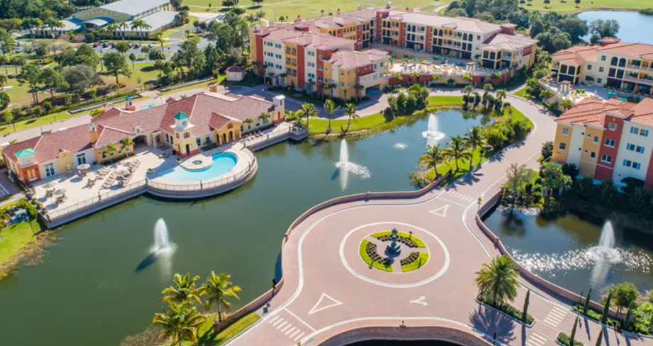
  Genova Condominiums
  Linear Park
  “Stealth” gates
  Contribution to build second access to Community Park

Slide 27
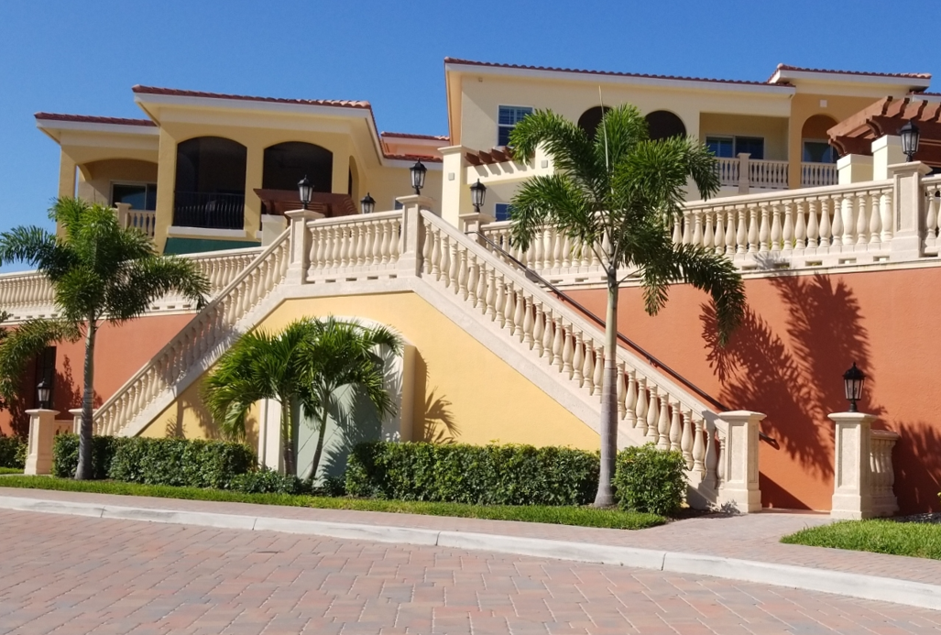
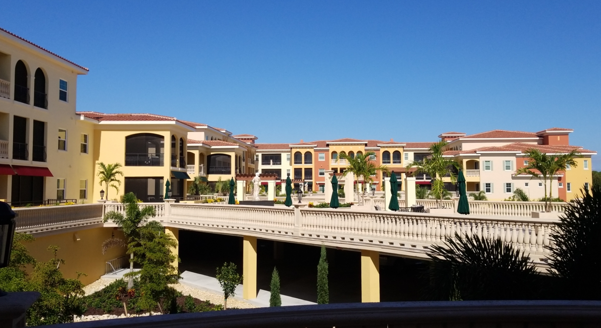
  Genova Condominiums
  Liner buildings to minimize “massing”
  Ped connections to community park
  Parking under buildings

Slide 28
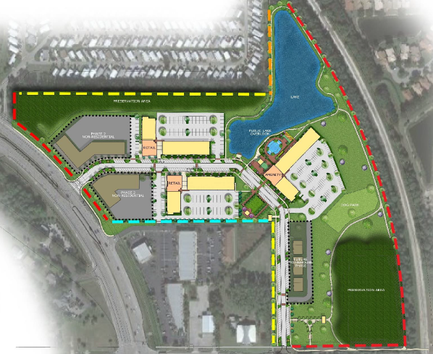
Downtown Estero
Located on
US 41
On Street Parking
Village Green Area
Main Street Area

Slide 29
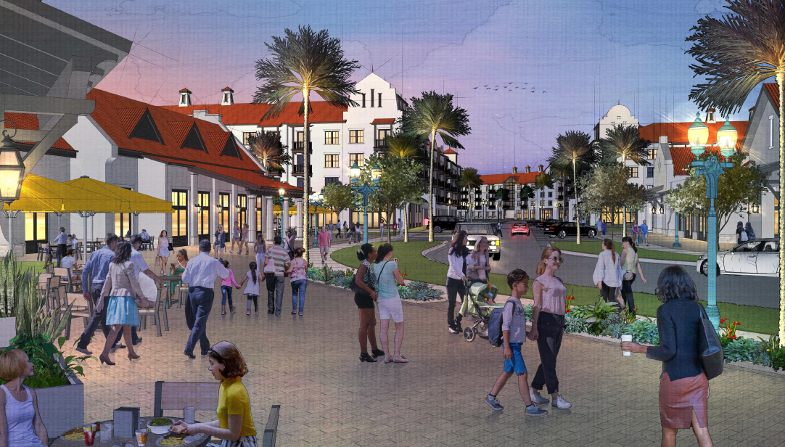
Downtown Estero
Mixed Use
Plaza
Consistent Architectural Theme

Slide 30
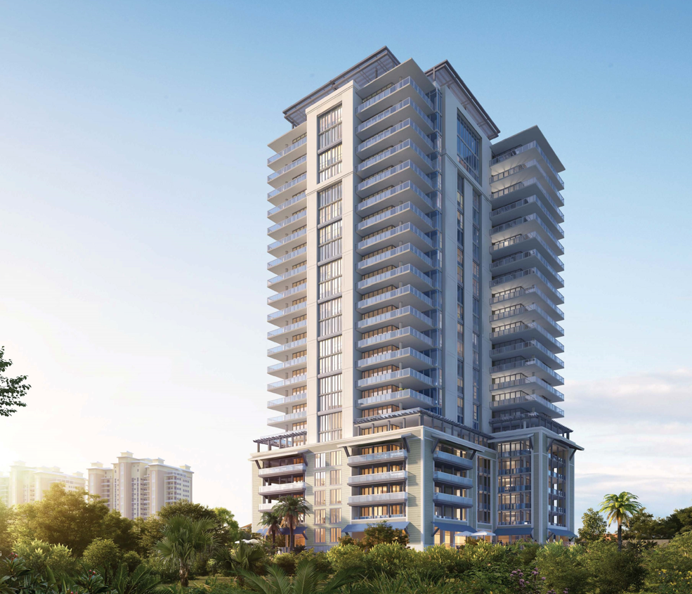
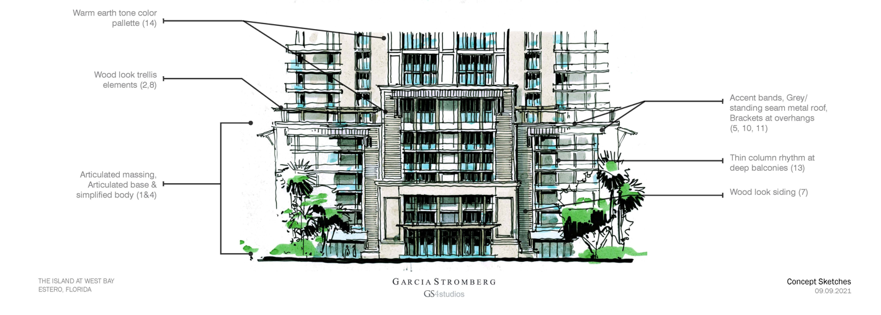
West Bay Club – High Rise

Slide 31
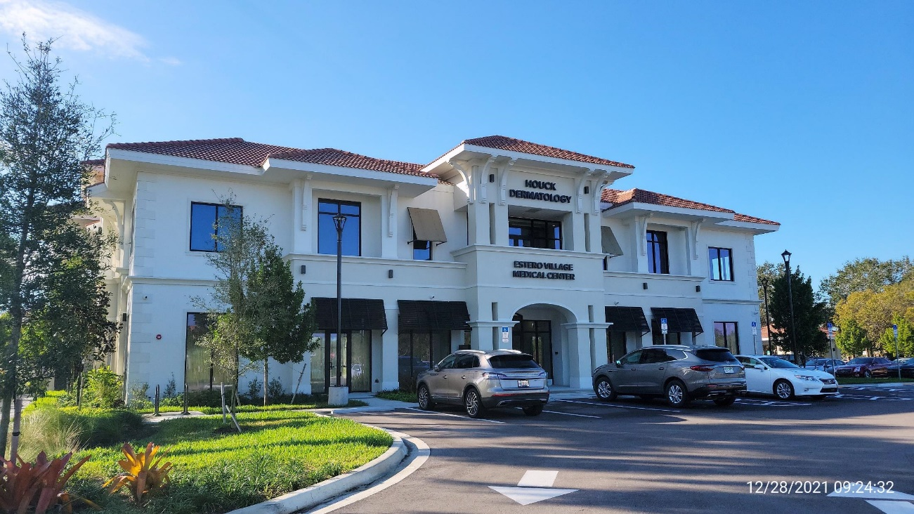
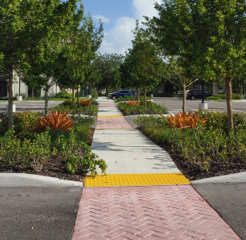
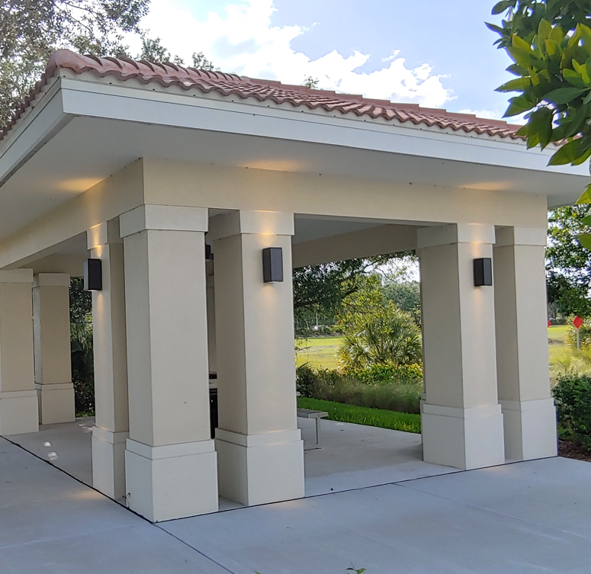
Houck Medical Office
Public gazebo
Pedestrian Connections
Design and Landscape

Slide 32
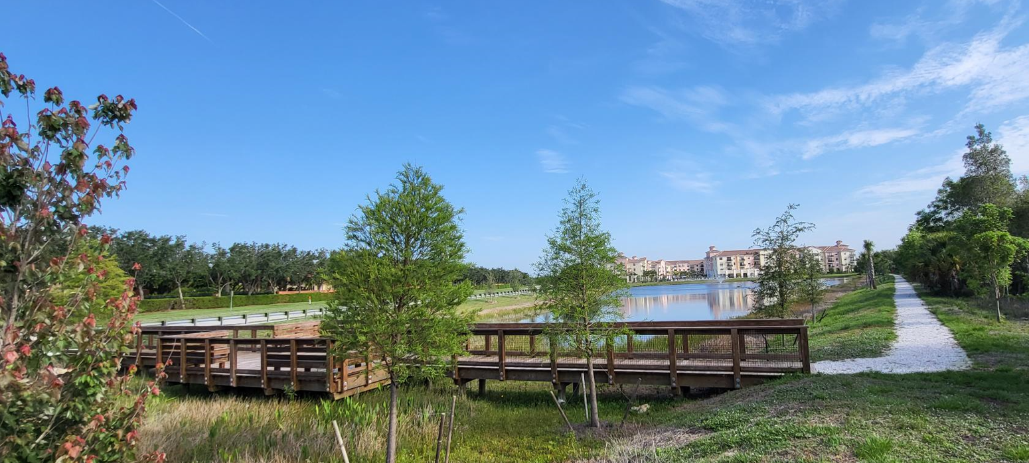
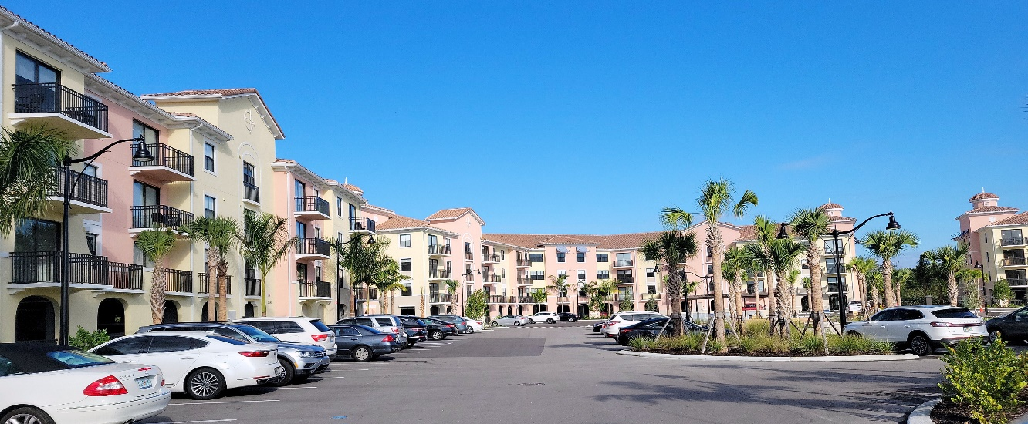
Edera - The Reserve at Coconut Point
Public amenity for increased density

Slide 33
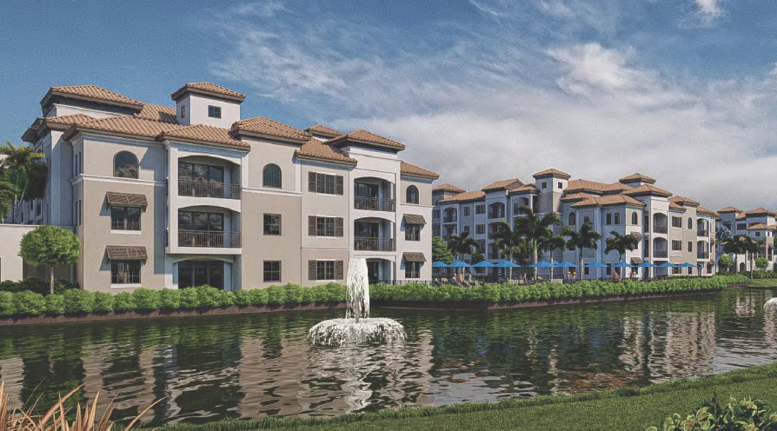
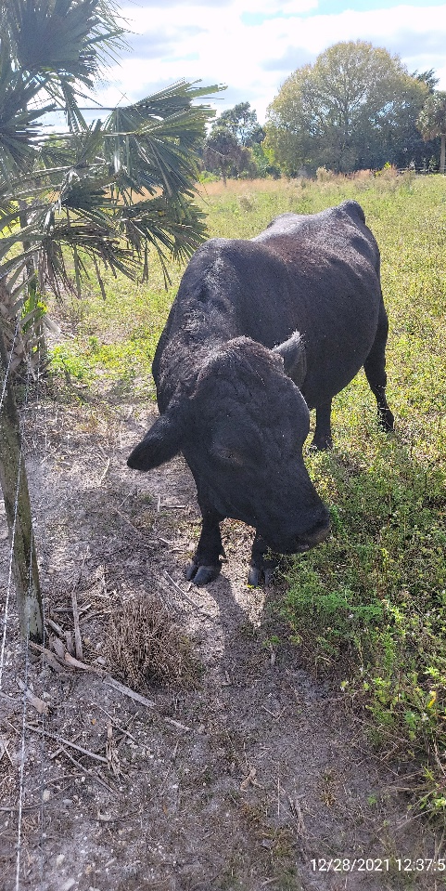
Via Coconut Mixed Use
I-acre Park Donation
Main Street area with Vertical Mixed Use
Median landscaping of Village road
Stepped back architecture with some hidden parking – not gated

Slide 34
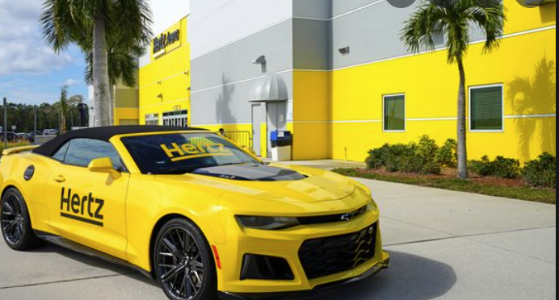
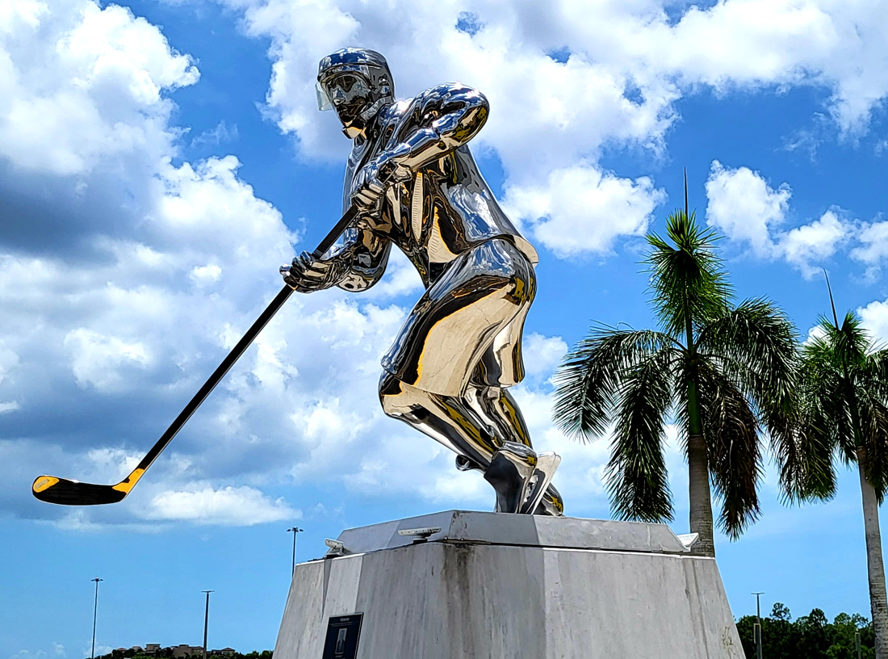
Example Under Old Code
Hertz Arena

Slide 35
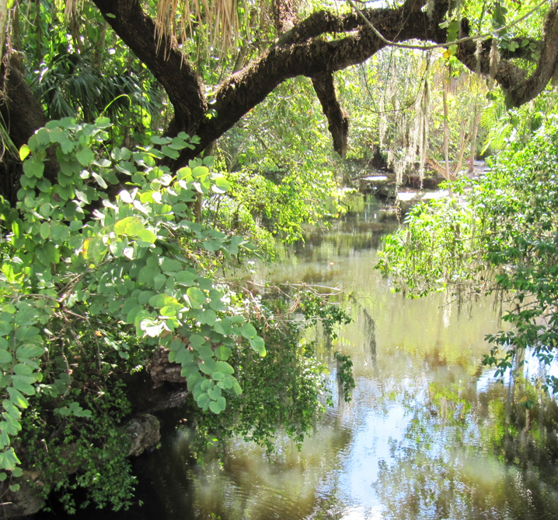
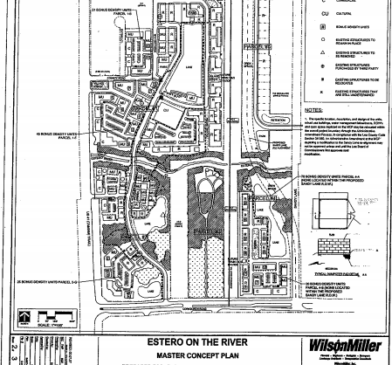
Recently Purchased
Village Property on Estero River
Public access to river
Preserve heritage trees
Complement Koreshan State Park

Slide 36

One Year Later…
Helpful Hints & Lessons Learned
“Hindsight is 20/20”
– Billy Wilder

Slide 37
Mary & Laura’s Top 10 Tips
10. Prepare a schedule and be prepared to abandon it
9. Include extra time for the unexpected (Covid, Holidays, etc.)
8. Designate a team member to monitor schedule and deadlines

Slide 38
Mary & Laura’s Top 10 Tips
7. Team members should set aside specific time periods to work on the project (Otherwise daily tasks and putting out fires takes precedence.)
6. Be mindful of existing property rights

Slide 39
Mary & Laura’s Top 10 Tips
Remember who will be interpreting the code
every day (not the attorney or consultant)
  Language must be clear
4. Don’t forget public involvement and interested parties

Slide 40
Mary & Laura’s Top 10 Tips
Have a “Transparent” process
- make information available
Keep your elected officials and advisory boards informed through meetings, workshops & updates or through an appointed “liaison”

Slide 41

Mary & Laura’s Top 10 Tips
1. what you do
This Photo by Unknown Author is licensed under CC BY-SA

Slide 42
Wait – You aren’t done yet!

Slide 43
Finalize Changes
Think about after code adoption
  Finalize changes
  Municode?
  Revisions to application forms and fees
  Consider “Glitch Bill”

Slide 44
Contacts / Links
Mary Gibbs, FAICP Laura DeJohn, AICP
Director, Community Development Director, Planning & Landscape Village of Estero Architecture
Johnson Engineering, Inc.
239-221-5036 239-229-1726
gibbs@estero-fl.gov ldejohn@johnsoneng.com
9401 Corkscrew Palms Circle 2122 Johnson St.
Estero, FL 33928 Fort Myers, FL 33901
LDC links
Village of Estero website
https://estero-fl.gov/land-development-code/
Municode
https://library.municode.com/fl/estero/codes/land_development_code

