Slide 1
Florida Planning and Zoning Association
Erin L. Deady, Esq., AICP, LEED AP
June, 2022
Copyright Erin L. Deady, P.A. 2022.

Slide 2
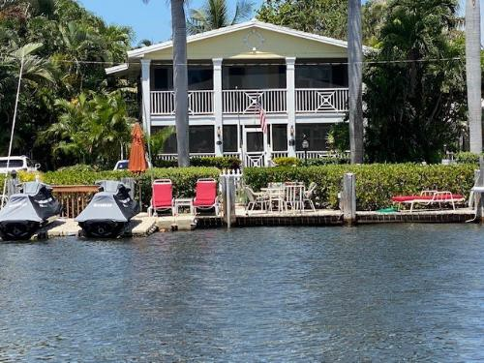
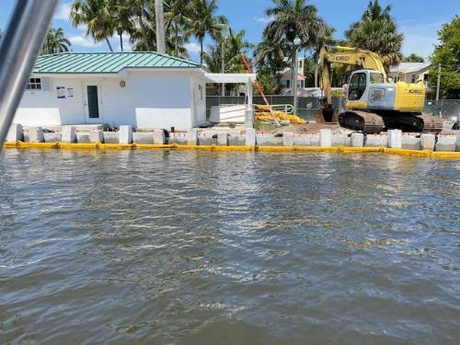
RESILIENCY-RELATED STATE LAW AND POLICY
Photo: Erin Deady
Photo: Erin Deady
Copyright Erin L. Deady, P.A. 2022.

Slide 3
FLORIDA POLICY ON GHG REDUCTIONS AND CLIMATE
 EO 07-127: Reduction of emissions to 2000 levels by 2017, to 1990 levels by 2025, and by 80% of 1990 levels by 2050
& California vehicle emission standards reductions (22% by 2012 and 30% by 2016).
 Building Efficiencies/Energy Code, Chapter 553, F.S. increasing standards
 HB 7123: Model Green Building Code (2007)
 HB 697 (GHG reduction strategies in local government’s Comprehensive Plan). Some requirements later eliminated.
 HB 7135 (State and Local Government Buildings “greener” and FF landscaping) (Section 255.2575 & 255.259, F.S.)
- many don’t realize this is law
 HB 7179 (PACE)- financing wind resistance/energy efficiency initiatives
 Adaptation Action Areas (2011)
 HB 7117 (Energy Bill- 2012)- increase solar output
 2015- 5 Bills Passing Related to flood insurance, wind insurance, construction standards/building codes, Citizen’s insurance, Peril of Flood (Section 163.3178, F.S.)
 2016- Solar Constitutional Amendments
 2017- SB 90 on solar disclosures and Amendment 4 Implementation & Natural Hazards coordination
 2020- Section 161.551, F.S. Sea Level Impact Projection Studies for state-funded projects (Rule 62S-7, F.A.C.)
 2021 & 2022- Section 380.093, F.S. Resilient Florida program (rulemaking in process)
21
Copyright Erin L. Deady, P.A. 2022.

Slide 4
SECTION 380.093, F.S.: RESILIENT FLORIDA
Copyright Erin L. Deady, P.A. 2021.
Section of the Law | Significance
Intent and definitions | Coastal and inland communities can participate Critical assets defined
Resilient Florida Grant Program | Items that can be funded (planning and projects) Standards for vulnerability assessments
Comprehensive Statewide Flood Vulnerability and Sea Level Rise Dataset and Assessment | Dataset to support a comprehensive statewide flood vulnerability and sea level rise assessment (inland and coastal infrastructure, geographic areas and vulnerable communities and their risk).
Statewide Flooding and Sea Level Rise Resilience Plan (local governments, flood control districts, regional resilience entities or WMDs). | Due to Legislature 12/1, 3-year planning horizon & ranked projects that address risks of flooding and sea level rise to coastal and inland communities. First one submitted for this year, December 1, 2021, will be a “preliminary plan” to address risks already identified in existing local government vulnerability assessment. 50% cost share unless disadvantaged community. Includes ranking criteria.
Regional Resilience Entities | Providing technical assistance to counties and municipalities, (b) coordinating multijurisdictional vulnerability assessments and (c) developing project proposals to be submitted for inclusion in the Statewide Flooding and Sea Level Rise Resilience Plan.
Florida Hub for Applied Research and Innovation (USF) | Lead institution and engage other academic and research institutions, private partners, and financial sponsors to coordinate efforts to support applied research and innovation to address the flooding and sea level rise challenges of the state
Annual assessment of Florida’s water resources and conservation lands | Expand the requirements of the existing annual assessment of Florida’s water resources and conservation lands (conducted by the Office of Economic and Demographic Research) to now include flooding information
21

Slide 5
Critical and Regionally Significant Assets
Definition: “Critical asset” includes:
1. Transportation assets and evacuation routes, including airports, bridges, bus terminals, ports, major roadways, marinas, rail facilities, and railroad bridges.
2. Critical infrastructure, including wastewater treatment facilities and lift stations, stormwater treatment facilities and pump stations, drinking water facilities, water utility conveyance systems, electric production and supply facilities, solid and hazardous waste facilities, military installations, communications facilities, and disaster debris management sites.
3. Critical community and emergency facilities, including schools, colleges, universities, community centers, correctional facilities, disaster recovery centers, emergency medical service facilities, emergency operation centers, fire stations, health care facilities, hospitals, law enforcement facilities, local government facilities, logistical staging areas, affordable public housing, risk shelter inventory, and state government facilities.
4. Natural, cultural, and historical resources, including conservation lands, parks, shorelines, surface waters, wetlands, and historical and cultural assets.
Definition: "Regionally significant assets" means critical assets that support the needs of communities spanning multiple geopolitical jurisdictions, including, but not limited to, water resource facilities, regional medical centers, emergency operations centers, regional utilities, major transportation hubs and corridors, airports, and seaports. (new this year)

Slide 6
SECTION 380.09, F.S.: RESILIENT FLORIDA
Requirements of subsection (3):
Assets covered (critical and regionally significant)
Types of mapping
Metadata
Tidal, storm surge and rainfall (and compound to the extent practicable)
Datum
Sea level rise scenarios
2040 and 2070
Two closest tide gauges (or one if using the highest of two)
This is indeed going to impact how projects are ranked and what does it mean? It means local governments are going to have to work cross-departmentally to identify “critical assets” and “regionally significant assets” in vulnerability assessments
IF YOU WANT TO BE COMPETITIVE FOR FUNDING.
21
Copyright Erin L. Deady, P.A. 2022.

Slide 7
HB 7053/SB 1940 Changes this Year
State Chief Resilience Officer Duties
Promote and coordinate flood resilience efforts in the state / provide trategic direction for interagency and cross-disciplinary initiatives and ID gaps in state activities
Work with federal, state, regional, and local entities and NGOs to align flood resilience and mitigation activity
Collaborate with the Florida Flood Hub for Applied Research and Innovation to incorporate future standards and projections regarding flooding and sea level rise into state projects and programs and improve utility of data products
Work with water management districts to innovate processes to bolster flood mitigation activities
Report to Governor and Legislature (with DEP)
Local governments that must copy with Peril of Flood provisions
Local governments that have completed vulnerability assessments
Geographic distribution of funded projects
Statewide inventory of basin-level planning efforts by water management districts or special districts
FDOT- Produce a Resilience Action Plan by June 30, 2023
Section 380.093, F.S. Changes-
Expansion to inland communities
Funding for preconstruction activity for city less < 10,000 or county < 50,000
Vulnerability assessments for rainfall induced flooding must include 100 year and 500 year storm events
Change date of comprehensive statewide flood vulnerability and sea level rise assessment to 2023
Disclosure of methodology for ranking projects in the Statewide Flooding and Sea Level Rise Plan
Eligible grant entities to now include special districts responsible for the management and maintenance of inlets and intracoastal waterways or for the operation and maintenance of a potable water facility, a wastewater facility, an airport, or a seaport facility.
Allows “grace period” for VA compliance supporting project submittals until 2023
Allows water management districts, drainage districts, erosion control districts, flood control districts and regional water supply authorities to submit projects for inclusion in the Statewide Flooding and Sea Level Rise Plan.

Slide 8
VULNERABILITY ASSESSMENTS & ASSETS
Best available data on assets is important:
GIS locations
Top of structure elevations
Invert elevations
Locations of controls and supporting components
Severity of impacts to system
How many structures?
How many impacted v. overall total?
What flood zone are they located in?
What is the projected year of impact?

Slide 9
PERIL OF FLOOD LEGISLATION
Section 163.3178(2)(f), F.S.: A redevelopment component that outlines the principles that must be used to eliminate inappropriate and unsafe development in the coastal areas when opportunities arise. The component must:
 1. Include development and redevelopment principles, strategies, and engineering solutions that reduce the flood risk in coastal areas which results from high-tide events, storm surge, flash floods, stormwater runoff, and the related impacts of sea-level rise.
 2. Encourage the use of best practices development and redevelopment principles, strategies, and engineering solutions that will result in the removal of coastal real property from flood zone designations established by the Federal Emergency Management Agency.
 3. Identify site development techniques and best practices that may reduce losses due to flooding and claims made under flood insurance policies issued in this state.
 4. Be consistent with, or more stringent than, the flood-resistant construction requirements in the Florida Building Code and applicable flood plain management regulations set forth in 44 C.F.R. part 60.
 5. Require that any construction activities seaward of the coastal construction control lines established pursuant to s. 161.053 be consistent with chapter 161.
 6. Encourage local governments to participate in the National Flood Insurance Program Community Rating System administered by the Federal Emergency Management Agency to achieve flood insurance premium discounts for their residents.

Slide 10
RELATIONSHIP BETWEEN PERIL OF FLOOD, SLIP AND RESILIENT FLORIDA
 Approximately 50% of local governments have completed Peril of Flood amendments (for those that have a Coastal Element)
 Previous DEP grant program (RPGs) prioritized Peril of Flood compliance as a funding area; still does in RF legislation. Section 380.093, F.S.: (3) Subject to appropriation, the department may provide grants to a county or municipality to fund the costs of community resilience planning and necessary data collection for such planning, including comprehensive plan amendments and necessary corresponding analyses that address the requirements of s. 163.3178(2)(f)… (3)(d) (d) A vulnerability assessment conducted pursuant to paragraph (b) must include all of the following, if applicable: 1. Peril of flood comprehensive plan amendments that address the requirements of s. 163.3178(2)(f), if the county or municipality is subject to such requirements and has not complied with such requirements as determined by the Department of Economic Opportunity.
 SLIP studies required under Section 161.551, F.S. & Rule 62S-7, F.A.C. if project receives state funding. Use of SLIP tool formulated by DEP recommended.
 Bottom line: The policy and technical environments are aligning driven by funding $$$ opportunities to adapt and maintain infrastructure in the face of increasing flooding-related threats.

Slide 11
Definitions/authority for AAA
Definition: “Adaptation action area” or “adaptation area” means a designation in the coastal management element of a local government’s comprehensive plan which identifies one or more areas that experience coastal flooding due to extreme high tides and storm surge, and that are vulnerable to the related impacts of rising sea levels for the purpose of prioritizing funding for infrastructure needs and adaptation planning. S. 163.3164(1), F.S.
Authority: At the option of the local government, develop an adaptation action area designation for those low-lying coastal zones that are experiencing coastal flooding due to extreme high tides and storm surge and are vulnerable to the impacts of rising sea level. Local governments that adopt an adaptation action area may consider policies within the coastal management element to improve resilience to coastal flooding resulting from high-tide events, storm surge, flash floods, stormwater runoff, and related impacts of sea-level rise. Criteria for the adaptation action area may include, but need not be limited to, areas for which the land elevations are below, at, or near mean higher high water, which have a hydrologic connection to coastal waters, or which are designated as evacuation zones for storm surge. S. 163.3177(6)(g)(10), F.S.

Slide 12
A Case Study: AAA Approach & Maps
3 Types of AAAs:
1. Infrastructure/Assets AAA- Example Policies to address structures, assets & facilities
2. Residential Neighborhood AAA- Example Policies to address private development
3. Natural Resources AAA- Example Policies to address habitat/shoreline
Review results of the vulnerability assessment for the year 2040 and determine the scope of the sea level rise impacts (based on NOAA Intermediate High 17” or other projection) for that particular type of AAA. Those results and analysis will provide the basis for the mapping component of the example AAAs. Key team discussions have included the following basic goals for the AAA map series:
Residents should be able to look at the maps and easily determine if they are within or outside of that particular AAA.
Lines should generally follow streets or other easily understandable “markers”. For instance, a demarcation of everything NOAA Intermediate High by 2040 (17”) serves as the basis for an AAA, but the actual “line” where that inundation falls based on tidal conditions and land elevation may have to be altered so it does not cut across someone’s property where a portion of the property is in and also out of the AAA at the same time.
For infrastructure/assets: Generalized land area and specific structures can be identified within an AAA.
A manageable number of AAAs and maps at a scale to see impacts.

Slide 13
Example Monroe County AAA Approach & Maps
Objective 1.0 - The County shall improve resiliency and address vulnerabilities through the establishment of Adaptation Action Areas (AAA), or a similar geographic concept as defined by the County, to identify areas within the County that experience coastal flooding, storm surge and sea level rise and use the AAAs to provide targeted strategies improving resilience, reducing risks, prioritizing funding, creating adaptation planning standards and sharing information.
Type of AAA | Number of AAAs | Information
Infrastructure and Assets | 7 | Includes roads, utility facilities, government and institutional buildings & impacted Heritage Trail
Residential Neighborhoods | 15 | Number of lots by type: Residential: 5167 Vacant: 2361 Commercial: 84 Government: 12 Utilities: 6
Natural Resource | 10 | Acres of Land that are not Tier 1 (environmentally sensitive land) in Natural Resource AAA: Tier 1: 12156.408 Acres Tier 2, Tier 3, or Tier 3A: 544.875 Acres No Tier - Military Designation:2067.310 Acres (This is on the naval air station island near Key West)

Slide 14
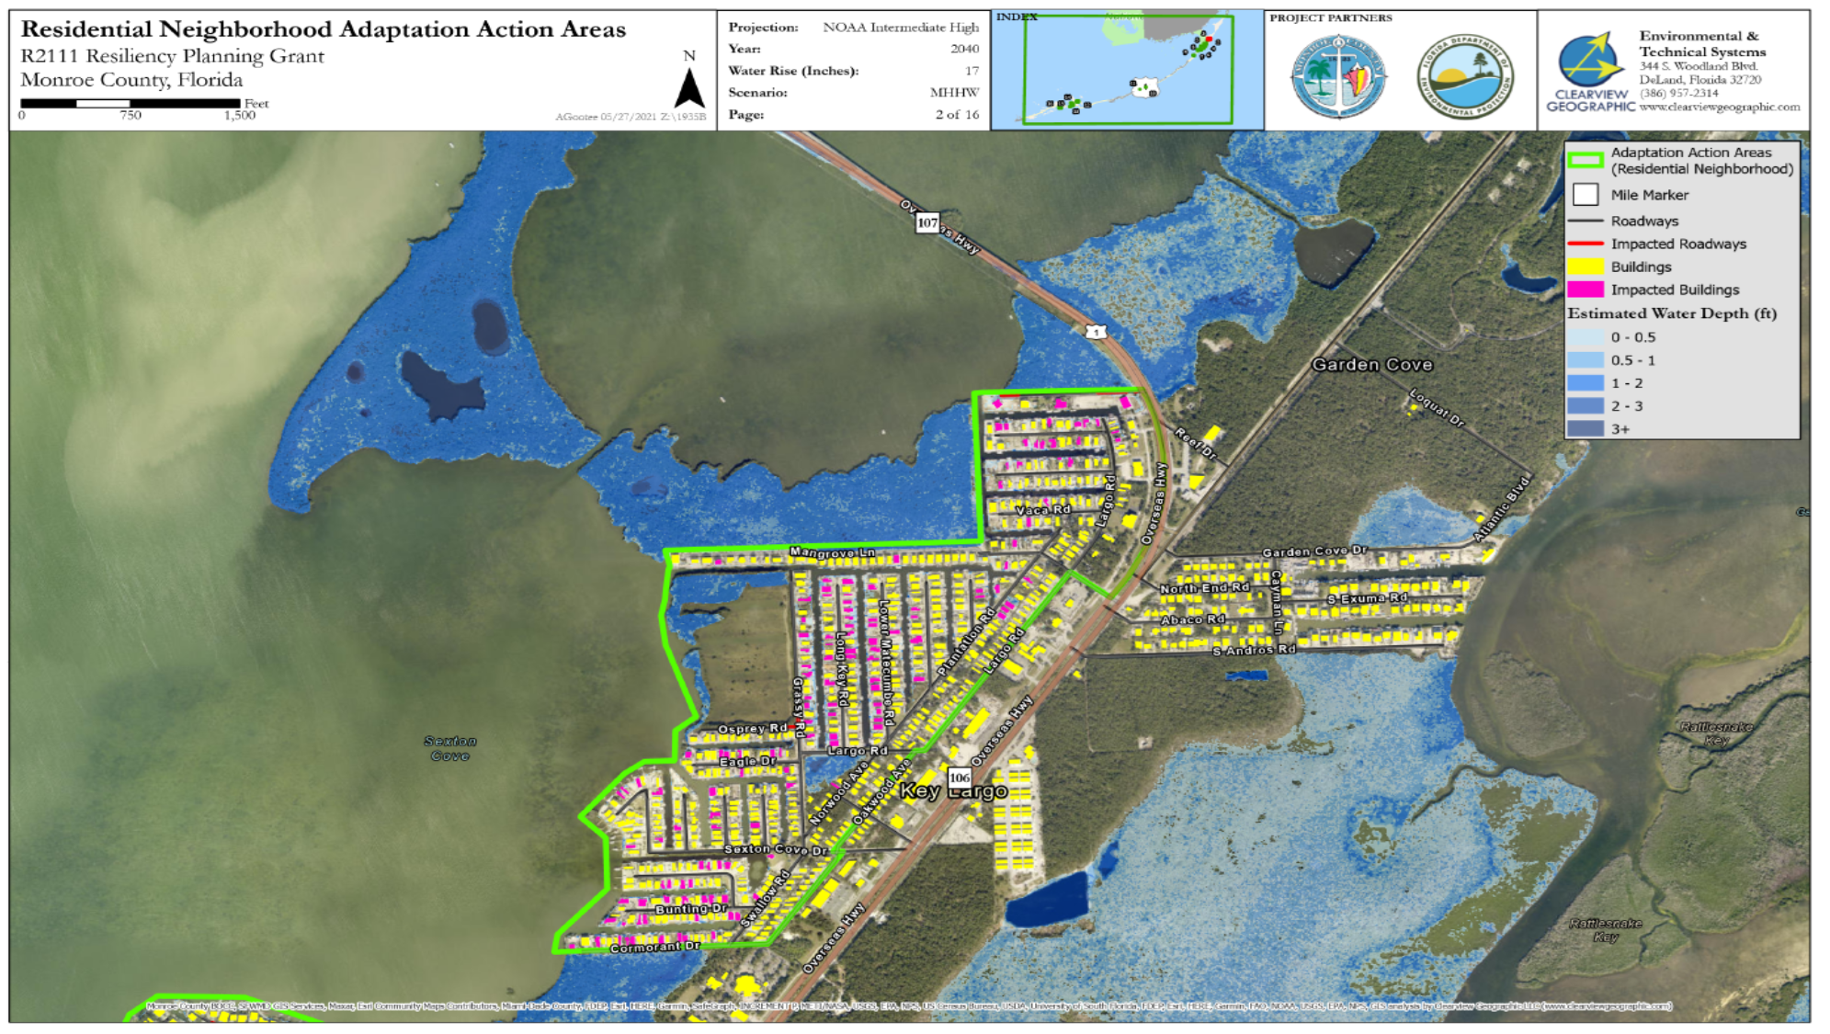
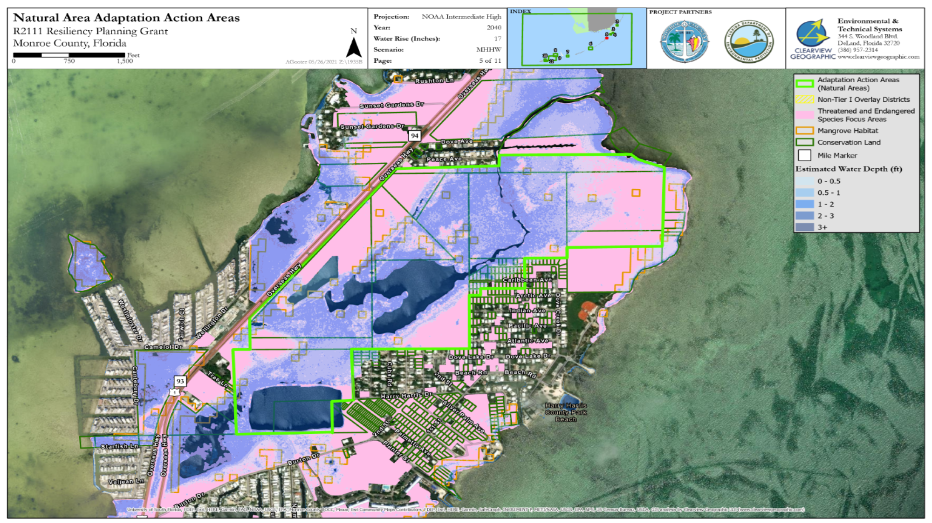
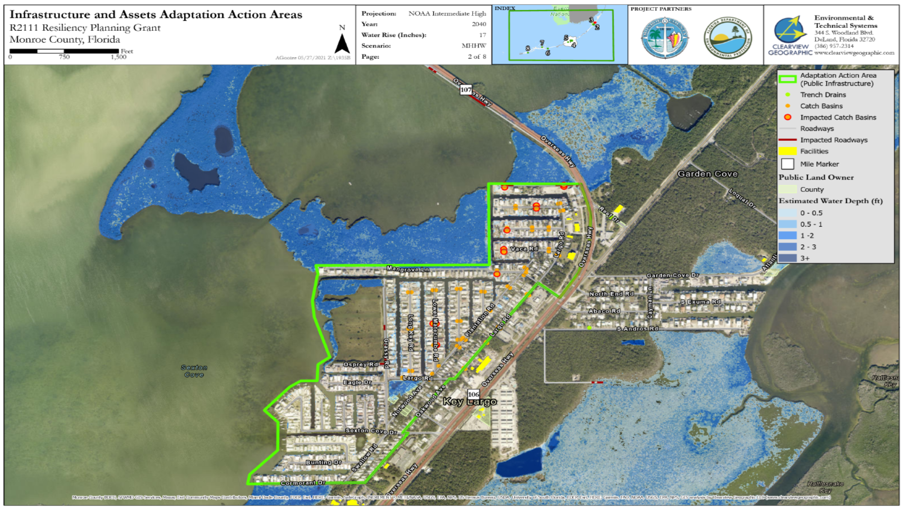
Case study for AAAs- Supporting Maps

Slide 15
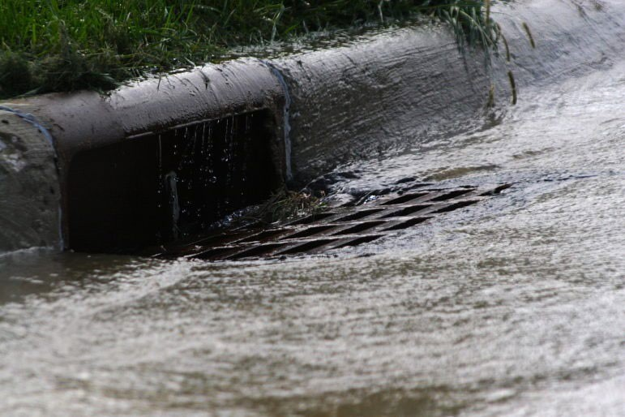
EXAMPLES OF OTHER EVOLVING LAWS & REGULATIONS
Freeboard
Section 553.73(5), F.S. was amended in 2010 to allow communities to adopt local administrative amendments to implement the flood provisions of the FBC and local technical amendments to adopt flood provisions that are more stringent than the FBC (also called “higher standards”).
Photo: Robert Lawton
Confluence of water quality and stormwater design?
In 2020, the Florida Legislature passed Senate Bill 712, also known as the Clean Waterways Act, now Chapter 2020-150, Laws of Florida and directed DEP and WMDs to update stormwater design and operation regulations under Part IV, Chapter 373, Florida Statutes (F.S.), using the latest scientific information.
Local Level of Service or Design Standards
Tailwater elevations for stormwater, stormwater retention, road elevation standards
Shorelines
Seawalls, living shorelines, hybrid structures, shoreline protection zones or overlays
Copyright Erin L. Deady, P.A. 2022.

Slide 16
OTHER REGULATORY & POLICY ISSUES FOR SLR AND RESILIENCY
Scope | Entity | Issues
Road abandonment | Section 336.09 and 336.125, F.S. | Is local procedure in Code same as statutory requirements or does it require more?
Greenbook Standards | FDOT- Section 336.045, F.S. | Minimum standards for design, construction, and maintenance of roads, which are published in the “Manual of Uniform Minimum Standards for Design, Construction, and Maintenance for Streets and Highways”. The Greenbook is intended for all projects not on the state and national highway systems (+ design exceptions).
Road/Drainage permitting | WMD- ERP Criteria | WMD does not DIRECTLY regulate sea level rise in design, but applicant may need to respond to functionality questions during permitting process (can address quality and management of quantity).

Slide 17
OTHER REGULATORY & POLICY ISSUES FOR SLR AND RESILIENCY
Scope | Entity | Issues
Stormwater criteria | DEP/WMDs | Current rulemaking to strengthen quality component of ERP program which hasn’t been updated in decades. Climate and sea level rise issues likely a discussion. Quantity = quality. Absolutely no mention in DRAFT TAC Report of how tidal flooding and increased precipitation from climate change will impact the efficacy of STW management systems.
State delegation of 404 | Corps to State | Still playing out and not likely to be a factor unless wetlands mitigation is involved.
SLIP Copyright Erin L. Deady, P.A | DEP . 2021. | Sea Level Impact Projection (SLIP) rulemaking ongoing to require sea level analysis for projects receiving ANY state funds. Local government use of tool (for design standards in Code?)

Slide 18
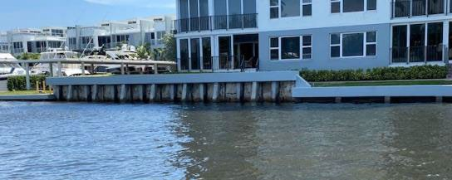
SEAWALL REGULATIONS (ONLY TWO EXAMPLES)
City of Miami | Broward County
6’NAVD and 8’ NAVD SLR by 2070 | Prior to 1/1/2035 = 4’ but must accommodate 5’ by 1/1/2050
Substantial Repairs can trigger compliance; 50% length, repairs > 50% cost of new seawall or BH or elev. change > than 50% length | Substantial Repairs can trigger compliance; > 50% length or appurt. structure > 50% value
Defines disrepair | Defines disrepair
Specifies materials; Promote living shorelines | Promote enhancing habitat
POs are prohibited from tidal water entering property to flow to adjacent properties or public ROW | POs are prohibited from tidal water entering property to flow to adjacent properties or public ROW (trespass of water = public nuisance)
Code enforcement + initiate abatement w/in 180 days and begin repairs w/in 265 days; complete in 18 months | Failure to maintain = violation; progress within 60 days and complete w/in 265
 | Allows automatically elevated structure not dependent on human intervention
 | Disclosure on tidally influence area and meeting min. barrier elevation stds.
Photo: Erin L. Deady
Important points: We don’t just want seawalls elevated everywhere, we want to encourage habitat and water quality benefits.
Tampa Bay Regional Planning Council is developing a Model Shoreline Ordinance for use by local governments addressing living shorelines, hybrid structures and seawalls through an overlay.
Copyright Erin L. Deady, P.A. 2022.

Slide 19
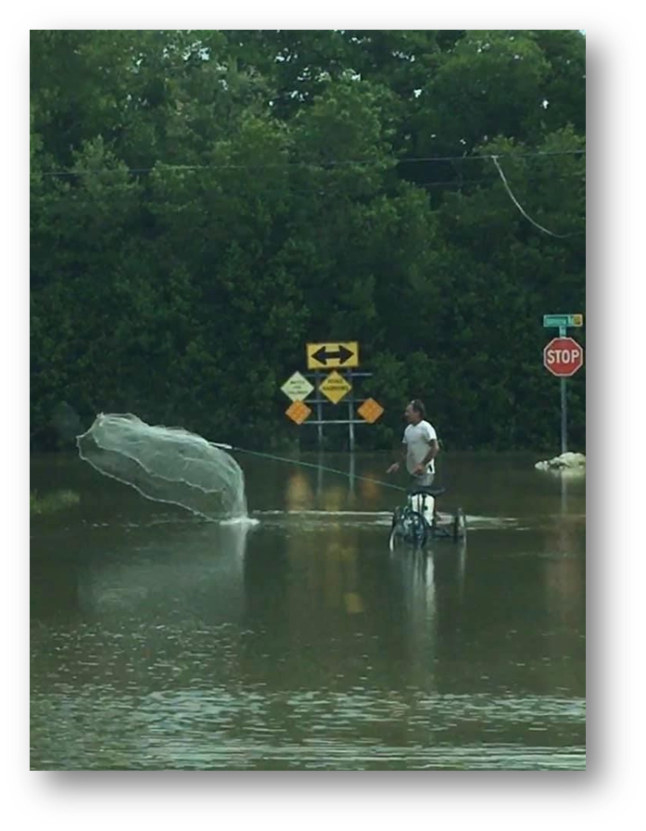
What does existing voluntary real estate disclosure cover for flooding?
3. Water Intrusion; Drainage; Flooding:
(a) Has past or present water intrusion affected the Property? Yes No Unknown
(b) Have past or present drainage or flooding problems affected the Property? Yes No Unknown
(c) Is any of the Property located in a special flood hazard area? Yes No Unknown
(d) Is any of the Property located seaward of the coastal construction control line? Yes No Unknown
(e) Does your lender require flood insurance? Yes No Unknown
(f) Do you have an elevation certificate? If yes, please attach a copy. Yes No Unknown
(g) If any answer to questions 3(a) - 3(d) is yes, please explain:__________________________________

Slide 20
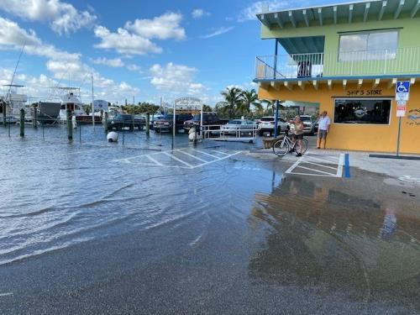
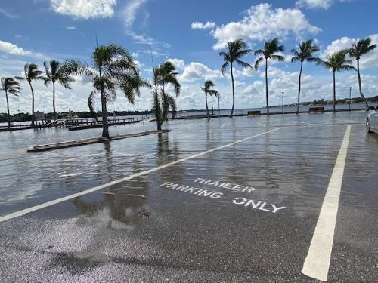
OTHER DRIVERS: LEGAL OBLIGATIONS TO MAINTAIN INFRASTRUCTURE
Photo: Erin Deady
Photo: Erin Deady

Slide 21
SOME OF THE BIG LEGAL AND POLICY ISSUES
 Overview of some of the big takings issues:
 Liability for takings for failure to maintain with reasonable care (St. Johns County)
 Nuisance for seawall induced flooding (can be nuisance to private or public property owners or infrastructure)
 Takings determinations factoring in benefits of “adaptation” (Borough of Havey Cedars v. Karan, 214 N.J. 384 (2013)).
 Levels of service/torts:
 Duty to maintain v. upgrade infrastructure: what is “maintenance” with continued tidal inundation and flooding impacts?
 Apportioning costs: who pays for what level of service when everyone is not receiving the same?

Slide 22
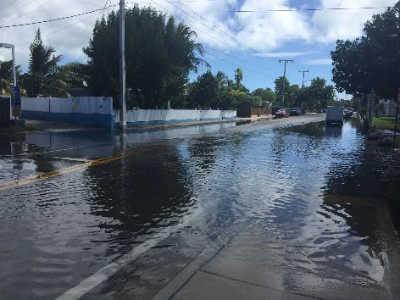
STATE OF SLR-RELATED CASE LAW
 There is currently no case law in the State of Florida that directly addresses government liability when flooding damages private property as a result of sea level rise.
 However, there is existing, helpful case law regarding the construction and maintenance of infrastructure projects, such as roads and drainage and other assets, which can provide some assistance in determining what responsibility a government entity (GE) has for managing flooding in general.
 A GE has a responsibility to maintain the infrastructure and assets it owns, builds, and maintains, but there is some uncertainty about what that responsibility may be in response to a condition it does not control – sea level rise and the government has not “acted” to create.

Slide 23
CAUSES OF ACTION: TORTS V. TAKINGS
Torts:
 It depends on whether the injury was caused by operational- or planning- level conduct on the part of the GE.
 GEs can be liable to property owners where there is a breach of duty in the course of executing adopted policy (operational-level conduct), but Florida courts typically do not tread into the purview of a GE’s discretion to engage in legislative or executive functions (planning-level conduct).
 Example: the Hurricane Harvey “dam” cases against the Corps [or insert drainage district or whoever “let” infrastructure fail]….
Takings:
 If a GE experiences a benefit from the use of private land at the expense of a protected property interest that is infringed upon or damaged due to a GE’s actions, a taking may arise.
 Takings inquiries are heavily fact- specific, but where a GE project diverts traditional floodwaters onto private property such that an involuntary servitude arises, a finding of inverse condemnation is likely.

Slide 24
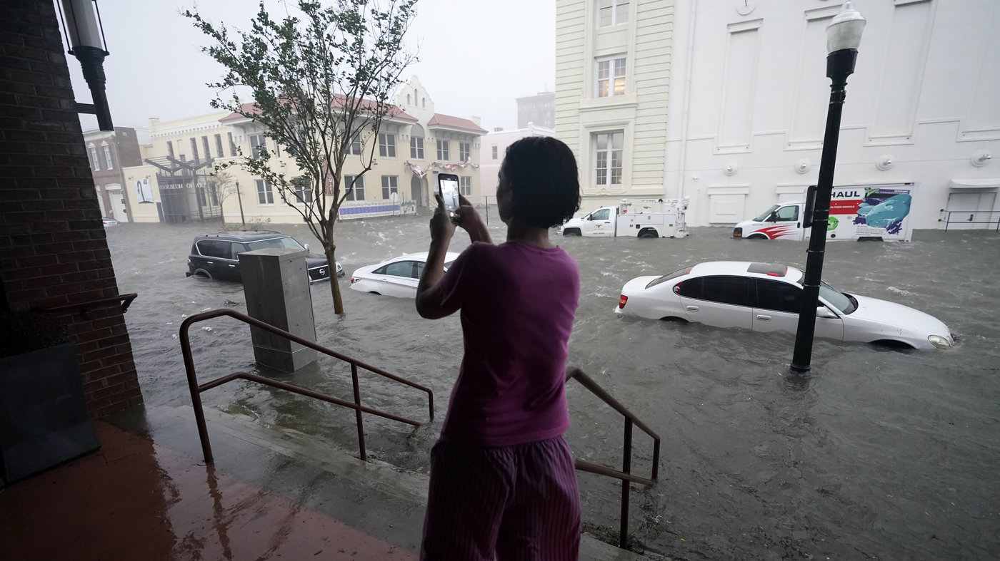
What “Flooding” Are We Talking About?
Road Design must account for rainfall driven flooding (regulated by WMDs and other design factors) and sea level rise (not regulated by WMDs) based on conditions in the future, not in the past
Monroe BOCC Presentation 11/20/20
NPR (Pensacola), 9/16/20

Slide 25
ROAD ELEVATION / STORMWATER TAKINGS CASE (VARCAMP V. MIAMI BEACH)
 Varcamp requests court to declare City’s actions related road elevation a taking under U.S. Constitution, determine value of taking and grant plaintiff’s claims for inverse condemnation + attorney’s fees. Parties in discussions, service extended to 4/2/22.
 Varcamp arguments
 1. Properties drain onto 14th Street and West Avenue
 2. City significantly elevated road
 3. Property owners allege they now flood violating Article X, §6 of the Florida Constitution
Issue | Disposition
Complaint filed | Case filed 8/5/21- no disposition yet. No response from City as of yet.
Actions by City | Cause “permanent” flooding on plaintiff’s properties eliminating long held drainage rights without compensation and have deprived plaintiff’s of “all” beneficial use of property
Case law relied up | Kendry v. State Road Dept (1968), “…“[c]onstruction by the state which causes flooding on abutting private property may constitute a taking where flooding is a permanent invasion of land amounting to an appropriation….”
Copyright Erin L. Deady, P.A. 2022.

Slide 26
FUNDING STRATEGIES FOR RESILIENCY
Taxes
Direct taxes (i.e., property taxes) and indirect taxes (i.e., sales taxes and use taxes) levied for lawful public purpose. Local discretionary sales surtaxes ie; infrastructure + resiliency?
Assessments/Special Districts
Charge against property receiving 1) special benefit and 2) fairly apportioned. Authorized by specific statutes or home rule authority.
Bonding
General Obligation (full faith and credit of an issuer with taxing power) and Revenue (payable with specific sources of revenue ie; utilities).
Fees for the impact of new development (link between additional facilities and growth.
“Tax increment“: the difference between the assessed value of the property before and after the redevelopment project.
Impact Fees or TIF
User Fees
Payments for voluntarily purchased services which benefit the specific individual to the exclusion of non-feepayers such as stormwater utility.
Grants
New trends include: disaster recovery funds for resiliency and infrastructure; traditional uses to address stormwater, septic and water quality; moving from planning to implementation.
Copyright Erin L. Deady, P.A. 2022.

Slide 27
MIAMI BCH STORMWATER ASSESSMENT (SETAI V. MB)-2019-022086-CA-01
 Plaintiffs seek restitution for stormwater utility payments
 Challenges stormwater utility fee:
 1. Declaratory judgment that City’s stormwater fee is invalid (disproportionate impacts in fee calculation)
 2. Restitution for illegally assessed tax
 3. Breach of contract
 City filed MTD denied 3/2020
 Plaintiffs filed two amended complaints and case is still in discovery
Issue | Argument
Invalid fee-method of calculation for ERU disproportionately impacts commercial and multi-family property owners. | Section 403.031(17), F.S. requires stormwater fees be charged based on relative contribution to the need for stormwater system. Different rates okay but can’t be arbitrary or unreasonable. Using data about residential impervious surface area to calculate fees and lumping property types together (resi & comm) does not reflect commercial property contribution and must be invalidated (reliance on: City of Gainesville v. State, 63 So. 2d 138 (2003)).
Restitution | Local government must refund illegally assessed tax if it was not paid voluntarily (reliance on: City of Key W. Key West Golf Club Homeowners' Association, Inc., et al., 81 So. 3d 494, 500 (Fla. 3d DCA 2012)).
Breach of contract | Plaintiffs are City utility customers and receive services on the basis of contracts which were materially breached by City with imposition of improper fee (reliance on S. 403.031(17), F.S.).

Slide 28
KEY BISCAYNE BOND CHALLENGE (TELLEZ V. VILL OF KB)
 Tellez seeks to nullify $100 Million bond for the purpose of “financing costs of improvements relating to mitigating the effects of sea level rise and flooding, protecting the Village’s beaches and shoreline and hardening infrastructure to the effects of hurricanes”
 Challenges referendum (on primarily procedural grounds):
 1. Village improperly borrowed more without an ordinance
 2. Voters asked “for” or “against” the bonds v. “yes” or “no”
 3. Ballot language confusing and the Village Reso approving Referendum did not contain the projects articulated on Village website
Issue | Disposition
Ordinance | Village hasn’t borrowed any money yet. When it does, it needs to pass an ordinance (Section 4.03(b) of Village Charter).
For/against v. yes/no | Voters must be “afforded an opportunity to express themselves fairly”- here yes. State v. Special Tax Sch. Dist. No. 1 of Dade Cty., 86 So. 2d 419, 419 (Fla. 1956).
Confusing language | Court says no: language clear (see purpose above) and plaintiff failed to meet clearly and conclusively defective language standard. Metro Dade Cty. V. Shiver, 365 So. 2d 210, 213 (Fla. 3d DCA 1978).

Slide 29
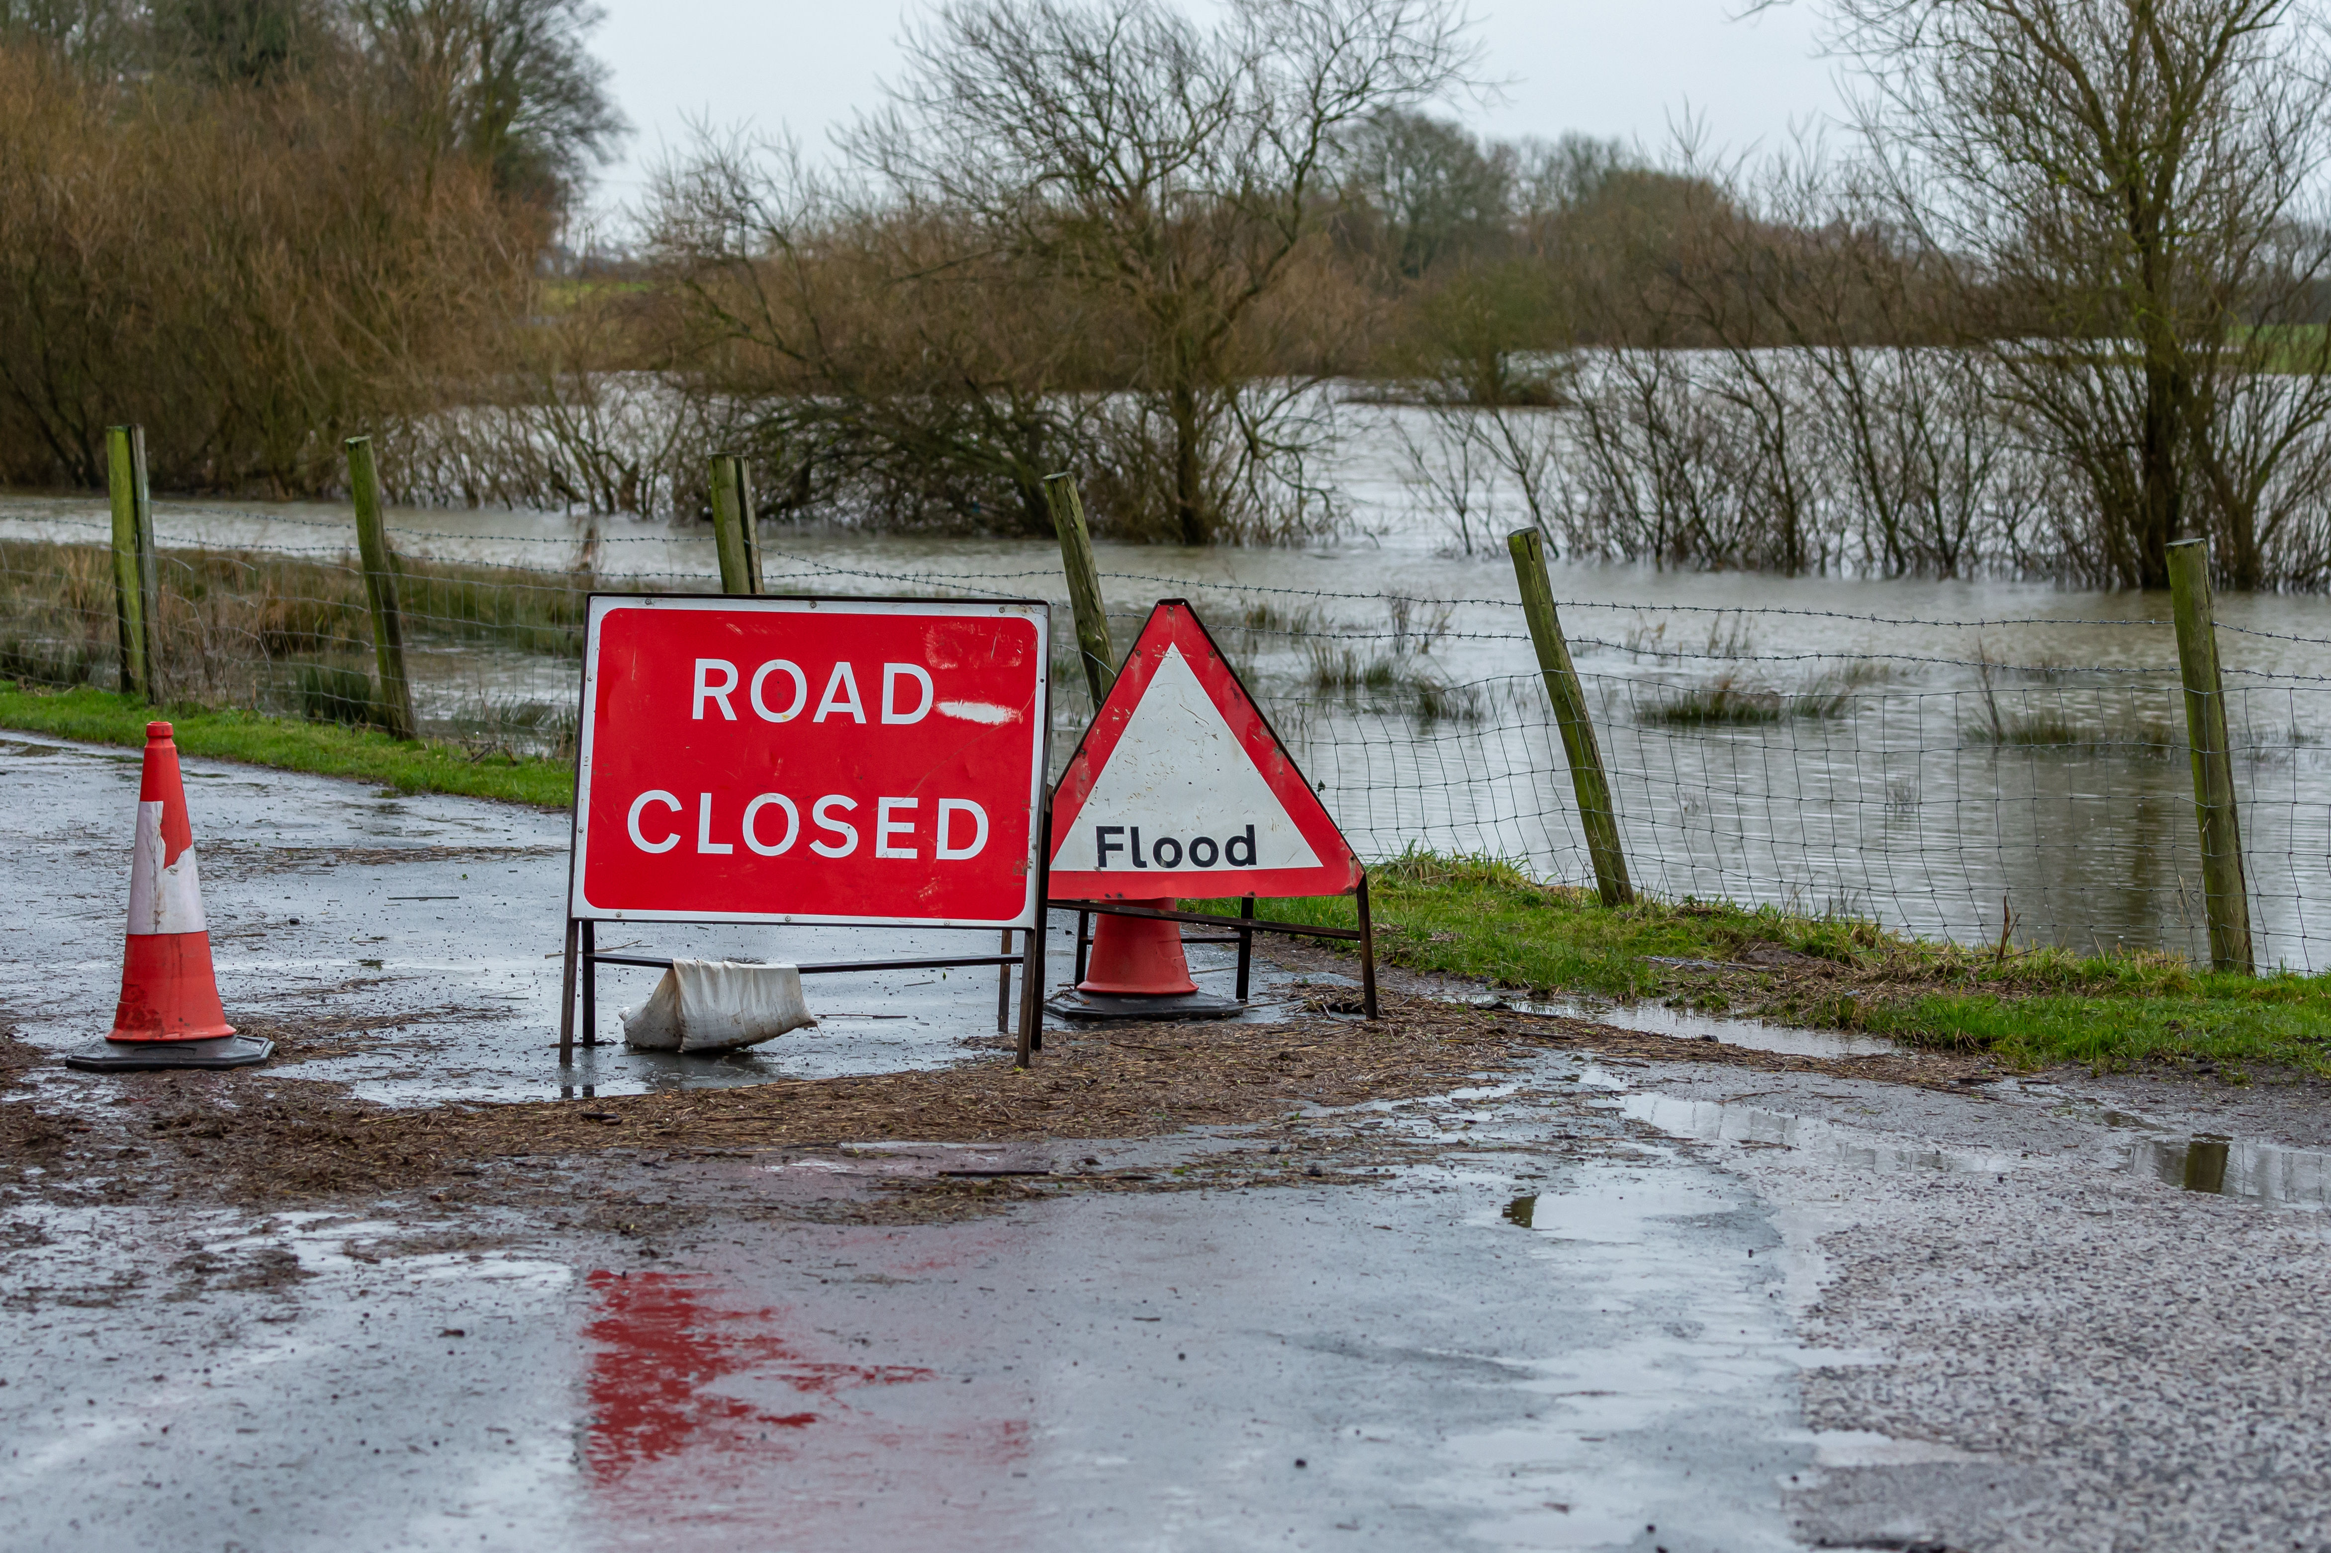
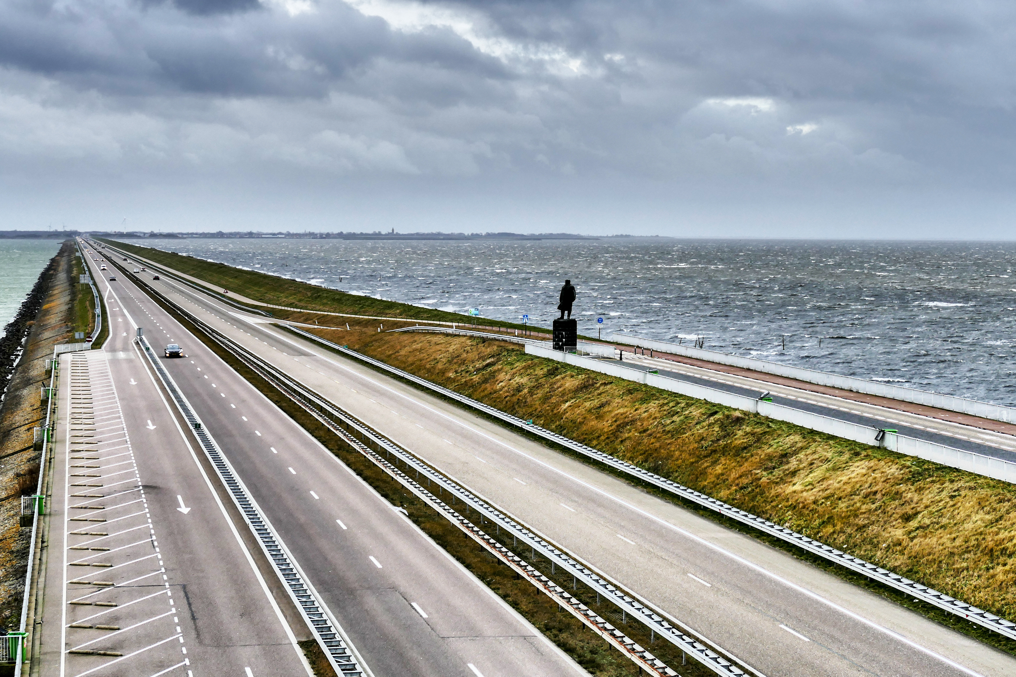
Initial Recommendations from the cases
Noticing to public:
Road design can contemplate a periodic flooding condition but lessens the extent of it, the GE may have a duty to warn the public of those flooding conditions. This could be accomplished through signage indicating periodic flooding conditions.
Another way to warn the public may be through some type of designation and publication of a map series that indicates those areas may be subject to periodic tidal flooding from sea level rise, and as such, may not receive the same level of flood service for flood mitigation as in other locations in the County. AAAs?
Prudent measures:
What is clear is that takings cases are heavily fact-specific and this lends value to planning efforts for sea level rise adaptation including acknowledging the existing known seasonal or tidal flooding impacts already occurring during King Tides and normal high tides and incorporating “prudent measures” into the design process or features that will mitigate or avoid impacts to adjacent property owners.

Slide 30
Initial Recommendations from the cases
Abandonment:
Review your abandonment procedures to include provisions allowing abandonment in the interest of public health and safety due to tidal flooding and sea level rise or default to state statute.
Greenbook:
Consider a provision within the Code of Ordinances that specifically acknowledges Design Exceptions as authorized by the Greenbook.
Beyond that, pass an ordinance articulating the parameters of Design Exceptions, such as the approach taken by St. Johns County.
Flooding Levels of Service:
Flooding LOS response to sea level rise for roadways and drainage beyond just transportation capacity.
Comp Plan and Code language to reflect what you are and are not going to do (for instance consistency in Comp Plan with road abandonment rationale)

Slide 31
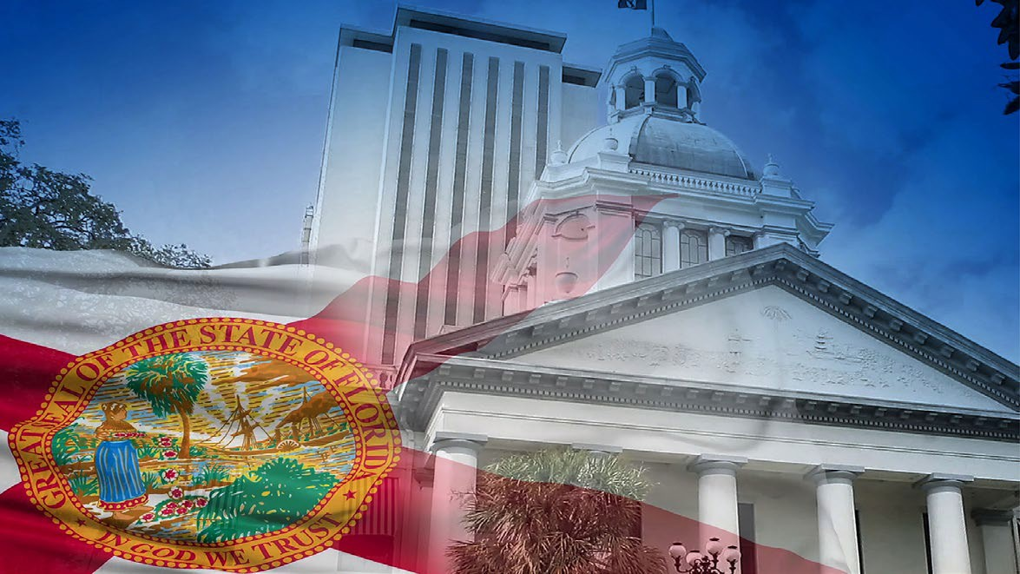
FORECASTS AND PREDICTIONS OF LEGAL AND POLICY ISSUES
 State is getting more active in planning, funding, legislation and leadership (ie; roll out of Resilient Florida)
 Pressure to legislate:
 Solutions, funding sources
 More comprehensive flood disclosures (Bi- partisan)?
 Local government response:
 Planning and changing regulations
 More mapping of risk and SLR available
 Funding capital improvements is likely to require debt financing / special assessments, etc.
 Presidential / congressional politics – infrastructure funding
 Flood insurance reform
 Litigation:
 Among property owners individually on flooding and its source
 More takings litigation in terms of impacts on private properties and/or against government to compel or prevent actions
 Against realtors by aggrieved property owners
 “Expertise and tools” to determine risk causes and solutions

Slide 32
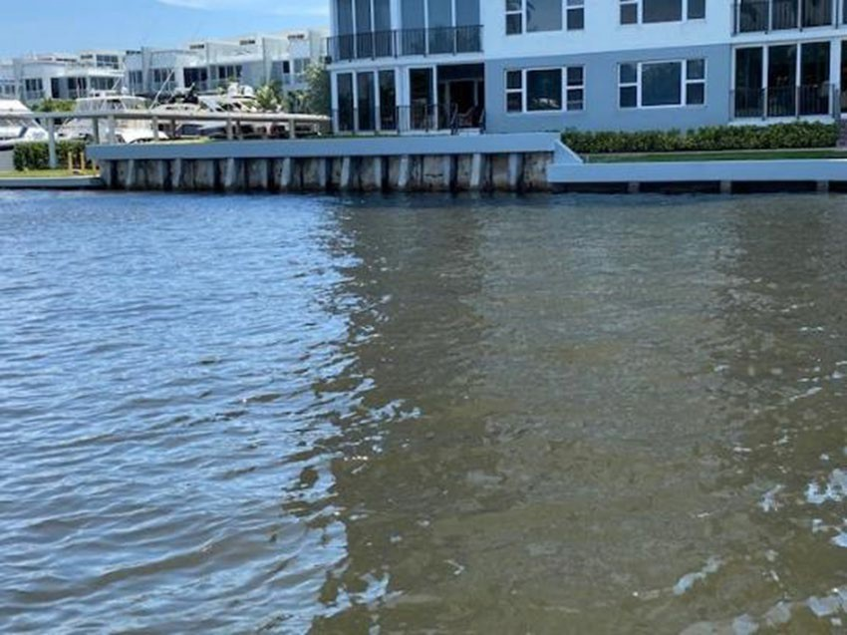
THANK YOU
ERIN@DEADYLAW.COM
Copyright Erin L. Deady, P.A. 2022.

