Slide 1
Broadband Feasibility: Bridging the Rural Digital Divide
FLORIDA STATE UNIVERSITY
DEPARTMENT OF URBAN AND REGIONAL PLANNING

Slide 2
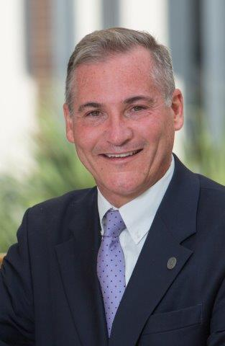
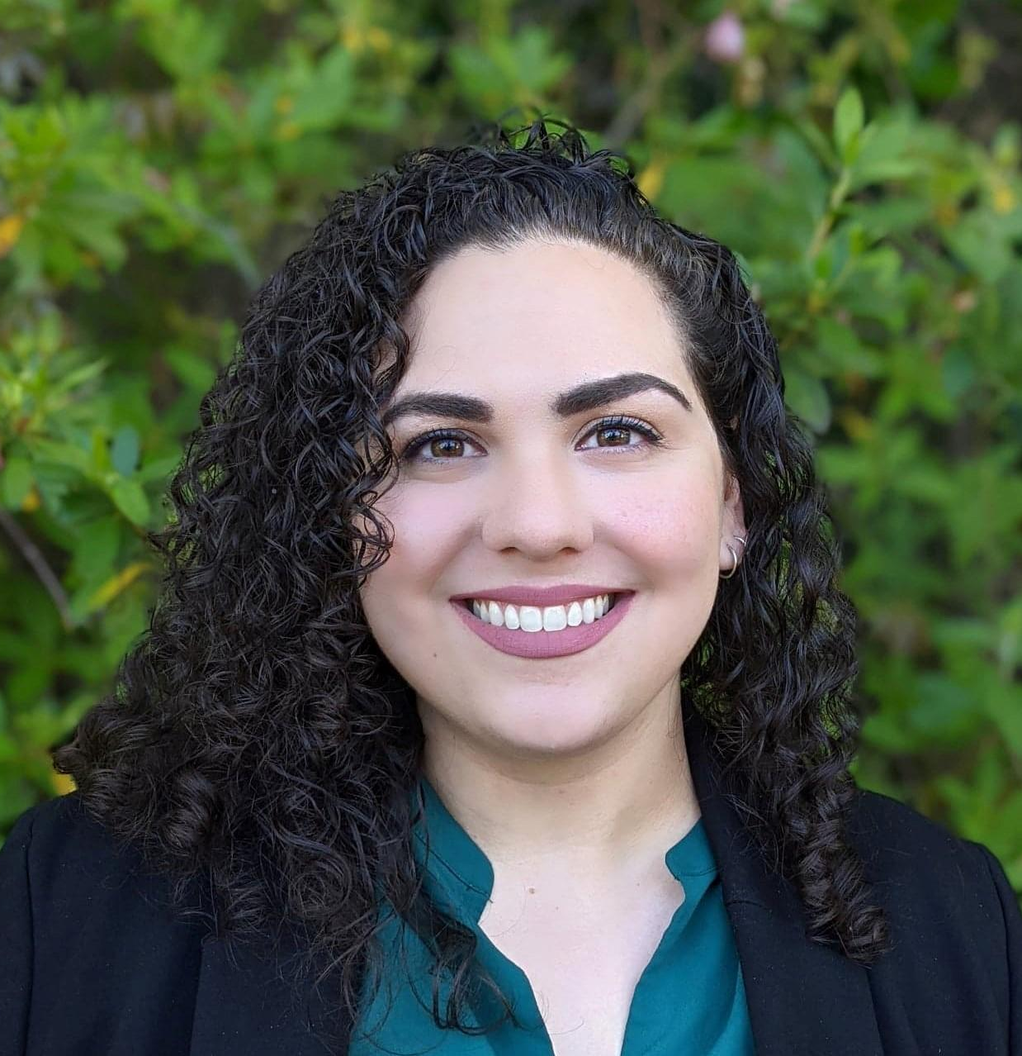
Introduction
Dennis Smith AICP
Billie Ventimiglia MSP

Slide 3
Presentation Overview
Does your current internet Service meet your needs?
PollEv.com/billieventim549

Slide 4
Presentation Overview
What did you use internet for during the COVID-19 Pandemic?
PollEv.com/billieventim549

Slide 5
Presentation Overview
Why is Broadband Provision an Equity Issue?
PollEv.com/billieventim549

Slide 6
Presentation Overview
Overview
Background
Context
Paths Forward
Case Study- Liberty and Wakulla Counties

Slide 7
Background

Slide 8
Presentation Overview
“Florida ranks second in the entire country in terms of the number of residents that don’t have any internet access or reliable internet access"
R-Sen. Joe Gruters of Sarasota. (Source: FIU's Metropolitan Center)

Slide 9
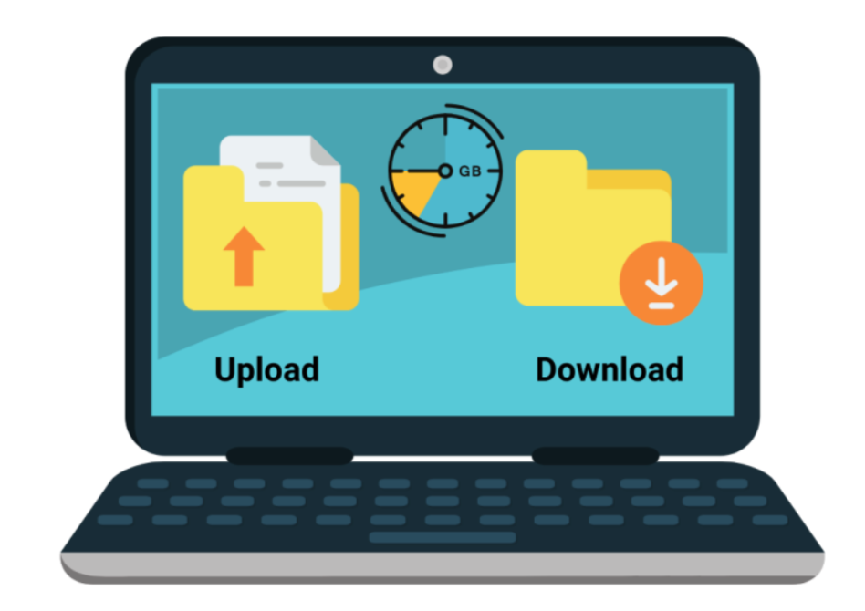
What is Broadband
Broadband is the transmission of wide bandwidth data over a high speed internet connection.
The FCC currently regards the speed threshold for an internet connection to be considered “broadband” to be no less than 25 Mbps download and 3 Mbps upload.
Broadband access is constant. It does not block phone lines, and there is no need to reconnect each time you need to use the internet.
Notes:
What are legacy communities (briefly)
Importance of project
Key stakeholders and grant from Dept. of State

Slide 10
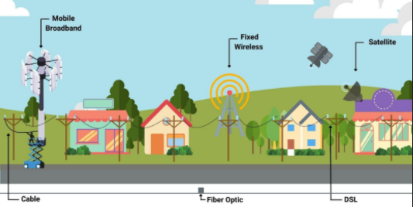
Types of Broadband Connection
Mobile Broadband (Cell phone)
Fixed Wireless
DSL (Digital Subscriber Line)
Satellite Internet
Fiber Optic
Cable
Notes:
What are legacy communities (briefly)
Importance of project
Key stakeholders and grant from Dept. of State

Slide 11
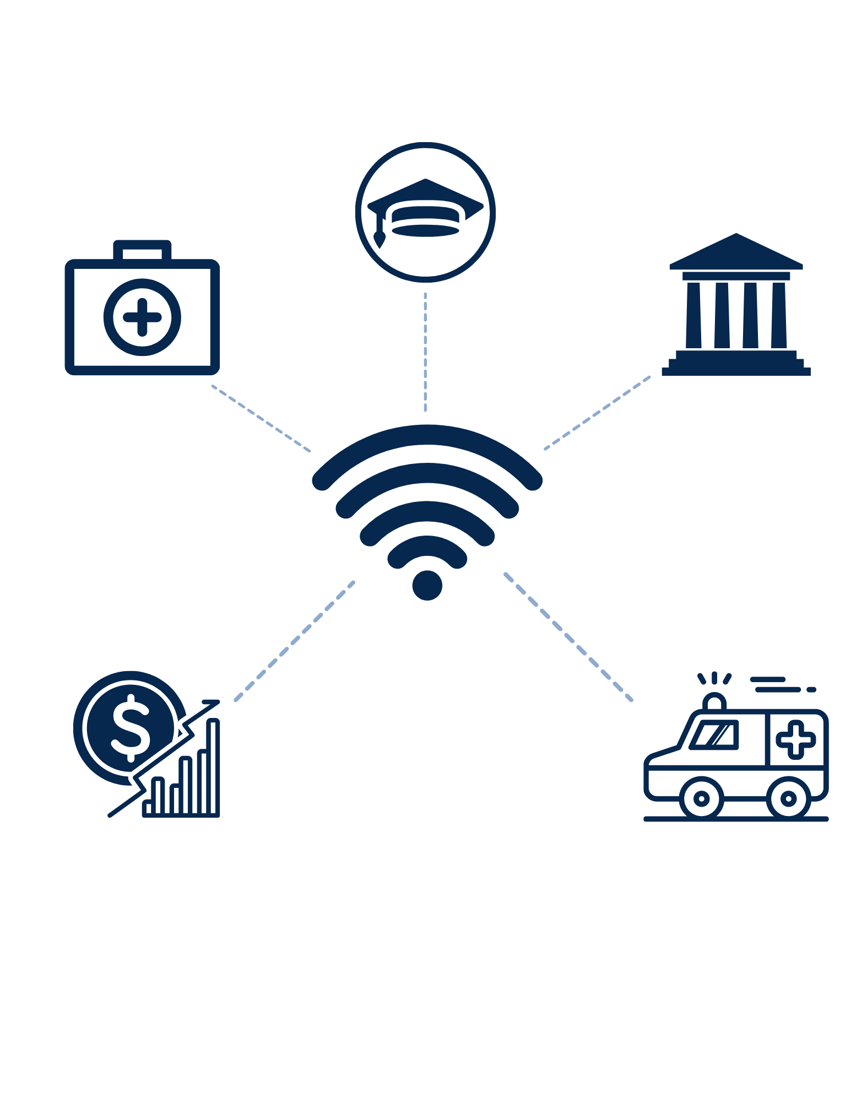
Importance of Broadband
Education
Telehealth
Governmental
Emergency Services
Economic
Notes:
What they are
How they were established
How many are there?
Show legacy community map

Slide 12
Equity Considerations
Rural counties with incomes of $50,000 or above have a 74% rate of home broadband adoption, while those falling below $50,000 only have around 63% of adoption (Martin, 2018).
52% of Americans believe that those without broadband service at home are at a “major disadvantage” when it comes to finding out about job opportunities or gaining new career skills. (Smith, 2015).
For those living below the poverty line, only 52% have access to broadband services (Swenson & Ghertner, 2020).
Black and Hispanic adults are among the least likely groups to have high speed internet at home. 71% for black adults 65% for hispanic adults (Perrin & Atske, 2021).
U.S. adults who graduated high school and have broadband connection at their homes is 59%, while those without a high school diploma only have a 46% broadband adoption rate. (Pew Research Institute).

Slide 13
Context

Slide 14
Context
Reflections
Rural counties are currently experiencing significant disparities in broadband provision compared to more urban counties.
The quality and availability of broadband service creates a service gap in rural counties.
Broadband is not considered a public utility, there is not a requirement for universal provision.
There are significant barriers to establishing municipal broadband throughout the state.

Slide 15
Barriers
Reflections
Government Regulation
Willingness of Providers
Funding
Data Insufficiency
Time

Slide 16
Government Regulations
196.012 - Provides a definition of what a
publicly owned telecommunication service
is for taxation reason: “providing a two-way
telecommunications services to the public for
hire by the use of a telecommunications facility”.
Only telecommunications services being used
for public airports or public hospitals will be
exempt. A broadband network operated by
a municipality for use by the public would not be eligible for tax exemptions.
125.421 - Municipalities must “separately
accounts for the revenues, expenses, property, and source of investment dollars associated
with the provision of such service”, so the local government would be unable to use revenue generated from another source to pay for broadband internet service
166.047 - Publicly owned telecommunication
services will have to pay full ad valorem tax
(a tax based on the value of property), though private businesses are exempt from part of this tax when selling to residential households
This is cost prohibitive for many rural
municipalities.
199.183 - Any immunity of any political
subdivision of the state or other entity of local
government from taxation of the property used
to provide telecommunication services that is
taxed... is hereby waived”, any other legislation
that would have given tax exempt status to
these properties is no longer applicable.
Publicly owned telecommunication services
would need to be housed on different property
from other government functions or lose their
tax exempt status.
350.81 - States “Revenue bonds issued in order
to finance providing a communications service
are not subject to the approval of the electors if
the revenue bonds mature within 15 years”, so if
the bonds used to pay for the telecommunication
service are not going to be paid off in 15 years it must be approved by voters. Also, the
telecommunication service will need “a plan to
ensure that revenues exceed operating expenses and payment of principal and interest on debt within 4 years”
212.08 - Government owned telecommunication
services will not be exempt from sales, rental, use, storage or consumption taxes.

Slide 17
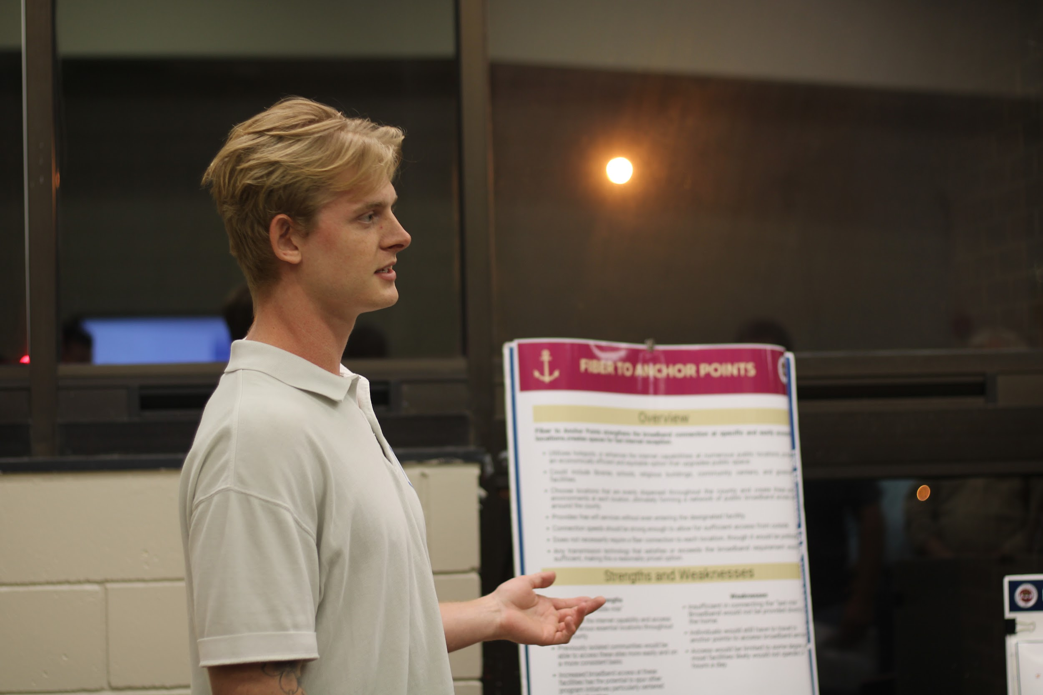
Willingness of Providers
Reflections
Market conditions may make it difficult to attract ISPs, they are under no requirement to provide service
Internet Service Providers (ISPs) are unconvinced of the ROI in rural areas.
Rural Areas “provide fewer customers to absorb the fixed costs of broadband infrastructure” (Canfield, 2019).
FCC Broadband maps sometimes overestimate the “the number of Americans who have reliable Internet connections” (Zakrzewski, 2021).
Some providers are unwilling to compete with “satellite monopolies”
Much of the information needed by the counties to create a business plan is proprietary and ISPs are unwilling to provide it.

Slide 18
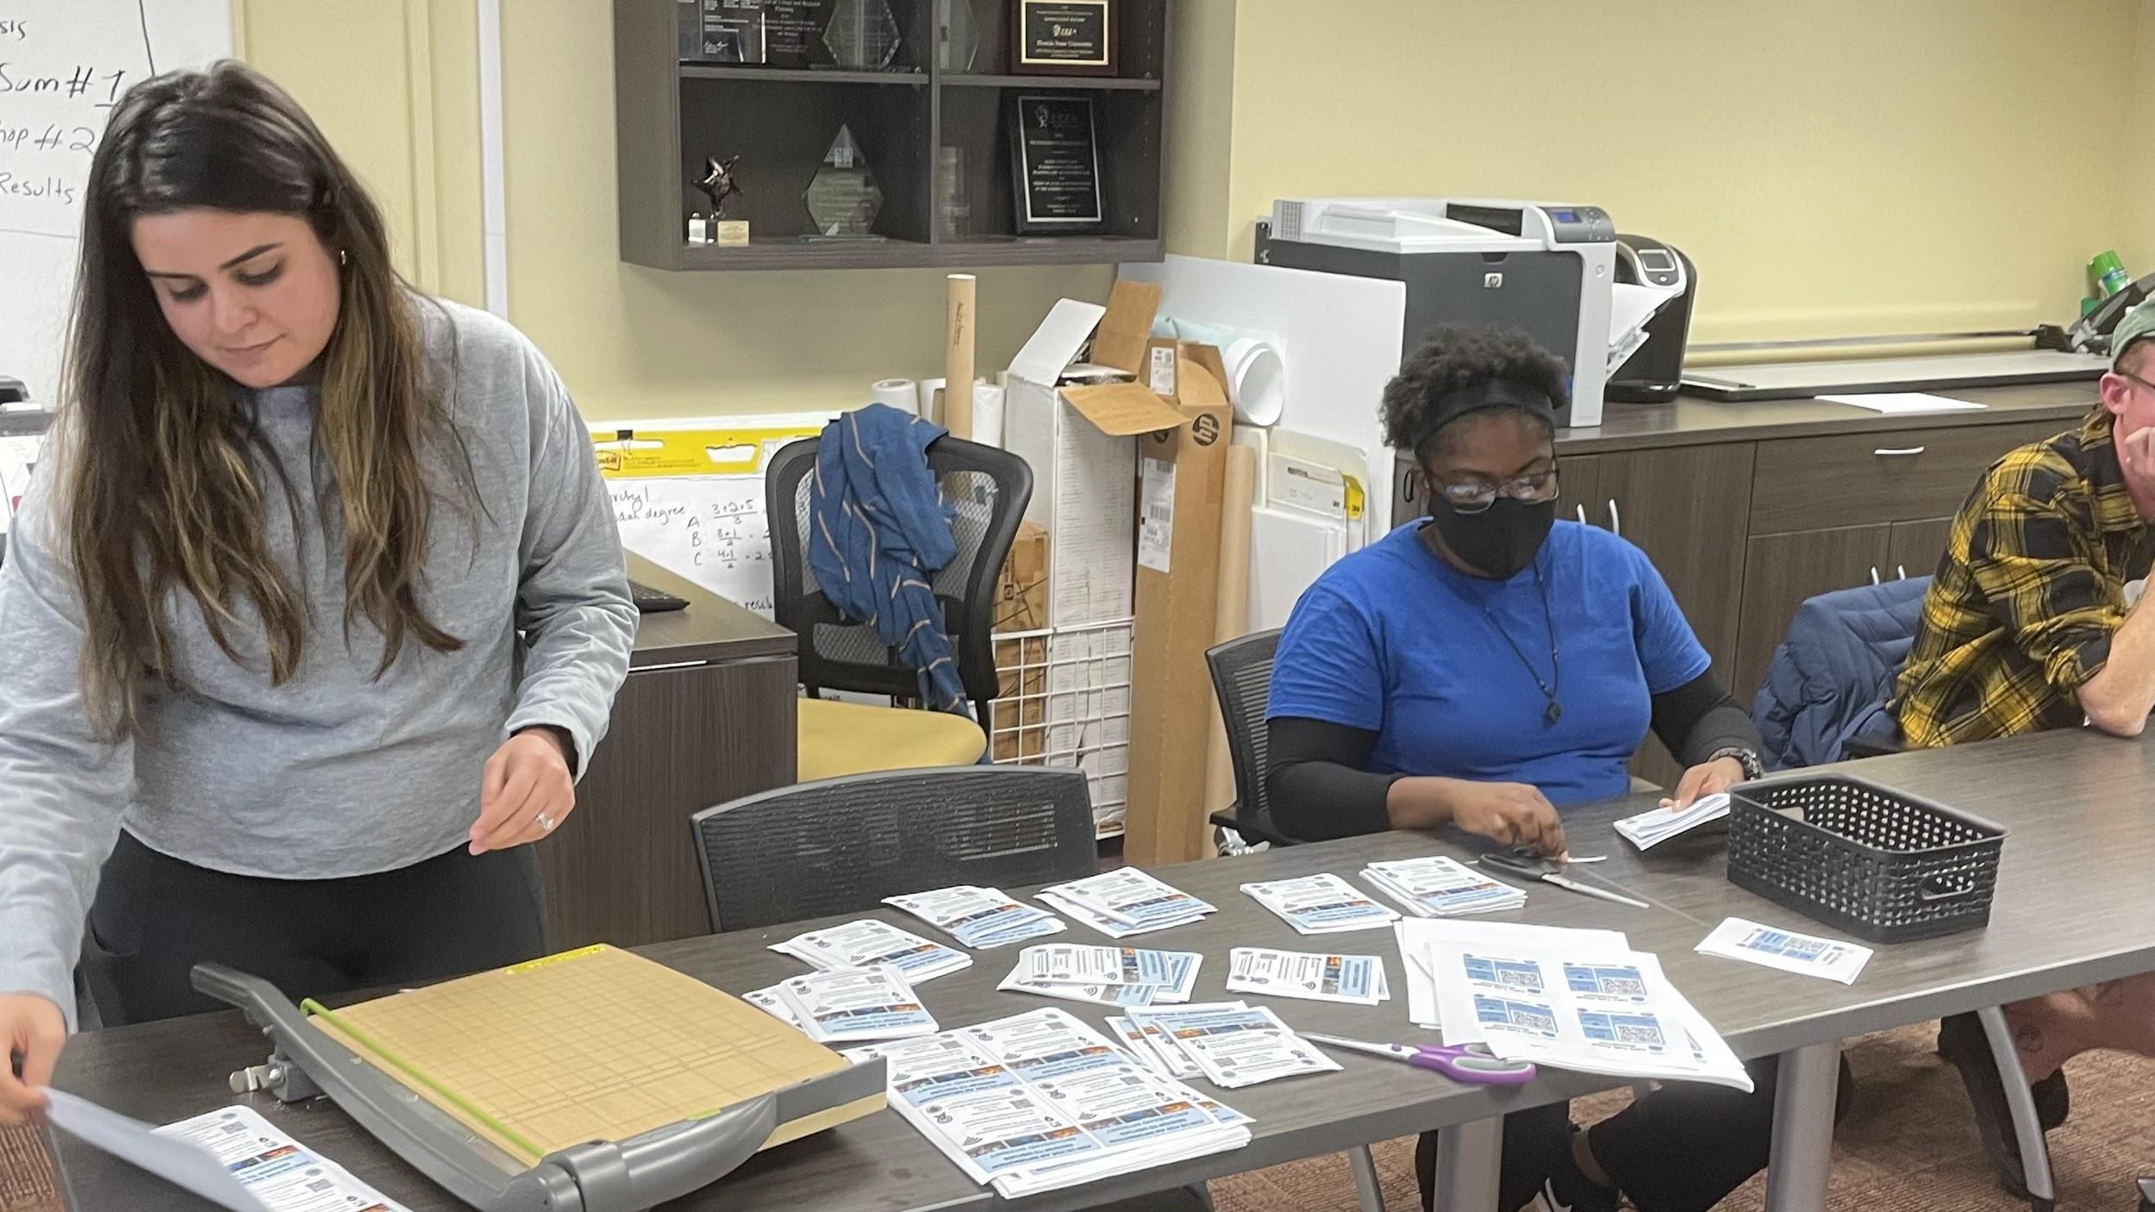
Funding
Reflections
Funding eligibility is often dependent on whether an area is unserved (has no broadband) or underserved (does not have adequate broadband).
The American Rescue Plan Act requires that all new broadband construction needs to be 100 Mbps download speed, much faster than the traditional FCC definition (Campbell, 2021).
Rural counties likely need dedicated staff to apply for complicated grants.
In some cases, “grants alone did not expand broadband adoption” (Canfield, 2019).
Even if service is available individual families may find it difficult to pay the subscription for reliable service.
Cost to lay new fiber is typically $74,000 a mile

Slide 19
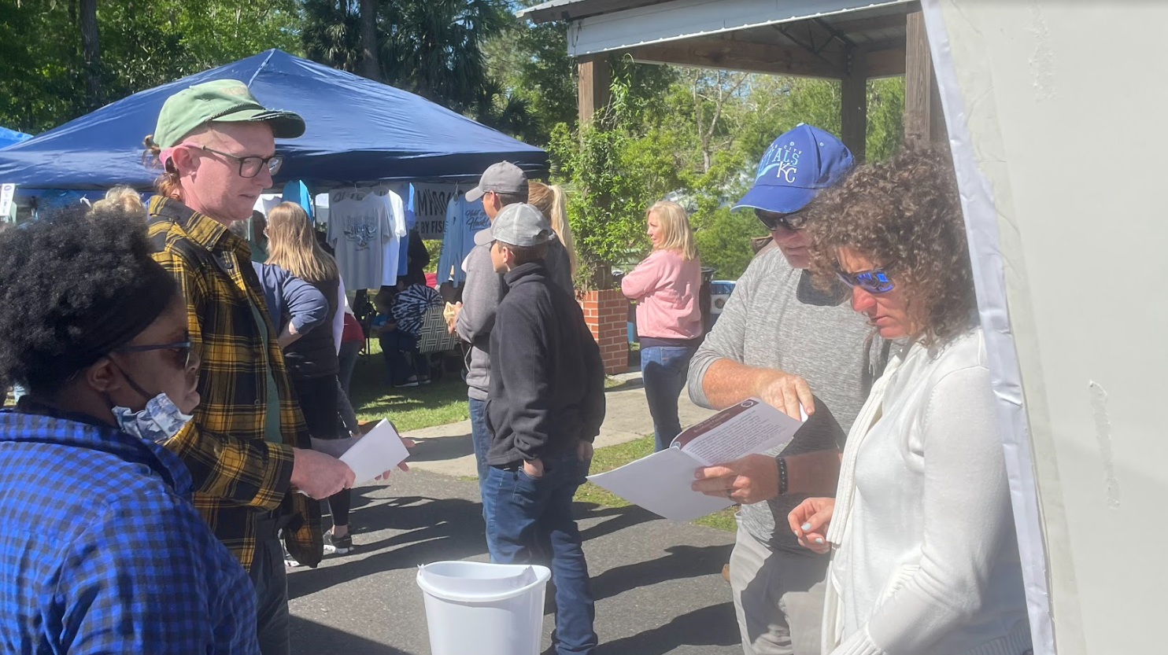
Data Insufficiency
Reflections
Some federal funding relies on maps from the FCC to determine where to distribute funds
“telecommunications experts, lawmakers and even the agency’s commissioners acknowledge that the maps overestimate the number of Americans who have reliable Internet connections” (Zakrzewski, 2021).
ISPs are unwilling to provide information about subscribers, infrastructure, markets, and location and ownership of fiber.

Slide 20
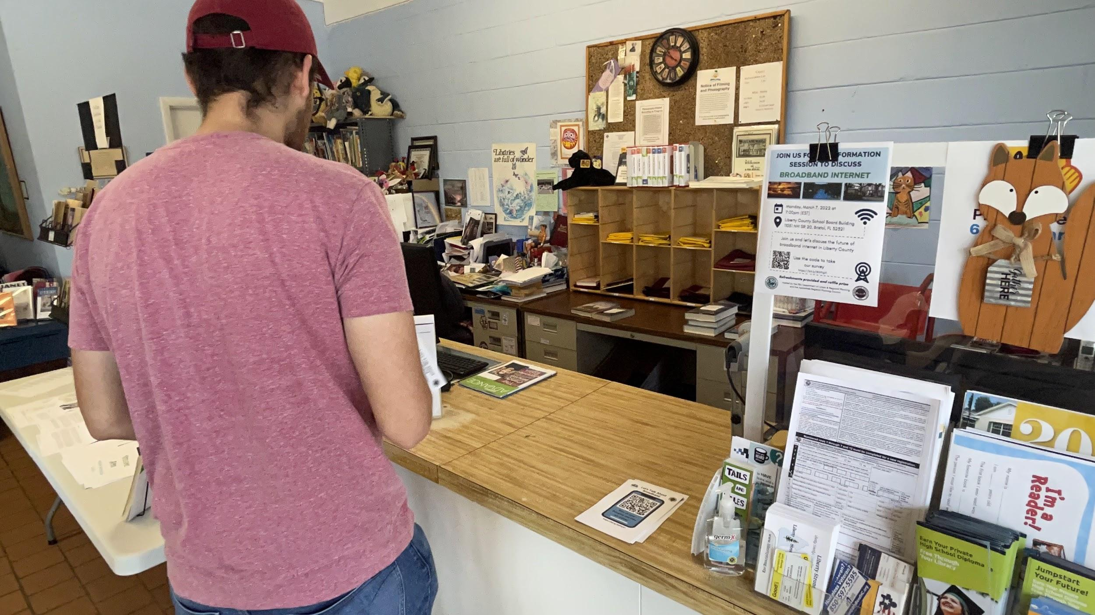
Time
Reflections
Many grant cycles will likely take several years for the award
As rural counties wait, the digital divide widens
Implementation and approval can take several years
Stop-gap and short term solutions are inefficient

Slide 21
Recap
Reflections
State statutes limit county’s ability to own and operate public broadband
Section 350.81 F.S.
Government Regulation
Higher construction and maintenance costs per user
Complete market coverage not required
Willingness of Providers
Funding
Restrictive
Many requirements
Data Insufficiency
Limited research
Proprietary data
Time
Digital divide already evident
Implementation is a process

Slide 22
Paths Forward

Slide 23
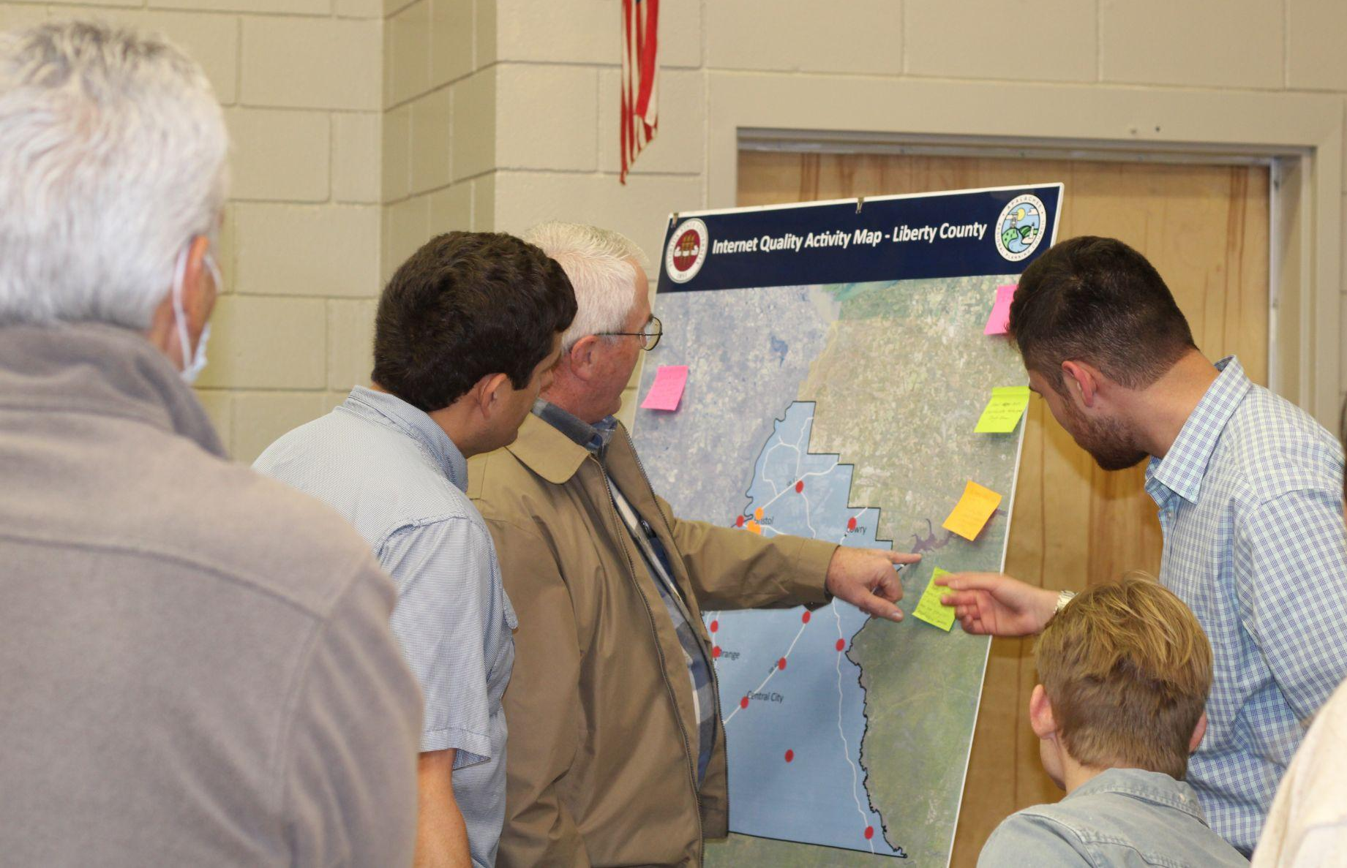
Paths Forward
Reflections
Dept. of Economic Opportunity
Ongoing Feasibility Studies
Local Technology Planning Teams (LTPT)
Broadband Alternatives
Grant Funding/Availability

Slide 24
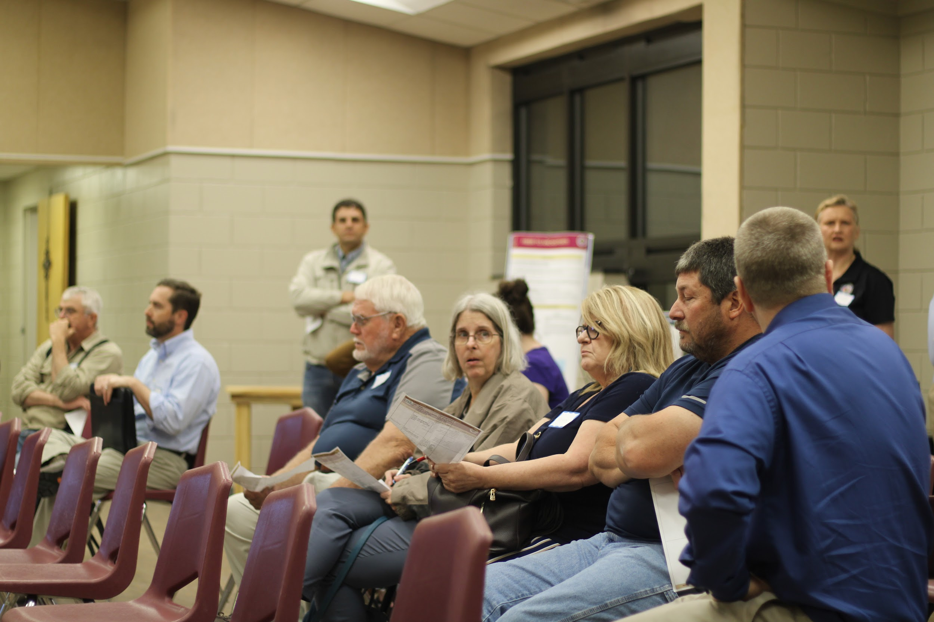
Dept. of Economic Opportunity
Reflections
DEO has an office of broadband
They are working parallel to projects and funding studies such as the ones in Liberty and Wakulla.
June 30th, they will have a published plan put before the office of the Governor.
Various toolkits are available to guide counties through this process.

Slide 25
Ongoing Feasibility Studies
Reflections
Current studies in Wakulla and Liberty counties
Previous study in Lakeland, FL led to the creation of a PPP.
Private companies have completed studies in Escambia, Marion, Walton, and Sumter.

Slide 26
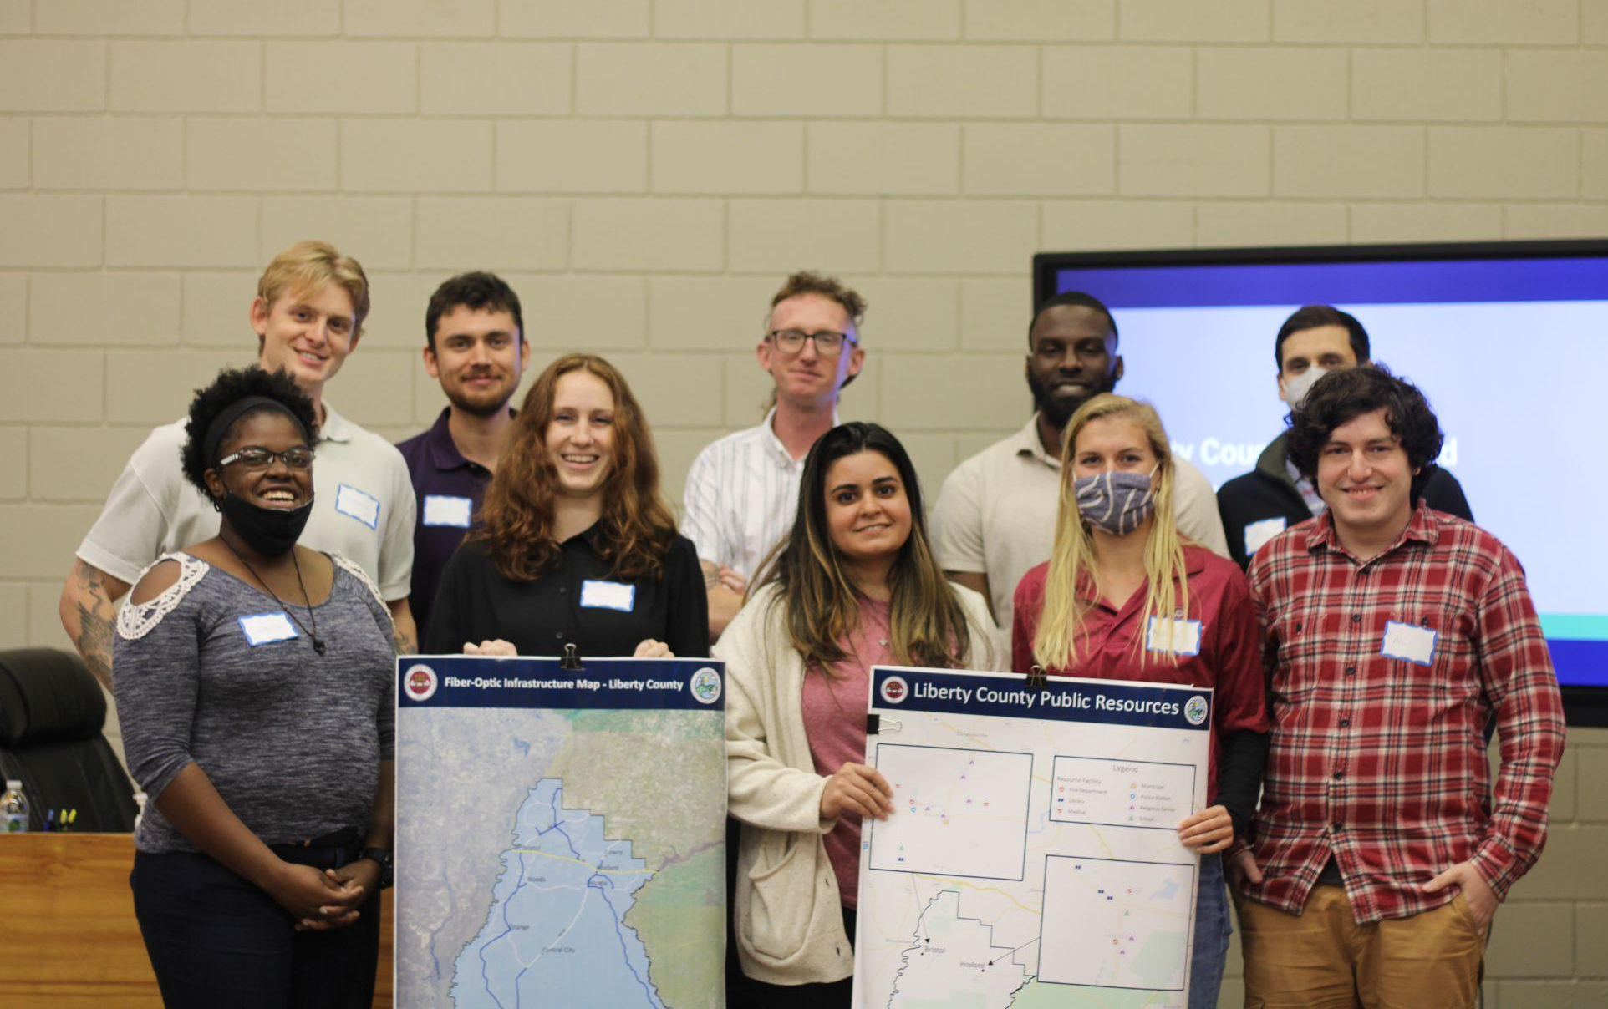
Local Planning Technology Teams
Reflections
The DEO office of broadband requires that counties/Regions create Local Technology Planning Teams (LTPTs)
Require professionals from different sectors to be sure all stakeholder groups are involved in the process.
LTPTs create working groups to make sure these broadband projects are moving forward.

Slide 27
Viable Rural Broadband Alternatives
Reflections
Alternative #1: Public Private Partnership
Alternative #2: Anchor Sites
Alternative #3: Hybrid Fiber with Fixed Wireless
Alternative #4: Fiber-to-Home

Slide 28
Alternative- Public Private Partnership
Reflections
Overview
Mechanism for governments to collaborate with the private sector. Contract between a government entity and a private company that will ease distribution and increases internet service access.
Pros
Cons
Combines public and private resources for more overall resources
Enables faster project completions and reduced delays
ROI is greater than a fully private or fully public project
Risks are fully analyzed before project start
Can increase government costs
Limits market competitiveness
Profits vary on assumed risk, competition, complexity and scope of project
Potential expertise imbalance may be detrimental to government

Slide 29
Alternative- Anchor Sites
Reflections
Overview
Broadband connection at select, accessible locations, utilizing key locations including libraries, schools, religious buildings, community centers, government facilities, and potentially even parks.
Pros
Cons
“Middle mile”
Internet capability and access for previously isolated communities
Potential to spur other program initiatives, particularly centered around education
Realistic and feasible
Insufficient in connecting the “last mile”
Individuals would still have to travel to access these services
Access would be limited to some degree, as facilities likely would not operate 24 hours a day

Slide 30
Alternative- Hybrid Fiber
Reflections
Overview
Utilizes existing fiber infrastructure paired with new fixed wireless tower installations
Pros
Cons
Reduced cost
Effective stop-gap
10-mile radius signal
Signal quality degradation
A degraded signal may result in download and upload speeds that fall below minimum federal thresholds for grant funding
Can be affected by inclimate weather
Some counties may not have any pre-existing fiber

Slide 31
Alternative- Fiber to Home
Reflections
Overview
Connects every home to the fiber optic network directly
Pros
Cons
Extremely fast service
Grant funding options are available
Market competitiveness
More failures than success stories for FTTH attempts
Might not be enough homes for ROI
Require mass amounts of permits, pole attachment negotiations, and negotiations with homeowners and landowners.
Expensive

Slide 32
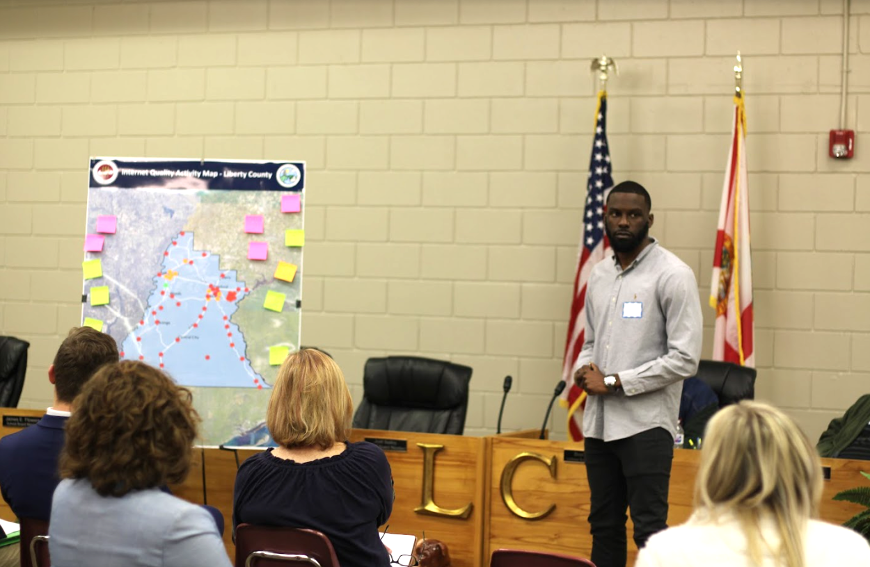
Funding
Reflections
HB 1239: The Florida Broadband Deployment Act of 2021
The bill provides $1.5 Million dollars to fund GIS mapping to increase use of Broadband
American Rescue Plan
Emergency Connectivity Fund
Fiscal Recovery Funds
Florida received more than $16 billion
FCC Rural Digital Opportunity Fund
FL is expected to receive $82.5 Million
This is for ISPs to receive funding to provide services to rural areas

Slide 33
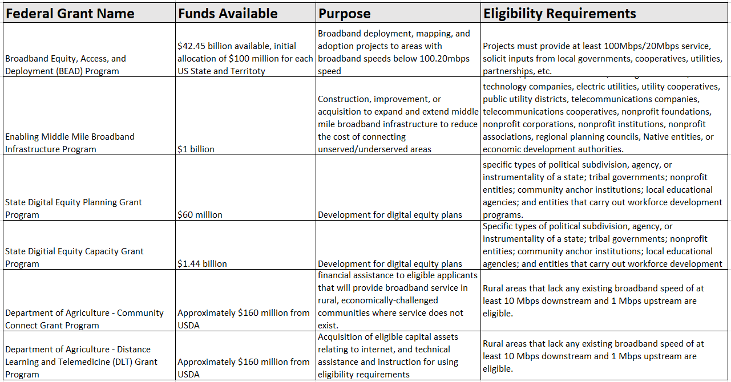
Funding
Reflections

Slide 34
Case Study

Slide 35
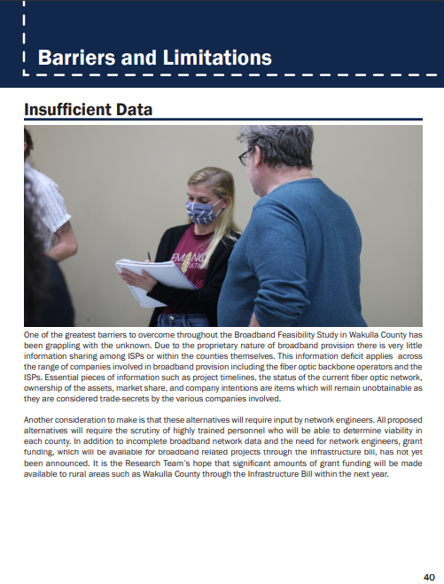
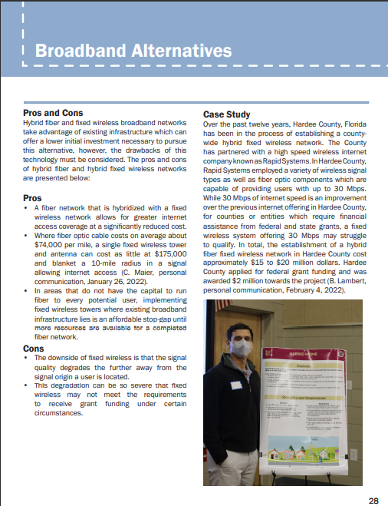
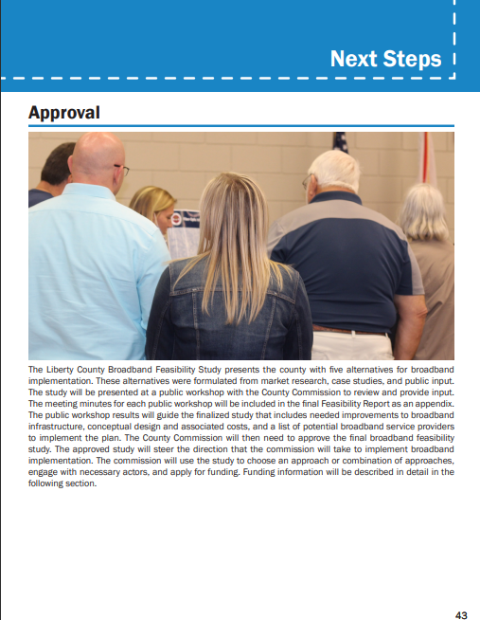
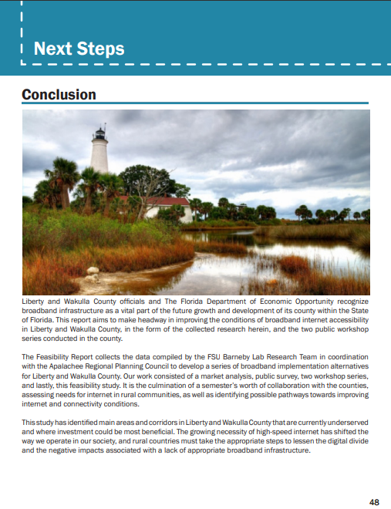
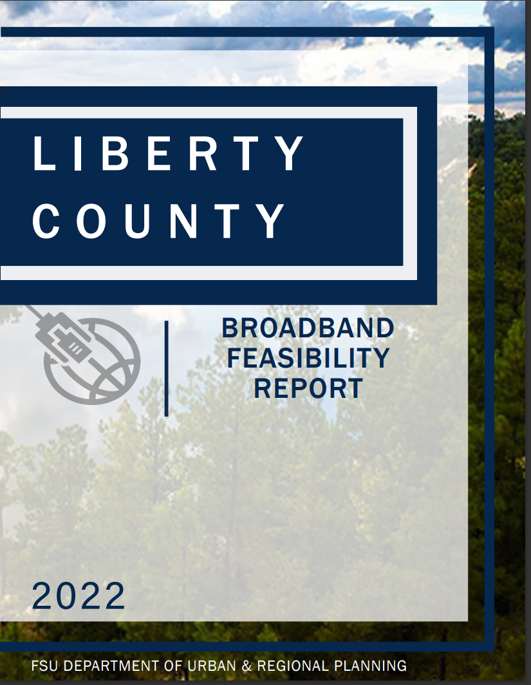
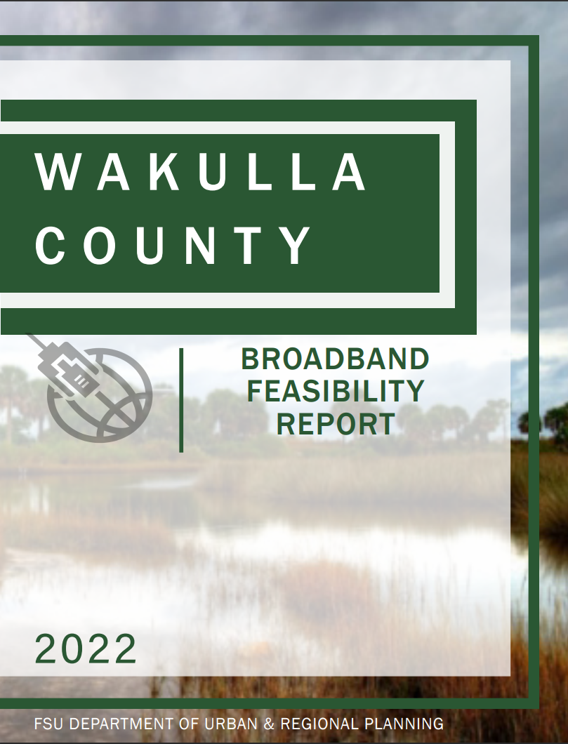
Case Study- Liberty and Wakulla
Current Feasibility Study funded by the ARPC through DEO
Deliverables include:
Public Outreach
Market Analysis
Prepare Alternatives
Final Feasibility Study

Slide 36
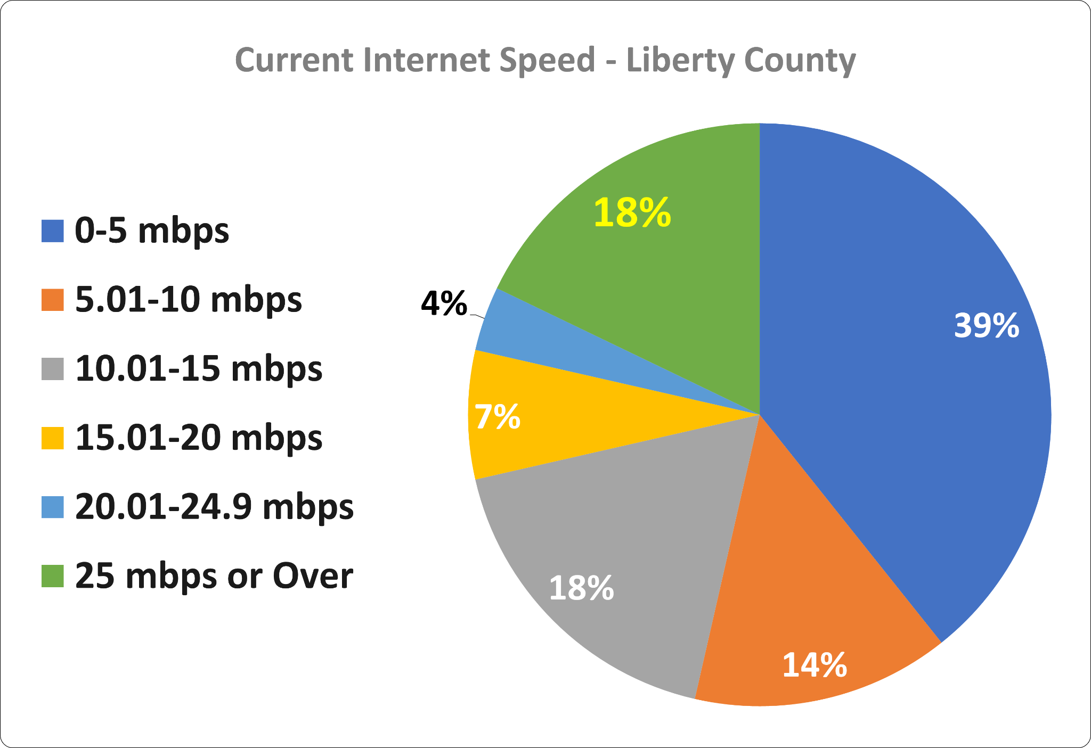
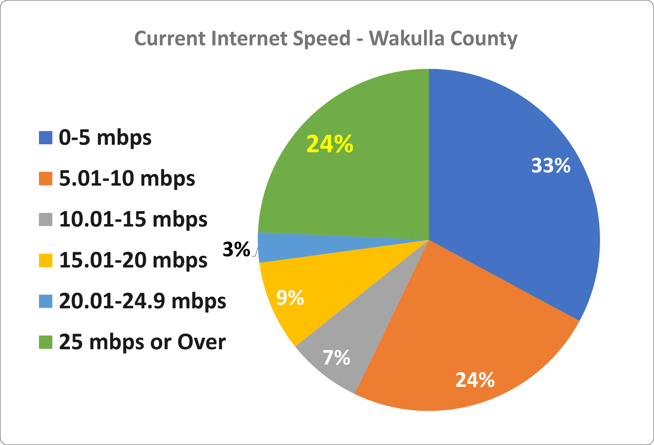
Findings
Current Speeds

Slide 37
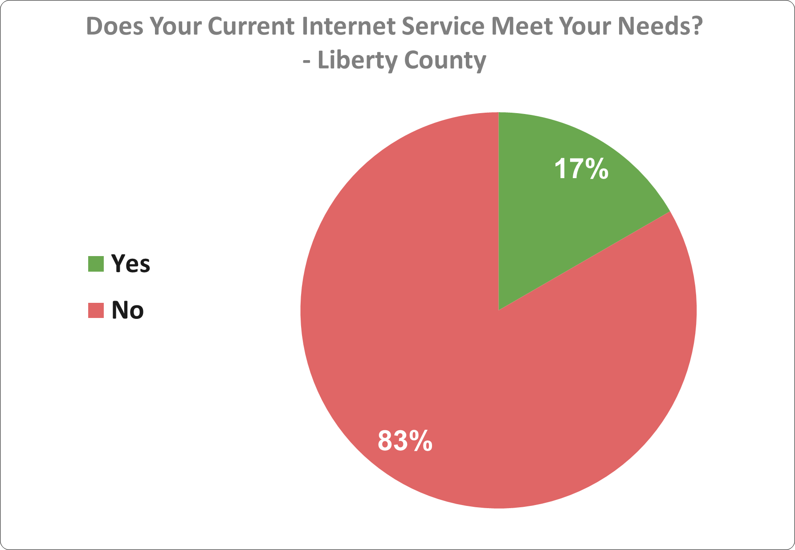
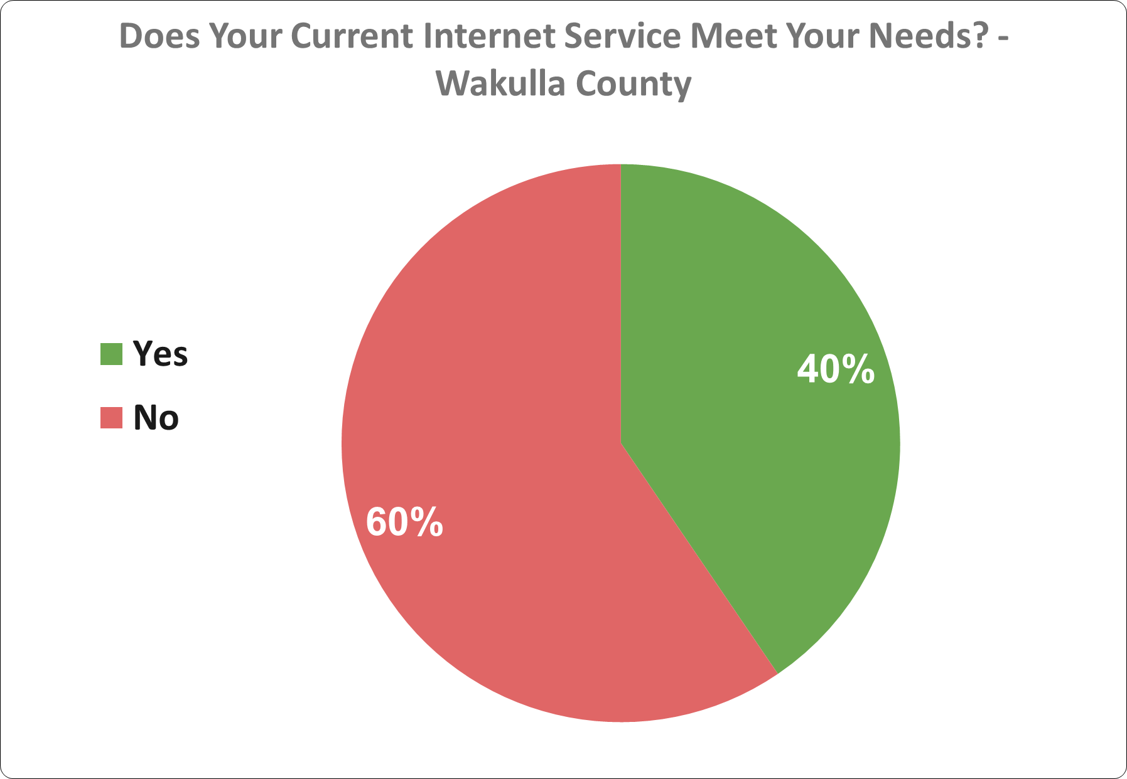
Findings
Internet Satisfaction

Slide 38
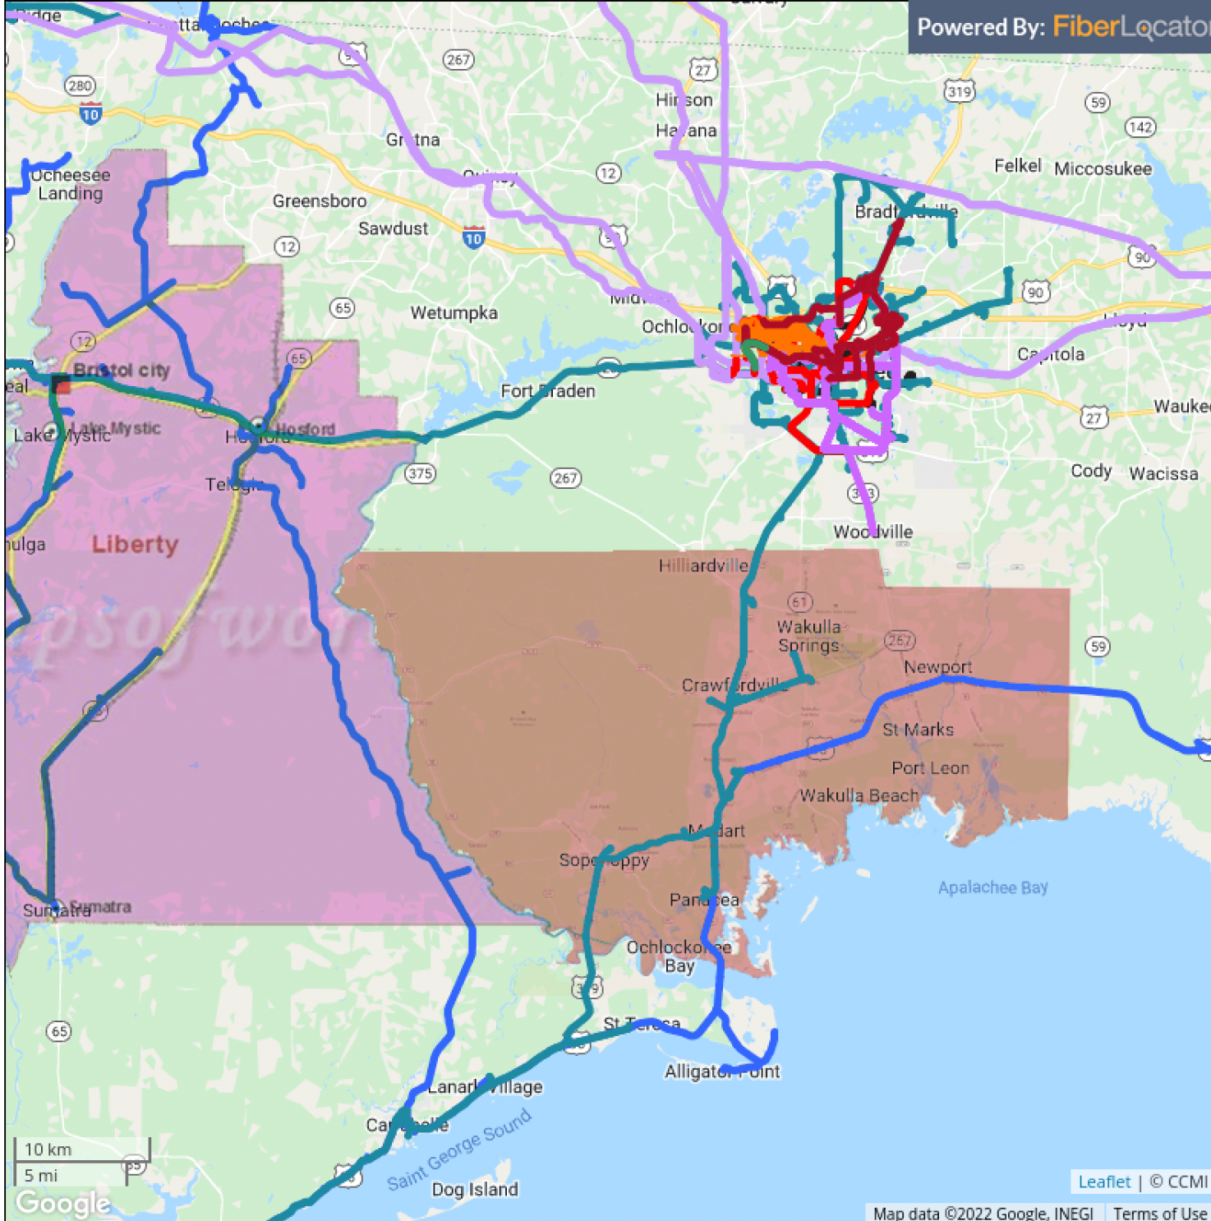
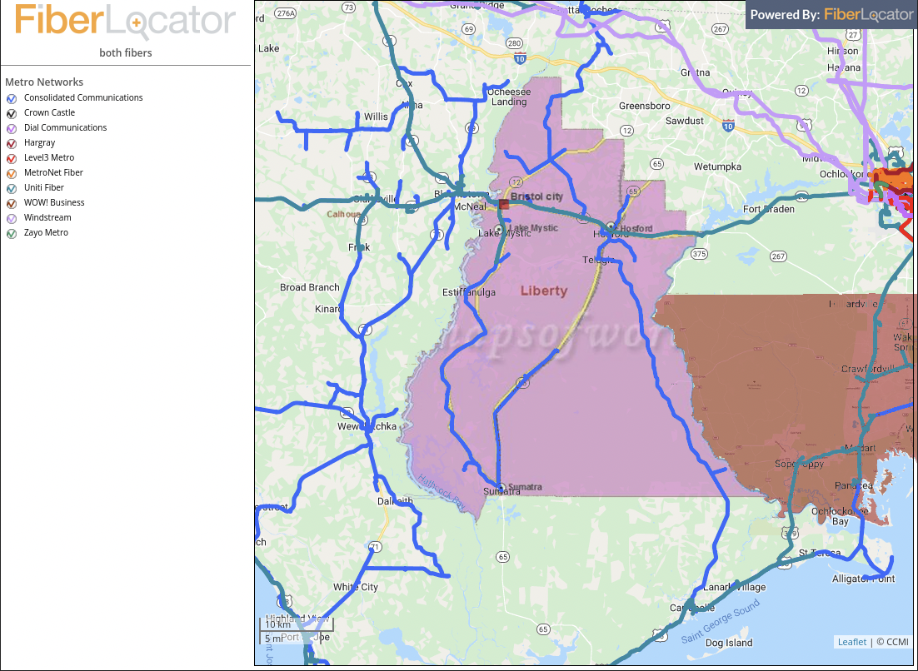
Findings- Fiber Locations
Wakulla County - Fiber Infrastructure
Liberty County - Fiber Infrastructure

Slide 39
Lessons Learned

Slide 40
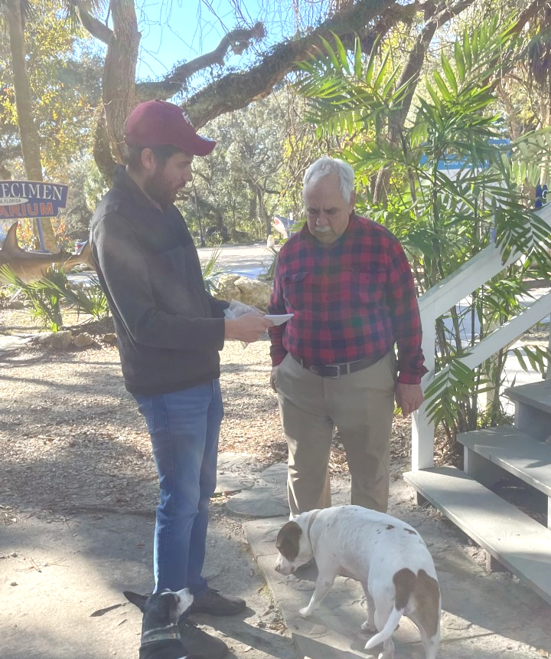
Lessons Learned
Full broadband provision in Rural counties is a priority, however there are significant barriers.
Internet should be considered a public utility
Funding is coming, but slowly and rural counties are struggling in the meantime.
The heavy reliance on internet technologies during the height of COVID-19 and since then has underscored this divide.

Slide 41
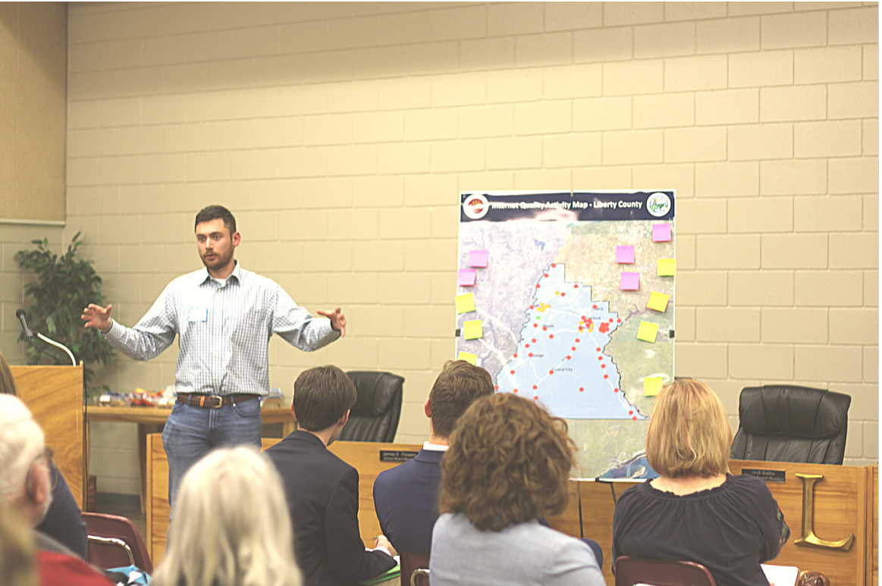
Q & A

Slide 42
Contact Us
Dennis Smith AICP Djsmith3@fsu.edu
Billie Ventimiglia MSP BVentimiglia@fsu.edu

